Slide 1
Backtracking search

Slide 2
Backtracking search
Backtracking is an algorithmic-technique for solving problems recursively by trying to build a solution incrementally, one piece at a time, removing those solutions that fail to satisfy the constraints of the problem at any point of time.
For example, consider the SudoKo solving Problem, we try filling digits one by one. Whenever we find that current digit cannot lead to a solution, we remove it (backtrack) and try next digit.

Slide 3
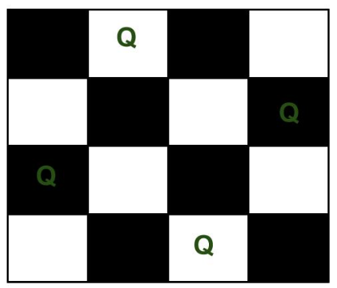
N-queen problem
The N Queen is the problem of placing N chess queens on an N×N chessboard so that no two queens attack each other.

Slide 4
The idea is to place queens one by one in different columns, starting from the leftmost column.
When we place a queen in a column, we check for clashes with already placed queens.
In the current column, if we find a row for which there is no clash, we mark this row and column as part of the solution.
If we do not find such a row due to clashes then we backtrack and return false.

Slide 5
Naive Algorithm for N-queen
Generate all possible configurations of queens on board and print a configuration that satisfies the given constraints.
while there are untried configurations
{
generate the next configuration if queens don't attack in this configuration then
{
print this configuration;
}
}

Slide 6
Backtracking algorithm
1) Start in the leftmost column
2) If all queens are placed
return true
3) Try all rows in the current column.
Do following for every tried row.
If the queen can be placed safely in this row then mark this [row, column] as part of the solution and recursively check if placing queen here leads to a solution.
If placing the queen in [row, column] leads to a solution then return true.
If placing queen doesn't lead to a solution then unmark this [row, column] (Backtrack) and go to step (a) to try other rows.
4) If all rows have been tried and nothing worked, return false to trigger backtracking.

Slide 7
