Slide 1
CONSTRAINT SATISFACTION PROBLEMS

Slide 2
Introduction
A problem is solved when each variable has a value that satisfies all the constraints on the variable.
A problem described this way is called a constraint satisfaction problem, or CSP.
CSP search algorithms solves complex problems.
The main idea is to eliminate large portions of the search space all at once by identifying variable/value combinations that violate the constraints.

Slide 3
DEFINING CONSTRAINT SATISFACTION PROBLEMS
A constraint satisfaction problem consists of three components, X,D, and C:
X is a set of variables, {X₁, . . . ,X_{n}}.
D is a set of domains, {D₁, . . . ,D_{n}}, one for each variable.
C is a set of constraints that specify allowable combinations of values.
F(x)=(x²+y), (x,y belong to R(real number)), and (x<10,y<12)
Examples of simple problems that can be modeled as a constraint satisfaction problem include:
Map coloring problem

Slide 4
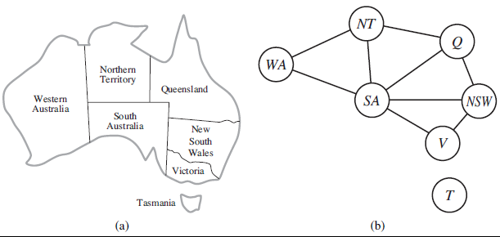
Example problem: Map coloring
The goal is to assign colors to each region so that no neighboring regions have the same color.

Slide 5
The variables to be the regions, X = {WA, NT, Q, NSW, V, SA, T} .
The domain of each variable is the set Di = {red , green, blue}.
The constraints require neighboring regions to have distinct colors. Since there are nine places where regions border, there are nine constraints:
C = {SA != WA, SA != NT, SA != Q, SA != NSW, SA != V, WA != NT, NT != Q, Q != NSW, NSW != V } .
SA != WA can be fully enumerated in turn as
{(red , green), (red , blue), (green, red ), (green, blue), (blue, red ), (blue, green)} .
There are many possible solutions to this problem, such as {WA=red ,NT =green, Q=red , NSW =green, V =red , SA=blue, T =red }.

Slide 6
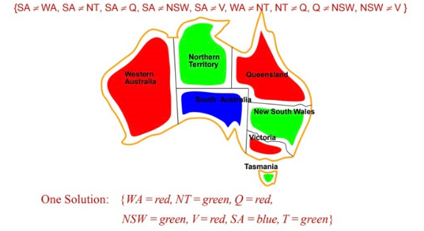

Slide 7
CSPs yield a natural representation for a wide variety of problems.
CSP solvers can be faster than state-space searchers because the CSP solver can quickly eliminate large swatches of the search space.
Many problems that are intractable for regular state-space search can be solved quickly when formulated as a CSP

