Slide 1
gAMES

Slide 2
In Competitive environment, agents’ goals are in conflict, giving rise to adversarial (legal proceedings) search problems—often known as games.
Games don’t require much knowledge; the only knowledge required is rules, legal moves and the conditions of winning or losing the game.
In two player game, both players try to win the game i.e. both of them try to make the best move possible at each turn.
Searching techniques like A* are not accurate for this as the branching factor is very high, so searching will take a lot of time.
So, we need another search procedures that can generate only good moves and best move can be explored first.

Slide 3
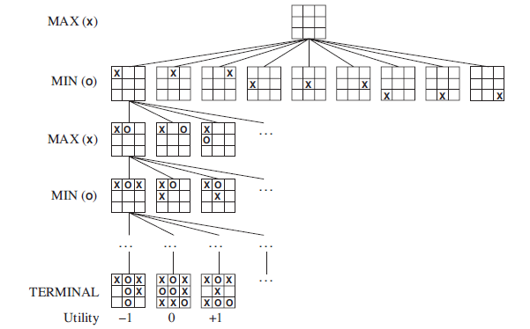
GAME TREE - tree where the nodes are game states and the edges are moves.
Utility values are given from the point of view of MAX; high values are assumed to be good for MAX and bad for MIN

Slide 4
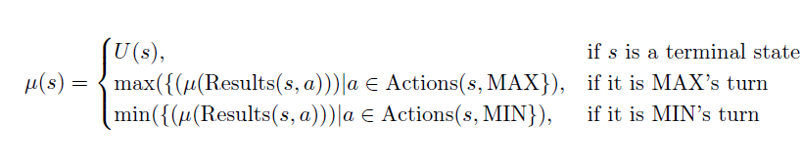
OPTIMAL DECISIONS IN GAMES
In a normal search problem, the optimal solution would be a sequence of actions leading to a goal state—a terminal state that is a win.
In adversarial (conflicting goal) search, some strategy is required. Strategy specifies that
MAX’s move in the initial state, then
MAX’s moves in the states resulting from every possible response by MIN, then MAX’s moves in the states resulting from every possible response by MIN to those moves, and so on.

Slide 5
Minimax search
It is depth-first depth-limited search procedure.
At the end of the game, points are awarded to the winning player and penalties are given to the loser.
In every move (MAX will try to maximize the utility and MIN will try to minimize the utility) –
MAX will try to choose best move to maximize its utility(winning ).
MIN will try to chose the worst move(according to MAX) to minimize the MAX’s utility.
It is a recursive algorithm, as same procedure occurs at each level.
Time complexity of minimax algorithm is O(b^{m}). The space complexity is O(bm). (b is legal moves and m is depth of tree)

Slide 6
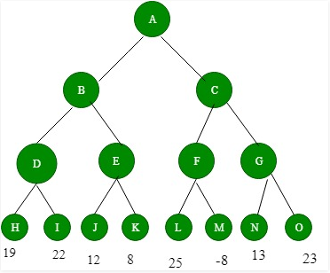
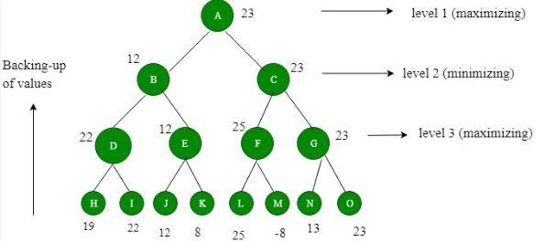
max
Before backing-up of values
min
max
After backing-up of values

Slide 7
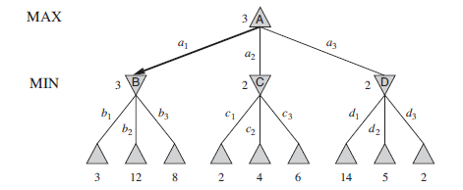
Two-ply game tree
MAX’s best move at the root is a1, because it leads to the state with the highest minimax value, and MIN’s best reply is b1, because it leads to the state with the lowest minimax value.

Slide 8
Formal definition of game
A game can be formally defined as a kind of search problem with the following elements:
• S0: The initial state, which specifies how the game is set up at the start.
• PLAYER(s): Defines which player has the move in a state.
• ACTIONS(s): Returns the set of legal moves in a state.
• RESULT(s, a): The transition model, which defines the result of a move.
• TERMINAL-TEST(s): A terminal test, which is true when the game is over and false otherwise. States where the game has ended are called terminal states.
• UTILITY(s, p): A utility function defines the final numeric value for a game that ends in terminal state for a player. In chess, the outcome is a win, loss, or draw, with values +1, 0, or 1 2 .

Slide 9
ALPHA–BETA PRUNING
The problem with minimax search is that the number of game states it has to examine is exponential in the depth of the tree i.e O(b^{d}) .
Unfortunately, we can’t eliminate the exponent, but it turns out we can effectively cut it in half by exploring lesser number of nodes.
It is possible to compute the correct minimax decision without looking at every node in the game tree.
When applied to a standard minimax tree, it returns the same move as minimax would, but prunes away branches that cannot possibly influence the final decision.

Slide 10
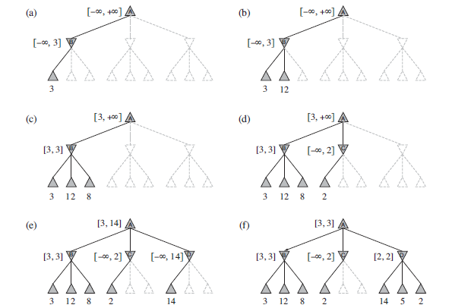

Slide 11
If this can be done, then it turns out that alpha–beta needs to examine only O(b^{m/2}) nodes to pick the best move, instead of O(b^{m}) for minimax.

