Slide 1
INFORMED SEARCH METHODS- one that uses problem-specific knowledge to find solutions more efficiently

Slide 2
Uninformed search:-
It is called as brute-force or "blind" search. Uninformed Searched uses no knowledge about the problem, hence possibly less efficient than an informed search.
Examples of uninformed search algorithm:-
Breadth-first search and Depth-first search, Depth-limited search, Uniform-cost search, Depth-first iterative deepening search and bidirectional search.
Informed search:-
It is also called "heuristic search", it uses prior knowledge or "domain knowledge" about the problem, hence possibly more efficient than uninformed search.
Examples of informed search algorithm:-
Best-first search and A*.

Slide 3
BEST-FIRST SEARCH
When the nodes are ordered so that the one with the best evaluation is expanded first, the resulting strategy is called best-first search.
Best-first search is general tree-search or graph-search algorithm in which a node is selected for expansion based on an evaluation function.

Slide 4
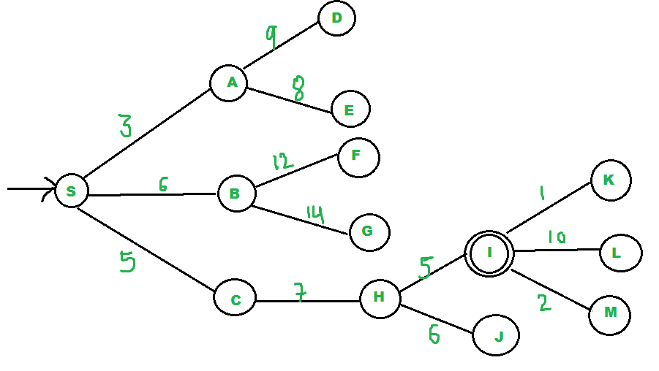
Priority queue is used
Pq--- {S}
Pq----{A, C, B} (C is put before B because C has lesser cost)
Pq----{C, B, E, D}
Pq----{B, H, E, D}
Pq----{H, E, D, F, G}
We remove H from pq.
Since our goal "I" is a neighbor of H, we return.

Slide 5
A greedy algorithm, always makes the choice that seems to be the best at that moment.
A Greedy algorithm makes greedy choices at each step to ensure that the objective function is optimized.
The Greedy algorithm has only one shot to compute the optimal solution so that it never goes back and reverses the decision.
Greedy algorithms often perform quite well and find solutions quickly.
Greedy search is susceptible to false starts.

Slide 6
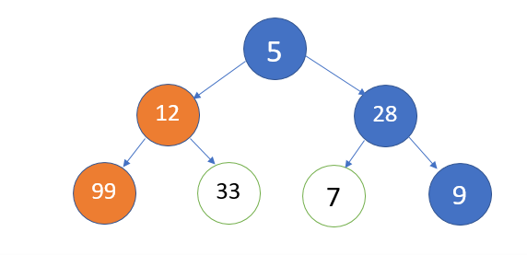
find the path with the largest sum.
Take the path with the largest sum overall. A greedy algorithm would take the blue path, as a result of shortsightedness, rather than the orange path, which yields the largest sum.

Slide 7
Greedy best first search using heuristic function h(n)
Greedy best-first search tries to expand the node that is closest to the goal, on the grounds that this is likely to lead to a solution quickly. Thus, it evaluates nodes by using just the heuristic function; that is,
f(n) = h(n).
For most problems, the cost of reaching the goal from a particular state can be estimated but cannot be determined exactly.
h(n) (heuristic function) = estimated cost of the cheapest path from the state at node n to a goal state.

Slide 8
Greedy search resembles depth-first search in the way it prefers to follow a single path all the way to the goal, but will back up when it hits a dead end.
It suffers from the same defects as depth-first search—it is not optimal, and it is incomplete because it can start down an infinite path and never return to try other possibilities

Slide 9
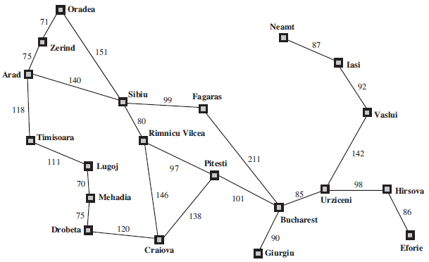
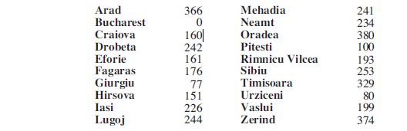
A simplified road map of part of Romania
Straight-line distances to Bucharest (h(n))

Slide 10
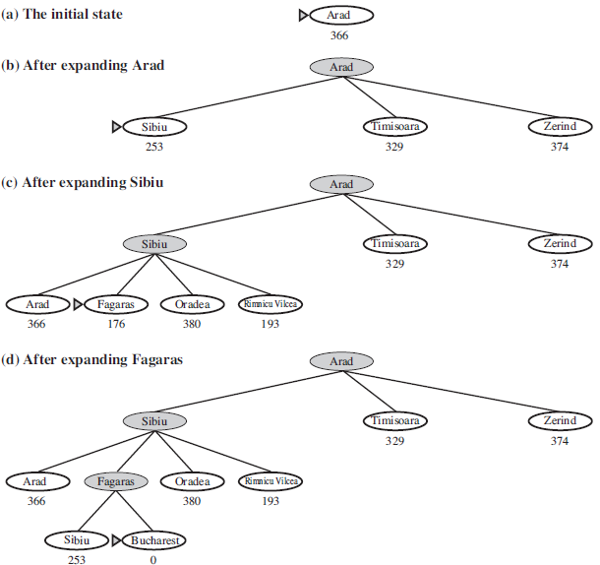
If the goal is Bucharest, we need to know the straight-line distances to Bucharest.
With the help of straight line distance we are finding the route.
Here, the search cost is minimal but not optimal however: the path via Sibiu and Fagaras to Bucharest (460KM)is 32 kilometers longer
than the path through Rimnicu Vilcea and Pitesti (418KM).

Slide 11
A* search: Minimizing the total estimated solution cost
It evaluates nodes by combining g(n), the cost to reach the node, and h(n), the cost to get from the node to the goal.
f(n) = g(n) + h(n)
Since g(n) gives the path cost from the start node to node n, and h(n) is the estimated cost of the cheapest path from n to the goal, we have
f(n) = estimated cost of the cheapest solution through n .
Thus, if we are trying to find the cheapest solution, a reasonable thing to try first is the node with the lowest value of g(n) + h(n).
A∗ search is both complete and optimal.
The algorithm is identical to uniform-cost-search except that A∗ uses g + h instead of g.

Slide 12
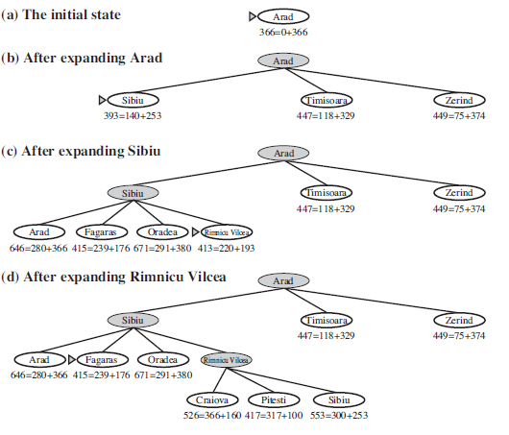
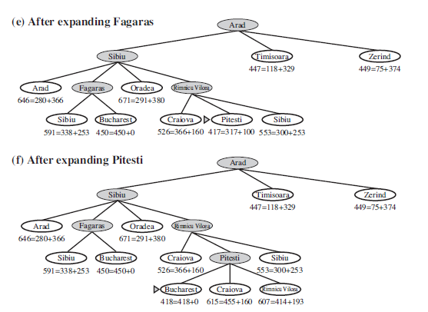
Stages in an A∗ search for Bucharest. Nodes are labeled with f = g +h. The h values are the straight-line distances to Bucharest

Slide 13
Memory-bounded heuristic search
1- Iterative deepening A* search (IDA*)
The simplest way to reduce memory requirements for A∗ is to adapt the idea of iterative deepening to the heuristic search context, resulting in the iterative-deepening A∗ algorithm.
The main difference between IDA∗ and standard iterative deepening is that the cutoff used is the f-cost (g+h) rather than the depth; at each iteration, the cutoff value is the smallest f-cost of any node that exceeded the cutoff on the previous iteration.
IDA* is also complete and optimal, but, as opposed to A*, it has a polynomial space complexity i.e. O(bd), where b is the (maximum) branching factor and d is the maximum depth of the tree.
IDA* still has an exponential time complexity of A*.

Slide 14
2-Recursive best-first search (RBFS)
Recursive best-first search (RBFS) is a simple recursive algorithm that attempts to mimic the operation of standard best-first search, but using only linear space.
Structure is similar to that of a recursive depth-first search (IDDFS), but rather than continuing indefinitely down the current path, it uses the f-limit variable to keep track of the f-value of the best alternative path available from any ancestor of the current node.
If the current node exceeds this limit, the recursion unwinds back to the alternative path. As the recursion unwinds, RBFS replaces the f-value of each node along the path with a backed-up value—the best f-value of its children.
Suffers from potentially exponential increase in complexity associated with redundant paths in graphs.

Slide 15
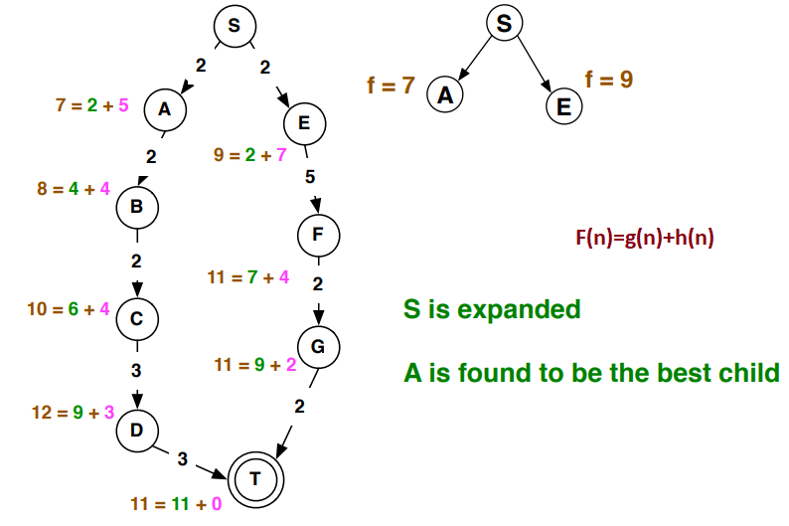
RBFS-fig-1

Slide 16
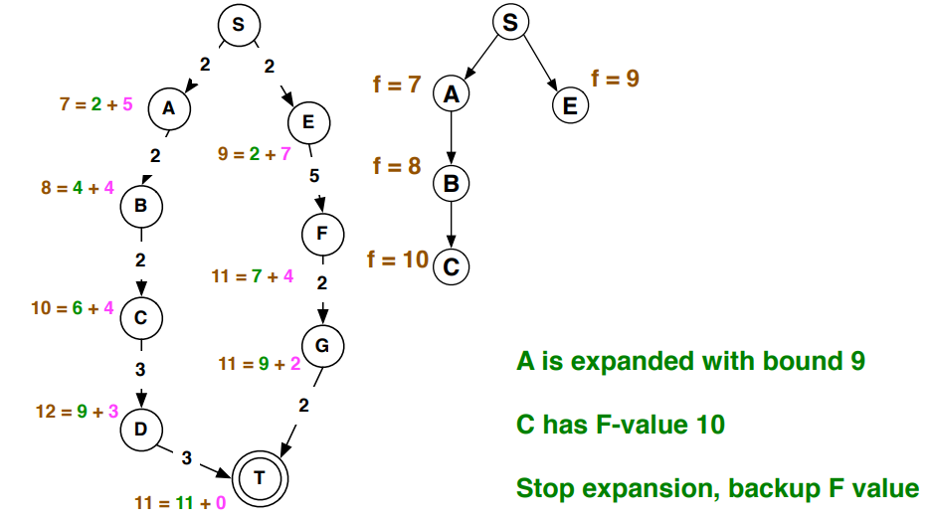
cont…

Slide 17
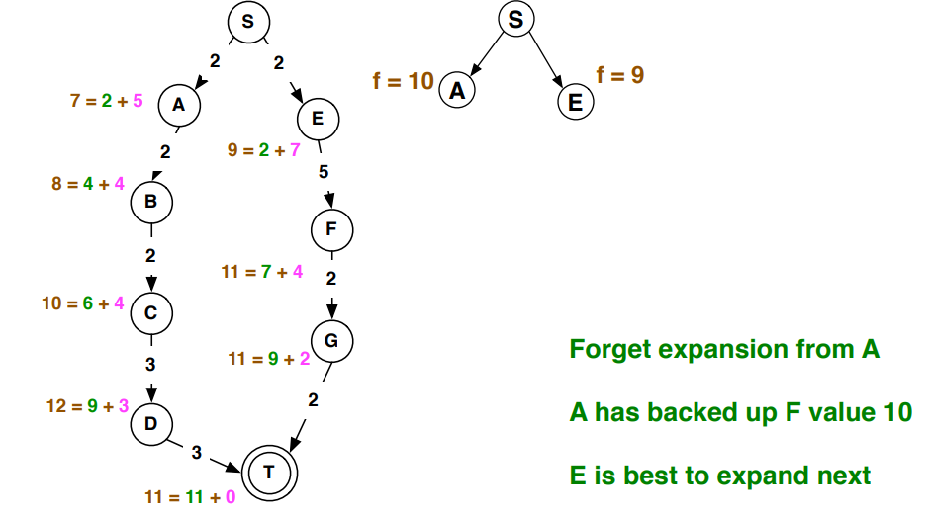

Slide 18
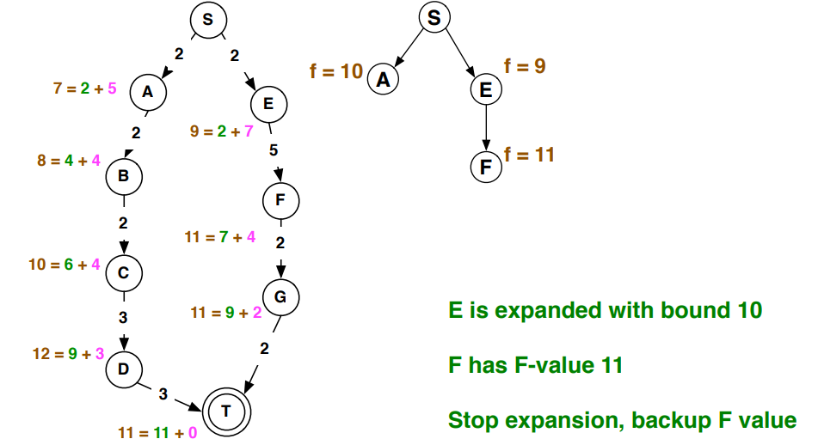

Slide 19
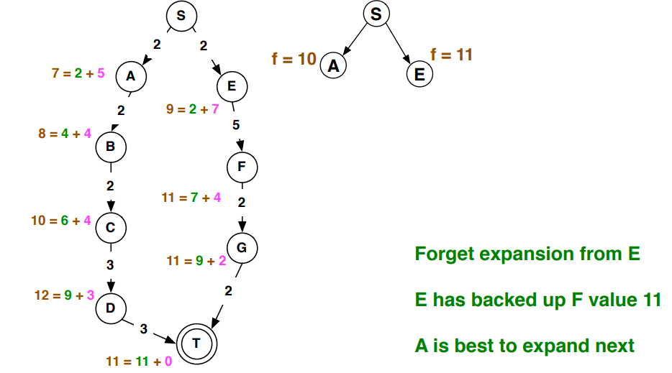

Slide 20
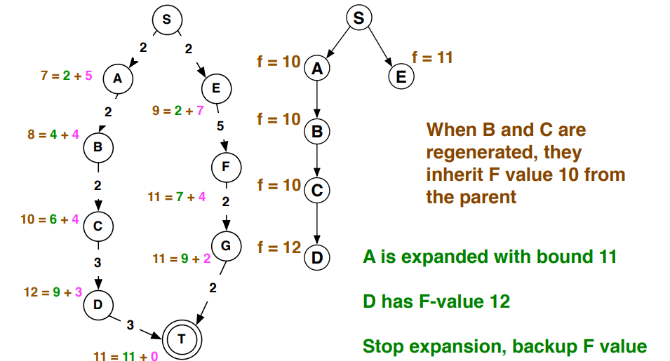

Slide 21
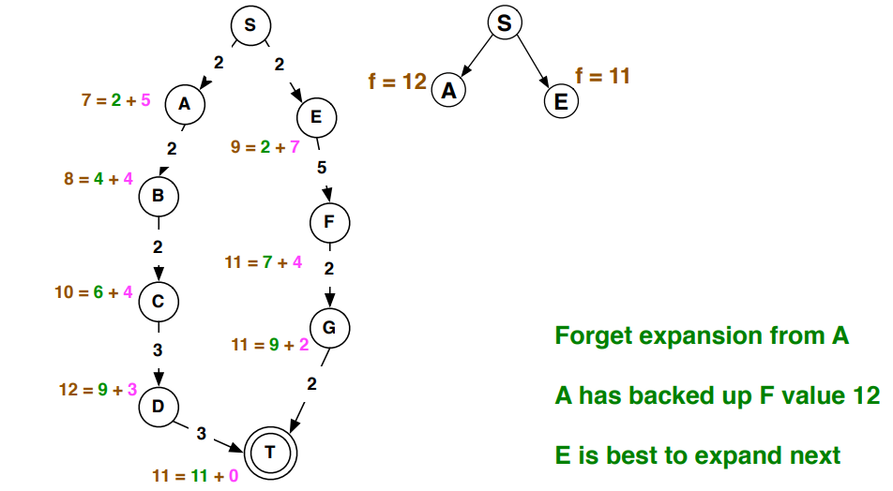

Slide 22
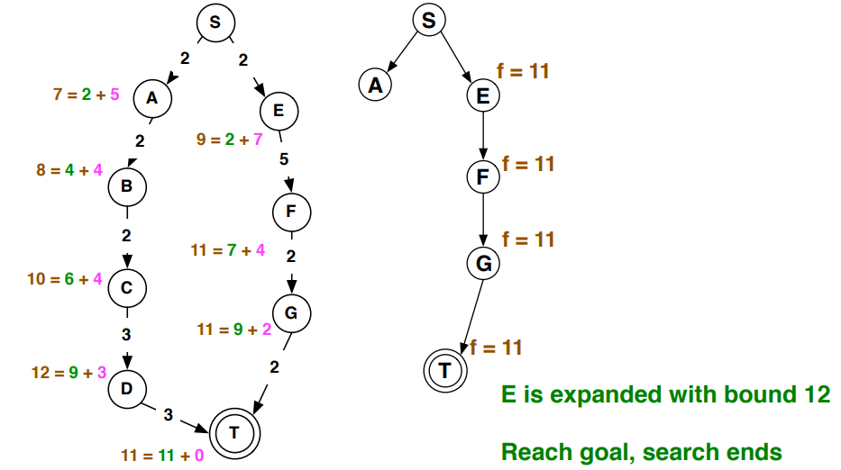

Slide 23
3- (Simplified Memory-Bounded A*) SMA* search
SMA* has the following properties:
It will utilize whatever memory is made available to it.
It avoids repeated states as far as its memory allows.
SMA∗ proceeds just like A∗, expanding the best leaf until memory is full. At this point, it cannot add a new node to the search tree without dropping an old one.

