Slide 1
logic

Slide 2
Logic
A logic must define the semantics or meaning of sentences.
The semantics defines the truth of each sentence with respect to each possible world.
For example, the semantics for arithmetic specifies that the sentence “x + y =4” is true in a world where x is 2 and y is 2, but false in a world where x is 1 and y is 1.
In standard logics, every sentence must be either true or false in each possible world (model)—there is no “in between.”

Slide 3
If a sentence α (alpha) is true in model m, we say that m satisfies α or sometimes m is a model of α.
In mathematical notation, we write α |= β to mean that the sentence α entails the sentence β.
The formal definition of entailment is this:
α |= β if and only if, in every model in which α is true, β is also true.
Using the notation just introduced, we can write α |= β if and only if M(α) ⊆ M(β)
Entailment is the relation between a sentence and another sentence that follows from it.

Slide 4
Propositional Logic: A Very Simple Logic
Propositional logic (PL) is the simplest form of logic where all the statements are made by propositions.
Propositional logic is a declarative language because its semantics is based on a truth relation between sentences and possible worlds.
It also has sufficient expressive power to deal with partial information, using disjunction and negation.
The atomic sentences consist of a single proposition symbol.
There are two proposition symbols with fixed meanings: True is the always-true proposition and False is the always-false proposition.

Slide 5
Following are some basic facts about propositional logic:
Propositional logic is also called Boolean logic as it works on 0 and 1.
In propositional logic, we use symbolic variables to represent the logic, and we can use any symbol for a representing a proposition, such A, B, C, P, Q, R, etc.
Propositions can be either true or false, but it cannot be both.
Propositional logic consists of an object, relations or function, and logical connectives.
These connectives are also called logical operators.
The propositions and connectives are the basic elements of the propositional logic.
Connectives can be said as a logical operator which connects two sentences.

Slide 6
Contd…
A proposition formula which is always true is called tautology, and it is also called a valid sentence.
A proposition formula which is always false is called Contradiction.
Statements which are questions, commands, or opinions are not propositions such as "Where is Rohini", "How are you", "What is your name", are not propositions.

Slide 7
Atomic sentences/proposition
Atomic propositions are the simple propositions. It consists of a single proposition symbol.
These are the sentences which must be either true or false.
Example-
The Sun rises from West (False proposition)
3+3= 7(False proposition)
5 is a prime number(True proposition).

Slide 8
Complex sentences/proposition
Complex or compound sentences are constructed from simpler sentences, using parentheses and logical connectives.
Examples:
"It is raining today, and street is wet."
"Ankit is a doctor, and his clinic is in Mumbai."
Logical Connectives:
Logical connectives are used to connect two simpler propositions or representing a sentence logically. We can create compound propositions with the help of logical connectives.

Slide 9
There are five logical connectives in common use:
1. Negation (not): A sentence such as ¬ P is called negation of P.
2. Conjunction (and): A sentence which has ∧ connective such as, P ∧ Q is called a conjunction.
Example: Rohan is intelligent and hardworking. It can be written as, P= Rohan is intelligent, Q= Rohan is hardworking. → P∧ Q.
3. Disjunction (or): A sentence which has ∨ connective, such as P ∨ Q. is called disjunction, where P and Q are the propositions.
Example: "Ritika is a doctor or Engineer", Here P= Ritika is Doctor. Q= Ritika is Engineer, so we can write it as P ∨ Q.

Slide 10
4. Implication (implies): A sentence such as P → Q, is called an implication. Implications are also known as if-then rules. It can be represented as If it is raining, then the street is wet. Let P= It is raining, and Q= Street is wet, so it is represented as P → Q
5. Biconditional (if and only if): A sentence such as P⇔ Q is a Biconditional sentence, example If I am breathing, then I am alive P= I am breathing, Q= I am alive, it can be represented as P ⇔ Q.

Slide 11
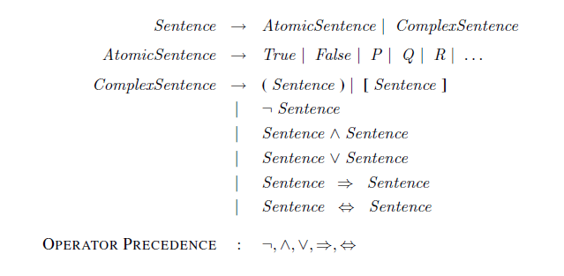
formal grammar of propositional logic

Slide 12
Semantics
The semantics defines the rules for determining the truth of a sentence with respect to a particular model.
In propositional logic, a model simply fixes the truth value—true or false—for every proposition symbol.
In atomic sentences True is true in every model and False is false in every model.
For complex sentences, we have five rules, which hold for any subsentences P and Q in any model m (here “iff” means “if and only if”):
• ￢P is true iff P is false in m.
• P ∧ Q is true iff both P and Q are true in m.
• P ∨ Q is true iff either P or Q is true in m.
• P ⇒ Q is true unless P is true and Q is false in m.
• P ⇔ Q is true iff P and Q are both true or both false in m.

Slide 13
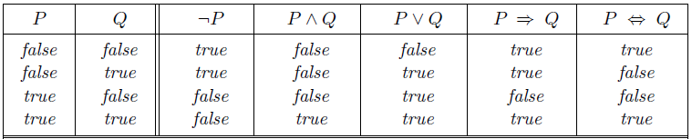
The rules can also be expressed with truth tables that specify the truth value of a complex sentence for each possible assignment of truth values to its components.

Slide 14
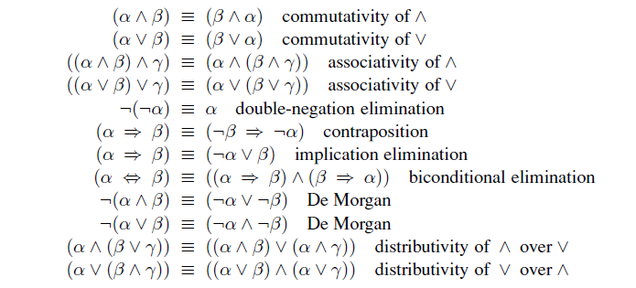
Standard logical equivalences. The symbols α, β, and γ stand for arbitrary sentences of propositional logic.

Slide 15
Limitations of Propositional logic:
We cannot represent relations like ALL, some, or none with propositional logic.
Example:
All the girls are intelligent.
Some apples are sweet.
Some humans are intelligent, or
Sachin likes cricket.
Propositional logic has limited expressive power.
In propositional logic, we cannot describe statements in terms of their properties or logical relationships.

Slide 16
First Order Predicate Logic
First order logic (FOL) is sufficiently expressive to represent a good deal of our commonsense knowledge.
First-order logic is also known as Predicate logic or First-order predicate logic.
First-order logic is a powerful language that develops information about the objects in a more easy way and can also express the relationship between those objects.

Slide 17
First-order logic (unlike natural language) does not only assume that the world contains facts like propositional logic but also assumes the following things in the world:
Objects: people, houses, numbers, theories, Ronald McDonald, colors, baseball games, wars, centuries . . .
Relations: these can be unary relations or properties such as red, round, bogus, prime, multistoried . . ., or more general n-ary relations such as brother of, bigger than, inside, part of, has color, occurred after, owns, comes between, . . .
Functions: father of, best friend, third inning of, one more than, beginning of . . .

Slide 18
Examples
1. “One plus two equals three.”
Objects: one, two, three, one plus two; Relation: equals; Function: plus. (“One plus two” is a name for the object that is obtained by applying the function “plus” to the objects “one” and “two.” “Three” is another name for this object.)
2. “Squares neighboring the wumpus are smelly.”
Objects: wumpus, squares; Property: smelly; Relation: neighboring.
3. “Evil King John ruled England in 1200.”
Objects: John, England, 1200; Relation: ruled; Properties: evil, king.

Slide 19
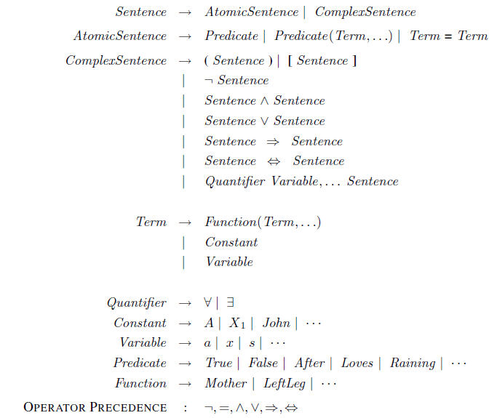
The syntax of first-order logic with equality

Slide 20
Atomic sentences
An atomic sentence (or atom for short) is formed from a predicate symbol optionally followed by a parenthesized list of terms, such as
Brother (Richard , John) states that Richard the Lionheart is the brother of King John.
Married(Father (Richard),Mother (John)) states that Richard the Lionheart’s father is married to King John’s mother

Slide 21
Complex sentences
￢Brother (LeftLeg(Richard), John)
Brother (Richard , John) ∧ Brother (John,Richard)
King(Richard ) ∨ King(John)
￢King(Richard) ⇒ King(John) .

Slide 22
Quantifiers
First-order logic contains two standard quantifiers, called universal and existential.
Universal quantification (∀)
∀ x King(x) ⇒ Person(x)
Sentence says, “For all x, if x is a king, then x is a person.” The symbol x is called a variable.
Intuitively, the sentence ∀x P, where P is any logical expression, says that P is true for every object x.
Richard the Lionheart is a king ⇒ Richard the Lionheart is a person.
King John is a king ⇒ King John is a person.
Richard’s left leg is a king ⇒ Richard’s left leg is a person.
John’s left leg is a king ⇒ John’s left leg is a person.
The crown is a king ⇒ the crown is a person

Slide 23
Existential quantification (∃)
Existential quantifiers are the type of quantifiers, which express that the statement within its scope is true for at least one instance of something.
If x is a variable, then existential quantifier will be ∃x or ∃(x). And it will be read as:
There exists a 'x.'
For some 'x.'
For at least one 'x.'

Slide 24
Some Examples of FOL using quantifier:
1. All birds fly. ∀x bird(x) →fly(x).
2. Every man respects his parent.
∀x man(x) → respects (x, parent).
3. Some boys play cricket.
∃x boys(x) → play(x, cricket).
4. Not all students like both Mathematics and Science.
¬∀ (x) [ student(x) → like(x, Mathematics) ∧ like(x, Science)].
5. Only one student failed in Mathematics.
∃(x) [ student(x) → failed (x, Mathematics) ∧∀ (y) [¬(x==y) ∧ student(y) → ¬failed (x, Mathematics)].

