Slide 1
PROLOG

Slide 2
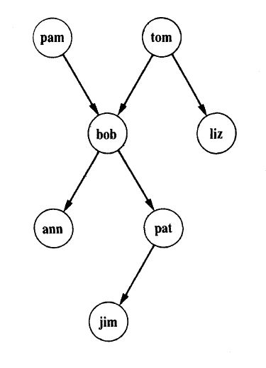
Family tree

Slide 3
This program consists of six clauses. Each of these clauses declares one fact about the parent relation
Prolog program:
parent( pam, bob).
parent( tom, bob).
parent( tom, liz).
parent( bob, ann).
parent( bob, pat).
parent( pat, jim).

Slide 4
When this program has been communicated to the Prolog system, Prolog can be posed some questions about the parent relation.
For example, Is Bob a parent of Pat?
This question can be communicated to the Prolog system by typing into the terminal:
?- parent( bob, pat).
Prolog answers- yes

Slide 5
A further query can be:
?- parent( liz, pat).
Prolog answers- no
A further query can be:
?- parent( tom, ben).
Prolog answers- no
W ho is Liz's parent?
?- parent( X, liz).
Prolog answers- tom
Who are Bob's children?
?- parent( bob, X).
Prolog answers- ann

Slide 6
Find X and Y such that X is a parent of Y.
?- parent( X, Y).
output-
X-pam
Y : bob;
X:tom
Y : bob;
X:tom
Y : liz;

