Slide 1
PROLOG-Introduction

Slide 2
What is Prolog?
Invented early seventies by Alain Colmerauer in France and Robert Kowalski in Britain.
Prolog = Programming in Logic
Prolog is a declarative programming language unlike most common programming languages.
In a declarative language
the programmer specifies a goal to be achieved
the Prolog system works out how to achieve it

Slide 3
traditional programming languages are said to be procedural-procedural programmer must specify in detail how to solve a problem:
mix ingredients; beat until smooth; bake for 20 minutes in a moderate oven; remove tin from oven; put on bench; close oven; turn off oven;
In purely declarative languages, the programmer only states what the problem is and leaves the rest to the language system

Slide 4
Applications of Prolog
Some applications of Prolog are:
intelligent data base retrieval
natural language understanding
expert systems
specification language
machine learning
robot planning
automated reasoning
problem solving

Slide 5
Relations
Prolog programs specify relationships among objects and properties of objects.
When we say, "John owns the book", we are declaring the ownership relationship between two objects: John and the book.
When we ask, "Does John own the book?" we are trying to find out about a relationship.
Relationships can also have rules such as:
Two people are sisters if
they are both female and
they have the same parents.
A rule allows us to find out about a relationship even if the relationship isn't explicitly stated as a fact.

Slide 6
A little more on being sisters
As usual in programming, you need to be a bit careful how you phrase things:
The following would be better:
A and B are sisters if
A and B are both female and they have the same father and they have the same mother and A is not the same as B

Slide 7
Programming in Prolog
Declare facts describing explicit relationships between objects and properties objects (e.g. Mary likes pizza, grass has colour green, Fido is a dog, Mizuki taught Paul Japanese )
Define rules defining implicit relationships between objects (e.g. the sister rule above) and/or rules defining implicit object properties (e.g. X is a parent if there is a Y such that Y is a child of X).
One then uses the system by: asking questions above relationships between objects, and/or about object properties (e.g. does Mary like pizza? is Joe a parent?)

Slide 8
Syntax of Prolog
 Terms
 Predicates
 Facts and Rules
 Programs
 Queries

Slide 9
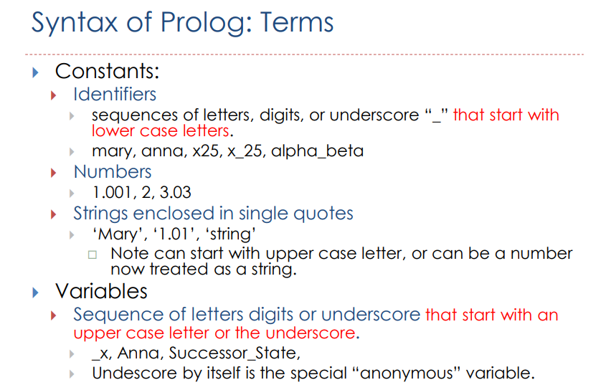

Slide 10
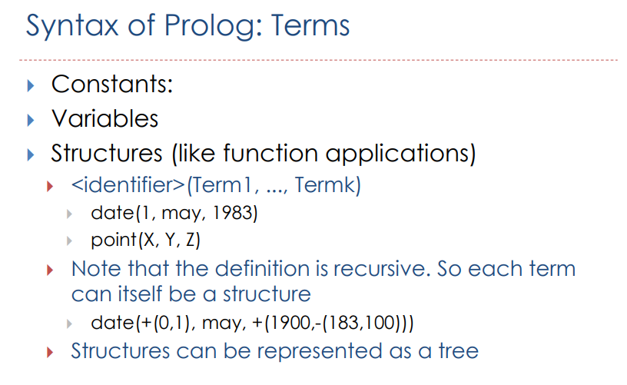

Slide 11
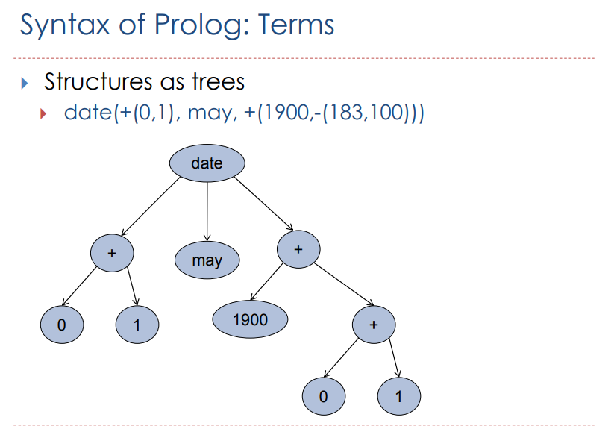

Slide 12
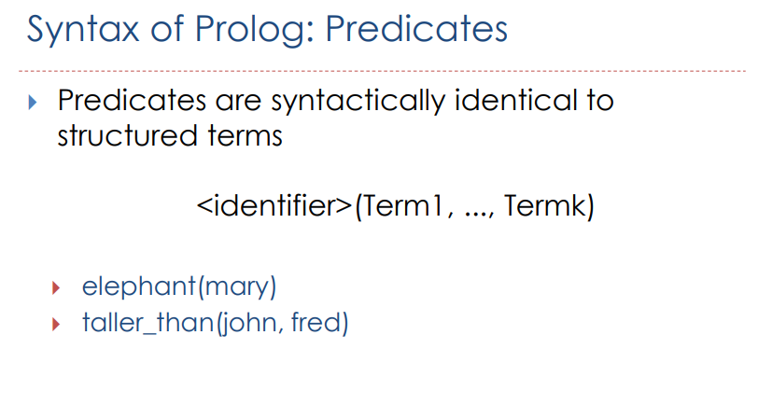

Slide 13
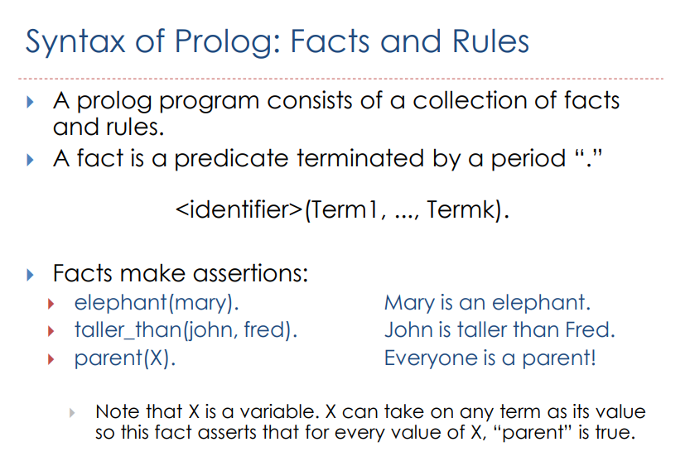

Slide 14

Rules
The previous question can be restated as a general rule:
One person, Teacher, teaches another person, Student if Teacher lectures in a course, Course and Student studies Course.
In Prolog this is written as:
teaches(Teacher, Student) :- lectures(Teacher, Course), studies(Student, Course).
?- teaches(codd, Student).
Facts are unit clauses and rules are non-unit clauses.

Slide 15
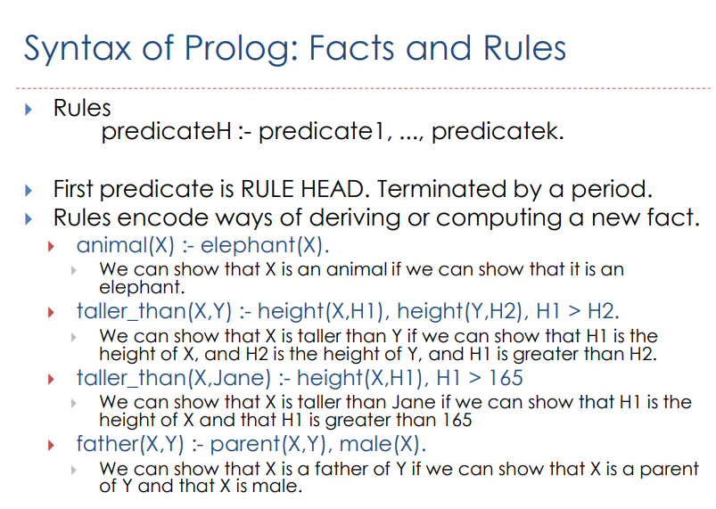

Slide 16
Facts
Facts are properties of objects, or relationships between objects;
Notice that:
names of properties/relationships begin with lower case letters.
the relationship name appears as the first term
objects appear as comma-separated arguments within parentheses.
A period "." must end a fact.
objects also begin with lower case letters. They also can begin with digits such as 9020, and can be strings of characters enclosed in quotes such as reads(fred, "War and Peace").
lectures(turing, 9020). is also called a predicate

Slide 17
Facts example
% lectures(X, Y): person X lectures in course Y
lectures(turing, 9020).
lectures(codd, 9311).
lectures(backus, 9021).
lectures(ritchie, 9201).
lectures(minsky, 9414).
lectures(codd, 9314).
%year(X, Y): person X is in year Y
year(fred, 1).
year(jack, 2).
year(jill, 2).
year(henry, 4).

Slide 18
% studies(X, Y): person X studies in course Y
studies(fred, 9020).
studies(jack, 9311).
studies(jill, 9314).
studies(jill, 9414).
studies(henry, 9414).
studies(henry, 9314).
Together, these facts form Prolog's database

Slide 19
Queries
Once we have a database of facts (and, soon, rules) we can ask questions about the stored information.
Notice that:
In SWI Prolog, queries are terminated by a full stop.
To answer this query, Prolog consults its database to see if this is a known fact.
In example dialogues with Prolog, the text in green italics is what the user types.

Slide 20
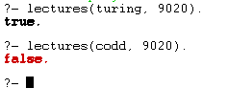
Another example query
?- lectures(turing, 9020). true.
?- lectures(codd, 9020). false.
if answer is true., the query succeeded
if answer is false., the query failed.
In the latest version of SWI Prolog, it no longer says "No." but says "false." instead.
The use of lower case for code is critical.
Prolog is not being intelligent about this - it would not see a difference between this query and
lectures(fred, 9020). or lectures(xyzzy, 9020).
Though a person inspecting the database can see that fred is a student, not a lecturer, and that xyzzy is neither student nor lecturer.

Slide 21
Variables
Suppose we want to ask, "What course does Turing teach"?
This could be written as: Is there a course, X, that Turing teaches?
The variable X stands for an object that the questioner does not know about yet.
To answer the question, Prolog has to find out the value of X, if it exists.
As long as we do not know the value of a variable it is said to be unbound. When a value is found, the variable is said to bound to that value.
The name of a variable must begin with a capital letter or an underscore character, "_".

Slide 22

To ask Prolog to find the course that Turing teaches, enter this:
?- lectures(turing, Course). Course = 9020 ← output from Prolog
To ask which course(s) Prof. Codd teaches, we may ask,
?- lectures(codd , Course). Course = 9311 ; ← type ";" to get next solution Course = 9314 ?-
If Prolog can tell that there are no more solutions, it just gives you the ?- prompt for a new query, as here.
If Prolog can't tell, it will let you type ; again, and then if there is no further solution, report false.

Slide 23

Conjunctions of Goals in Queries
How do we ask, "Does Turing teach Fred"?
This means finding out if Turing lectures in a course that Fred studies.
?- lectures(turing, Course), studies(fred, Course).
i.e. "Turing lectures in course, Course and Fred studies (the same) Course".
The question consists of two goals. To answer this question, Prolog must find a single value for Course, that satisfies both goals.
Read the comma, ",", as and.
However, note that Prolog will evaluate the two goals left-to-right. In pure logic, P1 ∧ P2 is the same as P2 ∧ P1. In Prolog, there is the practical consideration of which goal should be evaluated first - the code might be more efficient one way or the other. In particular, in "P1, P2", if P1 fails, then P2 does not need to be evaluated at all. This is sometimes referred to as a "conditional-and".

Slide 24

Example
elephant(fred).
elephant(mary).
elephant(joe).
animal(fred) :- elephant(fred).
animal(mary) :- elephant(mary).
animal(joe) :- elephant(joe).
QUERY
animal(fred), animal(mary), animal(joe).

Slide 25
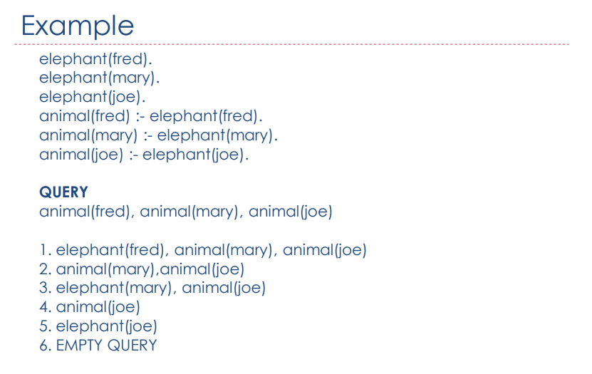

Slide 26
Disjunctions of Goals in Queries
It turns out explicit ors aren't needed much in Prolog
There is a way to write or: (";")
head :- body1 ; body2.
Avoid using ; if you can, at least until you have learned how to manage without it. While some uses of ; are harmless, others can make your code hard to follow.

Slide 27
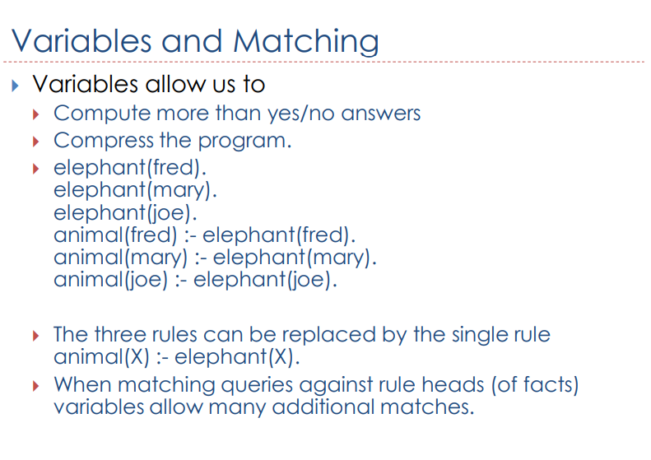

Slide 28
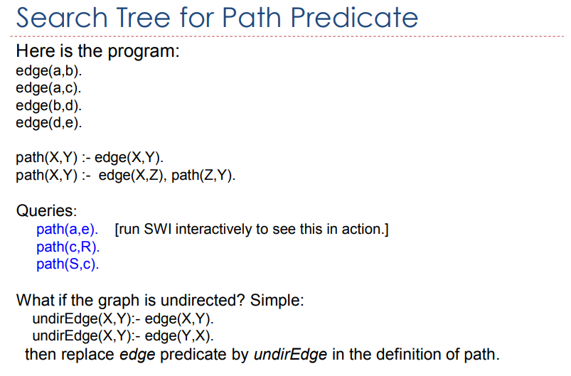
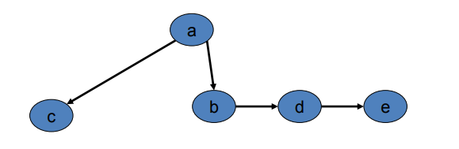

Slide 29
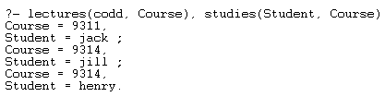
Backtracking in Prolog
Who does Codd teach?
?- lectures(codd, Course), studies(Student, Course).
Course = 9311 Student = jack ;
Course = 9314 Student = jill ;
Course = 9314 Student = henry ;
Prolog solves this problem by proceeding left to right and then backtracking.
When given the initial query, Prolog starts by trying to solve lectures(codd, Course)
There are six lectures clauses, but only two have codd as their first argument.
Prolog uses the first clause that refers to codd: lectures(codd, 9311).
With Course = 9311, it tries to satisfy the next goal, studies(Student, 9311).
It finds the fact studies(jack, 9311). and hence the first solution: (Course = 9311, Student = jack)

Slide 30
Backtracking cont...
After the first solution is found, Prolog retraces its steps up the tree and looks for alternative solutions.
First it looks for other students studying 9311 (but finds none).
Then it
backs up
rebinds Course to 9314,
goes down the lectures(codd, 9314) branch
tries studies(Student, 9314),
finds the other two solutions: (Course = 9314, Student = jill) and (Course = 9314, Student = henry).

Slide 31
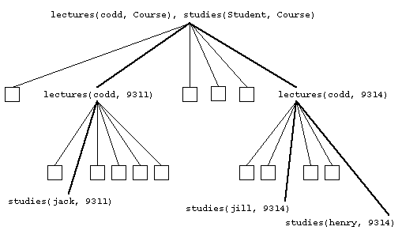
proof tree

Slide 32
Write a prolog program to maintain family tree.

