Slide 1
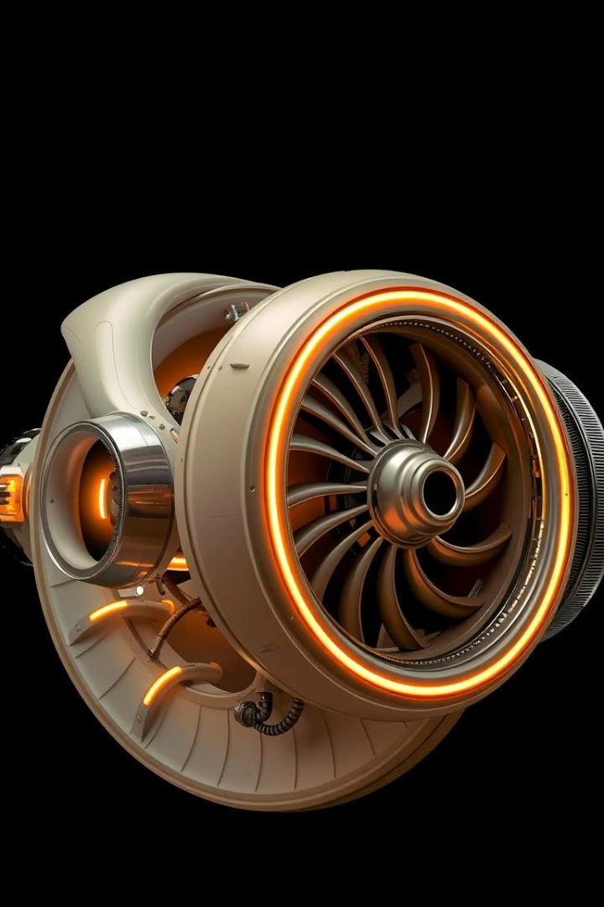

Turbo Engine RUL Prediction System
Predicting the remaining useful life (RUL) of turbo engines is critical for proactive maintenance and safety.
by Naman Bajpai

Slide 2
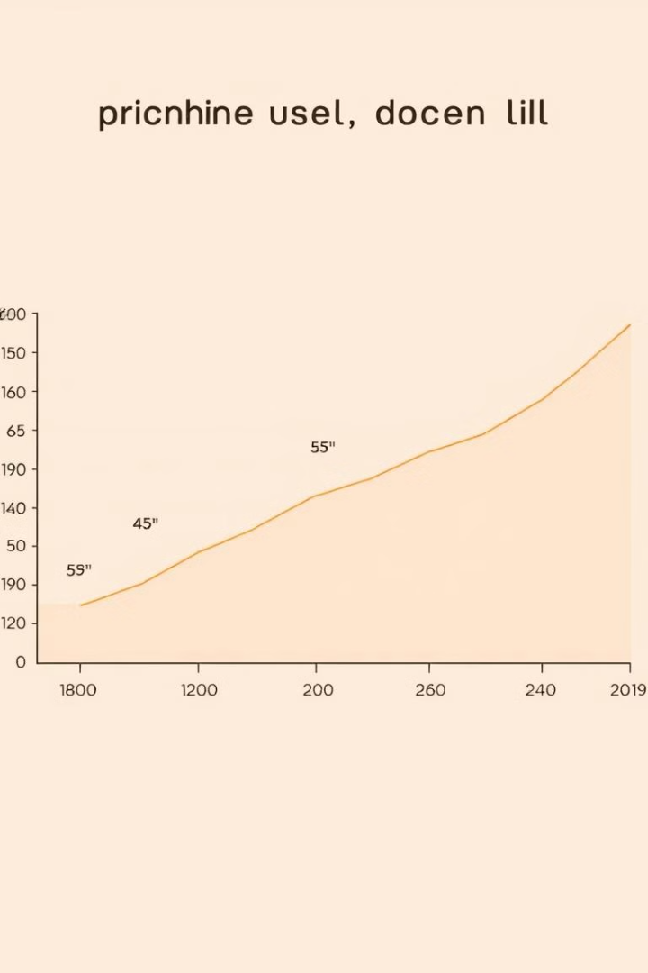
Project Abstract
Predictive Maintenance
Data-Driven Insights
Preventing costly breakdowns and maximizing uptime.
Leveraging sensor data to understand engine health.
Advanced Algorithms
Utilizing machine learning to predict RUL.

Slide 3
Problem & Solution
Problem
Solution
Predicting RUL is challenging due to complex engine dynamics and limited data.
Develop a system that leverages ML algorithms, including Random Forest, CNN, and Streamlit for deployment.

Slide 4
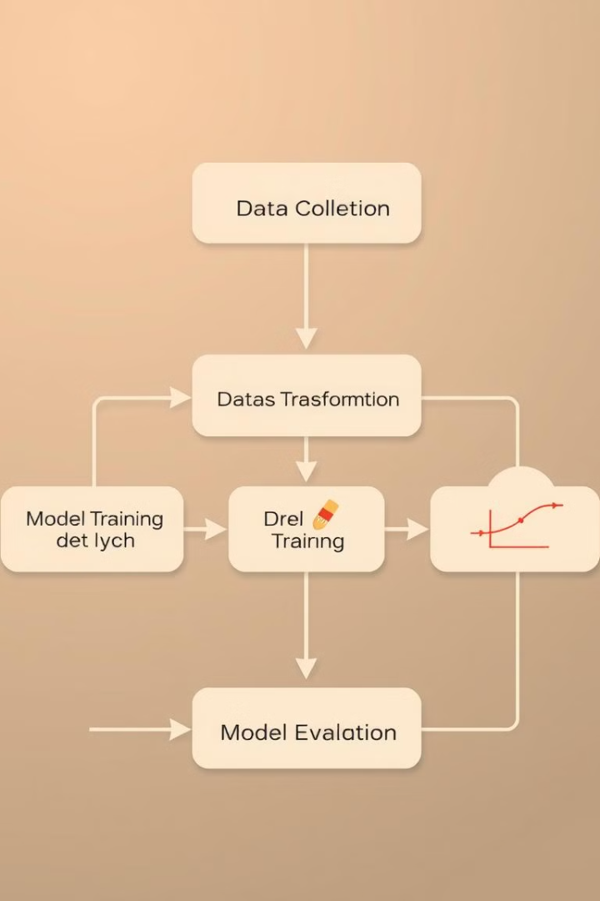
Technical Overview
1
Data Preprocessing
Cleaning, transforming, and preparing engine sensor data for analysis.
2
Model Training
Training ML models like Random Forest and CNN using labeled data.
3
Deployment
Deploying trained models on Streamlit for user-friendly access and predictions.

Slide 5



Project Importance & Use Case
Safety
1
Preventing engine failures and potential accidents.
Cost Reduction
2
Optimizing maintenance schedules and minimizing downtime.
Improved Efficiency
3
Maximizing engine performance and extending operational lifespan.

Slide 6
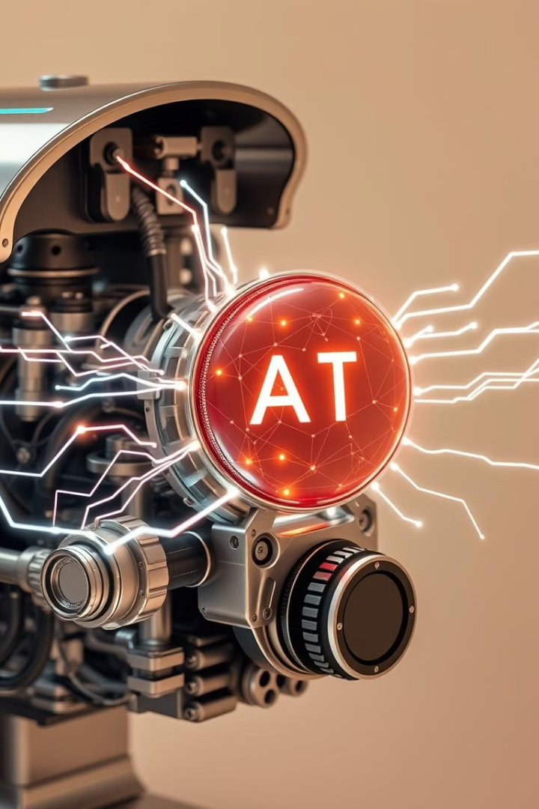


Future Scope
IoT Integration
Explainable AI
Integrating real-time sensor data for continuous monitoring.
Making model predictions more transparent and understandable.

Slide 7

Conclusion
1
2
Improved Accuracy
User-Friendly Interface
Achieved high accuracy in RUL prediction using ML models.
Streamlit deployment provides an intuitive user experience.

Slide 8
Key Learnings & Future Steps
Data Quality
1
Importance of high-quality sensor data for model performance.
Model Selection
2
Choosing the right ML model based on data characteristics.
Deployment Considerations
3
Ensuring scalability, security, and maintainability of the system.

