Slide 1
Potential of Neural Networks to Predict Moisture Performance of Building envelopes.
Naman Bansal
Coop Student

Slide 2
OUTLINE
Problem
Application of Support Vector Regression (SVR) method
Application of Neural Networks
Summary and next steps

Slide 3
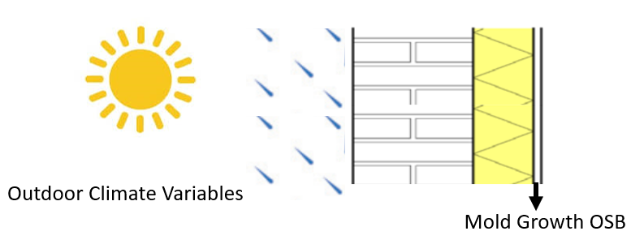
Problem
Design of climate resilient building envelopes (BEs) requires prediction of moisture response of BE components to outdoor conditions.
The common approach is to use an hygrothermal simulation (HAM) tool such as DELPHIN, COMSOL, WUFI, etc. However:
Proper use requires some technical knowledge
Long time required to prepare, set up and run simulations, i.e., 2D simulations may take several days or weeks to complete depending on the number of years
There is a need for an alternative approach that does not require technical knowledge and is less time consuming: Machine Learning.

Slide 4
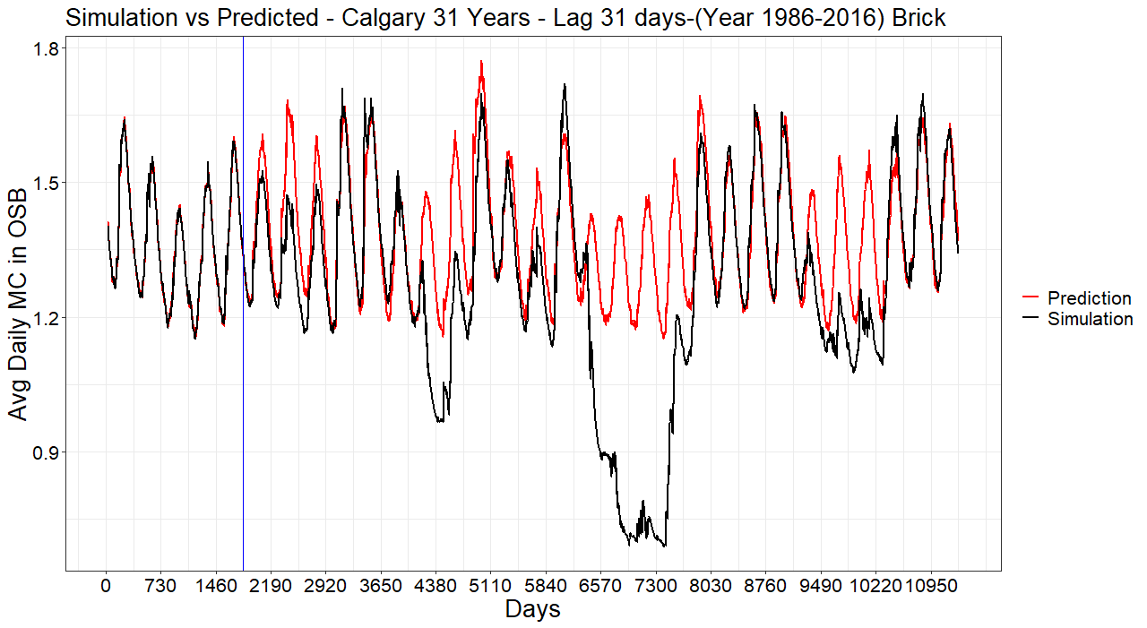
Support Vector Machine (SVR) from Last Term

Slide 5
SVR Limitations
Still need to run the simulation for 5 years to train the model for each city.
Climate Conditions should not vary drastically over the 31 years otherwise predictions can be bad.
Potential Solution
Neural Networks which allows the prediction of all 31 years and can capture drastic variability in the climate.

Slide 6
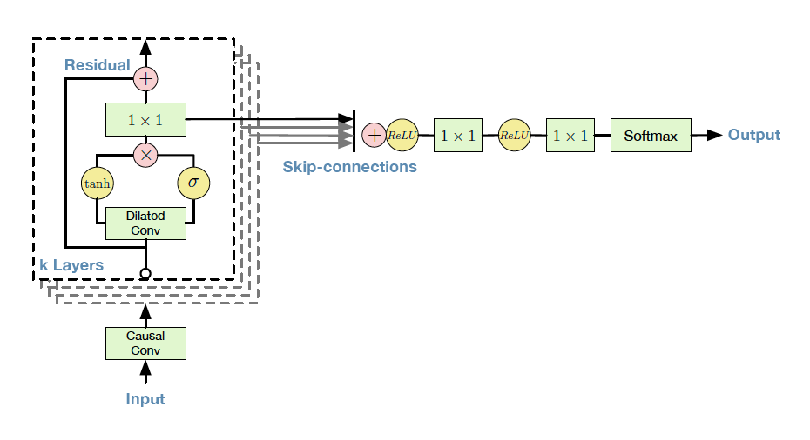
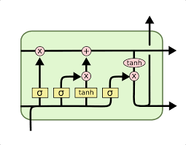
Convolutional Neural Network & Long Short Term Memory Neural Network
Long Short Term Memory (LSTM)
Convolutional Neural Network (CNN)

Slide 7

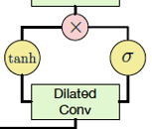
Neural Network Basic Idea
Made of 2 components
Neurons:
Gates:

Slide 8
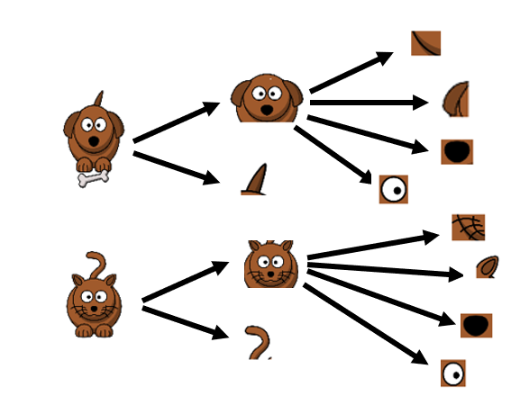
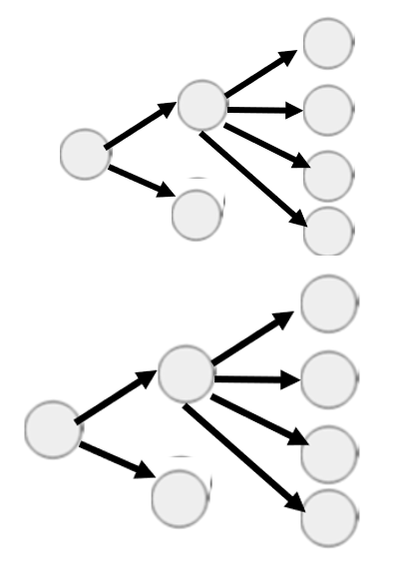
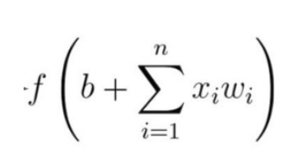

Neurons
Break a large Complex Problem into smaller manageable parts.
Example Form
Neural Form
Mathematical Form

Slide 9
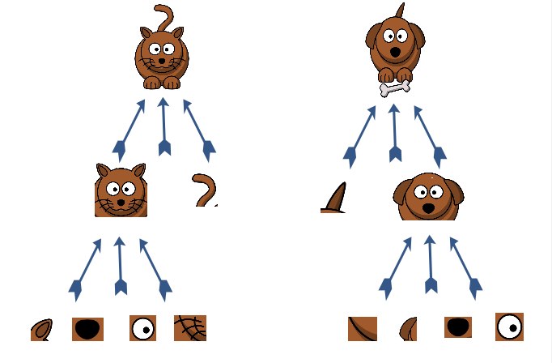
Gates
?
Time Day 1 Day 2 Day 3 Day 4 Day 5
A Cat followed by a Dog and a Dog by a Cat and so on.
Forget Gate | Input Gate | Current Cell State Action
0 (Closed) | 0 (Closed) | Erase the previous value
1 (Open) | 0 (Closed) | Remember the previous value
0 (Closed) | 1 (Open) | Overwrite the pervious value
1 (Open) | 1 (Open) | Remember and add to the previous value
To Predict the current time step need information from previous time steps (called Lag)

Slide 10
Methods
Perform 62 HAM simulations on wood frame wall using DELPHIN
Two claddings: Brick and Fibreboard
City: Ottawa
Each simulation: Average year (based on moisture index) + each year of the 31 years of Historical (1986-2016) and Future (2062-2092).
Train the model to predict T and RH of OSB using 50 randomly selected simulations
Predict T and RH of the 12 remaining cases
Temperature
Temperature OSB out
Direct Radiation
Mould Index
Relative Humidity
Relative Humidity OSB out
Wind Driven Rain
Outdoor Climate Variables
Predicted variables inside Wall Assembly
Using Predicted Variables Compute Mould

Slide 11
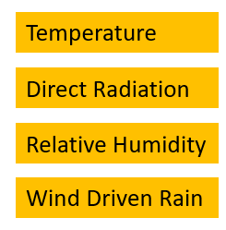
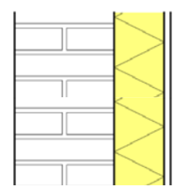
Optimal Lag
Temperature OSB out
Past 2 Days
Relative Humidity OSB out
Past 10 or more Days
Outdoor Climate Variables

Slide 12
Results From LSTM (Long Short Term Memory Neural Network)

Slide 13
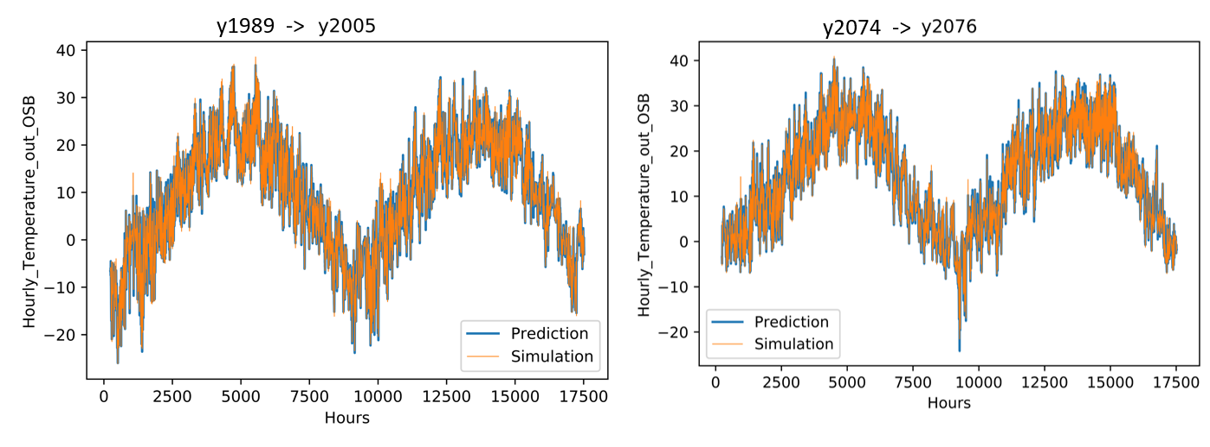
Ottawa - Temperature out OSB – Brick (Lag 2 Days)

Slide 14
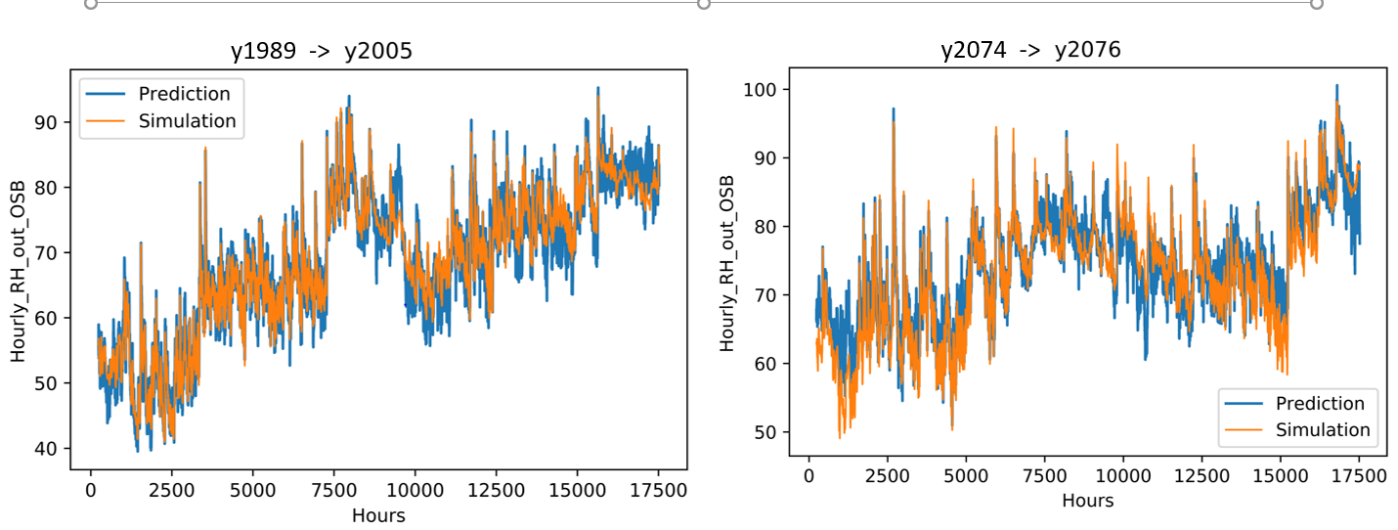
Ottawa - Relative Humidity out OSB – Brick (Lag 10 Days)

Slide 15
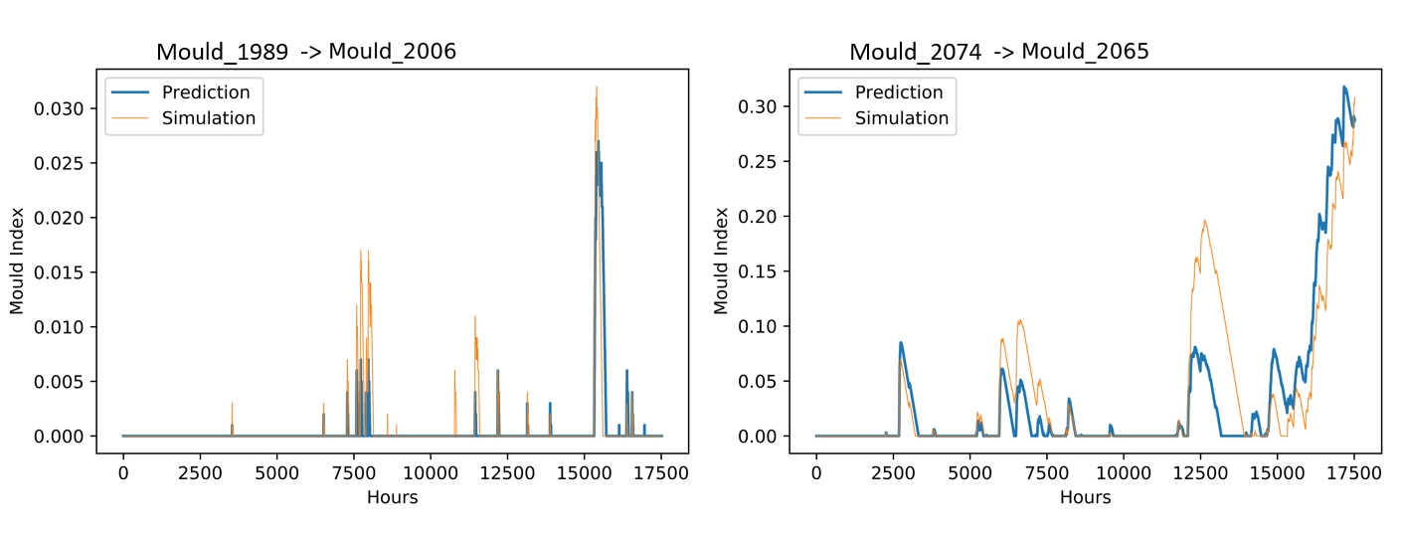
Mould Index out OSB – Brick - Ottawa

Slide 16
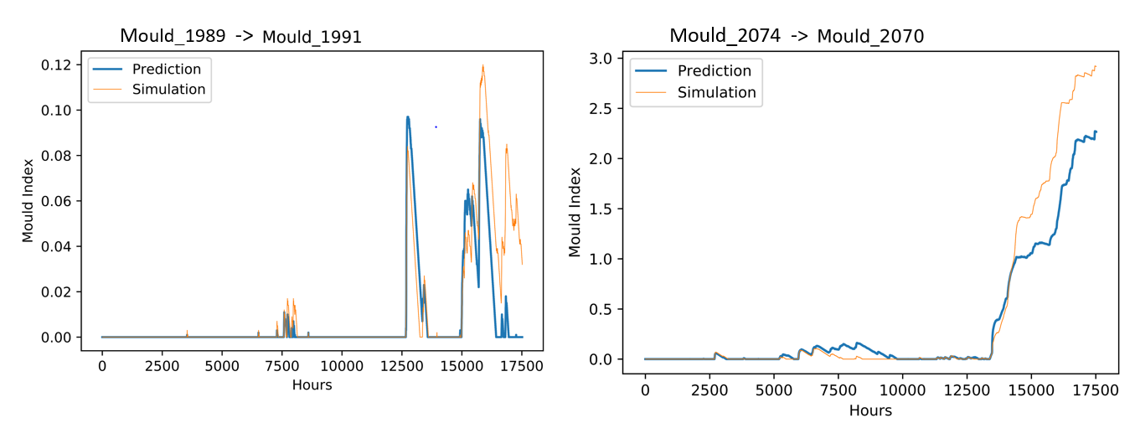
Mould Index out OSB – Brick - Ottawa

Slide 17
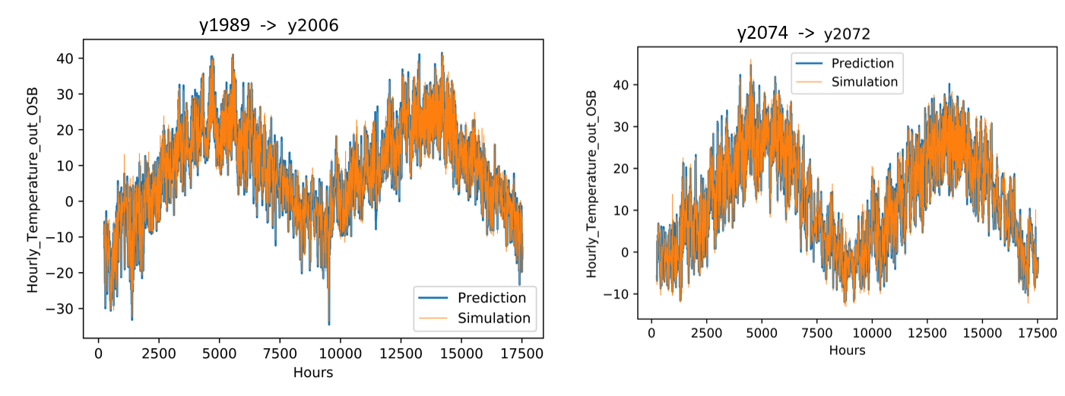
Ottawa –Temperature out OSB- Fibreboard (Lag 2 Days)

Slide 18
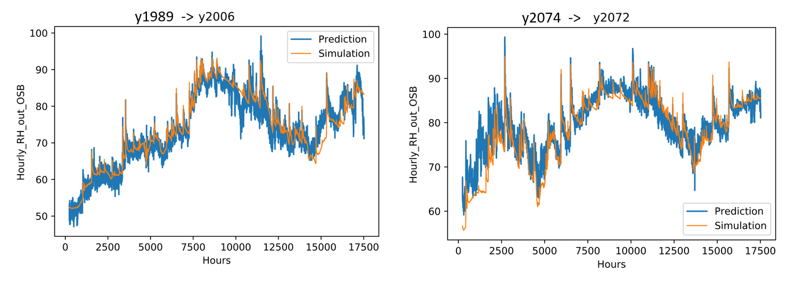
Ottawa –Relative Humidity out OSB-Fibreboard (Lag 10 Days)

Slide 19
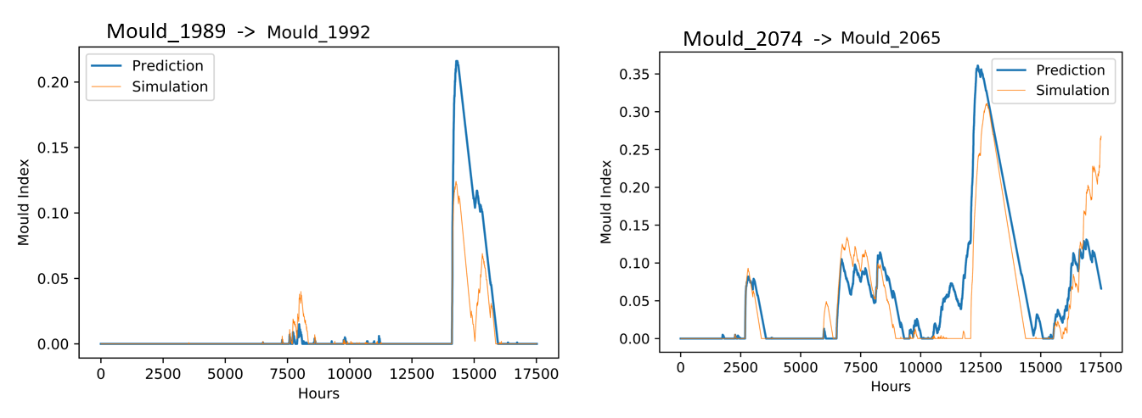
Mould Index out OSB – Fibreboard - Ottawa

Slide 20
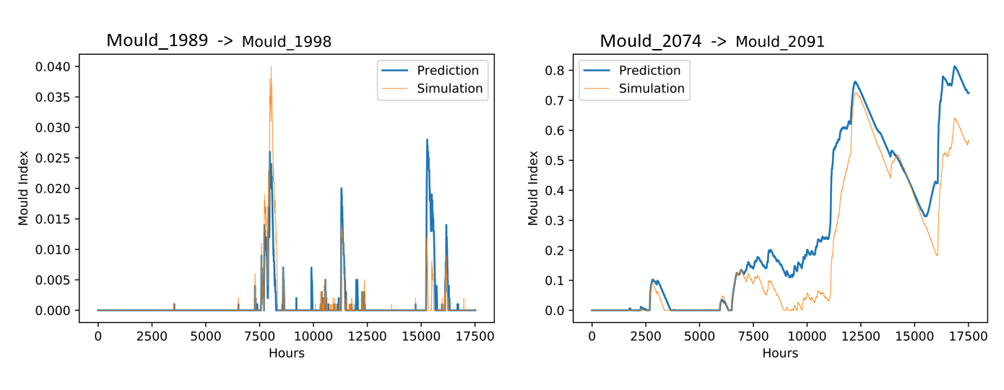
Mould Index out OSB – Fibreboard - Ottawa

Slide 21
Time to Run 12 Simulations
DELPHIN Software:
= 4 hours (~ 20 minutes/simulation)
LSTM Network:
Data Preparation (20 min) + Training (25 min) + Predicting (5 min)
= 50 minutes (~ 5 minutes/simulation)

Slide 22
Summary
Initial Results from LSTM Network are reasonable and fast.
Able to adapt to different cladding like Brick & Fibreboard.
Able to incorporate both Historical & Future Years in one model.
Extension
Train on some Runs in a City and predict the remaining runs.
Train on multiple cities in similar zones and see if predictions hold up.
Compare prediction of LSTM Network with CNN Network.

Slide 23
Acknowledgements
Mr. Shawn (Setup of Neural Networks)
Mr. Max (Mold Calculations)
Mr. Chetan (DELPHIN Simulation Data)
References
Tijskens, A.; Janssen, H.; Roels, S. Optimising Convolutional Neural Networks to Predict the Hygrothermal Performance of Building Components. Energies 2019, 12, 3966.

Slide 24



THANK YOU

