Slide 1
Application of Support Vector Machine Regression (SVR) and Partial Least Square Regression (PLSR) for improving a method used to select moisture reference year (MRY) and Long term Predictions of moisture performance of walls
Naman Bansal
Coop Student

Slide 2
OUTLINE
Goal
Problem
Methods:
Selecting MRYs
Long Term Predictions Through Time Series Analysis
Summary

Slide 3
Goal of the Project
Make current and new buildings durable to existing and future climate change by developing decision support tools. (i.e. codes, guides, models)
Running hygrothermal simulations using software like DELPHIN where we use climate data to predict how the building will perform in terms of moisture now and in the future.

Slide 4
Problem
Climate varies across the country
Climate change is expected in the future (global warming)
Uncertainties in climate projection, e.g., for 1 city there are 15 different runs of 31 years (15*31 simulations)
Time consuming to run simulations for all 15 sets of 31 years for just one city.

Slide 5
Overview of the Two Methods
1) Reduce simulation time by selecting moisture reference years (MRYs)
What is a Moisture Reference Year?
A set of representative years selected among the 31-year series.
Example a Dry + Wet as MRYs
Currently will not select MRYs but will compare different methods like PLSR and SVR that could be used to select MRYs.
2) Time Series Analysis through SVR (eliminate the need to select MRY)

Slide 6
Support Vector Regression

Slide 7
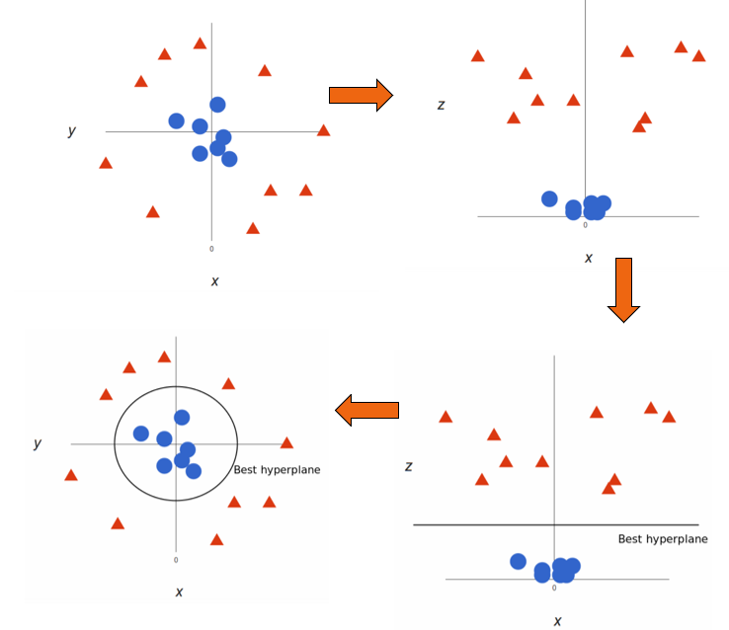
Support Vector Regression – Kernel

Slide 8
Partial Least Square Regression (PLSR)
Climate
PC1 Linear comb of climate variables that explain the most variance in response
PC2 Linear comb of climate variables that explains the variance not explained by PC1.
And so on…
Final equation be Y=PC1+PC2+…..
Response
(Moisture)
Principal
Comp 1
Principal
Comp 2

Slide 9
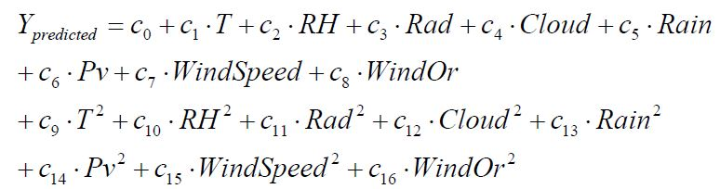
Method 1
ASHRAE Research Project Report By Mr. Zhang and others- Comparison of 5 different method (MI, ANK etc.)
Regression Model (INPUT weather data -> OUTPUT RHT70 of OSB)

Slide 10
Problems with the report model
Correlated Variables
Methods to Overcome these issues:
PLSR-Partial Least Square Regression (Handles Correlated Variables)
SVR- Support Vector Regression (Handles Correlated Variables + No assumption about data)
Based on 5 cities in the US, may not be applicable to use in Canada.
Need to re-train the report model on current data.

Slide 11
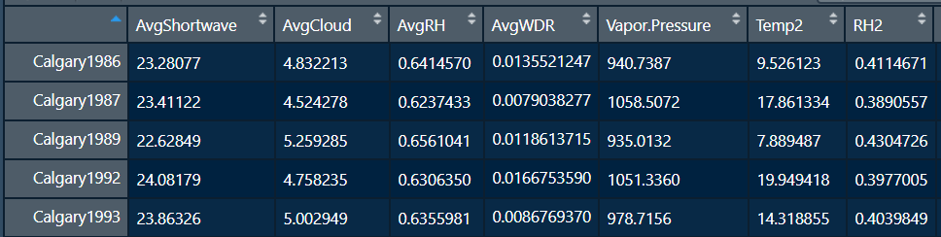
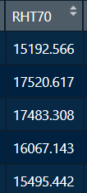
Method 1 Setup
Variables: Shortwave,Cloudiness,RH,WDR,Vapor Pressure,Temp²,RH², Vapor²
3 Cities (Calgary, Vancouver, Ottawa) 186 data points
North Orientation
Train (120 Observations) Test(66 Observations)
1 value of each weather variable represent the whole year. (Avg, Sum)

Slide 12
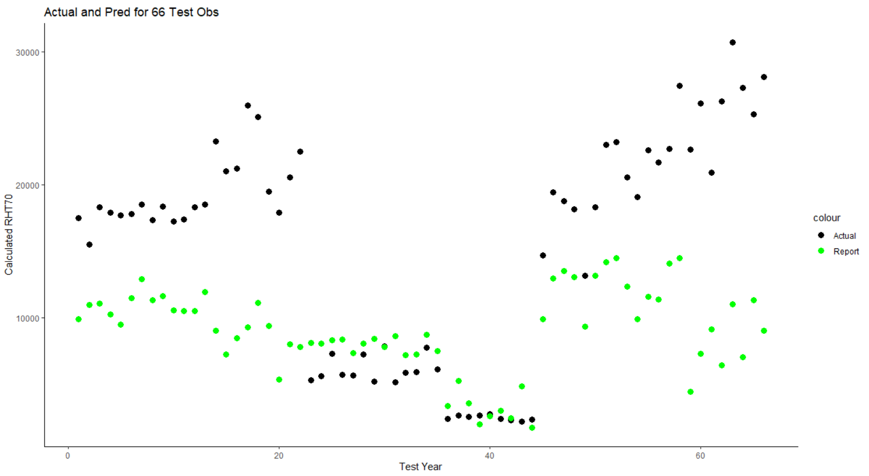
Calgary
Ottawa
Vancouver

Slide 13
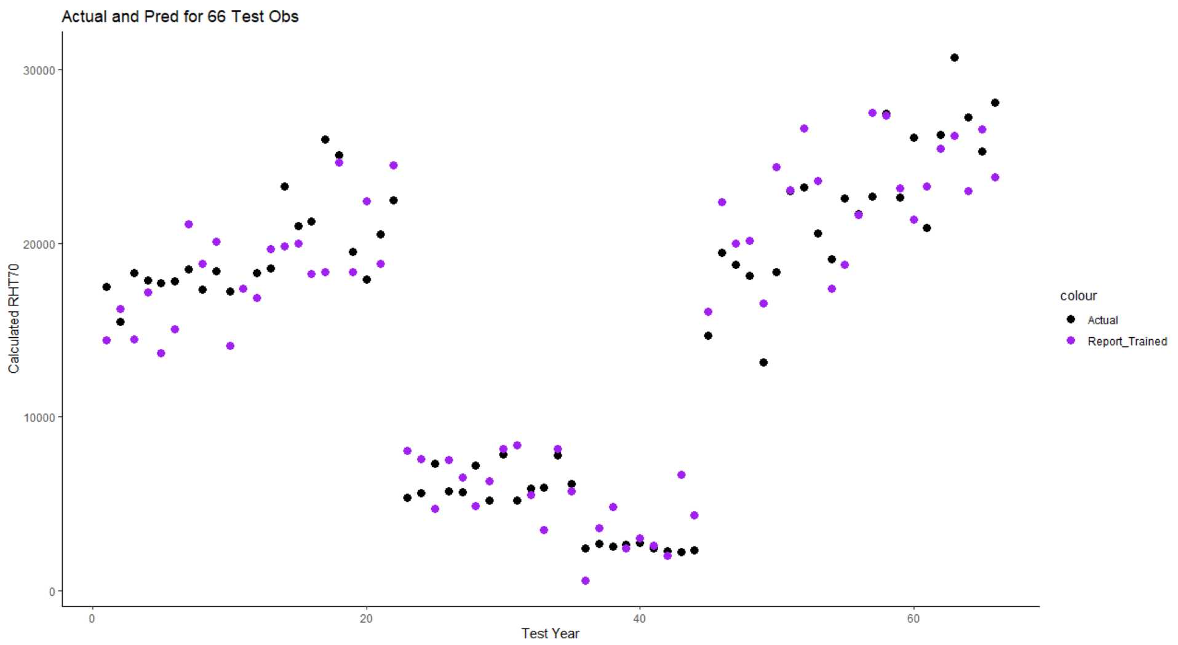
Ottawa
Calgary
Vancouver

Slide 14
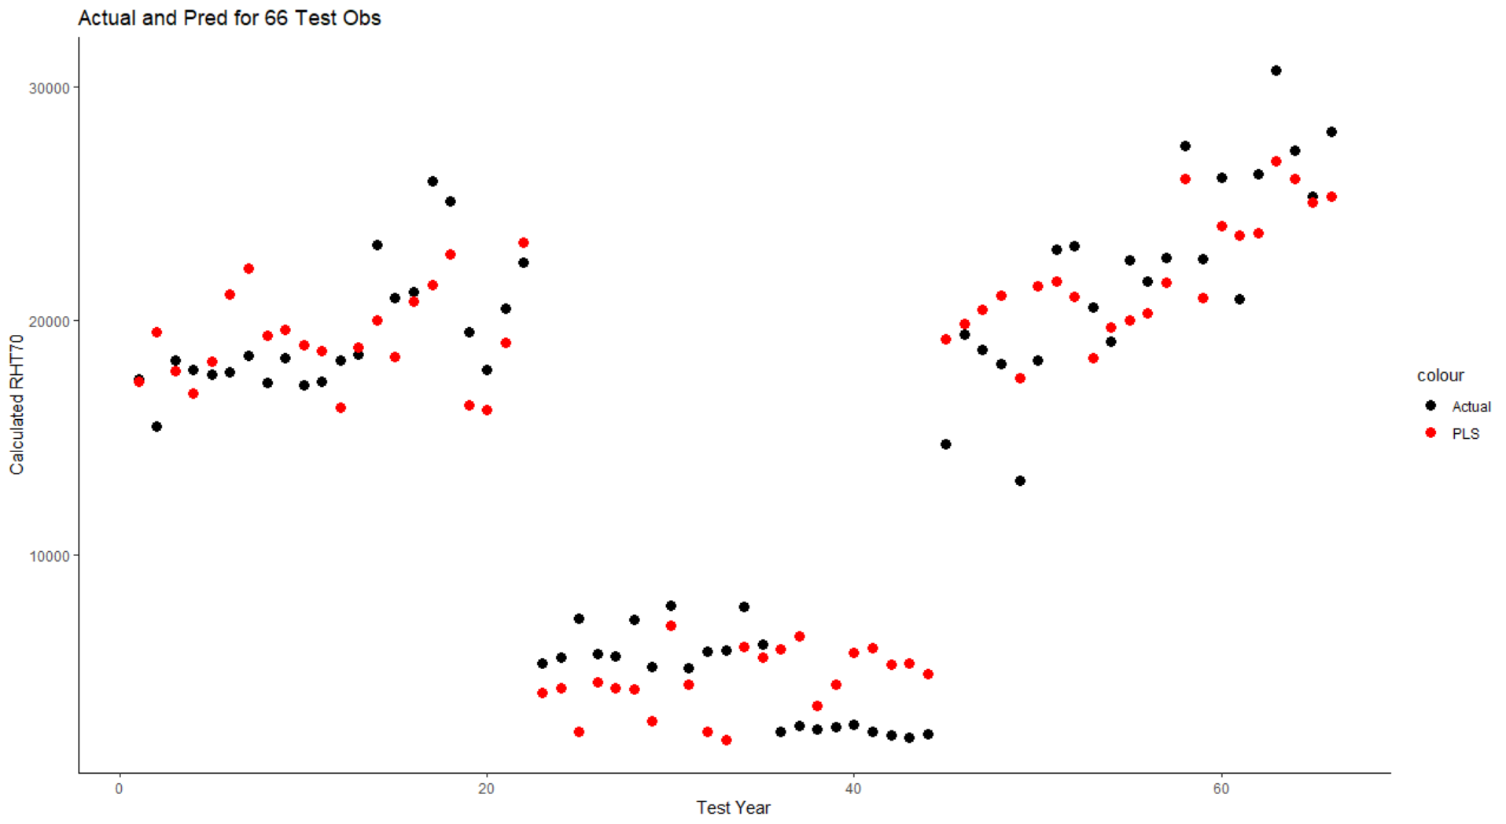
Ottawa
Calgary
Vancouver

Slide 15
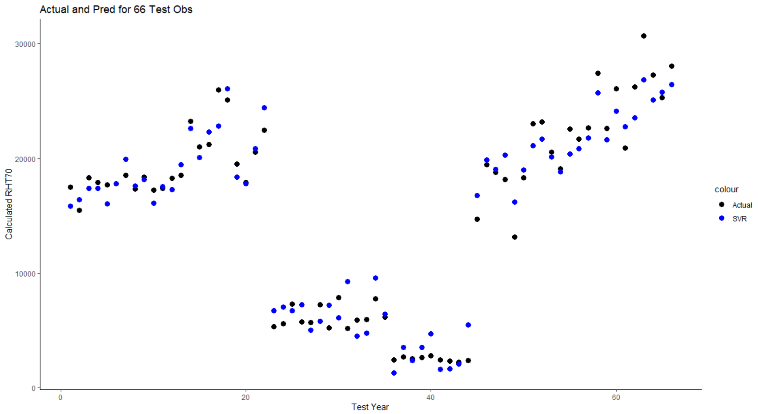
Ottawa
Calgary
Vancouver

Slide 16
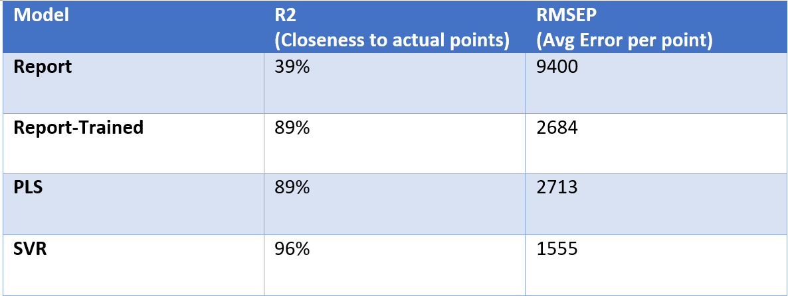
Comparison of Models

Slide 17
Model with different variables.
Variable:Shortwave,Cloudiness,RH,WDR,VaporPressure,Temp²,RH², Vapor²
Not restricted to the report.
Variables-> Shortwave,Cloudiness,RH,WDR,Vapor Pressure, Wind Orientation, Wind Speed, Temperature

Slide 18
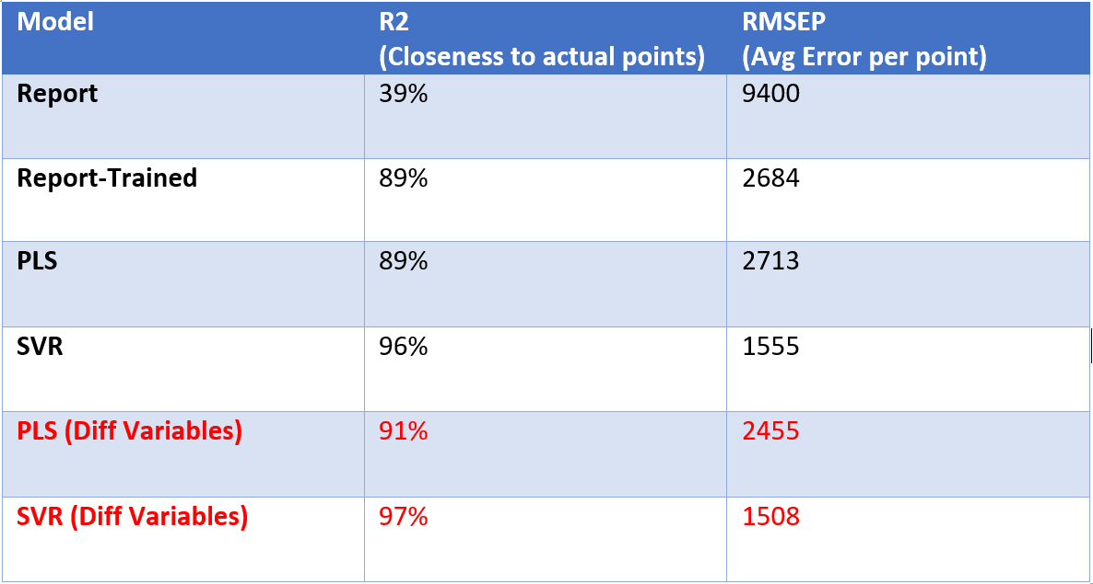
Comparison of Models

Slide 19
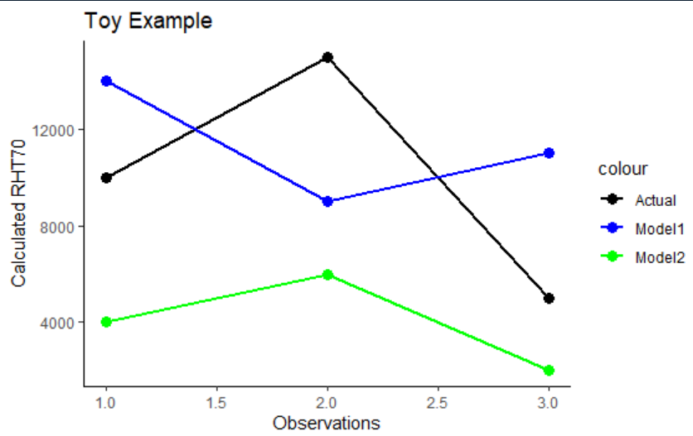
Method 1 Drawbacks
Predictions can be close but ranking may be incorrect.

Slide 20
Method 1 Conclusion
SVR model better at predicting than either regression or partial least square regression.
Still need to test on a large dataset of simulation for a more accurate comparison by ranking.
Still unsure about how to represent 31 years by picking few years.
1) Wet,Dry,Avg?

Slide 21
Method 2- Time Series
Look at the continuous Moisture profile for 3 years
Now- 365 value for each year (Hourly/Daily/Weekly values)
Setup
Temp,RH,WDR,WindDir,WindSpeed,Direct & Diffuse Rad, Cloudiness
3 years train -> predict 28 remaining years through SVR.

Slide 22
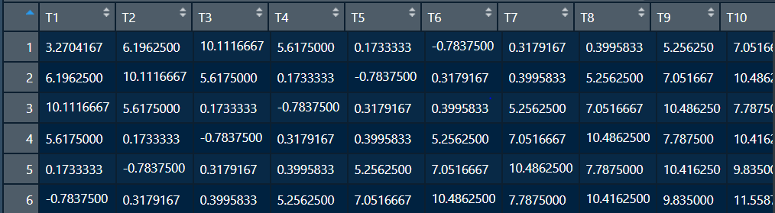
Use the memory of the past (lag) to predict the next.
To predict the first day of the 4th year, look at the past 10 values of each climate variable + last 10 values of Moisture.

Slide 23
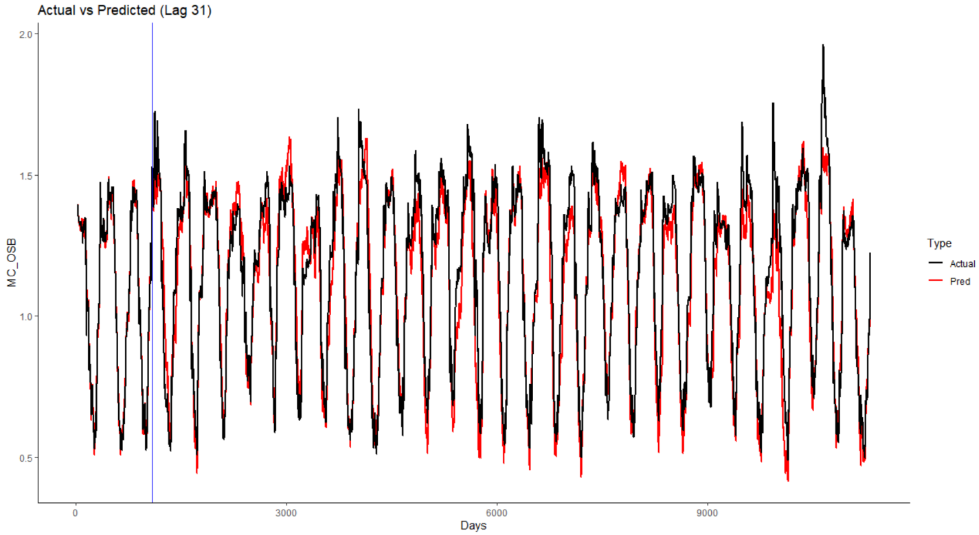
Comparison of Actual and Predicted in Vancouver

Slide 24
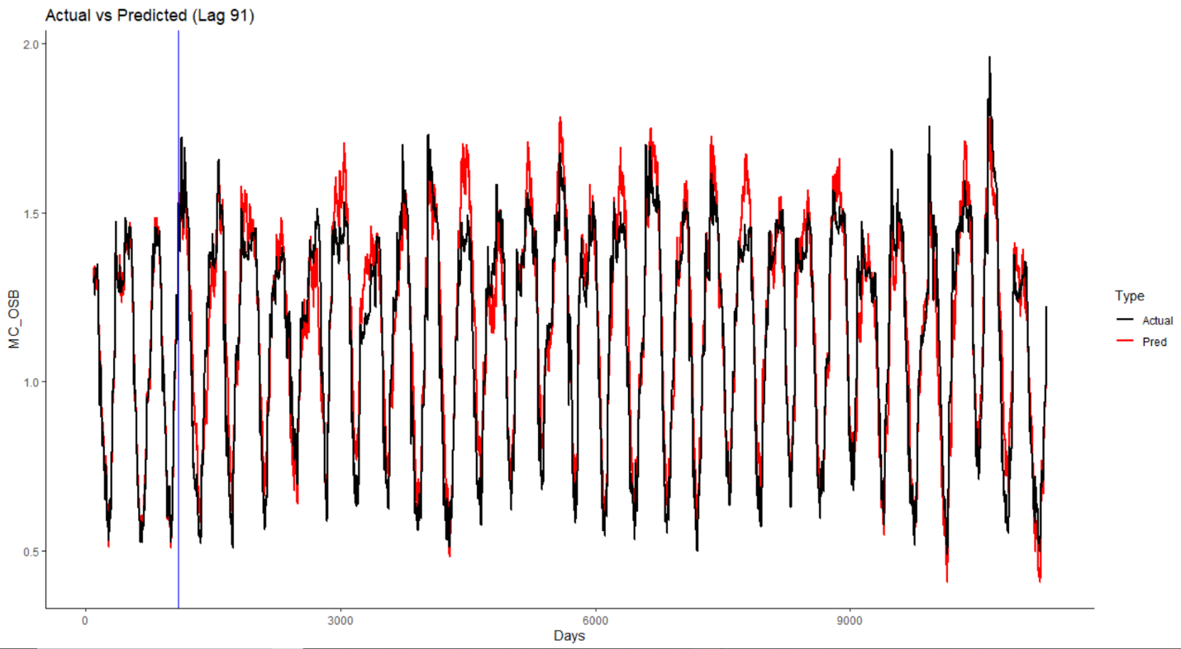
Comparison of Actual and Predicted in Vancouver

Slide 25
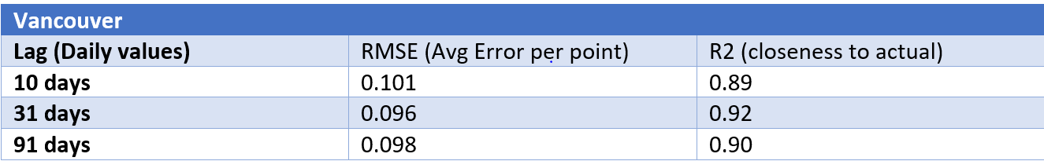
Comparisons of Different Lags

Slide 26
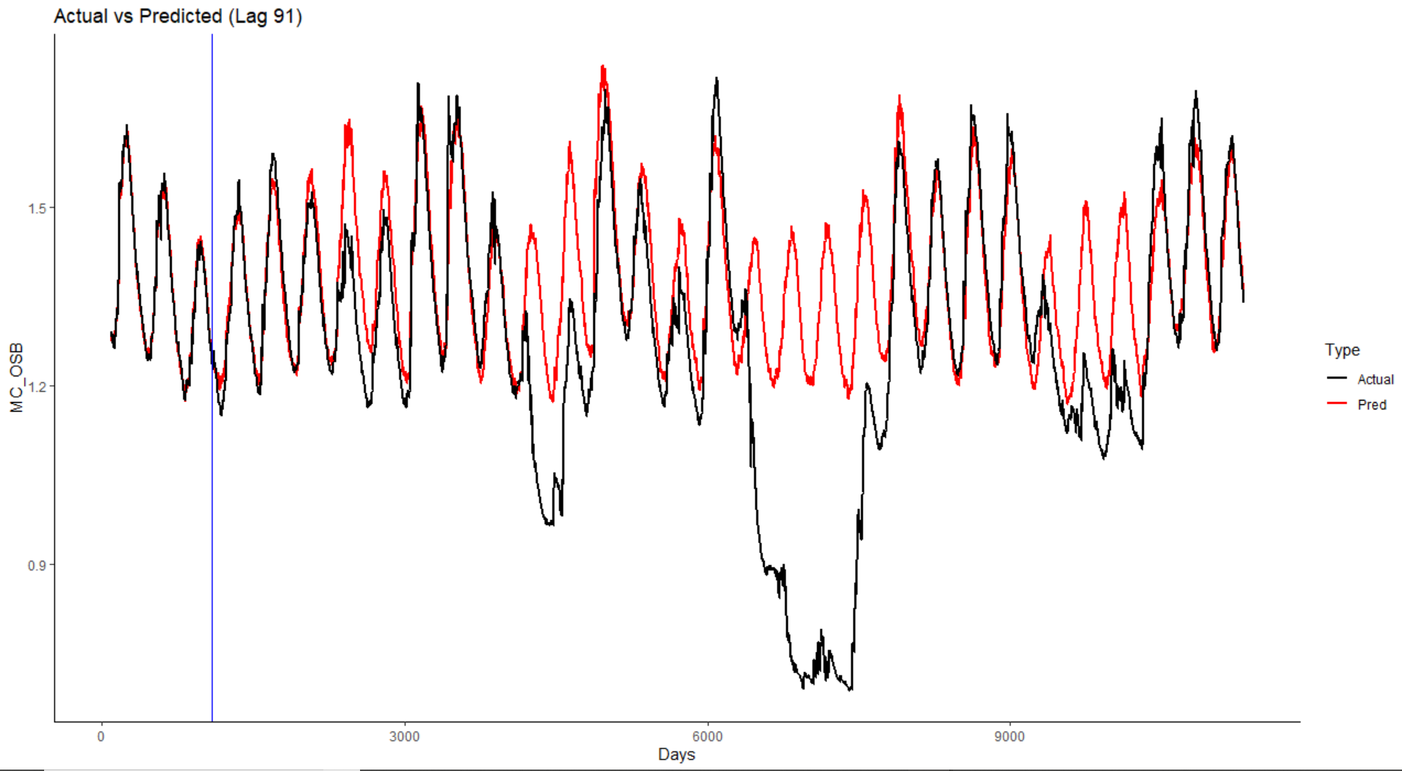
Comparison of Actual and Predicted in Calgary

Slide 27
Method 2 Drawbacks
Still need to run the simulation for 3 years to train the model for each city.
Climate Conditions should not vary drastically over the 31 years.

Slide 28
Summary
Looked at 2 approaches:
Comparison of different model to select MRY.
Long term Predictions of simulation to eliminate the need to select MRY.
Future Work
Look at other techniques to overcome the limitations of current methods
Incorporate time in the model, so can train on some cities and predict for another city starting at time= 1day.
1) XG Gradient Boosting.
2) Neural Networks.

Slide 29



THANK YOU
Naman Bansal
Coop Student

