Slide 1
bitgrit Data Science Contest
Round 2 for Inter-IIT
bitgrit Inc.

Slide 2
Round 2 Contest Overview
In Round 2 of the competition, bitgrit will facilitate the qualifying teams with a dataset along with all relevant context and information associated with the dataset.
The teams will have to explore the dataset to identify a Data Science use case pertaining to the keywords “attrition” & ”retention” that can extract the maximum value out of the dataset, build the relevant model to implement the use case, and explain its value with regards to the forecasts or justifications that are yielded by the model developed by the team.
The teams are free to use any public datasets along with the provided dataset to a certain extent such that the public dataset augments the provided dataset but does not overpower it.

Slide 3
Rules, Evaluation, Deadline
Rules
1. Only 1 team from each IIT that qualifies Round 1 of the competition (composed of a maximum of 4 students) can participate in the second round.
2. The submission will constitute a report in .pdf format (max 3 pages), wherein the team should explain the identified use case, the value it creates for the target industry (impact, innovation, scope) and how it is able to make the best out of the provided data set. It is to be supplemented with the Data Science Model (.ipynb file) and forecasts/results (can be integrated/interpreted in the report itself).
Evaluation
Submissions will be judged by a panel of industry leaders, subject matter experts and Data Science researchers on the basis of the following criteria:
Impact, Data Science Prowess, Dataset Utilisation, Accuracy, Innovation, Scope
Deadline
The files need to be submitted on https://forms.gle/UtRh9FJxkVaN74Fm7

Slide 4
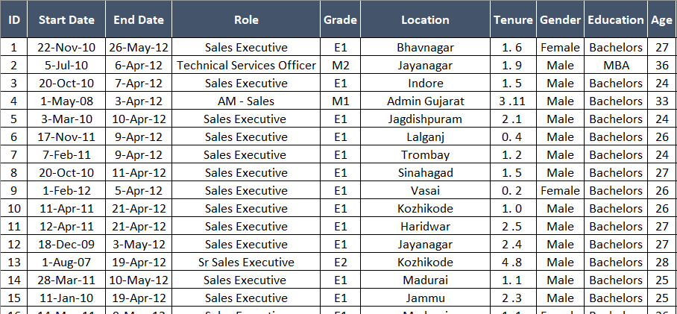
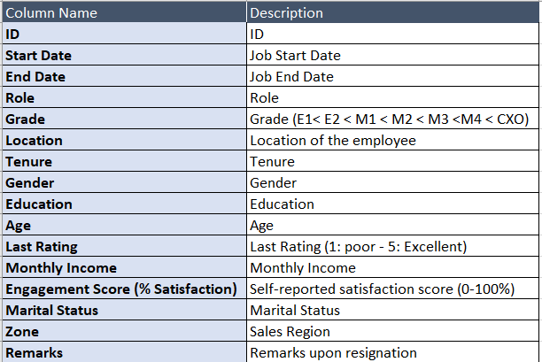
Data and Data Dictionary
Data contains employee data who left the company between 4/2012 and 3/2015.
Data Dictionary is include in the excel spreadsheet.
Data tab
Data Dictionary tab

Slide 5
Contacts
Email to support@bitgrit.net if you have any questions.

