Slide 1
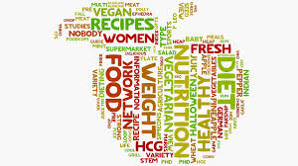

A Neighborhood Recommender for Upcoming Restaurants & Eateries

Slide 2
Introduction/Background
Every business, big or small is a vision backed by hard work, determination and aspirations.
A drive to take an idea from its inception to fruition.
Therefore, it becomes all the more neccessary that one's blood and sweat don't go in vain.
Presenting, RESTROLOGY: A Neighborhood Recommender for owners of upcoming Eateries & Restaurants.

Slide 3
Introduction/Background contd.
Restrology analyses local geographical data via Foursquare and recommends restaurant/eatry type(cuisines)
Restrology takes one's neighborhood preference for a better shot at success
Restrology analyses all the eateries and restaurants in every neighborhood of a city and then creates a list of top 10 spots (Restaurant/Eatry type) in every neighborhood

Slide 4
Introduction/Background (contd.)
Top 10 spots displayed against percentages of the total restaurants in that particular neighborhood
A prospective business owner can use Restrology to see which cuisine based restaurants are lacking or what type of Restaurants are doing well(due to their high number) in which neighborhoods
Restrology is like Astrology for Restaurants.

Slide 5
Data
Restrology, for the purpose of this project, will be restricted to New York City.
Data sets used for the Project:
New York Data (Boroughs + Neighborhoods)
Four Square City Guide Data (Venues)

Slide 6
NYC Data
The first Data set we will be using would contain all the required geographical data about New York city.
We would be using the same data set which was provided to us.
https://cocl.us/new_york_dataset

Slide 7
Foursquare API
Foursquare, is a local search-and-discovery mobile app which provides search results for its users.
The app provides personalized recommendations of places to go near a user's current location.
Also considers users' previous browsing history and check-in history.

Slide 8
Foursquare API (contd.)
The Foursquare API credentials you need to create are: your Client ID and your Client Secret.
With a free personal developer account, you can make up to approximately 99 thousand regular calls per day.
You still only get two photos and two tips per venue, which is just one more photo and tip compared to the sandbox account.

Slide 9
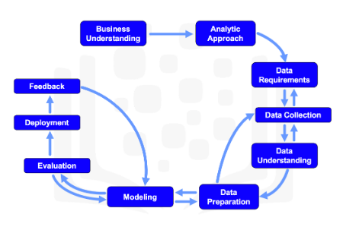
Methodology

Slide 10
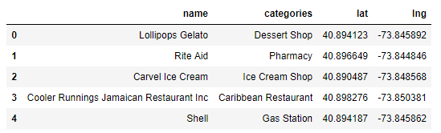
Download & Explore Data
Neighborhood has a total of 5 boroughs and 306 neighborhoods, all are extracted.
Transform the Data into Pandas Data Frame.
Segment the Neighborhoods of all 5 Boroughs.
Define Foursquare credentials and version.
Explore ‘Venues’ near every Neighborhood:

Slide 11
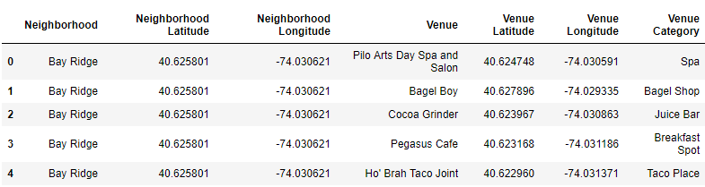
Download & Explore Data (contd.)
Explore Neighborhoods in all 5 Boroughs.
Output Data Frame:

Slide 12
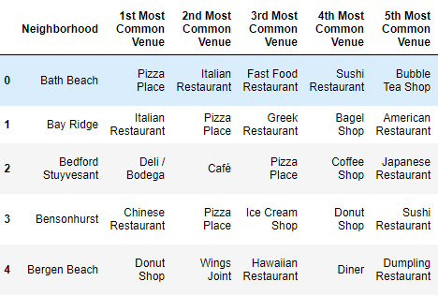
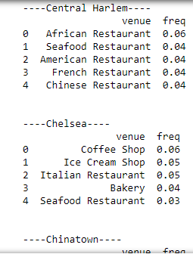
Analyze Each Borough + Neigh’d
Group rows by neighborhood and by taking the mean of the frequency of occurrence of each category.
Print the top 5 most common venues/Neigh’hd

Slide 13
Clustering
We will be using k-means clustering.
We would be using k-means to clusterall of our 5 boroughs:
Brooklyn
Manhattan
Queens
Bronx
Staten Island

Slide 14
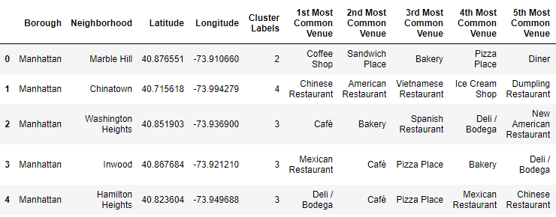
K-means Clustering
K-Means can group data only unsupervised based on the similarity of customers to each other.
Output Data Frames:

Slide 15
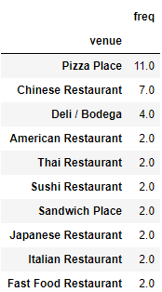
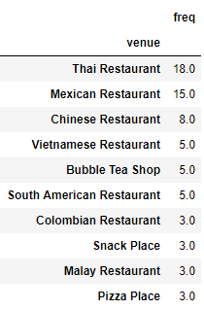
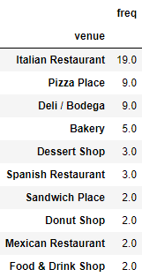
Restrology Output
Finally, Restrology gives us the output like the following:

Slide 16
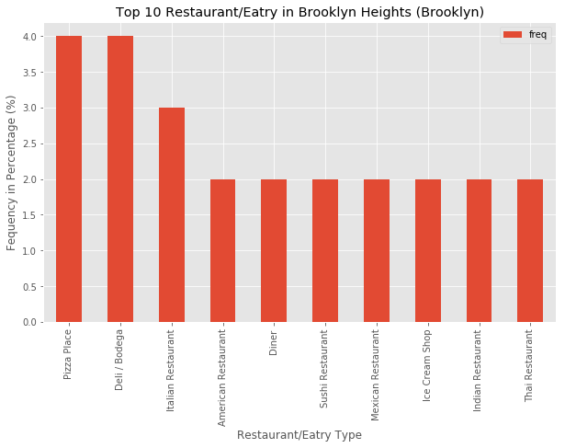
Results
Results derived, displayed using Bar Charts:

Slide 17
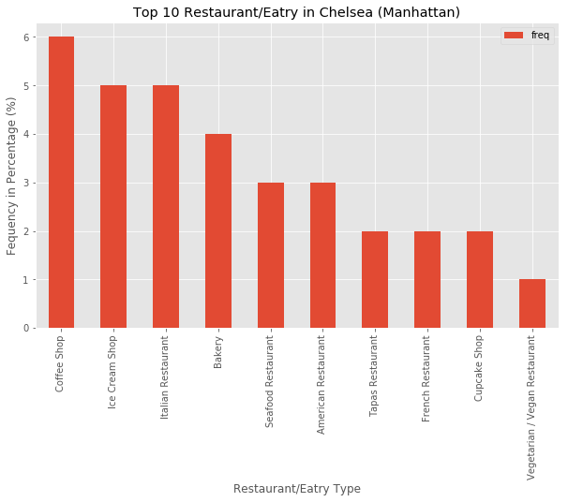
Results (contd.)
Results derived, displayed using Bar Charts:

Slide 18
Recommendations
First, we can integrate other data sets as well, which can add and quantify other factors for Restrology.
Similarly, apart from the current data set, we can also integrate some Past data where we have access to closed business's data in the neighborhood.
This would help us further strengthen Restrology to somehow quantify and predict the chances for 'Success' for any given Restaurant/Eatry.

Slide 19
Recommendations (contd.)
We can explore other features from services like Foursquare API to include and factor in parameters like 'Trending' to further enhance Restrology.
Something which we were not able to do due to the fact that we have used a free developer account.
Data from nearby cities can be integrated as well to uncover more trends and insights.

Slide 20
Conclusion
This concludes our journey with Restrology in this Capstone Project.
During this journey we covered all the gospels in the field of Data Science and Machine Learning.
A prospective Restaurant owner can make an informed decision and have a better chance of establishing a successful business.
Given the extensive scope of the subject which seems limitless, we have merely made a dent and there are far bigger and tougher horizons for us to conquer.

