Slide 1


Unicorn Startup’s Analysis
Naman Goyal

Slide 2
Country
Industry
Investor
Year
Introduction
Company
The Unicorn Startups Dataset is a comprehensive and dynamic collection of information that showcases the fascinating realm of unicorn startups.
The Unicorn Startups Dataset provides an opportunity to gain a deeper understanding of the entrepreneurial ecosystem and its evolution.
Data is reliable as it is taken from Kaggle.
Number of Unicorns: 1186
Number of Industries: 16
Data Range:
Valuation
City
2007
Veepee
2012
SpaceX
2017
Reddit
2022
Invoca

Slide 3


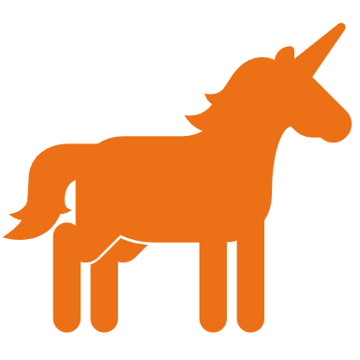
Problem Statement
Evaluating Regional Ecosystems: "What are the regional variations in the emergence and growth of Unicorn startups, and how do factors such as geographical location, regulatory environment, or access to talent impact their success?"
Tracking Growth Trajectories: "How do Unicorn startups evolve over time, and what can we learn from their growth trajectories in terms of expansion, pivoting, or market penetration strategies?“
Analyzing Market Disruption: "To what extent do Unicorn startups disrupt traditional industries, and how do their innovative business models or technologies influence market dynamics?“
Unveiling Valuation Trends: "What are the key factors that drive the valuation of Unicorn startups, and how have valuations evolved across different industry sectors?"

Slide 4
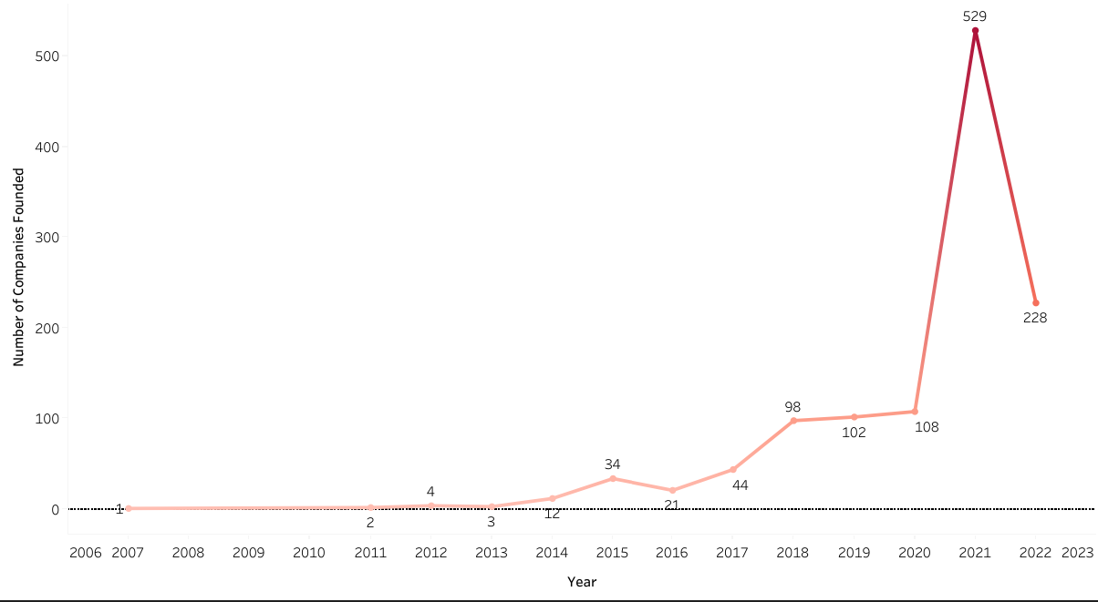
Unicorn’s Evolution Over Time
More than 500 Unicorns were founded in year 2021.
Significant drop after 2021 in number of startups evolved as Unicorn due to Covid restriction.
From 2018, we see consecutive around 100 startups founded which becomes Unicorn.

Slide 5
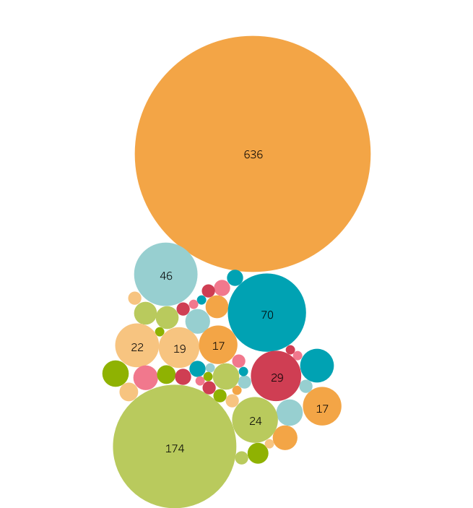
United States
Unicorn By Countries
The maximum number of Unicorns have their headquarters in United States.
The leading countries of the world in terms of the Gross Domestic Price(GDP) i.e., United States, China and India are homes of more than half of the Unicorns.
United Kingdom
India
China

Slide 6
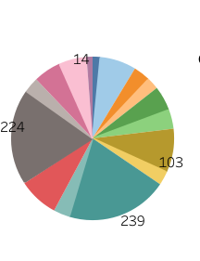

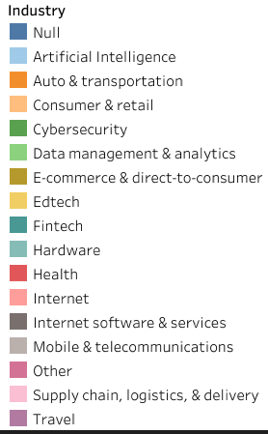

Industry Analysis
Internet
Fintech based startups are most likely to become Unicorn.
There are only 14 startup in Internet industry that evolved as Unicorn.
Approximately half of the Unicorns are of Fintech, E-commerce and Internet software & services industry.
Artificial Intelligence is also emerging industry.
Fintech

Slide 7
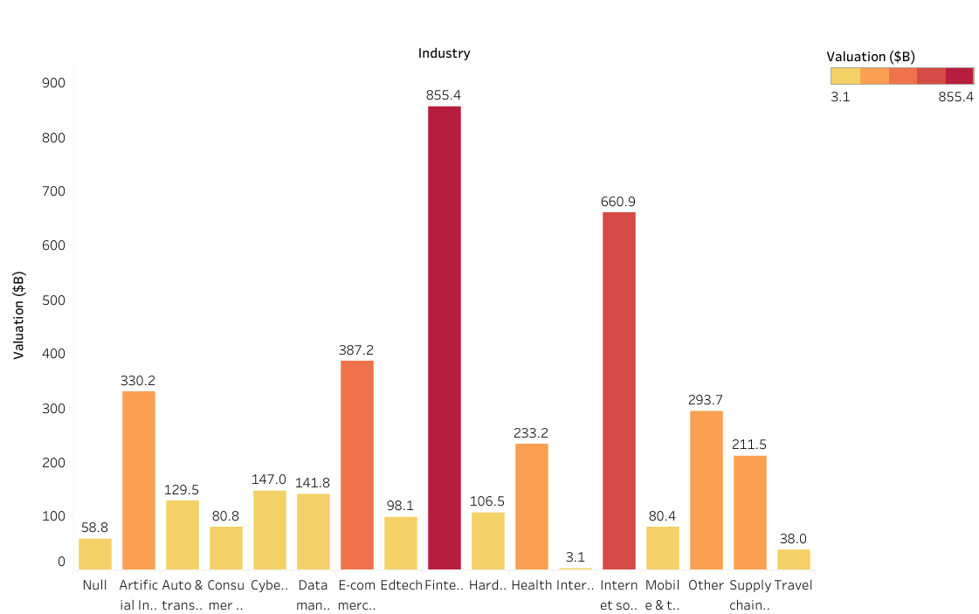
Unicorn’s Valuation
Fintech is leading industry with the total valuation of more than $850B.
Average Valuation of 1186 Companies is around $3.25B.
75% of Unicorn’s Valuation lies below $3B.
Approximately 300 Unicorns has valuation of $1B.

Slide 8
Recommendations
The success of Startup is impacted by its geographical location, industry and year founded. So following are some recommendation from investors perspective as well as of entrepreneur.
Entrepreneurs
Establishing and starting your journey in the leading economies of World gives you the edge over others as developed countries give access to best talent, great working environment, knowledge, and funding opportunities.
Investors
Investing in the recent demand based industry’s startup can be a profitable business as in recent times, most Unicorns are from the industry of technology and finance

Slide 9
Thank You

