Slide 1
Vedantu Class 6-12 International Boards
Edtech Startup Sector
Startup Landscaping
Focus on CHINA
Global
India

Slide 3
Plastic Water Labs uses VR to promote spatial thinking by leveraging the power of an immersive metaverse. Veative Labs is an edtech startup that uses VR to make learning interactive and fun in classrooms.
ToT Smart Education blends physical textbooks with a mobile app for game-based learning along with a performance monitor.
Entri is a plug-and-play test preparation platform on the cloud for schools, teachers and coaching institutes.
NeoStencil provides online classes to students from teachers and educational institutes for government jobs such as IAS, IES, GATE, and state PCS.

Slide 4
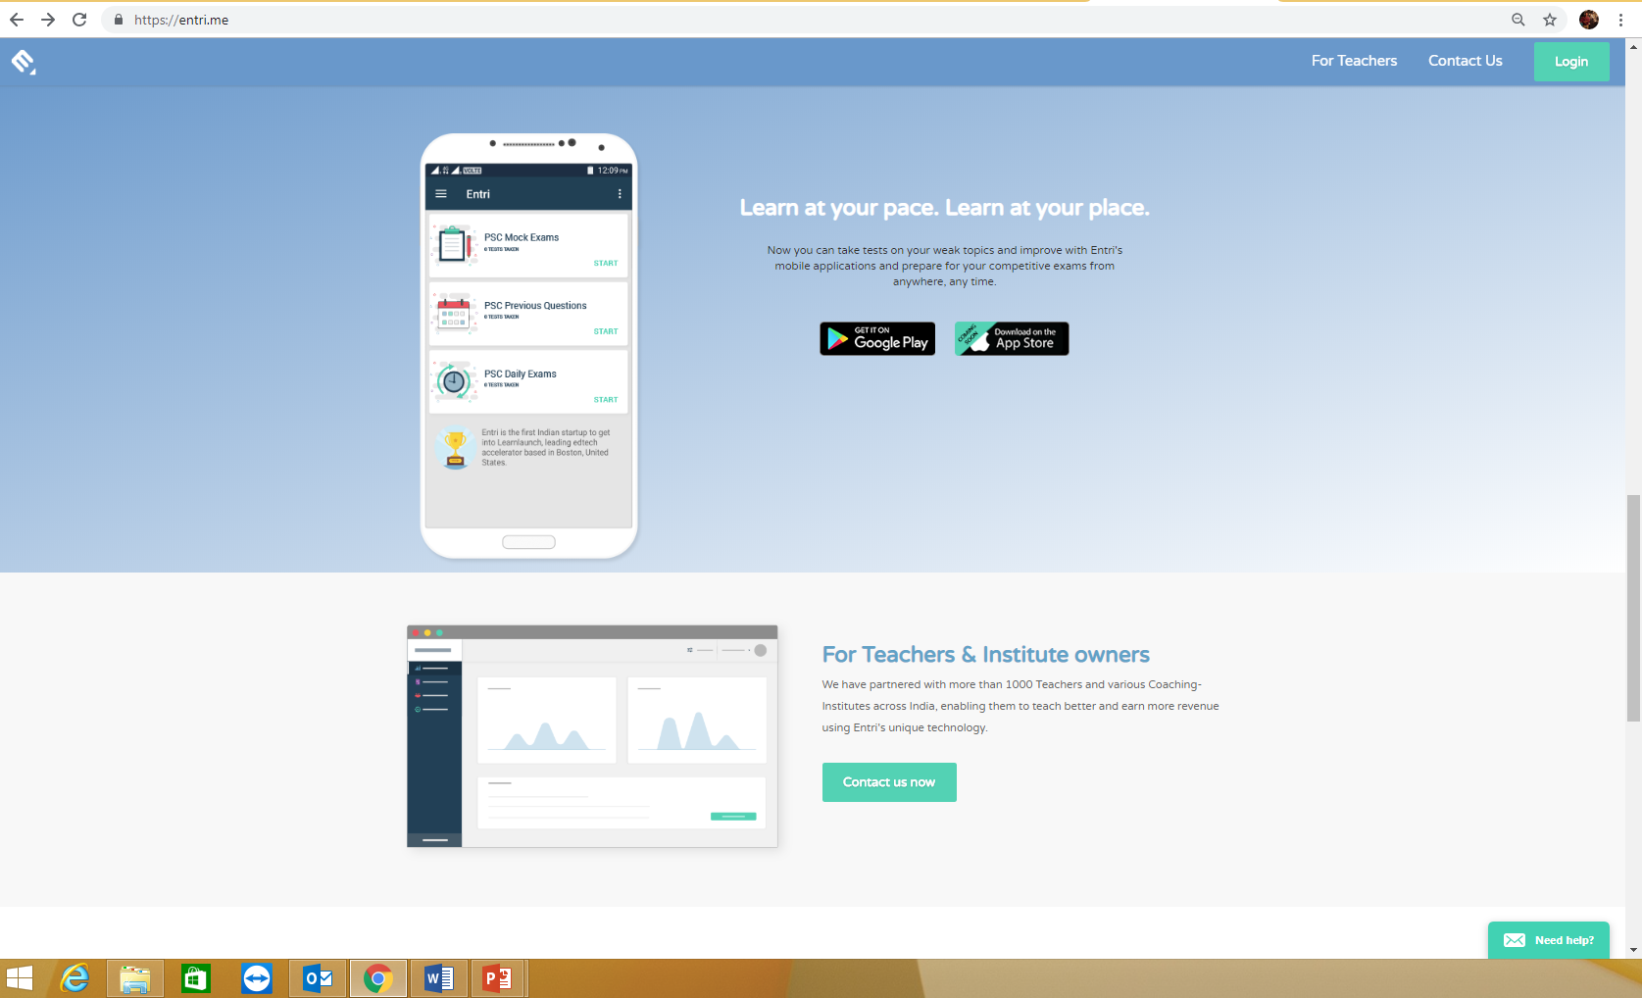

Slide 5
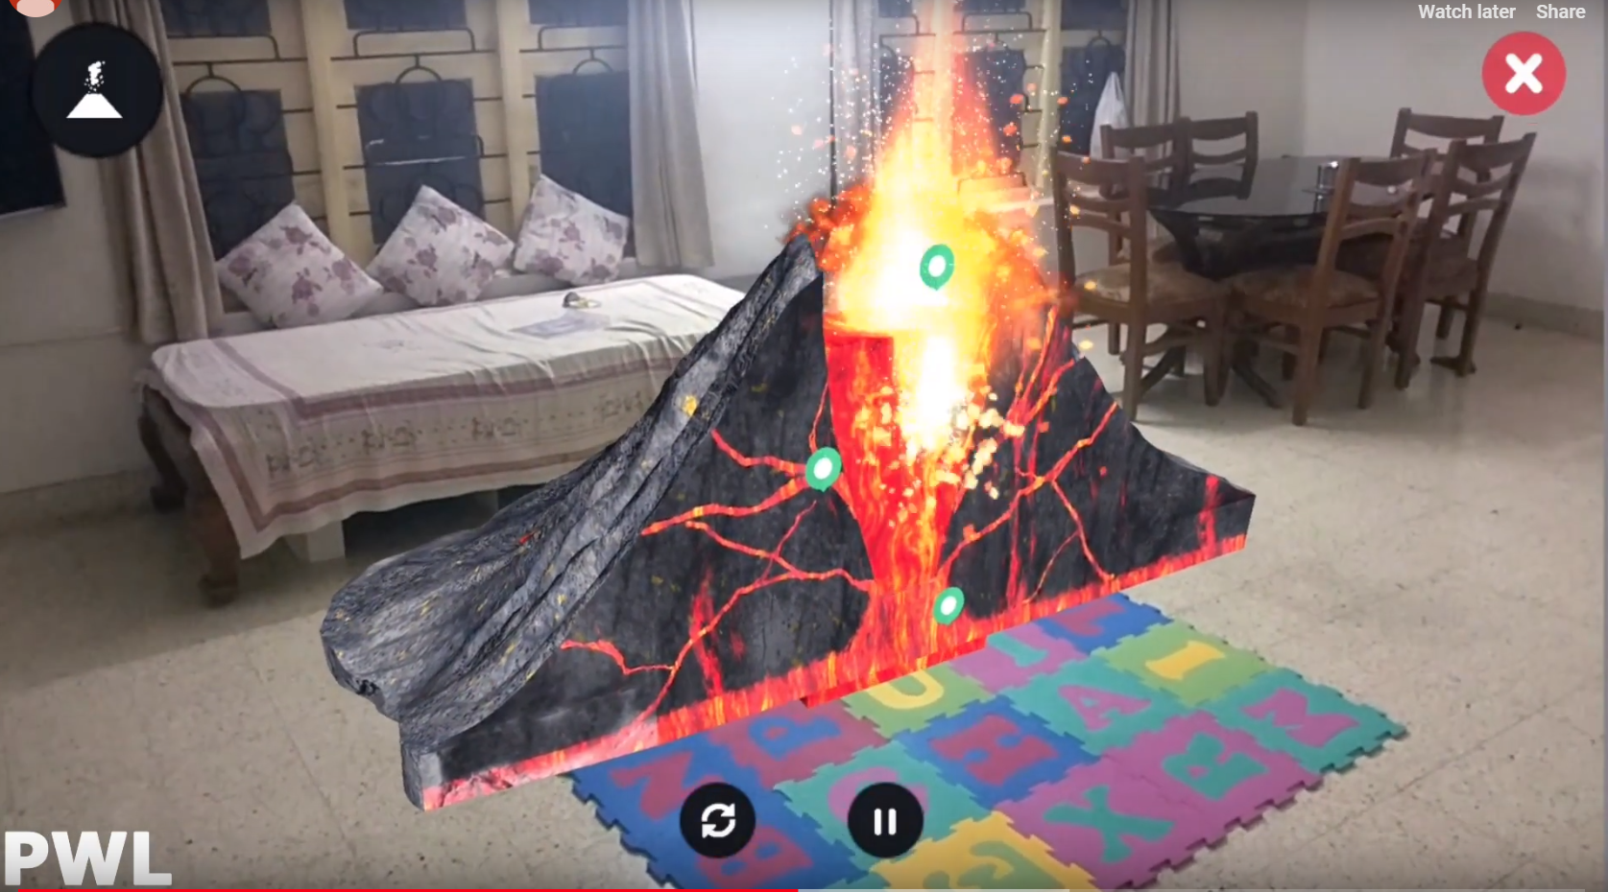
VR Based Learning

Slide 6
For Students
The need of edtech digital education is more in remote areas as you can still get quality education and good offline tutors in metro cities.
But remote area struggle with poor internet connection
Also edtech startups should be based on mobile apps as more no. of students can afford mobile and tablets than computers.
The most attractive content can be mocktest and engaging creative content using animations and VR technology.
The videos are recorded and uploaded or there are live sessions.

Slide 7
For teachers Schools and Coaching
Startups also make classroom management products.
They also do partnership with schools and help the teachers become better and refining them. Thinking Classrooms
If we shout on the Moon can we hear ourselves? Can you design the diet for Virat Kohli? How will our lives change if the Earth were to switch gravity off?
Thinking classroom is every Science teacher’s dream come true. Imagine a classroom where teaching begins with a questions, teacher uses questions to gamify classroom discussions and where students deliberate on thought-provoking case studies.

