Slide 1
team rnn
BharatAgentic Hackathon
Page 01 of 05
the problem
BUILT BY
TEAM RNN
No brand team.
Every post, a new business.
Marque.ai: the AI brand agent for Bharat's local businesses.
Track Build Your Own Problem Statement
Domain Marketing & branding for local business
Event BharatAgentic, powered by aiKart
Cafés, restaurants and shops need fresh posters every week. They have no designer and no brand guide, so each post looks like it came from a different business.
01
02
03
5 lakh+
₹5.69
85 lakh
Inconsistent look
No memory
Wrong signal
restaurants in India (NRAI)
lakh crore food-service industry (NRAI)
people directly employed (NRAI)
Fonts, colours and mood change post to post, so customers never remember the brand.
Generic AI tools forget the brand. The owner re-explains it in every prompt.
A playful burger joint posts something stiff and luxury. Nobody tells the owner.
marque.skunkworkslab.online
Notes:
Hook: Rohan owns a burger place. His last three posts look like three different businesses. Introduce Team RNN, then the three pains. Market numbers are NRAI figures.

Slide 2
marque.ai
Page 02 of 05
One goal in. A checked campaign out.
owner says
“Launch our truffle burger at ₹399 this weekend.”
→ poster, Instagram post, story and WhatsApp creative, all on-brand
A typical AI tool
The Marque.ai agent
Waits for a long prompt every time
Takes a goal and writes the campaign plan
Forgets your brand between chats
Reads Brand Memory before every action
Hands back one image, then stops
Signal Check: what will the customer feel?
Never checks its own work
Finds the gap, fixes it, re-checks (max 2 rounds)
Stops at owner approval. Never auto-posts
marque.skunkworkslab.online
Notes:
Chatbots wait for prompts. Marque takes a goal, plans, acts, checks the signal, fixes it, and stops for approval. Show the goal bar: one sentence in, four assets out.

Slide 3


marque.ai
Page 03 of 05
The agent loop
plan, act, observe, critique, revise. A human approves at the end.
01
02
03
04
05
06
07
UNDERSTAND
PLAN
ACT
OBSERVE
REVISE
RE-CHECK
APPROVE
Reads the goal, loads Brand Memory
One core message, asset list, image needs
Copy, background image and templates, in parallel
Brand Rules Check (code) + Signal Check (vision AI)
Changes style knobs, re-renders failing assets
Stops after 2 rounds and says what is left
Owner edits, approves, exports
TOOLS + MEMORY
RESPONSIBLE BY DESIGN
Brand Memory: one JSON profile per brand, edited by the owner and read on every run
Image AI draws only backgrounds. Text and logo are rendered by templates, so spelling stays correct
Built on React, FastAPI, Postgres and Docker
Drafts only. Nothing is published without the owner
Prices and dates come only from the owner. Missing info becomes a question
Uploaded files and sites are treated as data, not instructions
Contrast check on every text layer, and assets labelled AI-assisted
marque.skunkworkslab.online
Notes:
Walk the 7 steps left to right. Stress: Brand Rules Check is plain code, Signal Check is the vision model, max 2 revise rounds. Then the responsible-AI card.

Slide 4
marque.ai
Page 04 of 05
The prototype, live
Live today
BRAND SIGNAL
NEEDS FIX
74/100
target vs detected, sample run (Burger Lab)
Brand identity drafted from a few questions
Premium
88 (+18)
Brand rules the app remembers
Modern
82 (+2)
Signal Check on every uploaded asset
Playful
40 (-35)
Brand Audit across 2 to 5 images, with history
Niche
60 (+5)
Dockerized prod stack, live at marque.skunkworkslab.online
What we measure
Why: a thin gold serif headline and empty dark space read luxury and serious. The brand target is playful.
<90 sec
+10
85+
Agent fixes: bolder headline, warmer photo, more accent. Round 2: 91/100 PASS
goal to 4 assets
signal points after auto-fix
consistency on new assets
targets we log per run
marque.skunkworkslab.online
Notes:
Show the live product next to this slide. The signal card is a sample run. Replace the target tiles with measured numbers from the 5-brief test set if you have them.

Slide 5
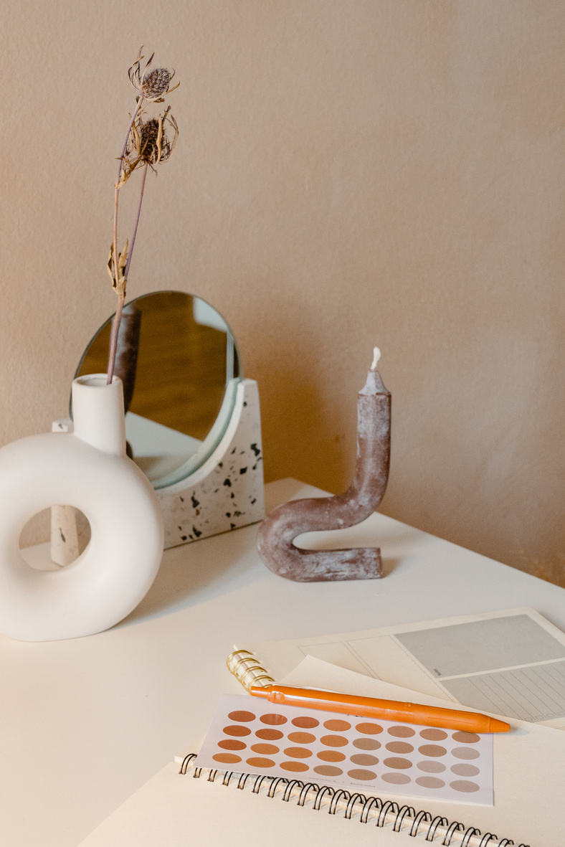
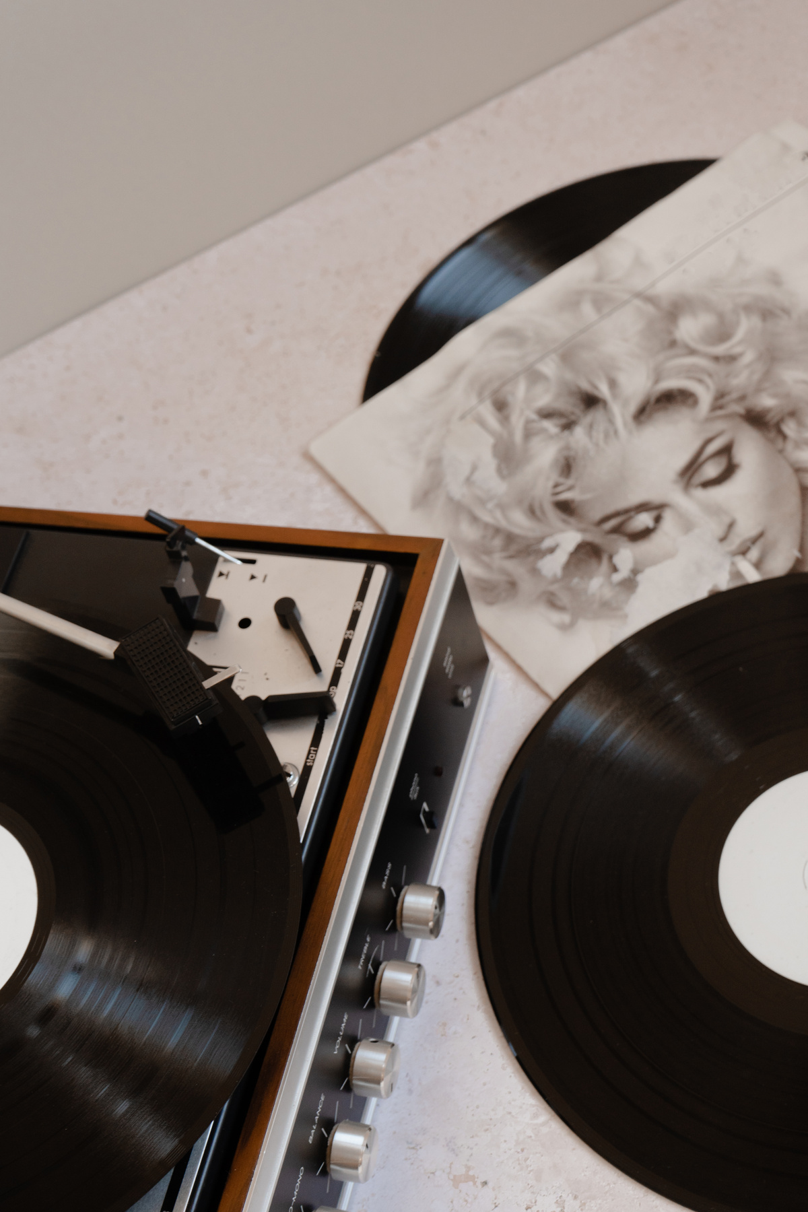

marque.ai
Page 05 of 05
Why Marque wins
Adoption path
TOOL
GREAT AT
WE ADD
Google Pomelli
Website to Business DNA to campaign assets. Free, live in India
Judges and fixes the work, audits old posts
Pilot
10 cafés and restaurants in Delhi NCR, onboarded in person
Canva
Templates, Brand Kit, resizing, a full editor
Agent does the work; owner approves
WhatsApp agent
Owner sends a voice note, gets finished creatives back
Channel drafts
ChatGPT / Gemini
Flexible text and image generation
Persistent brand rules, editable layers, correct text
Google Business posts, Zomato and Swiggy banners
Learn from results
Built for how Indian owners market: Instagram, Google, WhatsApp, ₹, Hinglish, festivals.
Performance data teaches the agent what works per brand
Rohan sends one voice note. His whole brand team replies on WhatsApp.
Live marque.skunkworkslab.online
Code github.com/namanjain24-sudo/Marque.ai
marque.skunkworkslab.online
Notes:
Pomelli is free and live in India, so do not say it is missing. Our edge is judging, fixing, auditing and Bharat channels. Close on the WhatsApp line and the two links.

