Slide 1


Quick Sort
Guided By- Mr. Ravi Khatri

Slide 2
Quick Sort – How it Works?
At every step, we select a pivot element in the list (usually the first element).
We put the pivot element in the final position of the sorted list.
All the elements less than or equal to the pivot element are to the left.
All the elements greater than the pivot element are to the right.

Slide 3
Quick Sort Partitioning
0
size-1
x:
pivot
Values smaller
Values greater
Perform
partitioning
Perform
partitioning

Slide 4
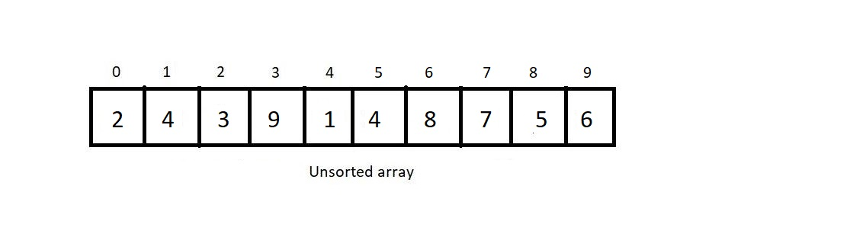
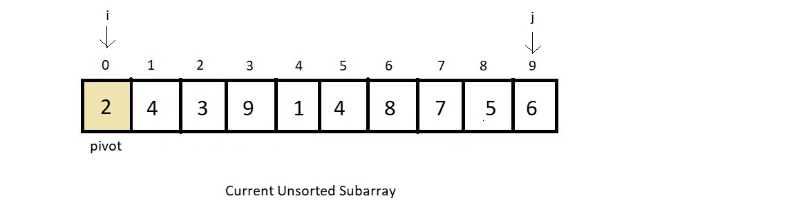
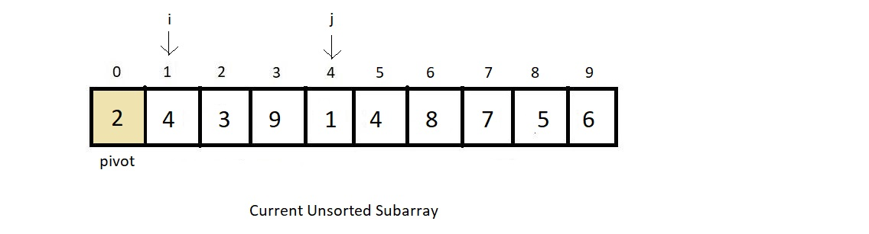
Quick Sort

Slide 5
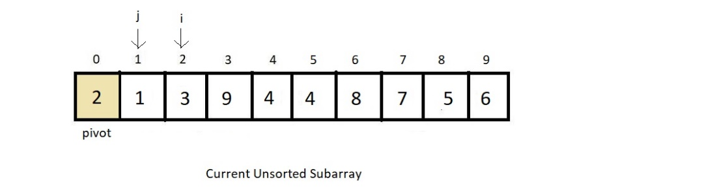
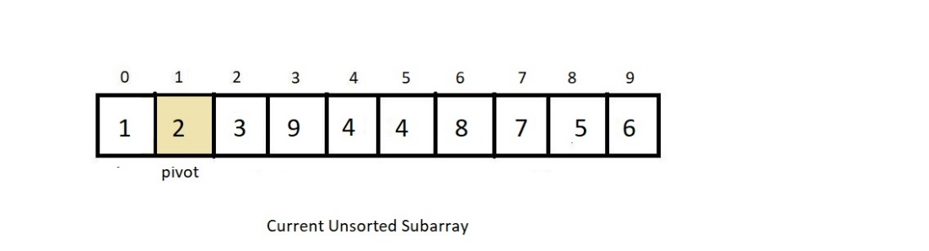
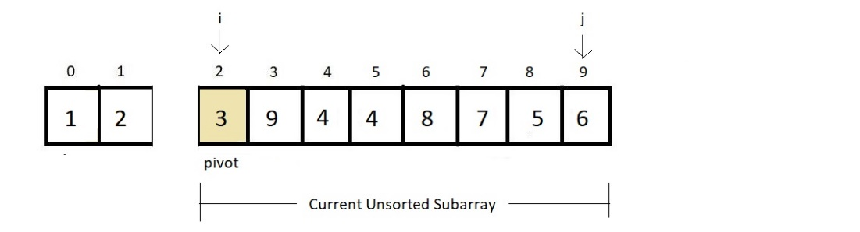
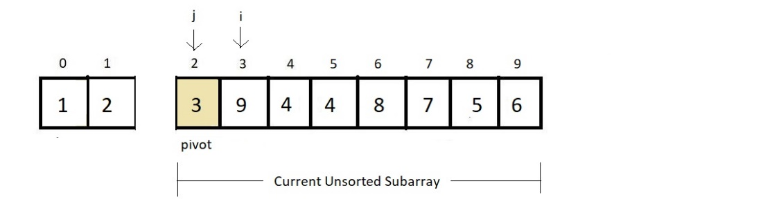
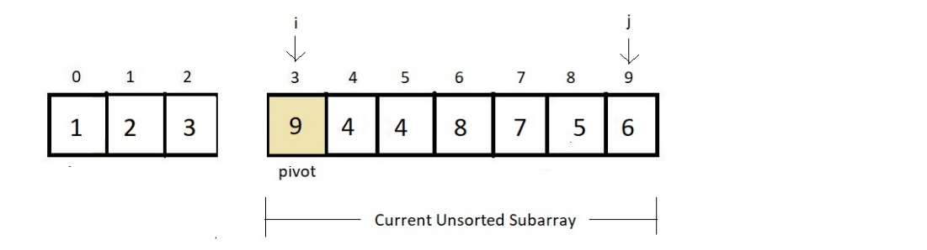
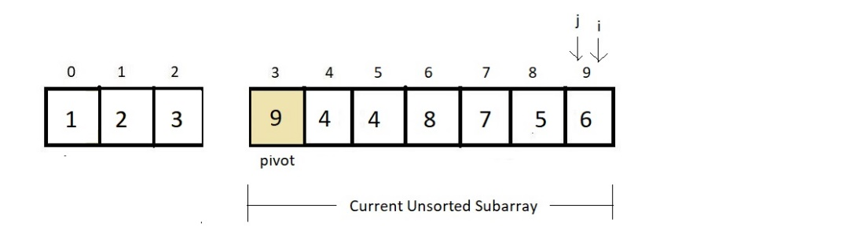
Quick Sort

Slide 6
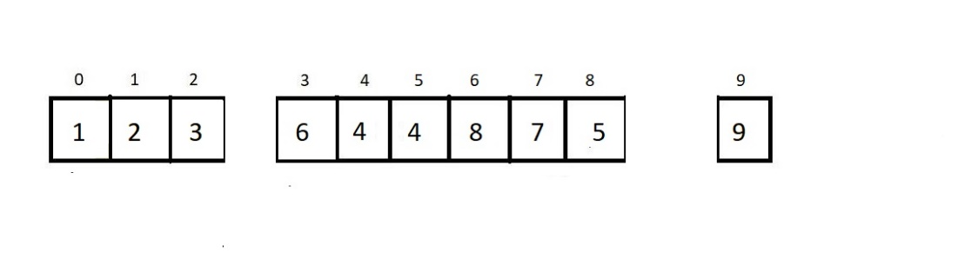
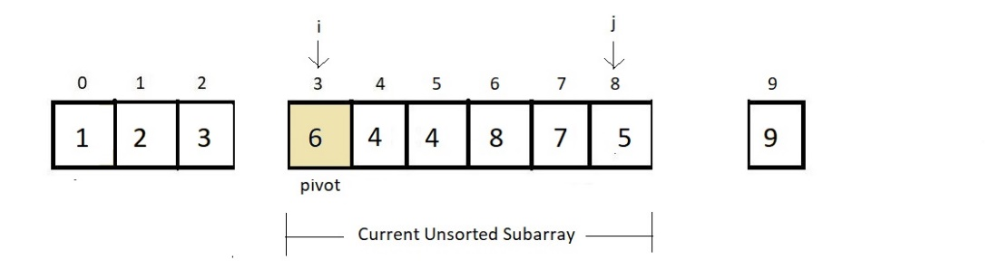
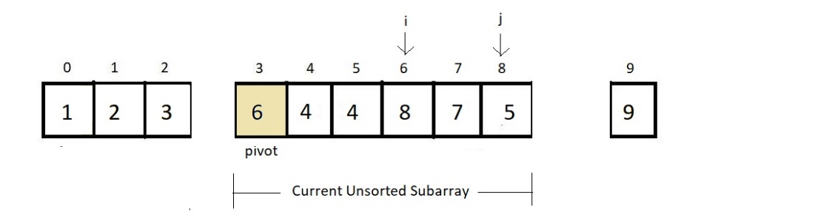
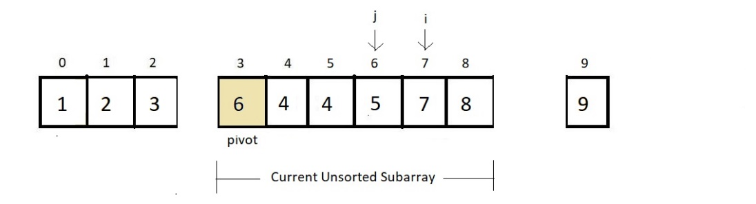
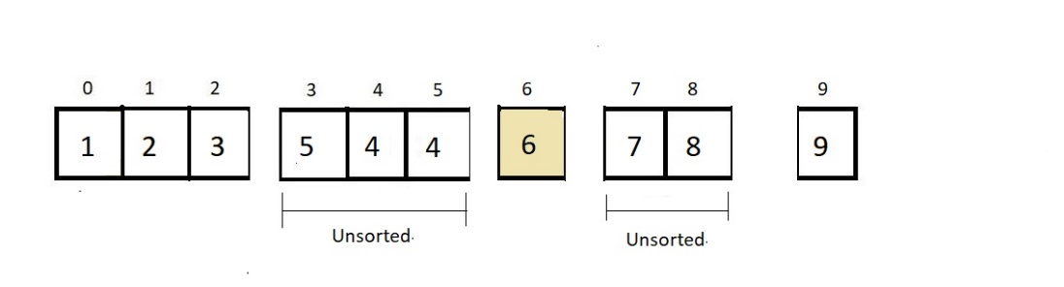
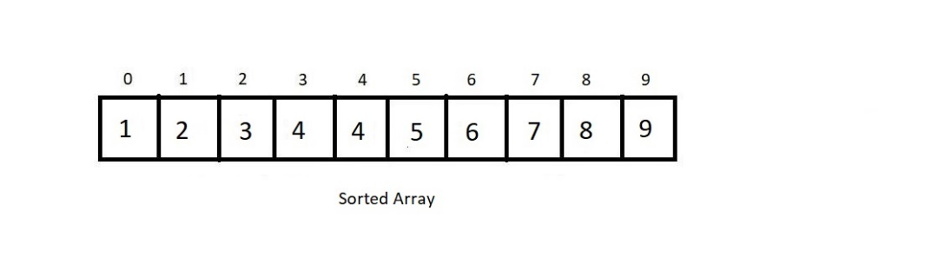
Quick Sort

Slide 7
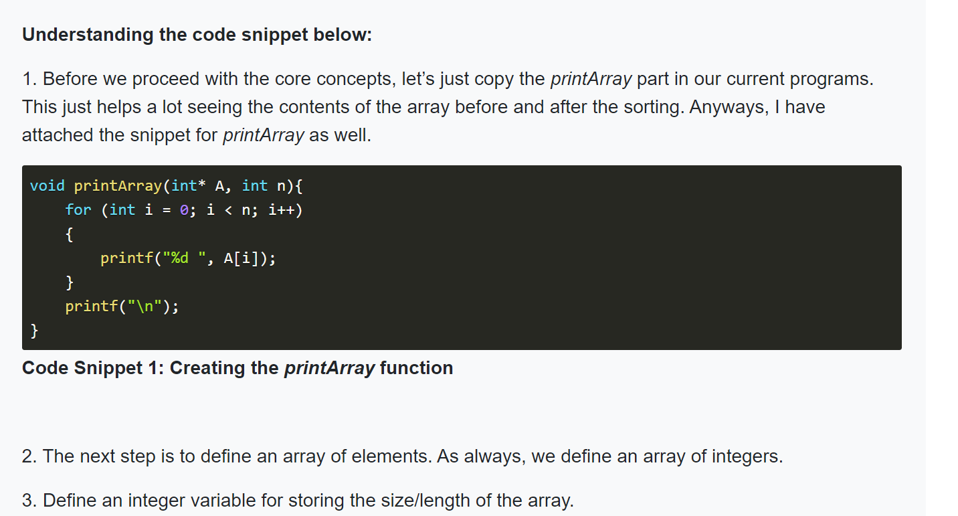
Quick Sort

Slide 8
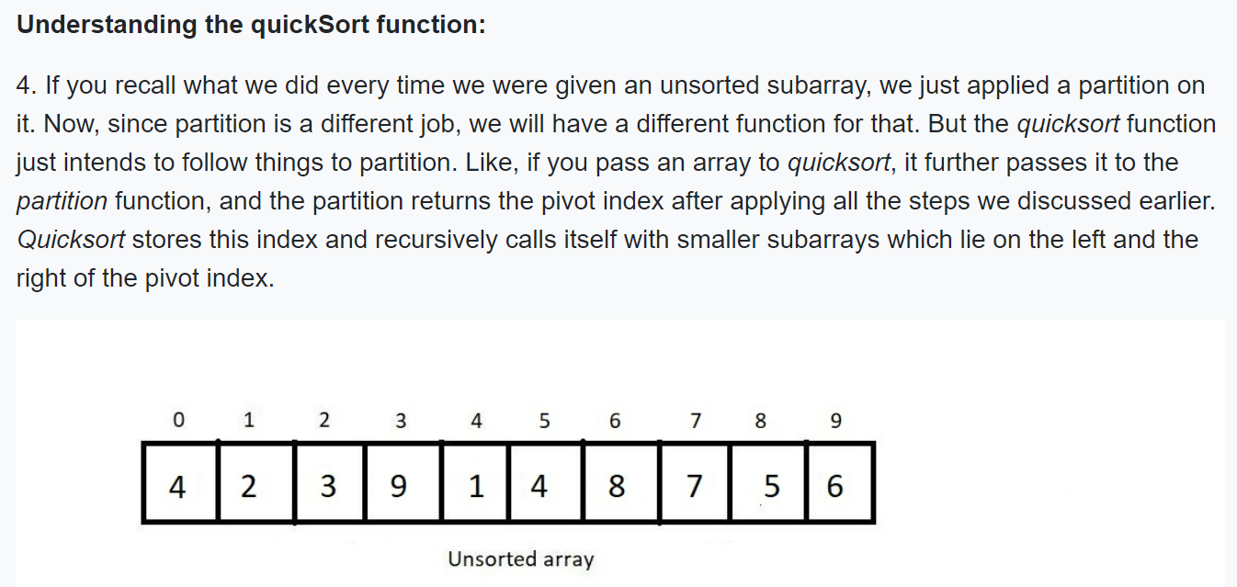
Quick Sort

Slide 9
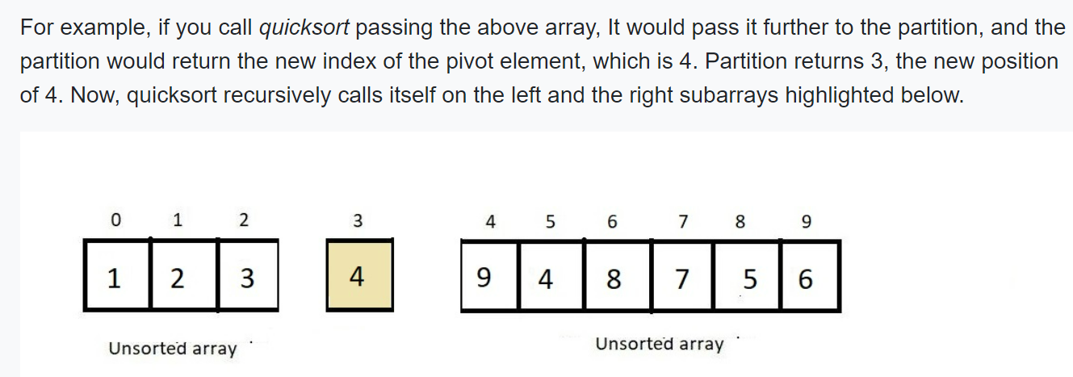
Quick Sort

Slide 10
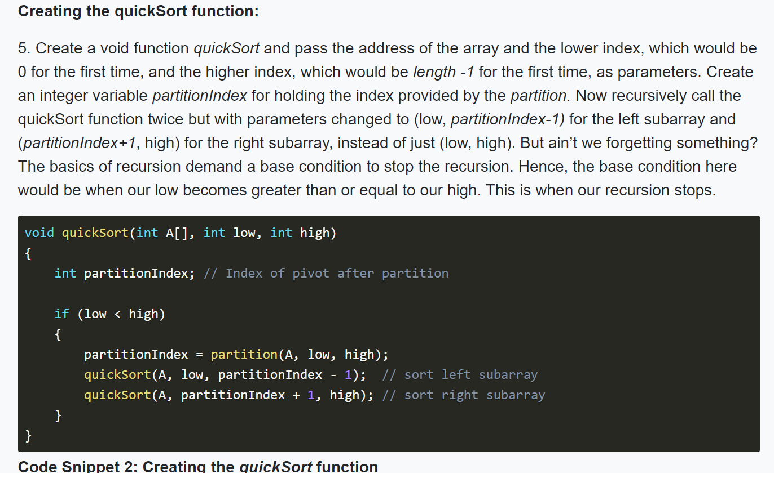
Quick Sort

Slide 11
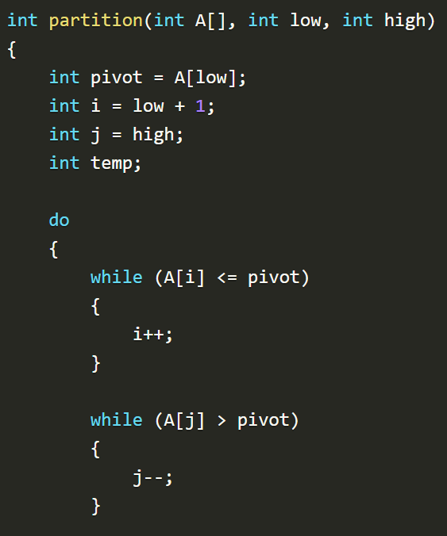
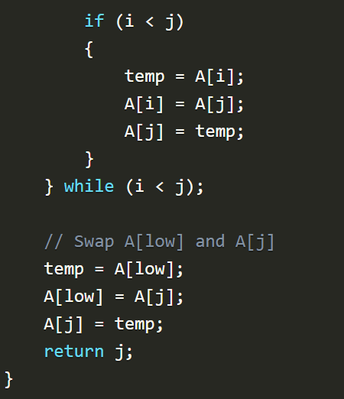
Quick Sort

Slide 12
Quick Sort - Example
Input: 45 -56 78 90 -3 -6 123 0 -3 45 69 68
45 -56 78 90 -3 -6 123 0 -3 45 69 68
-6 -56 -3 0 -3
45
123 90 78 45 69 68
-56
-6
-3 0 -3
123
68 90 78 45 69
-3
0 -3
45
68
78 90 69
-3
0
69
78
90
Output: -56 -6 -3 -3 0 45 45 68 69 78 90 123

Slide 13
Quick Sort: Complexity analysis
Worst case
quicksort is O(n²) when the array is already sorted and the smallest item is chosen as the pivot
A worst-case partitioning with quicksort

Slide 14
Quick Sort: Complexity analysis
Average case
quicksort is O(n * log₂n) when S₁ and S₂ contain the same – or nearly the same – number of items arranged at random
A average-case partitioning with quicksort

Slide 15
Quick Sort: Complexity analysis
Analysis
quicksort is usually extremely fast in practice
Even if the worst case occurs, quicksort’s performance is acceptable for moderately large arrays
also

Slide 16
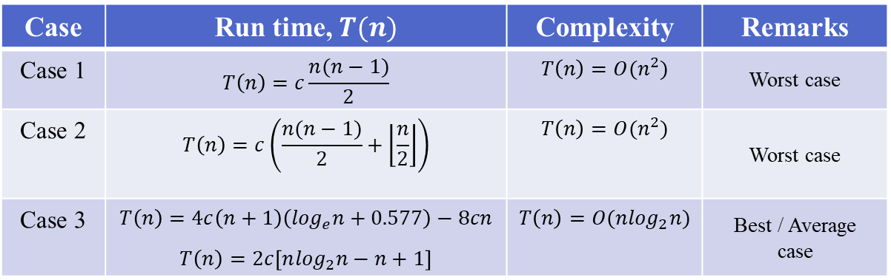
Quick Sort: Summary of Complexity analysis
Case | Run time, $T(n)$ | Complexity | Remarks
Case 1 | $$T\left(n\right)=c\frac{n(n−1)}{2}$$ | $$T\left(n\right)=O(n^{2})$$ | Worst case
Case 2 | $$T\left(n\right)=c\left(\frac{n(n−1)}{2}+\left\lfloor \frac{n}{2}\right\rfloor \right)$$ | $$T\left(n\right)=O(n^{2})$$ | Worst case
Case 3 | $$T\left(n\right)=4c\left(n+1\right)\left(\log_{e}n+0.577\right)−8cn$$ $$T\left(n\right)=2c\left[n\log_{2}n−n+1\right]$$ | $$T\left(n\right)=O(n\log_{2}n)$$ | Best / Average case

Slide 17
Thank You Stay Healthy Stay Safe

