Slide 1

LOCATION BASED APP FOR SMALL BUSINESS
Presentation By:
Sajan Nath Yogi
Narendra Nath Jha
Bishwadeep Chaudhary
RUNTIME TERROR

Slide 2

AGENDA
Introduction
Goals
Limitations of Existing system
Architecture
Demonstration
UI Design
Future Work

Slide 3
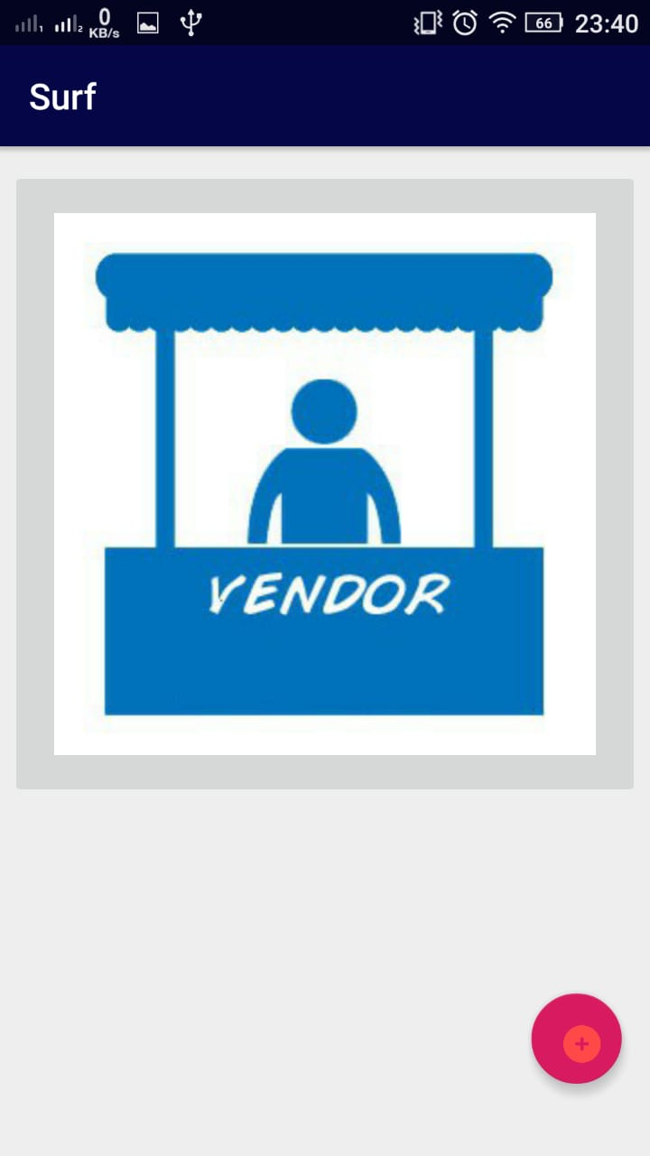
INTRODUCTION
This Application helps user find product and services near their locality.
Vendor can post their products, and users can post skill or services they want to provide to the community.
Vendor can add the listing of the product and prices and services.
2 types of Accounts 1. Vendor
2. Costumer
Time Efficiency and Getting Community Closer.

Slide 4
GOALS
The main motivation of this app is to solve the problem people have in searching for their needs online.
Not everyone(as Vendors) can afford to make websites to reach users.
Nearby Products and their vendors availability to the user.
Users can find any local stores where a product is available within certain radius.
Users can find individual people providing any kind of service. Eg. Cook, Cleaner, Plumber, Tutor, Guard, etc.
Socialization among the people is developed.
Vendors will be provided with analytics tools to analyze their business status.

Slide 5
LIMITATIONS
Most apps are developed to collect huge revenue combining the products and vendors from all around the world and are usually a centralized service.
This method increases the courier charge and hence the costumers are forced to pay more .

Slide 6
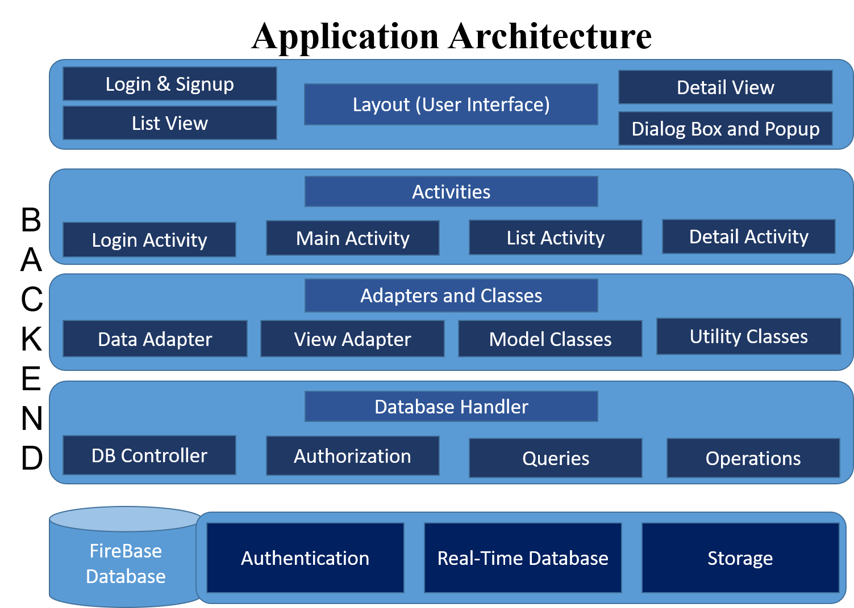
ARCHITECTURE

Slide 7
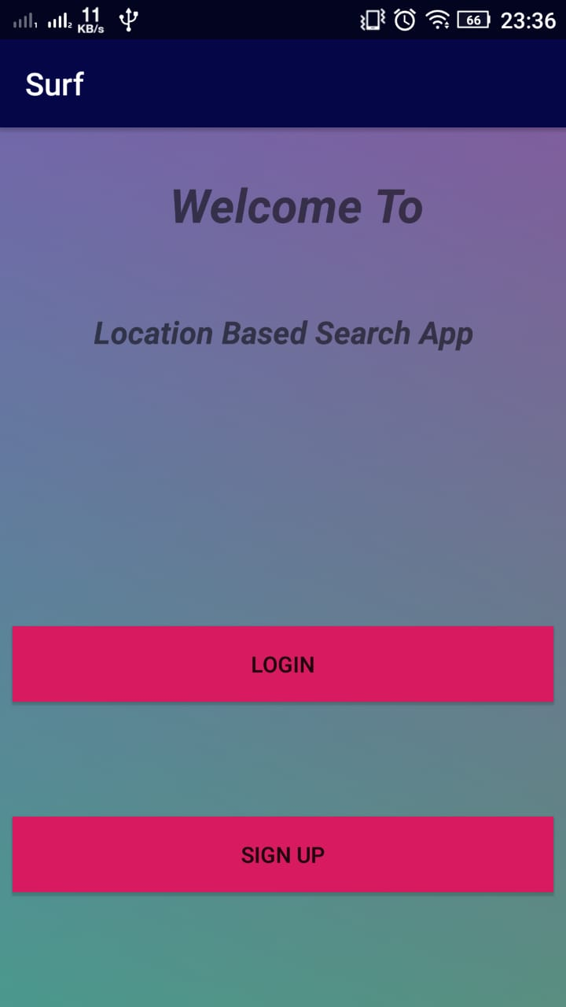
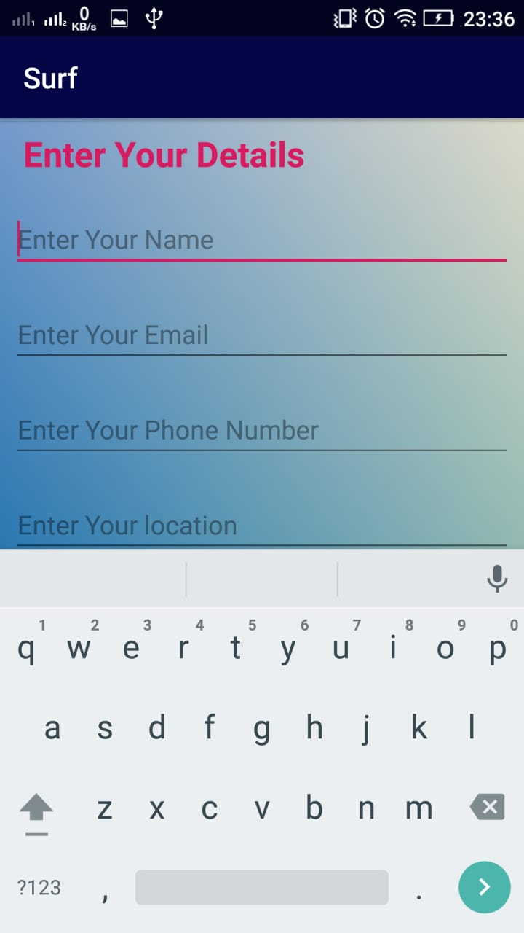
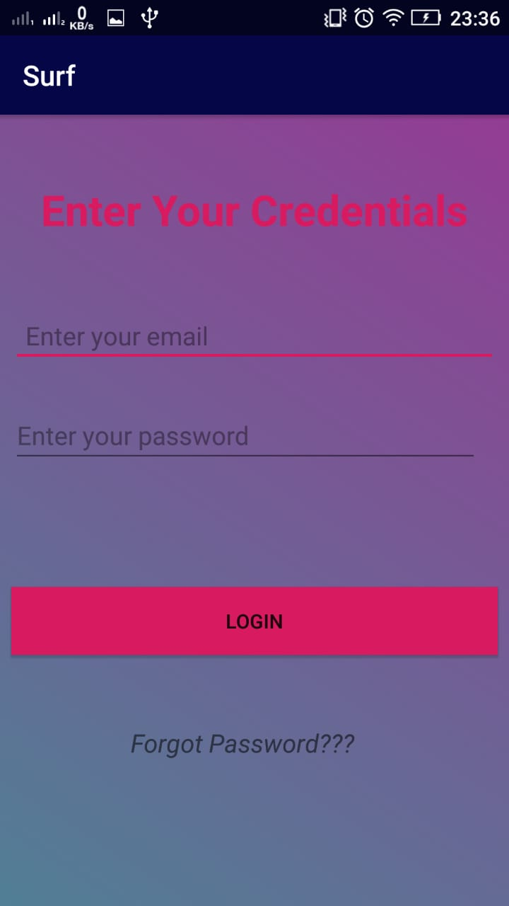
DEMONSTRATION
This is the partially developed application.

Slide 8
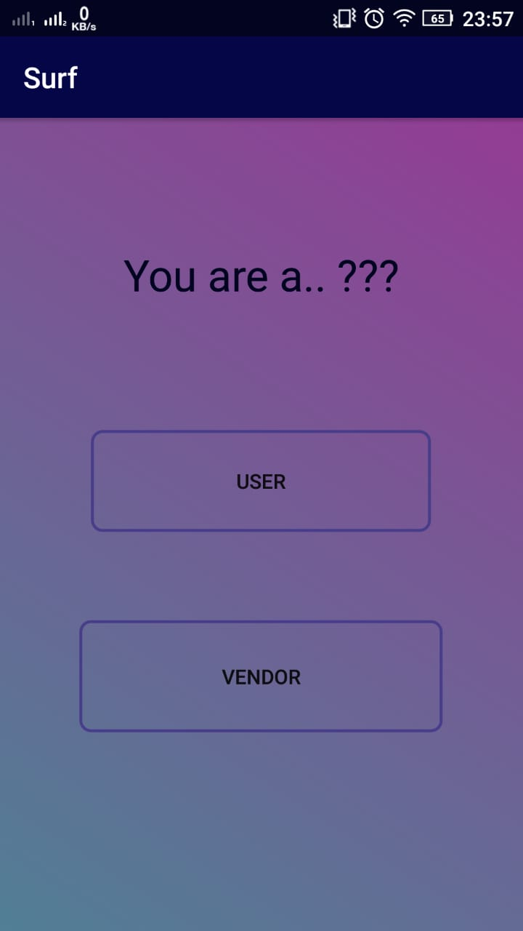
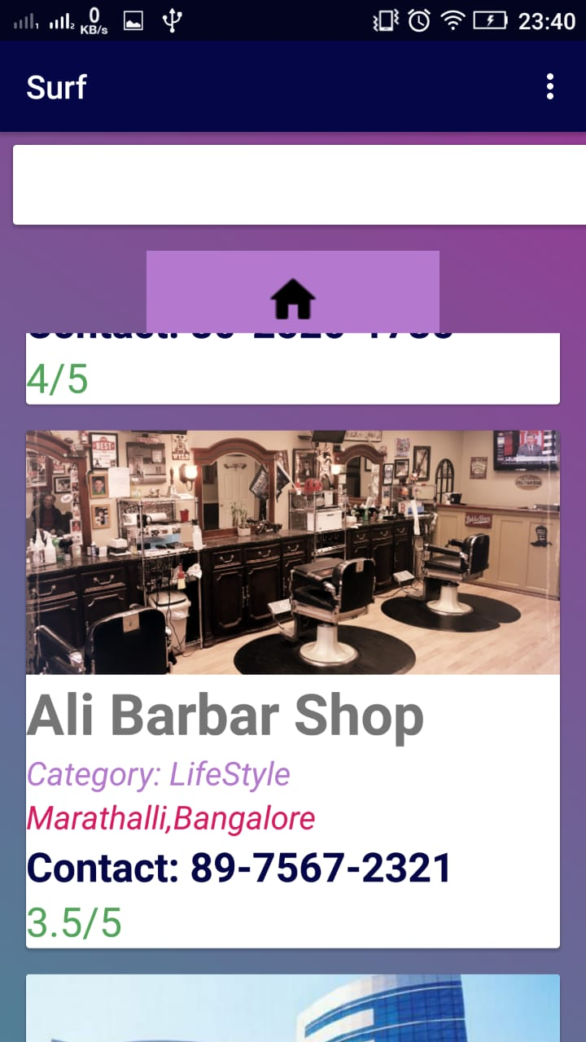
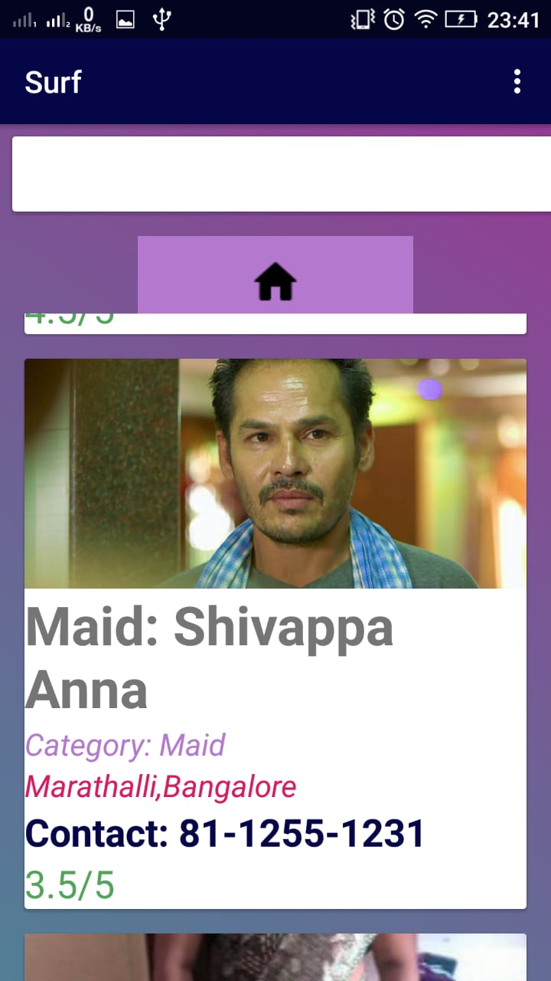
DEMONSTRATION

Slide 9
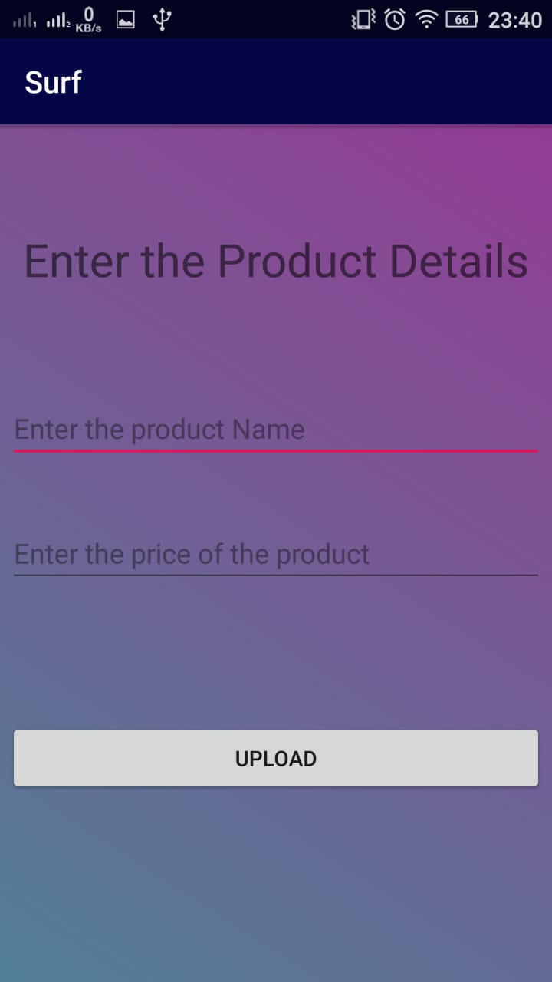
DEMONSTRATION

Slide 10
FUTURE WORK
Business Analytics: business analytical tool will help vendors to know about the total sales, profit, pending work, etc.
Location based notifications
Personalized newsfeed to the costumer using AI.
Delivery accordance to need and importance of the product.

Slide 11
CONCLUSION
This Android Application is designed and developed to enhance the use of the products and vendors around us in effective cost.
This Application gives a chance for small and individual business to become online and also helps the community to come closer.

Slide 12
THANK YOU
ANY QUESTIONS??

