Slide 1
Substation Data Logging System
CS421-22 Mini Project
Naman Agarwal Alan Aipe
1401CS28 1401CS50

Slide 2
Contents
Problem Statement
Components and Technology Stack
Modbus
RS485
Raspberry Pi
Django
Architecture
Demo
Conclusion
Future Work

Slide 3
Problem Statement
The project was adopted taking into account the human resources which goes into manual data logging at various electric substations of IIT Patna.
Objectives of the project include:
Automated logging of data available from EM-6400 meters installed in IIT Patna substation.
Create user interface for better visualization of electric consumption data.
Making data easily available for monitoring as well as analysis purposes.

Slide 4
Components and Technology Stack
Logging system has been designed and optimized taking into consideration various hardware as well as software components as listed below:
Hardware components:
CH340G chip (USB to RS485 converter)
RaspberryPi
Wifi router
Software components:
Libmodbus
CPP
Django
MySQL
Web Technologies like HTML, CSS and JS

Slide 5
Architecture
CH-340G
Chip
MySQL
Database
Register
Web
Interface
Data
POST Request
POST
Django
Server
Raspberry Pi
Response
API
Call
EM-6400
Meter
Server
Data Acquisition

Slide 6
Modbus
An open data communication protocol.
Published by Modicon.
Open structure & Flexible.
Widely known and supplied by many SCADA and HMI software.
2 serial transmission modes:
ASCII 10 bits (American Standard Code for Information Interchange)
RTU (Binary) 11 bits (remote terminal unit)
Communication interface
RS-232/485
Ethernet (TCP/IP)

Slide 7
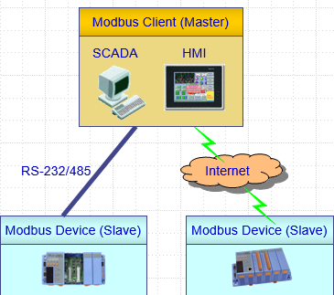
Modbus Protocol
Modbus protocol is defined as a master/slave protocol.
The master will write data to a slave device’s registers,
and read data from a slave device’s register.
Uses RS-485 or RS-232
Modbus TCP is defined as a client/server protocol.
The slave becomes the server,
and the master becomes the client.
Uses Ethernet
There can be multiple masters as well as multiple slaves

Slide 8

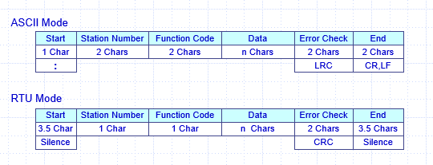
Two Serial Transmission Modes
ASCII Mode
Data system ASCII character, ‘0’~’9’,’A’~’F’
Bits per data unit
Error Check Field (Longitudinal Redundancy Check (LRC))
Message Packet

Slide 9

Contd.
RTU Mode
Data system 8-bit Binary, 00~FF
Bits per data unit
Error Check Field (Cyclical Redundancy Check (CRC))
Message Packet

Slide 10
Modbus Function Code
01: read Coil (Discrete Output) (0xxxx)
02: read Discrete Input (1xxxx)
03: read Holding Registers (4xxxx)
04: read Input Registers (3xxxx)
05: write Single Coil (0xxxx)
06: write single Holding Register (4xxxx)
15: write Multiple Coils (0xxxx)
16: write Multiple Holding Registers (4xxxx)

Slide 11
Advantages
It is scalable in complexity and scope.
It is simple to administer and enhance.
There is no vendor-proprietary equipment or software needed.
It is very high performance, limited typically by the ability of the computer operating systems to communicate.
It can be used to communicate with the large installed base of MODBUS devices, using conversion products, which require no configuration.

Slide 12
Libmodbus
Libmodbus is a library to send/receive data with a device which respects the Modbus protocol.
Supports RTU (serial) and TCP (Ethernet) communications.
Written in C.
Available for Linux, Mac OS X, FreeBSD, QNX and Windows.

Slide 13
RS485
RS-485, also known as TIA-485(-A), EIA-485, is a standard defining the electrical characteristics of drivers and receivers for use in serial communications systems.
It is balanced data-transmission scheme that offers robust solutions for transmitting data over long distances and noisy environments.
Used as physical layer specification by many protocols like Modbus, Profibus and many others.

Slide 14
Contd.
Half duplex connection.
32 to 282 devices.
Uses balanced differential lines for communication, usually twisted pairs of wires.
Data is logical 1 when polarity is positive(voltage level in ‘+’ wire is higher than ‘-’ wire) and 0 when negative polarity with a noise margin of +- 0.2 V.

Slide 15
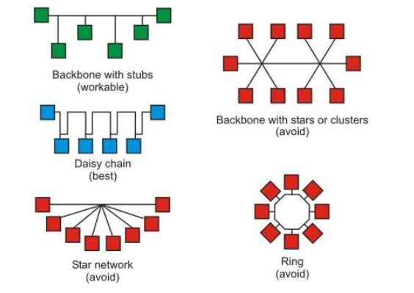
Topology

Slide 16
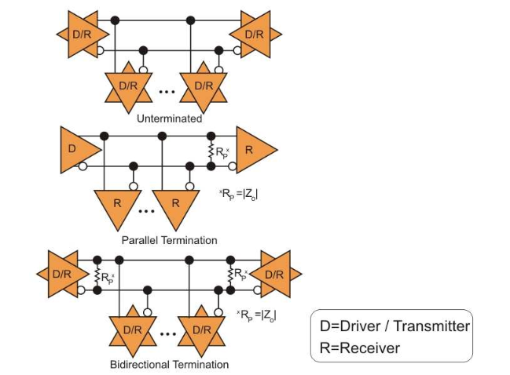
Termination registers
Unterminated | Parallel termination | Bidirectional termination
low power, low cost and simple to build. Data rates must be quite slow, or cable length must be short | Excellent data rates but limited to networks with one driver/transmitter. | Excellent signal Integrity. High power Consumption

Slide 17
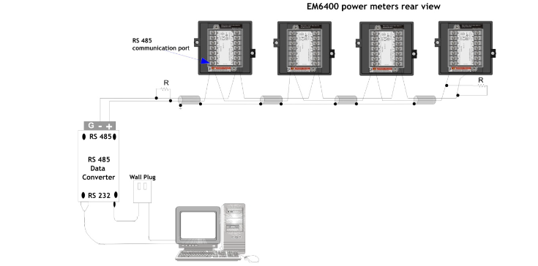
Connection with EM6400 meter

Slide 18
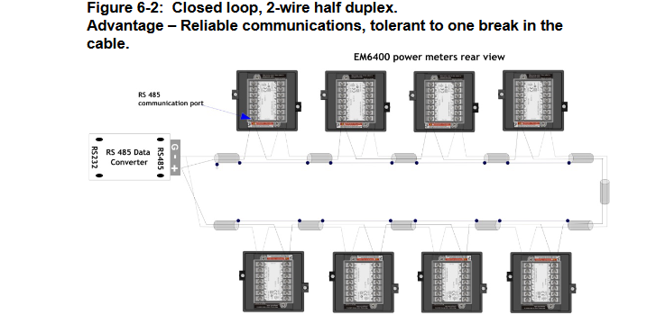
Contd.

Slide 19
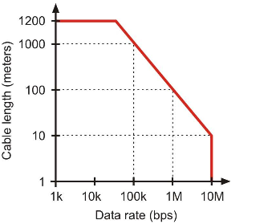
Cable length and data rate
Cable length (in m) * Data rate (in bps) <= 10^{8.}
Data-rate of 10Mbps.
Distance up to 1200m (4000 ft)

Slide 20
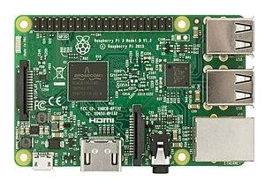
Raspberry Pi
Raspberry Pi is a single board computer which mimics the functionality of a computer system at a mini-level. Pi 3 has been used in this project for reception of data streams from RS485 and uploading in the remote server (REST API calls) using C++ programming.
Raspberry Pi 3

Slide 21
Django
Django is a high-level Python Web framework that encourages rapid development and clean, pragmatic design.
Why Django?
It facilitate faster development of server apps.
User authentication is very secure.
Easily scalable.
Better backend skeleton for database management.

Slide 22
MySQL & Front-end Web Technologies
MySQL is a relational database which has been used in the project ino rder to manage previous 24 hours as well as aggregate data for each day in server. MySQL database is easier to manage and facilitate better import/export features to other data formats.
Web Technologies like HTML, CSS and JS has been used at the dashboard. REST API calls are fetched and displayed using AJAX. Libraries of JS like CanvasJS has been used to create dynamic visual representations and aggregations of data.

Slide 23
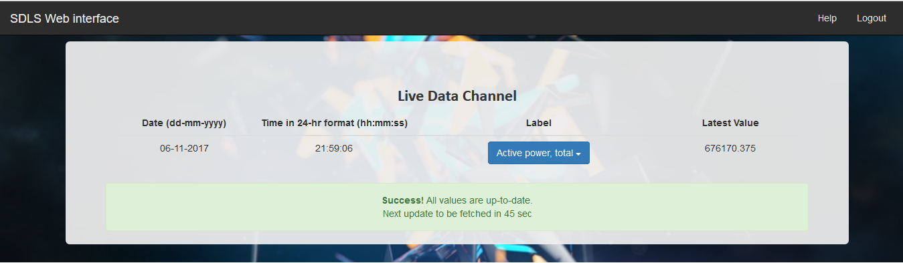
Demo / Screenshots

Slide 24
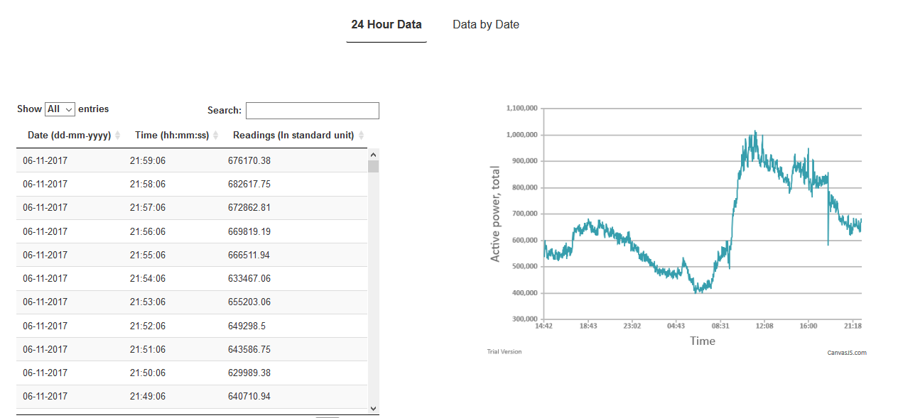
Contd.

Slide 25
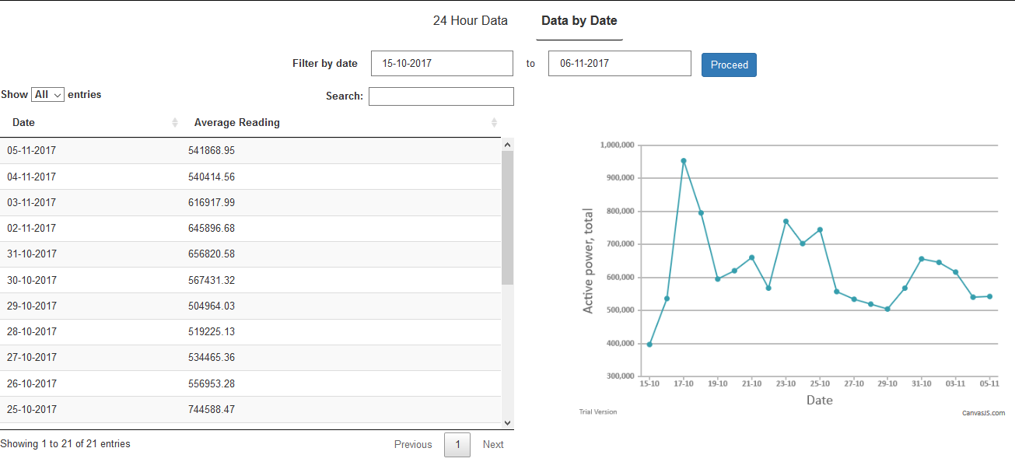
Contd.

Slide 26
Conclusion
Substation Data Logging System (SDLS) has been deployed successfully and tested in one of the substations in our campus. It streams in data every minute into the server which are dynamically shown in admin console of SDLS web interface.
This system would, inarguably, help in faster and accurate modelling of power consumption in the college, thus providing a helping hand to the upcoming research works in the field of smart grids.

Slide 27
Future Work
The project can be extended to :
Encompass data analytics to server.
Machine learning models to predict power surges.
Time series modelling of power consumptions.
Automated regulatory systems for the grids.

Slide 28
Thank You
References
http://www.modicon.com
http://www.modbus.org/default.htm
https://en.wikipedia.org/wiki/Modbus
https://github.com/stephane/libmodbus
https://en.wikipedia.org/wiki/RS-485
https://www.djangoproject.com
https://www.w3schools.com
Questions, if any?

