Slide 1
Effect of age, gender, race, ethnicity on COVID-19 symptoms

Slide 2
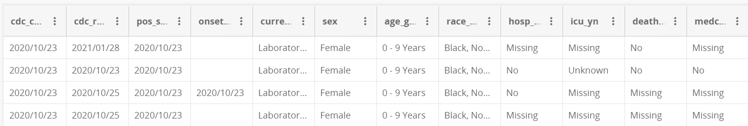
The dataset
https://data.cdc.gov/Case-Surveillance/COVID-19-Case-Surveillance-Public-Use-Data/vbim-akqf
20.5 million rows, 12 columns

Slide 3
Data Cleaning
Took a subset(as the total no. of rows is very high)(equal no. of rows from symptoms = Yes and No)
Kept columns age group, sex, race/ethnicity, onset_dt
Removed NAs, unknown, missing values
Separated race/ethnicity, replaced onset_dt with a “Symptoms” column(Yes/No)

Slide 4
Used various classifiers to predict Symptoms
Logistic Regression
Decision Tree
Random Forest
LDA
Naïve Bayesian

Slide 5
Assessment of the models
Accuracy
ROC curve

Slide 6
Classifier | Accuracy
Logistic | 0.545
Decision tree | 0.546
Random forest | 0.544
LDA | 0.545
Naïve bayesian | 0.541

Slide 7
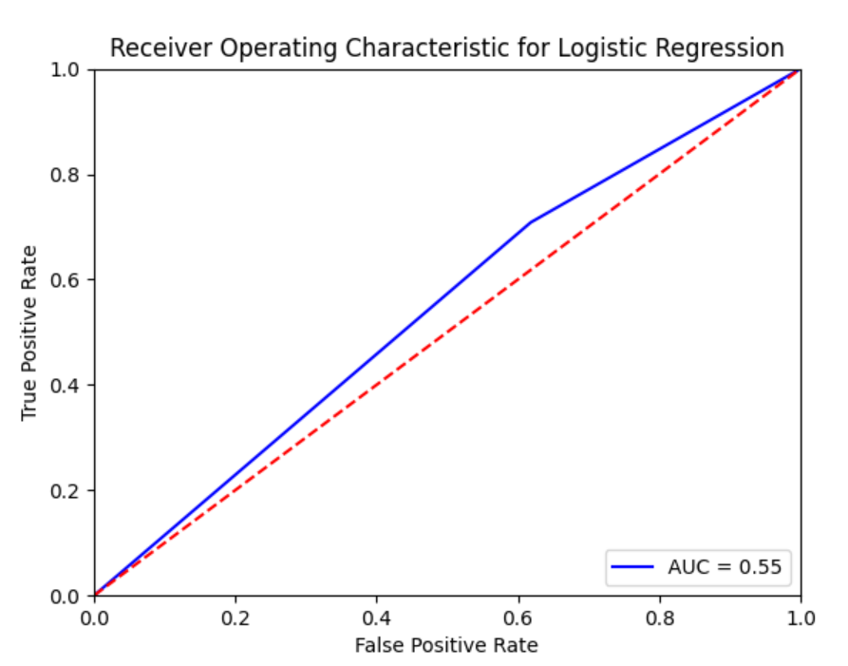

Slide 8
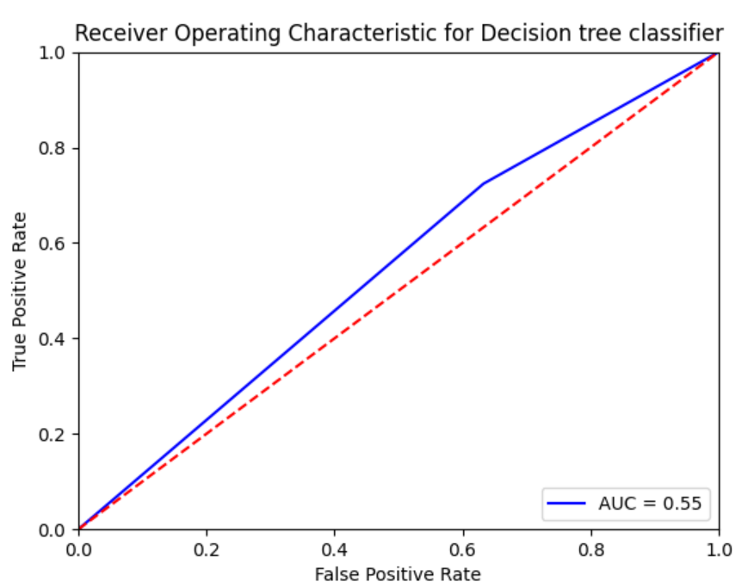

Slide 9
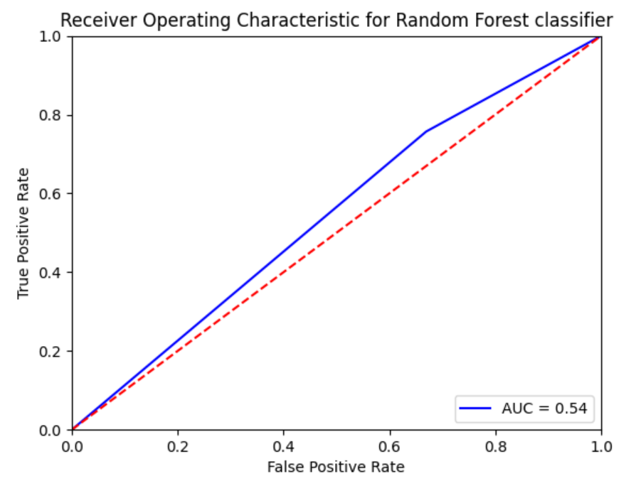

Slide 10
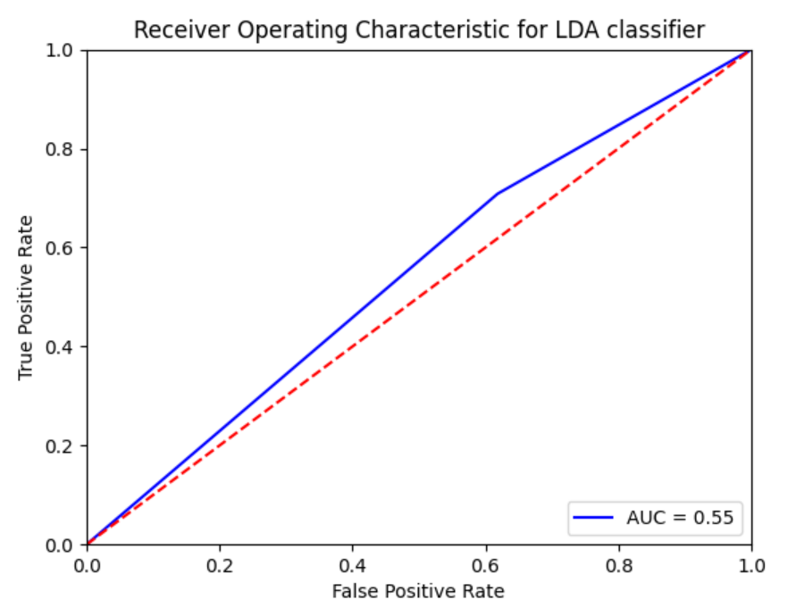

Slide 11
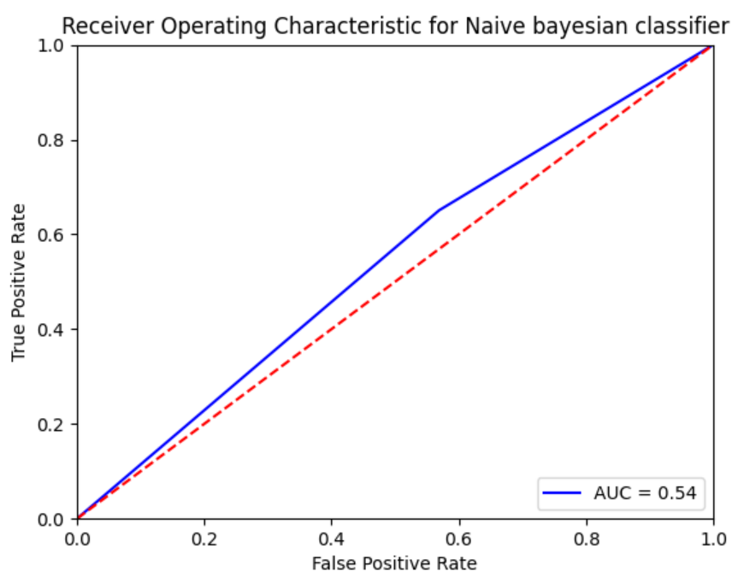

Slide 12
Removing features to check if accuracy improves
Classifier | Accuracy | Accuracy after removing age | Accuracy after removing sex | Accuracy after removing race | Accuracy after removing ethnicity
Logistic | 0.545 | 0.532 | 0.542 | 0.522 | 0.546
Decision tree | 0.546 | 0.533 | 0.543 | 0.523 | 0.546
Random forest | 0.544 | 0.533 | 0.541 | 0.523 | 0.543
LDA | 0.545 | 0.532 | 0.543 | 0.522 | 0.546
Naïve bayesian | 0.541 | 0.532 | 0.54 | 0.522 | 0.54

Slide 13
Conclusion and further scope
It is not predictable that whether an individual is expected to show symptoms(using features that we did)
Principal component analysis?

Slide 14
Thank you ☺

