Slide 1
Classification model for stroke prediction

Slide 2
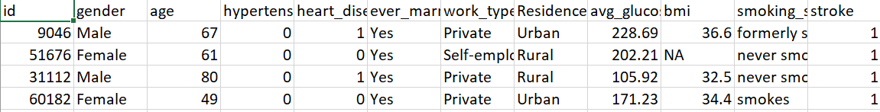
Dataset
Contains columns such: age, gender, diseases(Hypertension, heart disease), lifestyle(Residence type, work type, smoking status), Stroke output(target column)(1 or 0)
Over 5000 rows, only 250 positives(1)
Got it down to 360 rows(180 positives and 180 negatives) after cleaning the dataset(removing NAs and Unknowns)

Slide 3
Inspecting features through summaries
Through numerical and graphical summaries, it was possible to inspect if a feature seems to relate to stroke outcome.

Slide 4
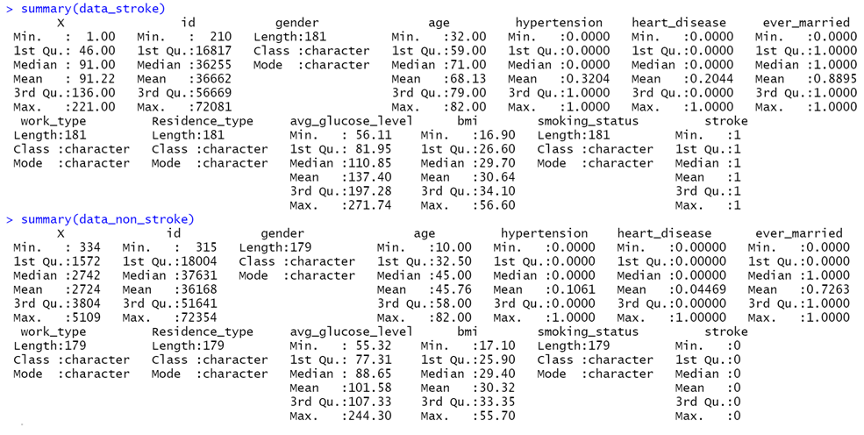

Slide 5
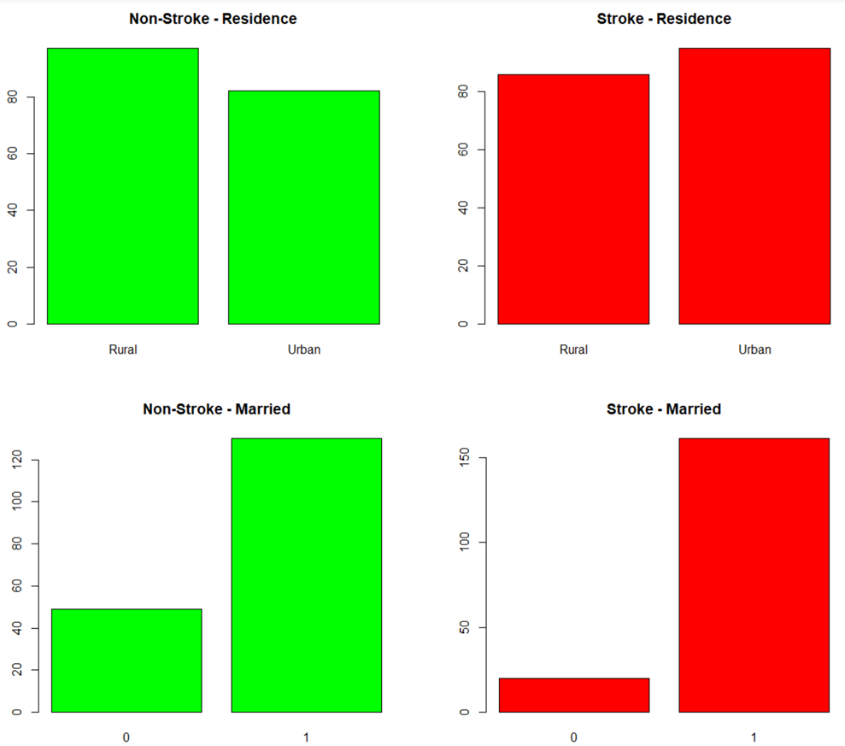

Slide 6
Statistically test which of the remaining features are significant
If yes, we would like to adjust for age and check again(because age has high correlation and is potentially a covariant)

Slide 7
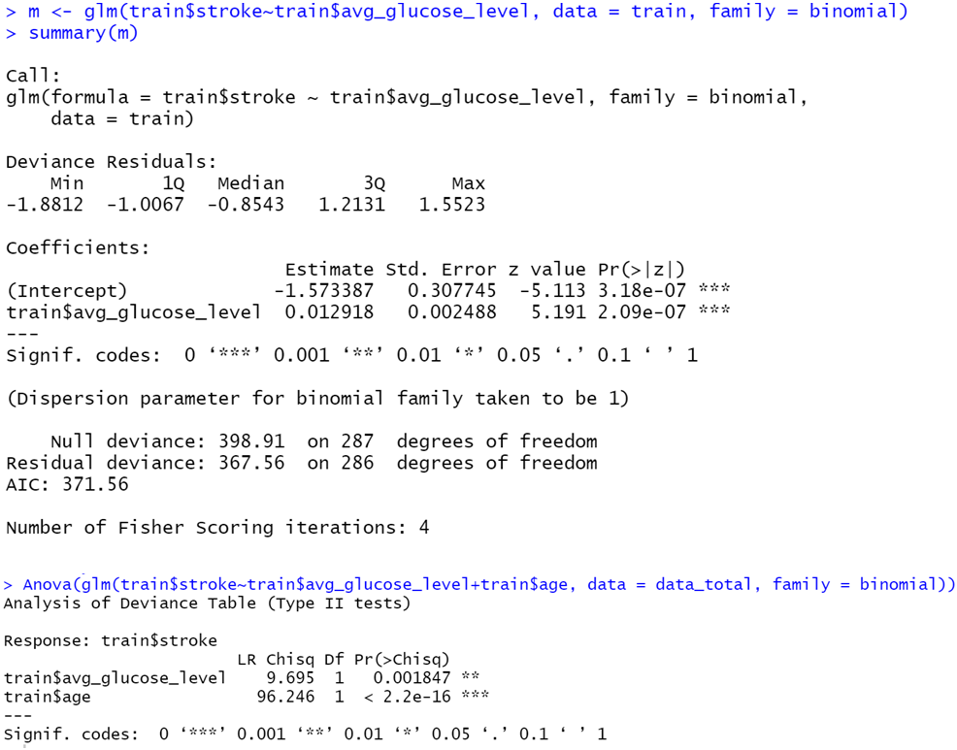
Significant before and after

Slide 8
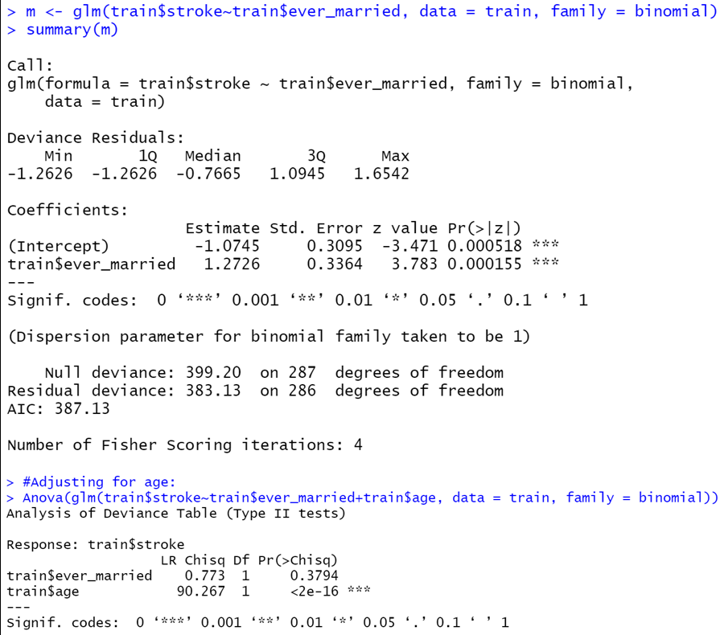
Not significant, once adjusted for age

Slide 9
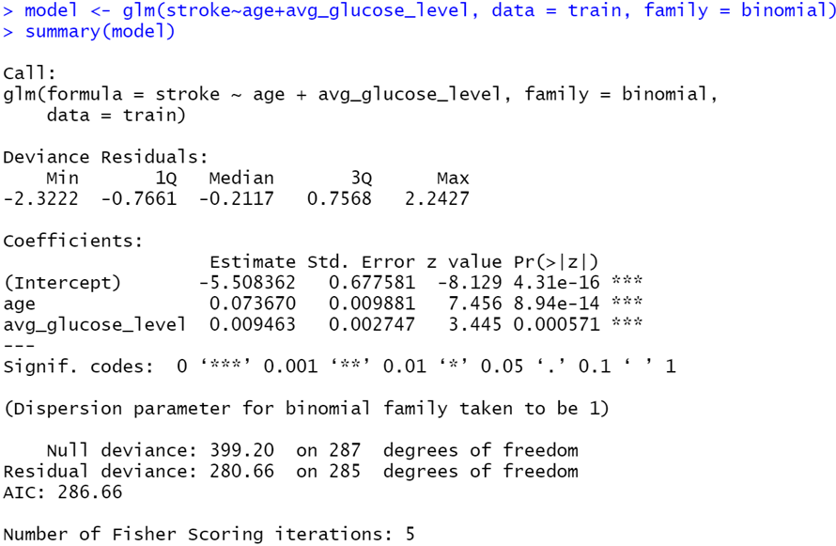
Logistic Regression model
Age and average glucose level were the only significant features remaining, after our filtering of features process.

Slide 10
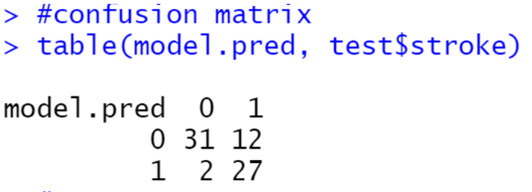
Assessment of the model
Confusion Matrix
Error rate = 19.44

Slide 11
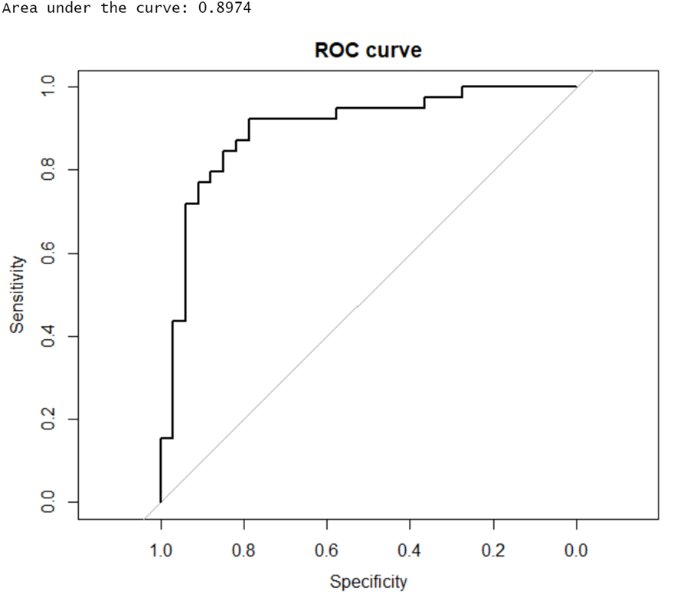
Assessment of the model
ROC curve:

Slide 12
Further Scope
Compare more classifiers’ accuracy(kNN, LDA, QDA…)
Replace random samples from stroke outcome == 0 observations and repeat this n times and find average accuracy.

Slide 13
Thank you ☺

