Slide 1
Analysis of Students’ Performance in Examinations

Slide 2
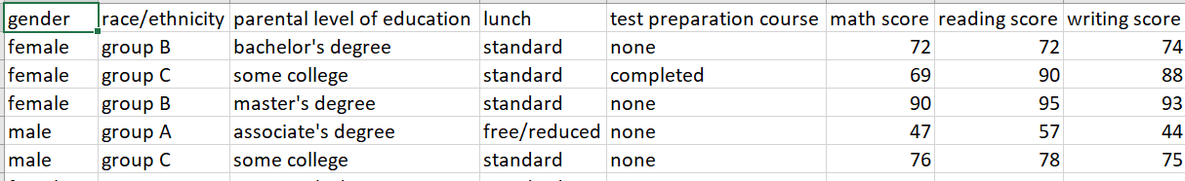
About the dataset
The dataset is 1000 rows long and there are 8 columns.
https://www.kaggle.com/adithyabshetty100/student-performance

Slide 3
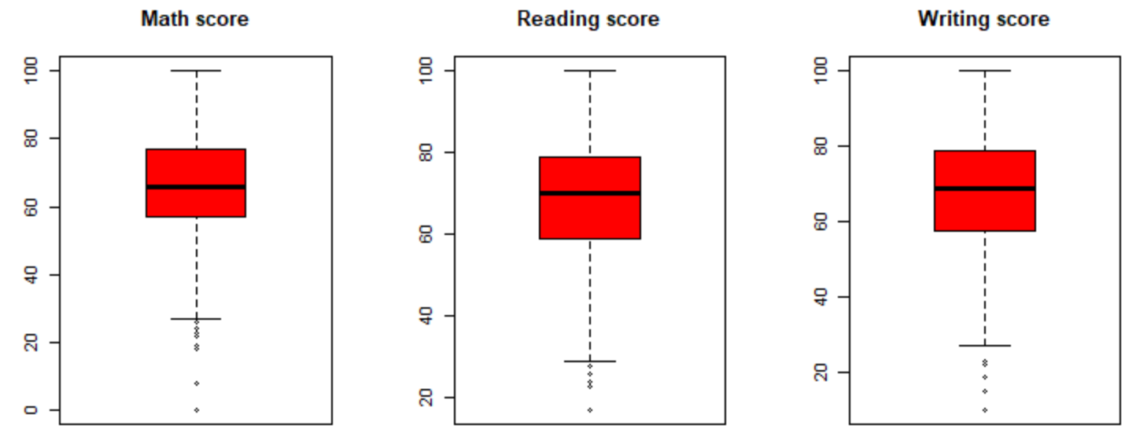
Preparing the data
No NA values
Found and removed outliers

Slide 4
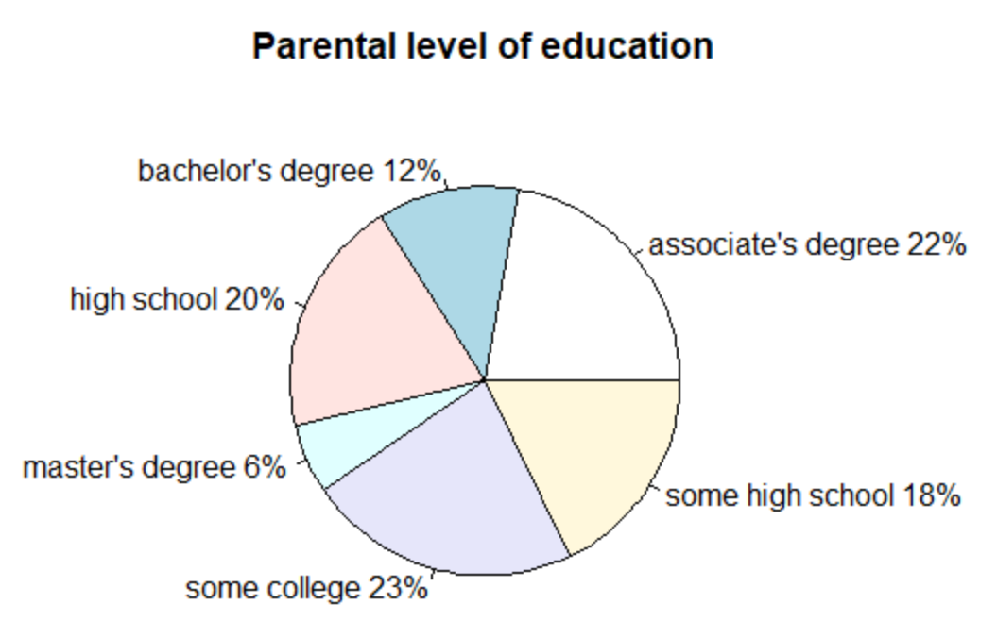
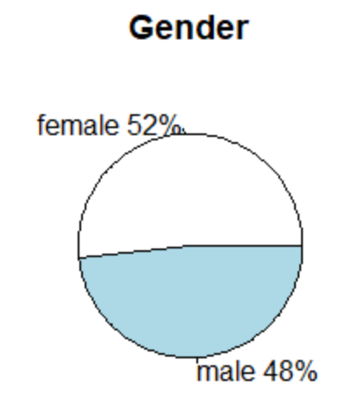
Categorical variables
Function defined to plot pie charts(with labels and percentages)

Slide 5
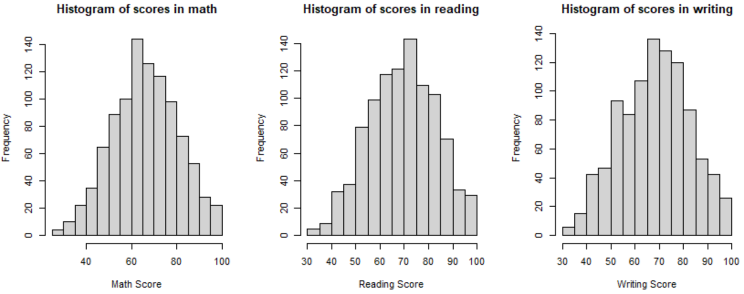
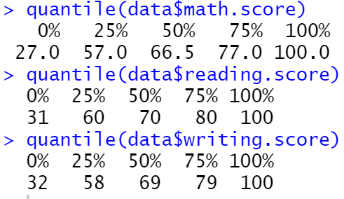
Numerical Variables
Quantiles and histogram

Slide 6
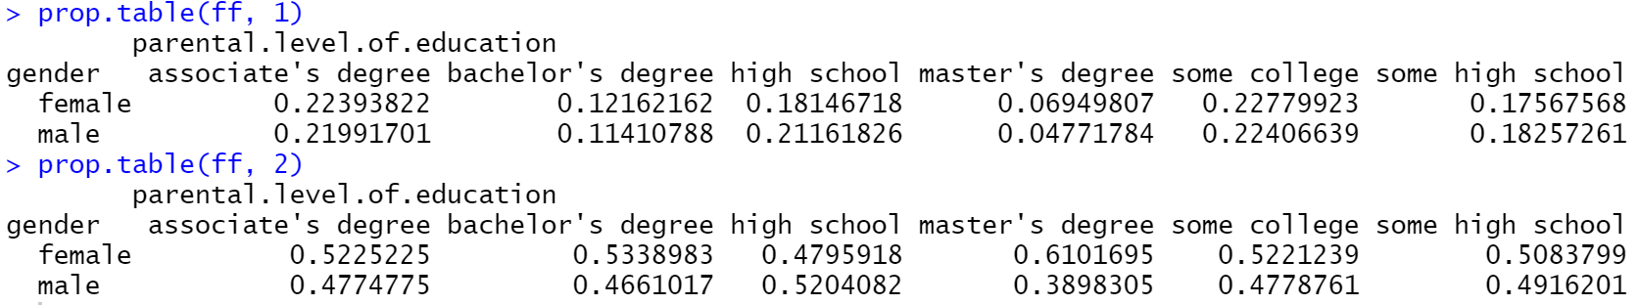
Set of variables
Two way (proportion) tables

Slide 7
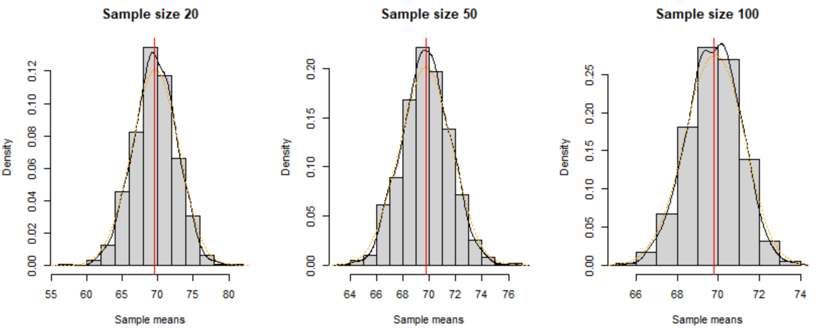
Central Limit Theorem
1000 samples of sizes 20, 50, 100

Slide 8
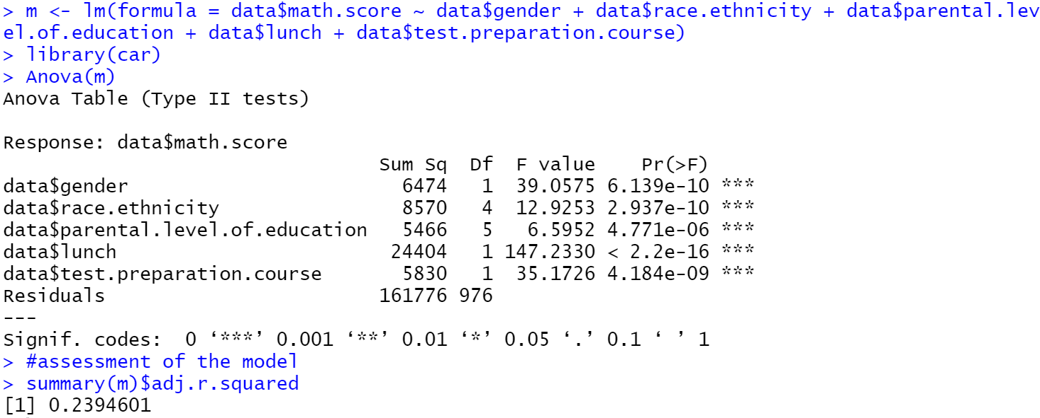
Linear Regression
Multivariable linear regression taking all the categorical features to predict scores(target variable)

Slide 9
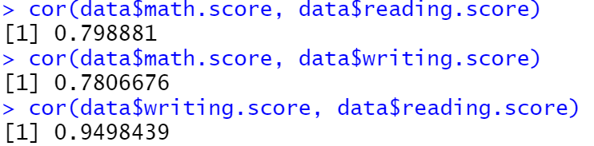
Linear Regression
What could give us a good model?
The scores are highly correlated.
The models to predict a score, using the other two scores were good(adj-R² ranging from 0.64 to 0.91), as expected intuitively.

Slide 10
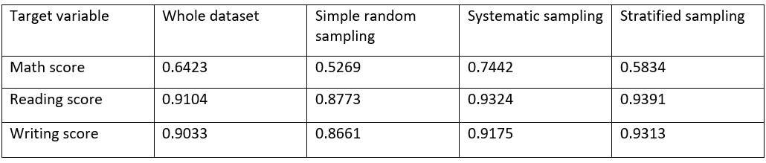
Linear Regression on samples
Samples of size 50 were created using simple random sampling, systematic sampling, stratified sampling(2 strata)
The adjusted R² of these models:

Slide 11
Further Scope
Feature selection
Measure accuracy(another way of assessment)

Slide 12
Thank You ☺

