Slide 1
Applied Data Science Capstone
Capstone Project - The Battle of Neighborhoods (Week 2)

Slide 2
Introduction: Business Problem
Idea of this project is If a business person want to open a restaurant in Dublin, help him analyze which area would be better depending on competition and population within Dublin.
In recent years Migrations to Ireland are increased and most of the migrant are based at Dublin location. Due to increased housing prices in Dublin city area, people are preferring to locate little away from Dublin, but they find difficult to locate good restaurants near their homes. In such scenario, restaurants like Asian, Chinese or Italian cuisine restaurant would be blessing for people and they won’t need to visit Dublin city central always.

Slide 3
Data
Dublin has postal districts 1-24 or Greater Dublin with 4 major regions can be scrapped from below sites,
https://en.wikipedia.org/wiki/County_Dublin
For the problem mentioned we would like to get:
Location data for Dublin postal districts and greater Dublin
Venues data around all Dublin postal districts and for Greater Dublin regions
Population data for 4 major regions of Dublin

Slide 4
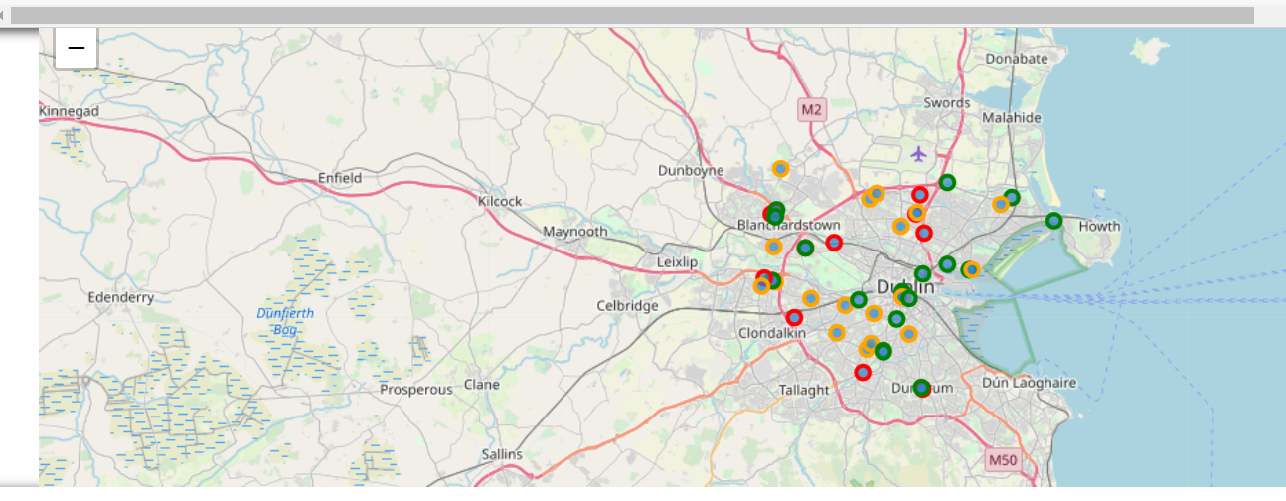
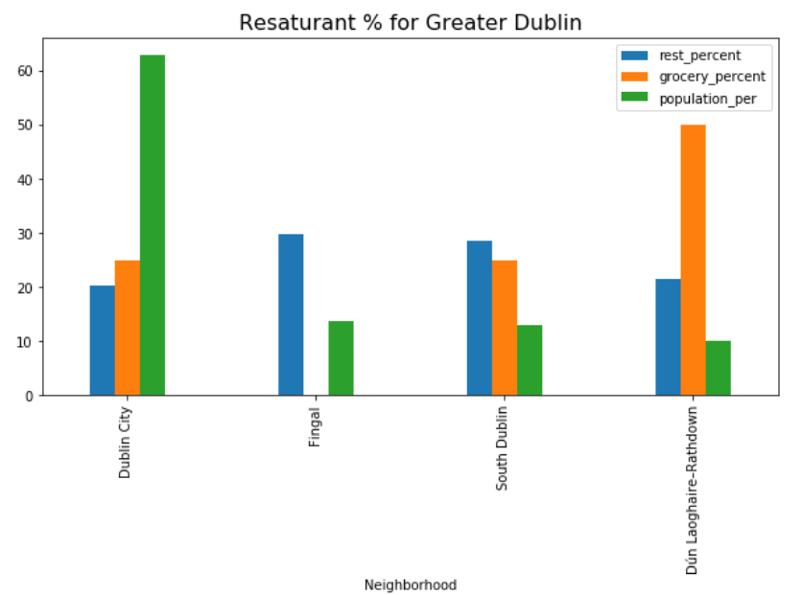

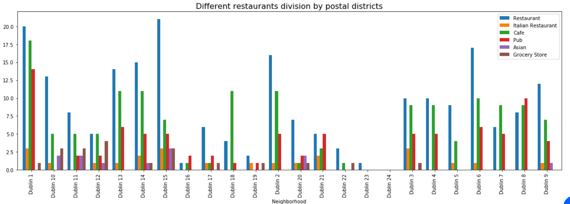
Results & Analysis
Fingal,Dublin4,8
Planning a restaurants business in Dublin?
Which area will be less competitive yet have good potential?

Slide 5
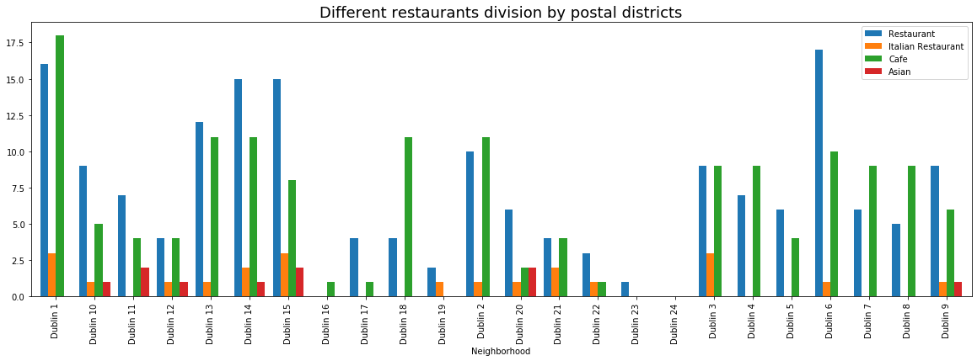
Results & Analysis

Slide 6
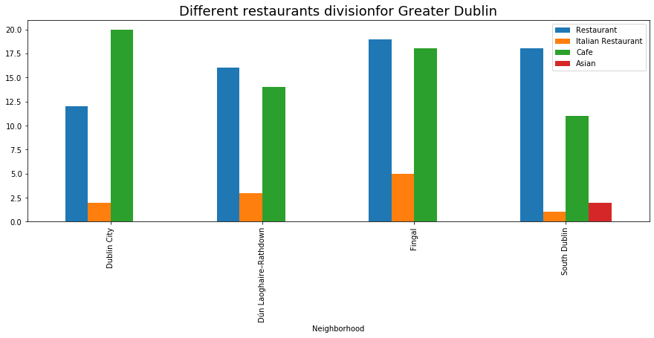
Results & Analysis

Slide 7
Results & Analysis

Slide 8
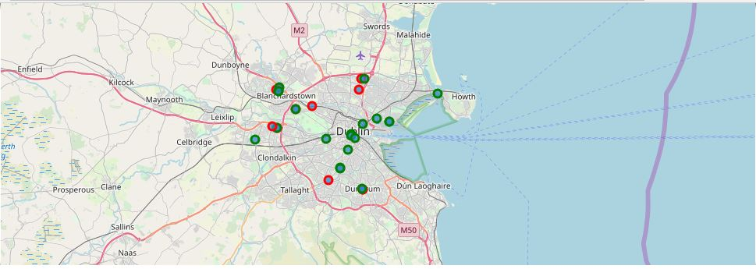
Results & Analysis

Slide 9
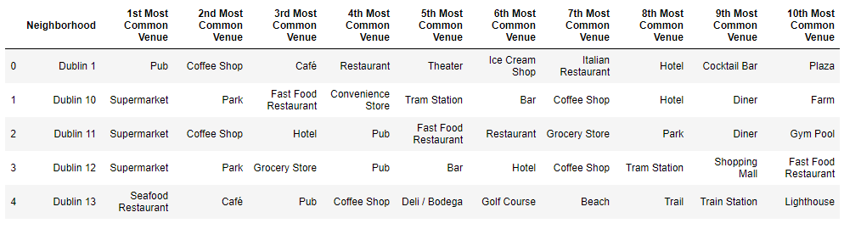
Results & Analysis

Slide 10
Analysis
Overall Asian Restaurants have less existence in Dublin City (Dublin 1, Dublin 2).
Fingal and Dun-Laghorie areas, region which has plenty of restaurants and cafe otherwise.
Assuming Asian migrated peoples are settling in Dublin 15, Dublin 2, Dublin 4 postal districts majorly, hence Dubin2 and Dublin4 can be a good potential area for Asian restaurant.

Slide 11
Conclusion
Dublin City, Fingal and Dun-Laghorie would be potential regions to open a Asian Restaurant
Assuming increasing population in Dublin 4, Dublin 8 and Fingal region, Asian restaurants would have good potential in these areas of Dublin

