Slide 1
Bootstrap 4

Slide 2
Agenda
Introduction
Layout
Content
Components
Utilities

Slide 3
Introduction
The world’s most popular framework for building responsive, mobile-first sites, with BootstrapCDN and a template starter page.
CDN links
CSS:
JS:
<link rel="stylesheet" href="https://stackpath.bootstrapcdn.com/bootstrap/4.2.1/css/bootstrap.min.css"
integrity="sha384-GJzZqFGwb1QTTN6wy59ffF1BuGJpLSa9DkKMp0DgiMDm4iYMj70gZWKYbI706tWS"
crossorigin="anonymous">
<script src=https://code.jquery.com/jquery-3.3.1.slim.min.js
integrity="sha384-q8i/X+965DzO0rT7abK41JStQIAqVgRVzpbzo5smXKp4YfRvH+8abtTE1Pi6jizo"
crossorigin="anonymous"></script>
<script src="https://cdnjs.cloudflare.com/ajax/libs/popper.js/1.14.6/umd/popper.min.js"
integrity="sha384-wHAiFfRlMFy6i5SRaxvfOCifBUQy1xHdJ/yoi7FRNXMRBu5WHdZYu1hA6ZOblgut"
crossorigin="anonymous"></script>
<script src=https://stackpath.bootstrapcdn.com/bootstrap/4.2.1/js/bootstrap.min.js
integrity="sha384-B0UglyR+jN6CkvvICOB2joaf5I4l3gm9GU6Hc1og6Ls7i6U/mkkaduKaBhlAXv9k"
crossorigin="anonymous"></script>

Slide 4
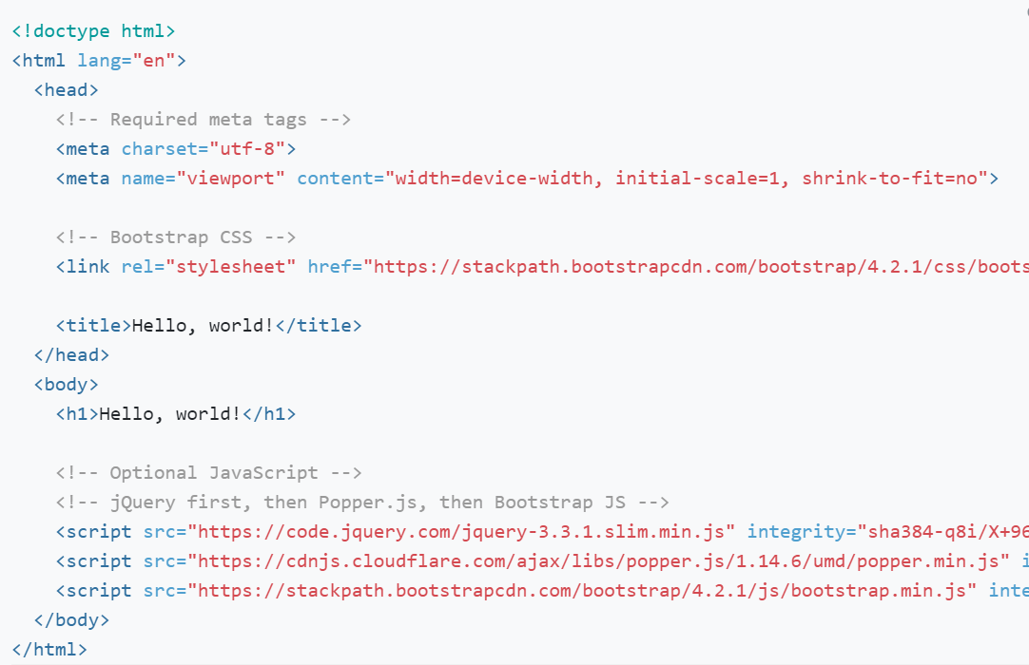
Introduction
Responsive Meta tag
<meta name="viewport" content="width=device-width, initial-scale=1, shrink-to-fit=no">

Slide 5
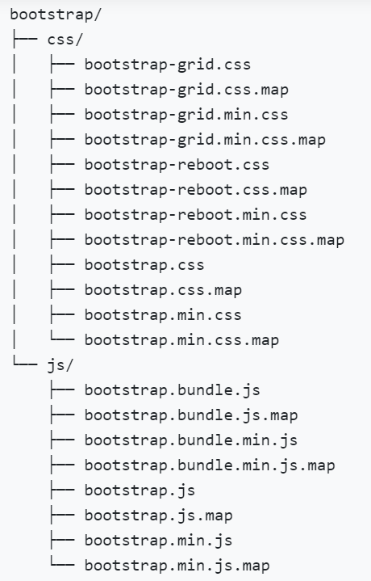
Introduction
Downloads
Compiled CSS and JS download
Source files download
Contents
Pre-compiled Bootstrap

Slide 6
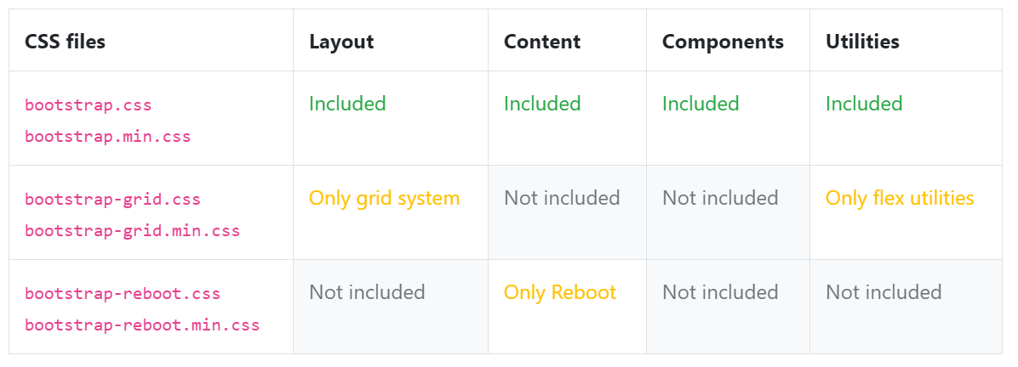
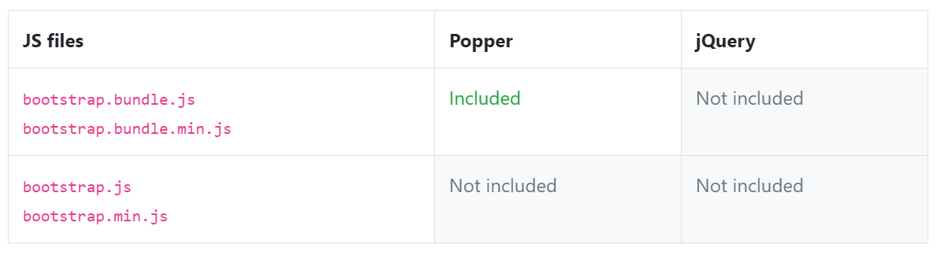
Introduction
CSS files
JS files

Slide 7
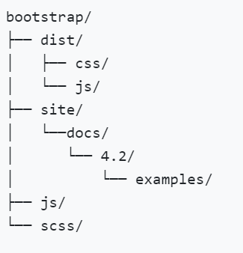
Introduction
Source Code
The dist/ folder includes everything listed in
the precompiled download section above.
The site/docs/folder includes the source code
for our documentation, and examples/ of Bootstrap usage.
Beyond that, any other included file provides support for packages,
license information, and development.
The scss/ and js/ are the source code for our
CSS and JavaScript.

Slide 8
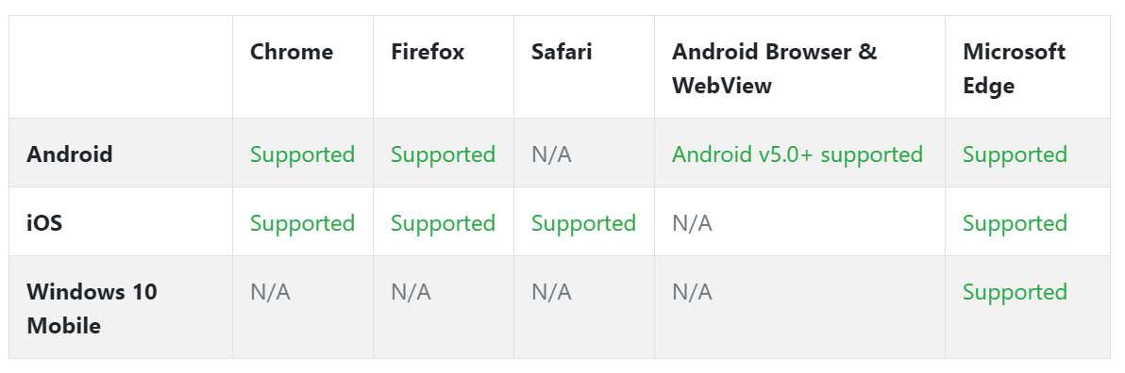
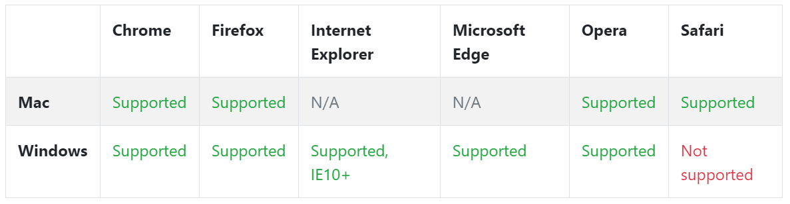
Browser and Device supports
Devices
Desktop
more details

Slide 9
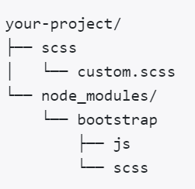
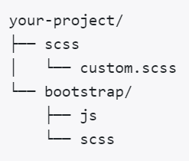
Theming with Bootstrap
In Bootstrap 3, theming was largely driven by variable overrides in LESS, custom CSS, and a separate theme stylesheet that included in dist files. With some effort, one could completely redesign the look of Bootstrap 3 without touching the core files. Bootstrap 4 provides a familiar, but slightly different approach.
File structure:
Package
manager
Manually
Setup

Slide 10
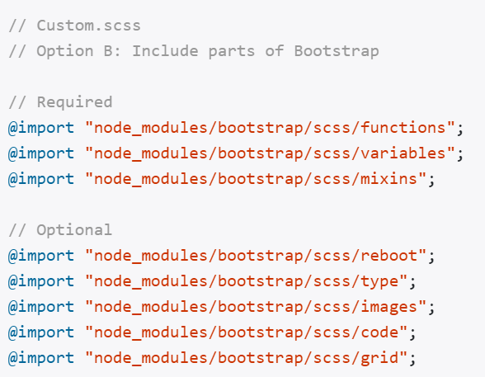
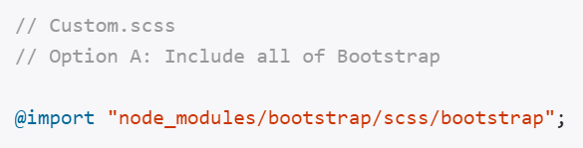
Theming with Bootstrap
Importing

Slide 11
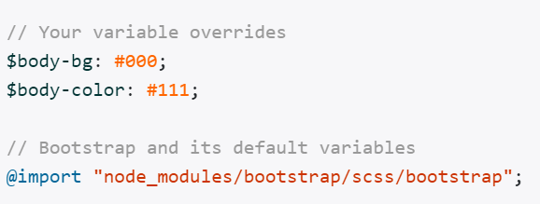
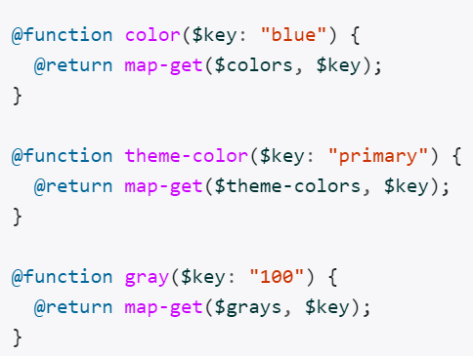
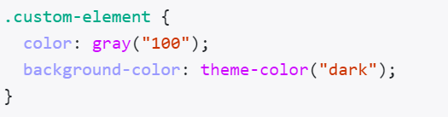
Theming with Bootstrap
Variable Default:
Functions:

Slide 12
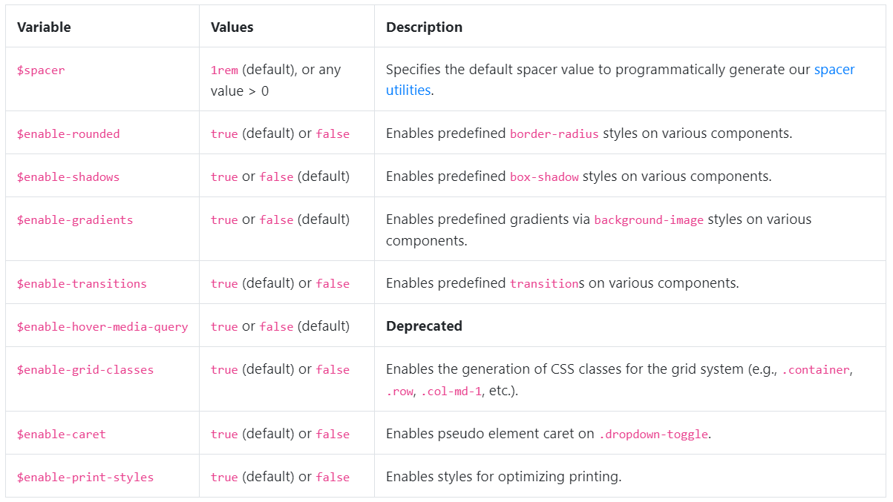
Theming with Bootstrap
SASS Options

Slide 13
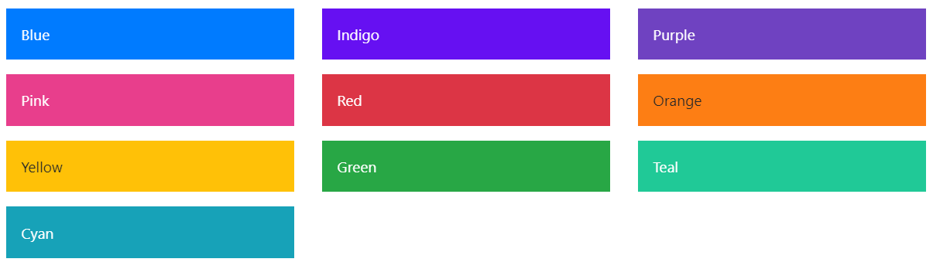
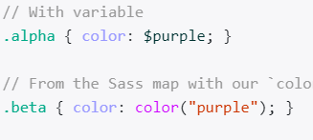

Theming with Bootstrap
Color:
Theme Colors:

Slide 14
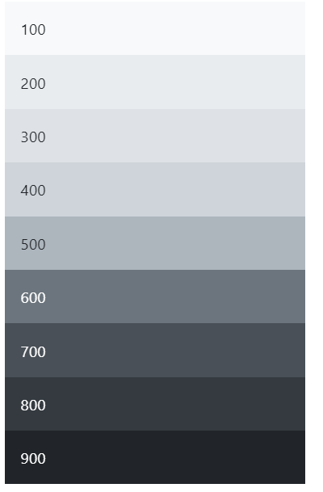
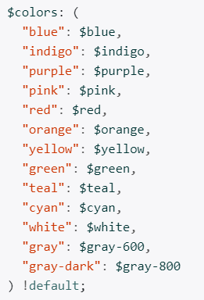
Theming with Bootstrap
Grays
_variables.scss

Slide 15
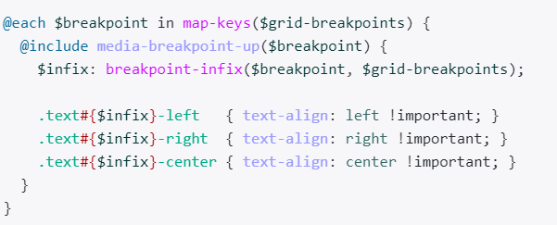
Theming with Bootstrap
Responsive
more details

Slide 16
Layout
Containers
Bootstrap also requires a containing element to wrap site contents.
There are two container classes to choose from:
The container class provides a responsive fixed width container.
The container-fluid class provides a full width container, spanning the entire width of the viewport.
Note: Containers are not nestable (you cannot put a container inside another
container).

Slide 17
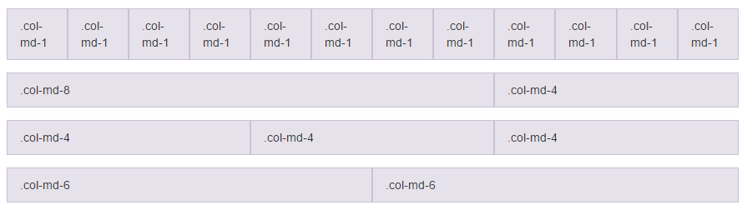

Grid System
Easy to use grid system for creating rows & columns for your content

Slide 18

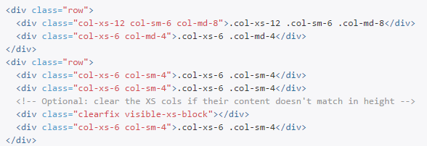
Grid System
Example Grid: Mobile, Tablet, & Desktop

Slide 19
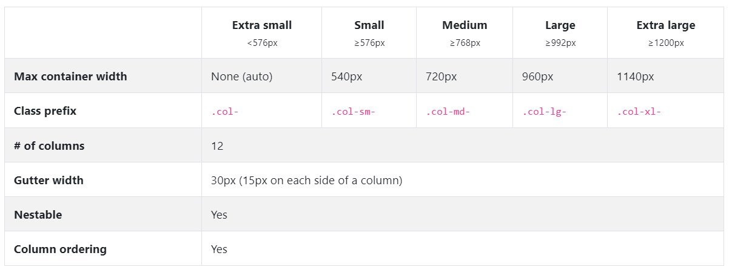
Grid System
Grid Options
Learn more

Slide 20
Content
Reboot
Reboot builds upon Normalize, providing many HTML elements with somewhat opinionated styles using only element selectors. Learn more

Slide 21
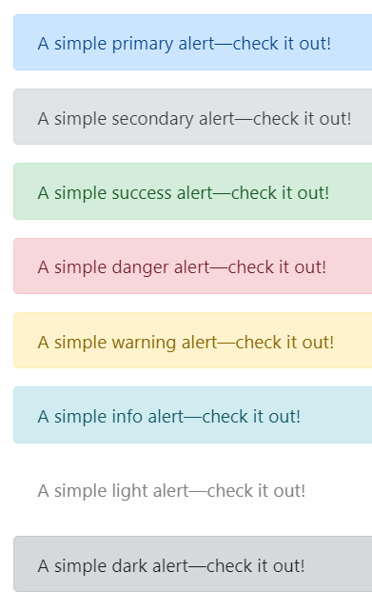
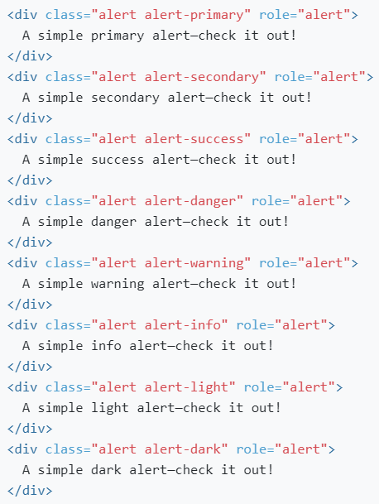
Component
alert

Slide 22

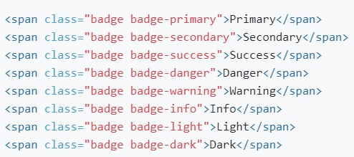
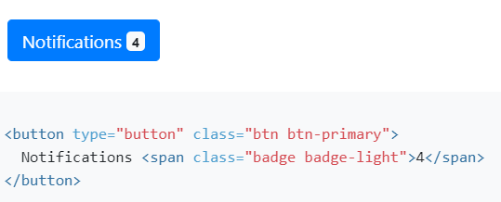
Component
Badge

Slide 23
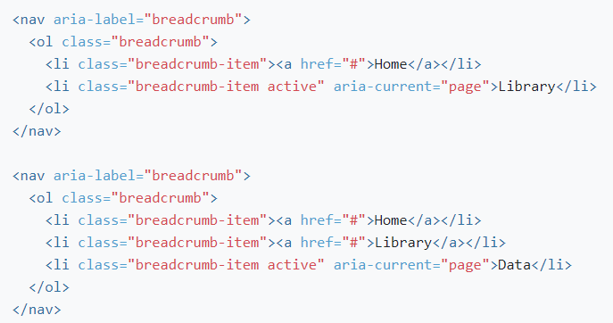
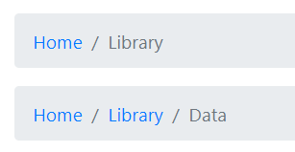
Component
Breadcrumb

Slide 24

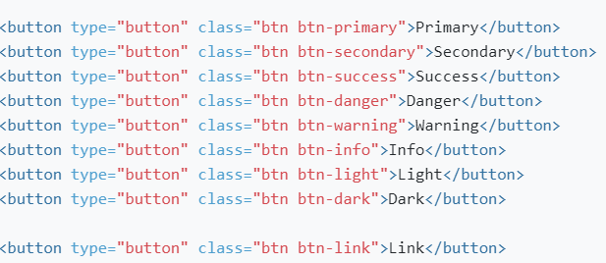
Component
button

Slide 25
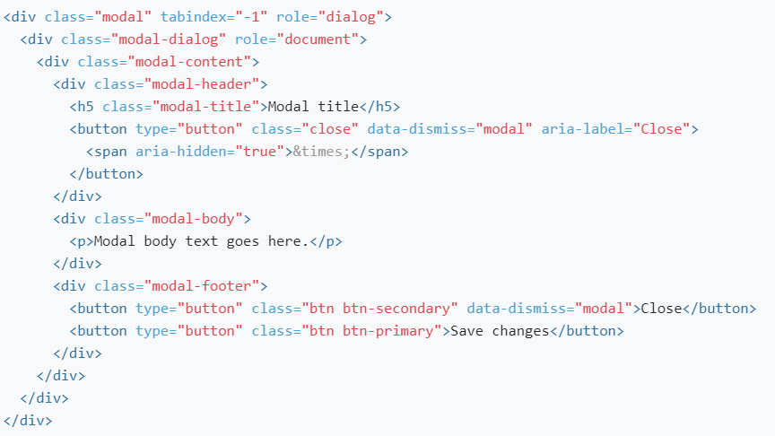
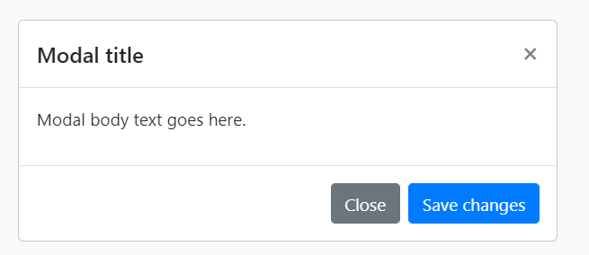
Component
Modal

Slide 26


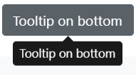
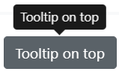
Component
Tooltip
More details

Slide 27
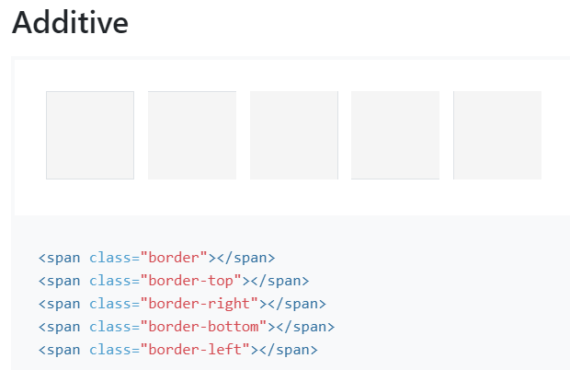
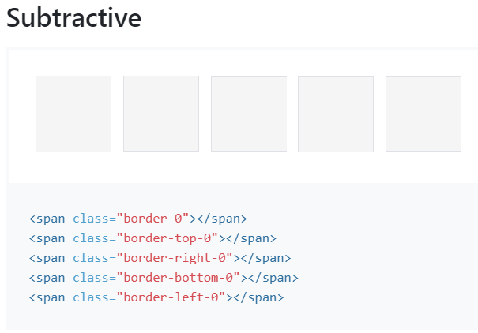
Utilities
Border

Slide 28
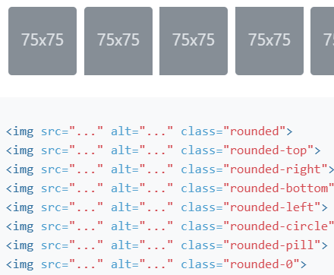
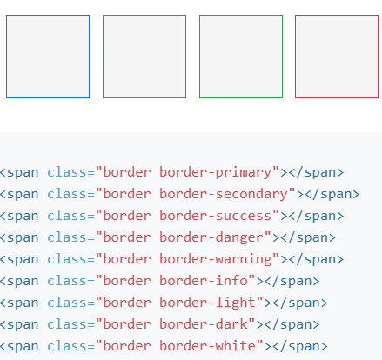
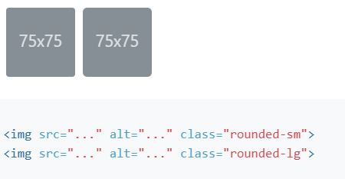
Utilities
Border

Slide 29
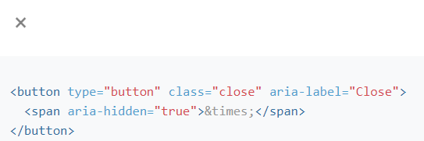
Utilities
Close Icon

Slide 30
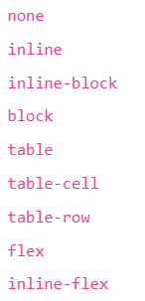

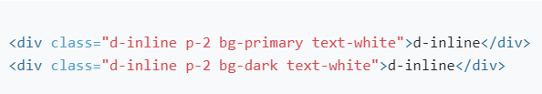
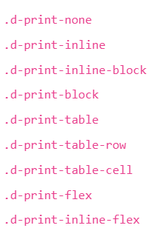

Utilities
Display
Notation
Display print

Slide 31
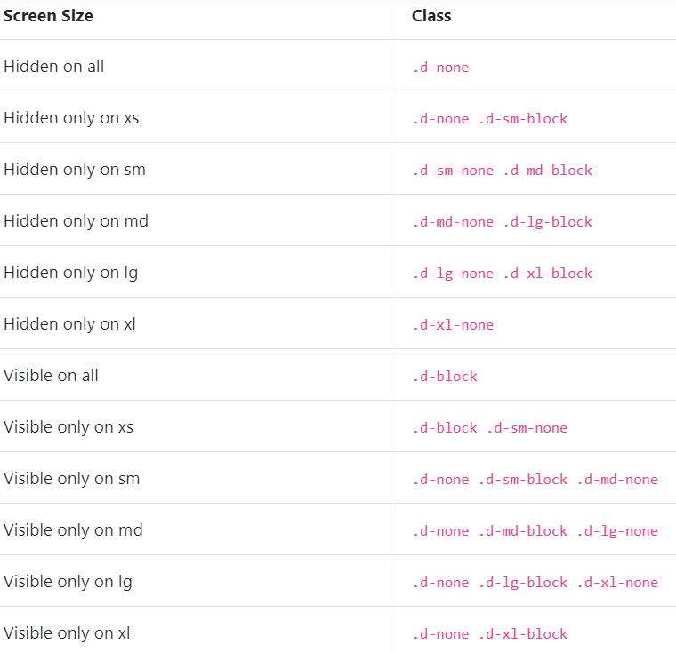
Utilities
Display
Hiding element

Slide 32
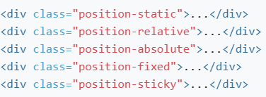
Utilities
Position
Common values
Fixed Top - fixed-top class
Fixed bottom – fixed-bottom class
Sticky top – sticky-top class
Screen readers

Slide 33

Utilities
Visibility
More details

