Slide 1
MODULE A7
Water and Supplies
How much water a job takes, and how many jobs fit in the tank
Naman Kumar · Ranu Raj · Vansh Rana · Priyanshu · Rudransh
Doorstep · Track A · Service as a Service
Notes:
Naman opens, 20 seconds. Doorstep washes cars wherever the customer already is. The van carries its own water, so the tank limits the day, not demand. Our module answers two questions: how much water will this job take, and how many jobs fit before a refill.

Slide 2
THE CONSTRAINT
Run out at job six and the rest of the day is cancelled
Capacity, not demand, is what bounds a crew's day.
262 L
200–350 L
61%
average drawn per crew-day
tank capacity across the fleet
of crew-days exceed the small van
Notes:
Naman. The three numbers do the work. Crews draw 262 litres a day, tanks hold 200 to 350, so on the small van six days in ten need a refill. That is the motivation: a single jobs-per-tank number cannot describe this.

Slide 3
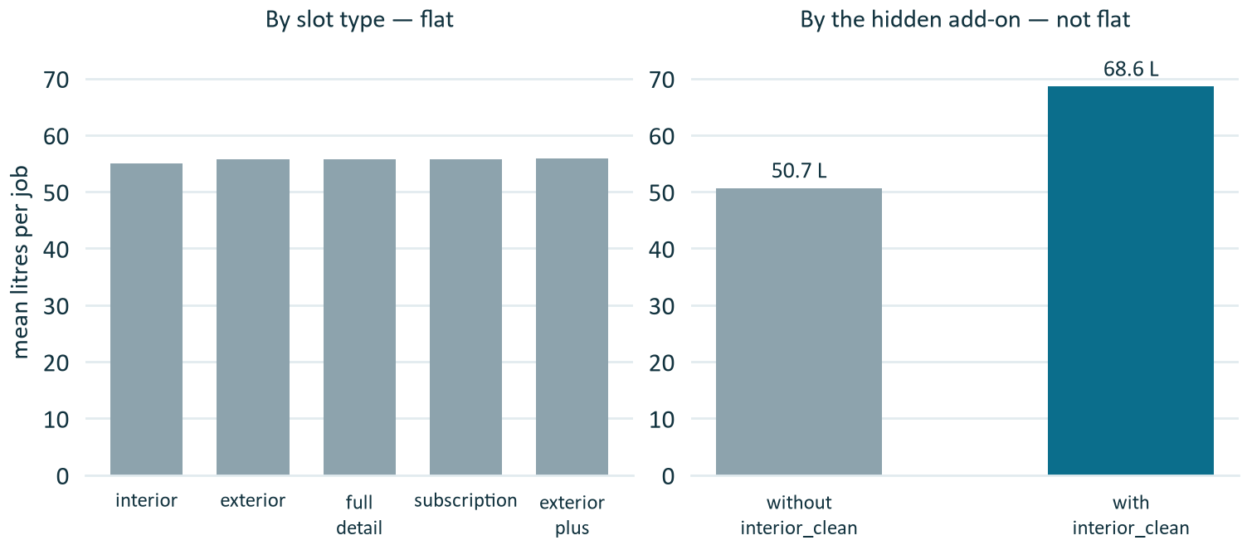
FINDING 1
The service tier tells you nothing
All five slot types average 54.9–55.8 L. The variable that actually moves water is an add-on hidden inside a pipe-separated item string.
interior_clean
27.9% of jobs
+18.0 L per job
sold across every tier
Parsed from bookings.items — not a column of its own
Key off slot_type and you miss it entirely.
39,302 completed jobs · bookings.items parsed for add-ons
Notes:
Ranu presents. The point to land: we nearly missed the second-largest effect in the data because it sat inside a delimited string rather than being exposed as a column. Left chart flat, right chart not, same jobs. Likely question: how did you find it? By exploding the items column and grouping — not from the correlation matrix.

Slide 4
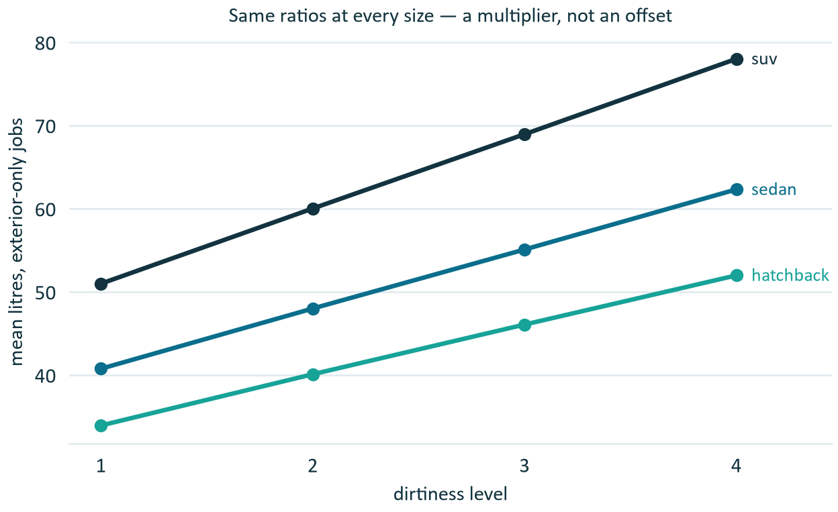
FINDING 2
Dirtiness multiplies, the add-on adds
Dirtiness scales the vehicle-size base by identical factors:
1.00 · 1.18 · 1.35 · 1.53
The interior add-on adds a flat +18 L, whatever the size or dirt.
An additive model is the wrong shape — it needs the interaction.
Exterior-only jobs · mean litres per cell
Notes:
Ranu. Short slide. The curves are parallel in ratio, not in difference — that is what multiplicative means, and the ratio table is how we saw it. Consequence in one line: we add the interaction term.

Slide 5
THE DESIGN DECISION
The best predictor arrives too late
dirtiness_level is recorded when the crew reaches the car. Nothing at booking time predicts it — not rain, not temperature, not the customer's history.
PLANNING MODEL
ON-SITE MODEL
vehicle size + interior_clean
adds dirtiness and its interaction
5.90 L
2.40 L
mean absolute error — routing, scheduling and quoting
mean absolute error — once the crew has seen the car
Notes:
Vansh, and do not rush this — the whole module rests on it. Using dirtiness at booking time would be leakage: the model benchmarks well and fails in deployment. So two models on disjoint feature sets, with a test enforcing that planning features never include dirtiness. Expect: why not predict dirtiness? We tried. It behaves as an independent draw — uncorrelated with weather, flat across months, and the same customer varies more than customers differ from each other.

Slide 6
RESULTS
Halved, then halved again
Guessing the mean costs 11.15 L. Booking-time halves it; knowing the dirt halves it again.
Every figure is the mean of ten seeds.
The on-site model is at the noise floor: within a cell, jobs scatter with sd ≈ 3 L whatever we do.
Held-out test split · mean of ten seeds · results/model_comparison.csv
Notes:
Vansh. Name the baseline before the model — the rubric rewards that specifically. Global mean 11.15 litres is what guessing gets you. Quote the spread: plus or minus 0.04 at planning, 0.014 on-site. Do not claim the on-site model could be improved; it is at the irreducible noise floor.

Slide 7
WHAT DID NOT WORK
Three model families, one answer
Cell mean, linear with interaction, and gradient boosting differ by 0.001 L. The seed-to-seed spread is 0.038 L.
The noise between splits is about forty times the gap between models.
From one split, the ranking would be an artefact of which rows landed in the test set.
We take the simplest family within 1% of the best — the cell mean — at both stages.
Notes:
Vansh. The honesty slide, and the guidebook says explicitly that it scores. We are not claiming a win; we are claiming we cannot tell the models apart, and we can only say that because we ran ten seeds. Expect: why build the complex models? To establish the simple one is sufficient. That is a result, not a failure.

Slide 8
DELIVERABLE 1
Mean arithmetic overstates the tank
Dividing capacity by the 55.7 L mean gives 3 / 5 / 6 jobs. Those loads fit:
91% 53% 70%
of the time — load the EV van for five and it runs dry every second day.
A capacity figure without a service level is not a usable number.
20,000 resampled crew-days · identical under all ten seeds · results/tank_capacity.csv
Notes:
Priyanshu. One of the two required deliverables. The trap: 280 divided by 55.7 equals five looks obviously right and is obviously wrong — it throws away the spread. We resample 20,000 crew-days instead. Add that 2/4/5 is identical under all ten resampling seeds, so it is a property of the distribution, not of one draw.

Slide 9
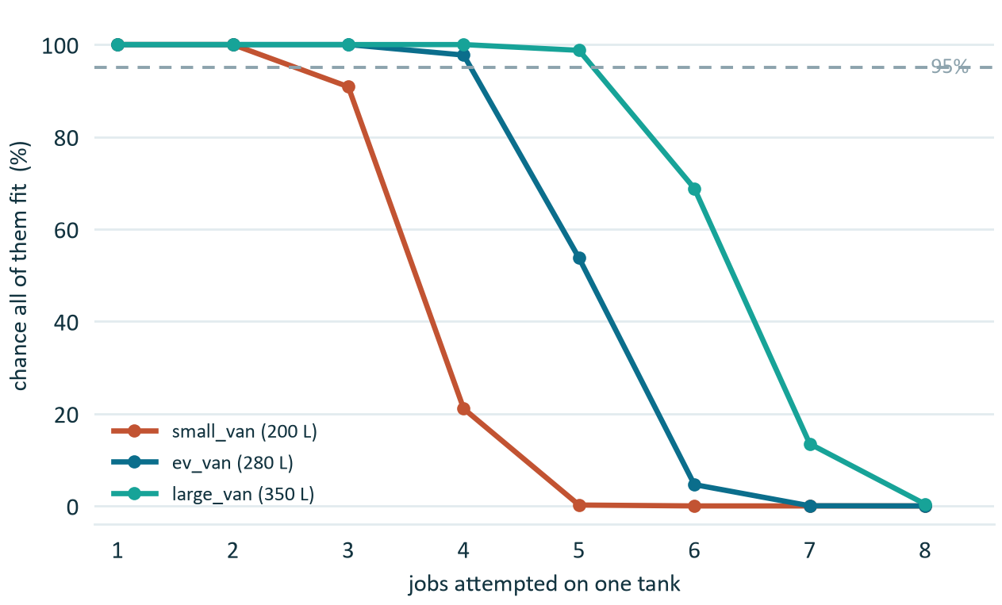
DELIVERABLE 2
One tank does not cover a working day
Mean refills needed per crew-day
0.88 · 0.45 · 0.26
200 L 280 L 350 L
A fifth of small-van days need two or more. For fleet sizing that is the difference — not jobs per fill.
8,342 crew-days · results/refill_planning.csv
Notes:
Priyanshu. A single jobs-per-tank number hides the real constraint. We count refills by walking each crew-day in arrival order and topping up before any job the remaining water cannot cover. This is the number A12 needs for fleet sizing, and it is in INTEGRATION.md.

Slide 10
THE SURPRISE
Optimising the plan made it fail more often
Exact knapsack captures 13 points more revenue than booked order — and doubles the rate of running dry.
Packing to the limit spends the slack that was absorbing prediction error.
Planning on the interval's upper bound removes it entirely, for about ten points of throughput.
200 L van · results/tank_plan.csv
Notes:
Priyanshu — spend time here, it is the most interesting result we have. We expected a better optimiser to be strictly better. It is not: the exact knapsack doubles the failure rate against simply serving in booked order, because tight packing consumes the slack that was quietly absorbing prediction error. The fix is to feed the optimiser the interval instead of the point estimate. If asked whether this is known: yes, Elmachtoub and Grigas, Smart Predict-then-Optimize — though their uncertainty sits in the objective and ours is in the constraint. Also note greedy reaches 99% of the exact solution, so we built the knapsack mainly to prove greedy was enough.

Slide 11
SUSTAINABILITY
The green claim, stated honestly
Doorstep uses 55.7 L per job, all of it freshwater — a van cannot reclaim.
WHAT WE CAN CLAIM
WHAT WE CANNOT
25% of a home hose left running
22% of an unreclaimed conveyor
49% of the measured conveyor fleet
Level with a self-service bay
189%
of a reclaim-equipped tunnel. It uses about half what we do per car, and the gap is structural — reclaim needs captured runoff, which a driveway cannot give.
EPA WaterSense 2012 · International Carwash Association 2018 · Zaneti et al. 2013
Notes:
Rudransh. Every figure is cited — EPA WaterSense, the International Carwash Association, and Zaneti et al., who audited a reclamation plant needing under 40 litres of fresh water per wash. That corroborates our result from outside our own data. The right-hand card is what earns marks: we are telling the examiner where our own product loses. INTEGRATION.md records what other teams may and may not claim on our behalf.

Slide 12
WHAT WE WOULD TELL THE COMPANY
Three recommendations
1
Quote capacity with a service level
2 / 4 / 5 jobs at 95% — never a bare number
2
Plan on refills, not jobs per tank
0.88 / 0.45 / 0.26 interruptions per crew-day
3
Feed the optimiser the interval
the point estimate doubles the rate of running dry
Biggest open gap: if A14's photo check can grade dirt at booking, our planning error halves — from 5.90 L to 2.40 L.
Notes:
Naman closes. Three recommendations, then the open gap — a good note to end on because it points at another team and shows we understand the system. Then questions. Reminder for all five: everyone is asked individually, so know the file you own line by line and roughly what the others built.

