Slide 1

SILVER OAK UNIVERSITY
EDUCATION TO INNOVATION
COLLEGE OF COMPUTER APPLICATION(04) Program Name: Bachelor of Computer Application
Department Name: BCA
Department Code: 023
Subject Name: Computer Network Subject Code: 2040233206
Academic Year: 2023-24
UNIT-1
1. Network Definition:
A network is a collection of interconnected devices or nodes that can communicate with each other to share resources, information, and services. Networks can be as small as a local area network (LAN) within a single building or as vast as the internet, connecting devices globally.
2. Network Topologies:
• Network Topology is the schematic description of a network arrangement, connecting various nodes (sender and receiver) through lines of connection.
• Network Topology is the arrangement with which computer systems or network devices are connected to each other.
Types of network topologies:-
1. Bus
2. Star
3. Ring
4. Mesh
5. Hybrid

Slide 2


Bus Topology:
It is a network type in which every computer and network device is connected to a single cable.
Bus Topology
Features:
• It transmits data only in one direction.
• Every device is connected to a single cable.
Advantage
• It is cost effective (cheaper).
• Cable required is least as compared to other network topology.
• Used in small networks.
• It is easy to understand.
• Easy to expand joining two cables together.
Disadvantage
• Cables fail than the whole network fails.
• If network traffic is heavy or nodes are more the performance of network decreases.
• Cable has a limited length.
Star Topology:

Slide 3
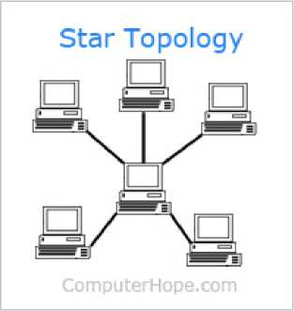
In this type of topology, all the computers are connected to a single hub through a cable. This hub is the central node and all other nodes are connected to the central node.
Features:
• Every node has its own dedicated connection to the hub.
• Acts as a repeater for data flow.
• Can be used with twisted pair, Optical Fibre or coaxial cable.
Advantages:
• Fast performance with few nodes and low network traffic.
• Hub can be upgraded easily.
• Easy to troubleshoot.
• Easy to set up and modify.
• Only that node is affected which has failed rest of the nodes can work smoothly. Disadvantage:
• Cost of installation is high.
• Expensive to use.
• If the hub is affected than the whole network is stopped because all the nodes depend on the hub.
Ring Topology: Each device is connected to exactly two other devices, forming a ring.

Slide 4
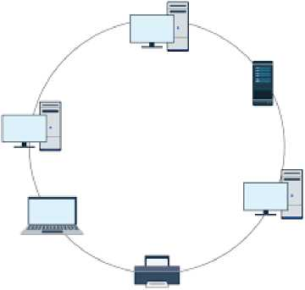
Features:-
• A number of repeaters are used and the transmission is unidirectional.
• A data is transferred in a sequential manner that is bitten by bit.
Advantages:
• Transmitting network is not affected by high traffic or by adding more nodes, as only the nodes having tokens can transmit data.
• Cheap to install and expand.
Disadvantage
• Troubleshooting is difficult in a ring topology.
• Adding or deleting the computer can disturb the network activity.
Mesh Topology:
• It is a point-to-point connection to other nodes and devices.
• Traffic is carried out between two devices or nodes to which it is connected.

Slide 5
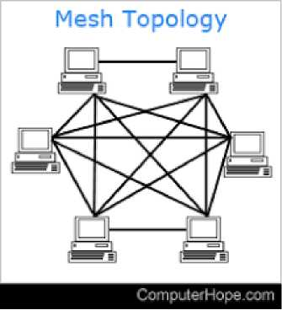
Features:
• Fully connected
• Robust
• Not flexible
Advantages:
• Each connection can carry its own data load.
• It is robust.
• A fault is diagnosed easily.
• Provides security and privacy.
Disadvantage:
• Installation and configuration are difficult.
• Cabling cost is more.
• Bulk wiring is required.
Hybrid Topology: Combination of two or more different topologies.

Slide 6
Hybrid Topology - II
■ Advantages: | ■ Disadvantages:
ª Used for creating larger networks | ª Installation and configuration is difficult
a Handles large volume of traffic | ª More expensive than other topologies
ª Fault detection is easy | □ More cabling is required

Slide 7
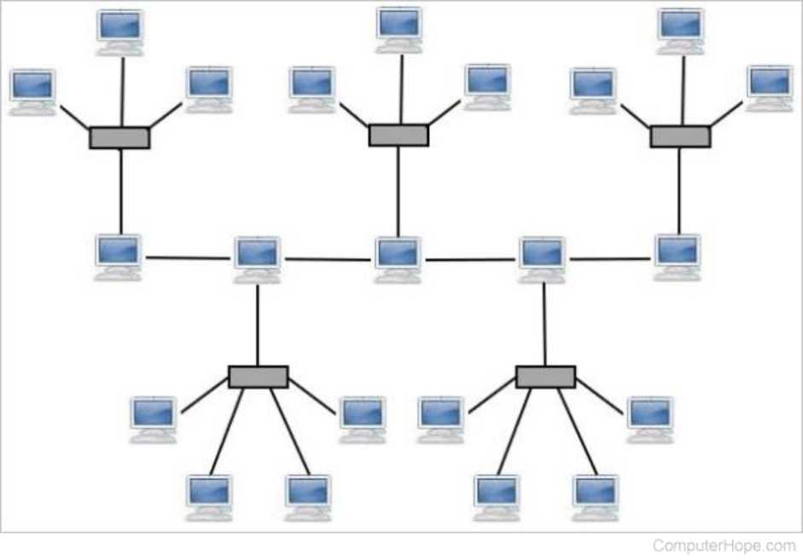
3. Computer Network:
A Computer Network is a system in which multiple computers are connected to each other to share information and resources.
The physical connection between networked computing devices is established using either cable media or wireless media.
The best known computer network is the internet.

Slide 8
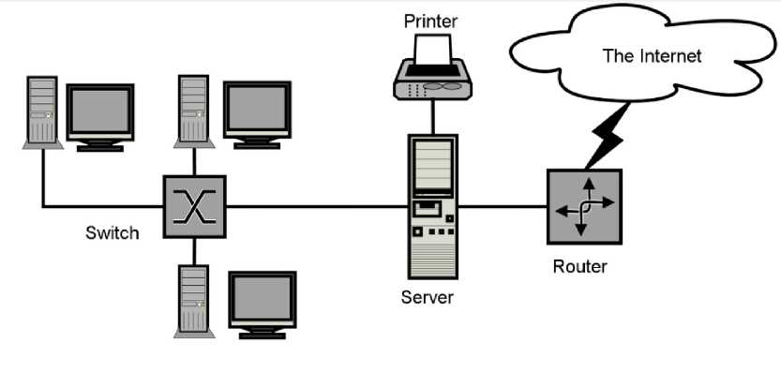
Advantages of Computer Network
1. File Sharing
Major advantage of computer network is that allows file sharing and remote file access.
A person sitting at one workstation that is connected to a network can easily see files present on another workstation, provided he is authorized to do so.
2. Resource Sharing
All computers in the network can share resources such as printer, fax machine, modems and scanner.
3. Better connectivity and Communication
It allows users to connect and communicate with each other easily. Various communication application included email and groupware are used.
4. Internet Access
Computer networks provide internet service over the entire network. Every single computer attached to the internet can experience high speed internet.
5. Entertainment
Many games and other means of entertainment are easily available on the internet. Furthermore, Local Area Networks (LANs) offers and facilitates other ways of enjoyments, such as many players are connected through LAN and play a particular game with each other from a remote location.
6. Inexpensive System
Shares resources means reduction in hardware costs. Shared files means reduction in memory requirement, which indirectly means a reduction in file storage expenses. A particular software can be installed only once on the server and made available across all connected computers at once. This saves the

Slide 9
expense of buying and installing the same software as many times for as many users.
7. Flexible Access
A user can log on to a computer anywhere on the network and access his files. This offers flexibility to the user as to where he should be during the course of his route.
8. Instant and multiple access
Computer networks are multiple processes. Many users can access the same information at the same time. Immediate commands such as printing command can be made with the help of computer network.
Disadvantages of Computer Network
1. Lack of data security and privacy
Because there would be a huge number of people who would be using a computer networks to get and share some of their files and resources, a certain user security would be always at risk. There might even be illegal activities that would occur which you need to be careful about and aware of.
2. Presence of computer viruses and malware
If even one computer on a network gets affected by a virus, there is a possible threat for the other systems getting affected too. Viruses can spread on a network easily, because of the interconnectivity of workstations. Moreover, multiple systems with common resources are perfect breeding ground for viruses that multiply.
3. Lack of independence
Since most networks have a centralized server and dependent clients , the client user lack any freedom whatsoever. Centralized decision making can sometimes hinder how a client user wants to use his own computer.
4. Lack of Robustness
As previously stated, if a computer network's main server breaks down, the entire system would become useless. Also, if it has a bridging device or central linking server that fails, the entire network would also come to a standstill.
5. Need an efficient handler
For a computer network to work efficiently and optimally, it requires high technical skills and know-how of its operations and administration. A person just having basic skills cannot do this job. Take note that the responsibility to handle such a system is high, as allotting permissions and passwords can be daunting. Similarly network configuration and connection is very tedious and cannot be done by a average technician who does not have advanced knowledge.

Slide 10
Applications of Computer Network
1. Financial Services
Nowadays almost all the financial services depend on the computer network. You can access the financial services across the world. For example, a user can transfer money from one place to another by using the electronic fund transfer feature. We can use networking in various financial areas such as ATM, foreign exchange and credit history search.
2. Business
Nowadays most of the works of businesses are done over the computers. To exchange data and ideas, you need effective data and resources sharing features. To do this, you need to connect the computer with each other through the network. For example, a person of one department of an organization can share or access the electronic data of other departments through a network.
3. Email Services
A computer network provides you the facility to send or receive emails across the globe in few seconds.
4. Mobile Applications
By using mobile applications, such as cellular or wireless phones, you can communicate (exchange your views and ideas) with one other.
5. Directory Services
It provides you the facility to store files on a centralized location to increase the speed of search operation worldwide.
6. Teleconferencing
It contains voice conferencing and video conferencing which are based on learning. In teleconferencing, the participants need not be presented at the same location.
Types of Computer Network LAN (Local Area Network)
1. It is privately-owned networks within a single building or campus of up to a few kilometers in size.
2. They are widely used to connect personal computers and workstations in company offices and factories to share resources (e.g., printers) and exchange information.
3. LANs are easy to design and troubleshoot.
4. In LAN, all the machines are connected to a single cable.
5. Different types of topologies such a Bus, Ring, Star, and Tree are used.

Slide 11
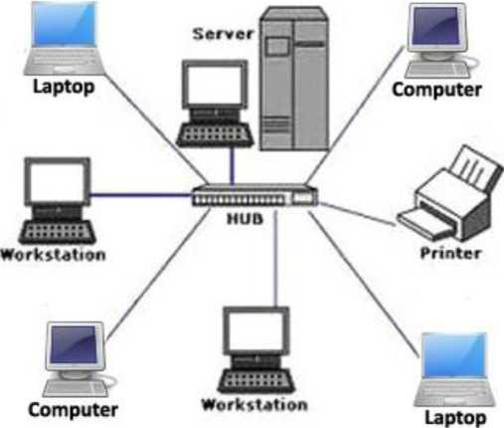
6. The data transfer rates for LAN is up to 10 Gbits/s.
7. They transfer data at high speeds. The high transmission rate is possible in LAN because of the short distance between various computer networks.
8. They exist in limited geographical area.
Advantages
1. LAN transfers data at high speed.
2. LAN technology is generally less expensive.
Local Area Network
MAN (Metropolitan Area Network)
1. MAN is a larger version of LAN which covers an area that is larger than the covered by LAN but smaller than the area covered by WAN.
2. A metropolitan area network or MAN covers a city. The best-known example of MAN is the cable television network available in many cities.
3. MAN connects two or more LANs.
4. At first, the companies began jumping into the business, getting contracts from city governments to wire up an entire city.
5. The next step was television programming and even entire channels designed for cable only.

Slide 12
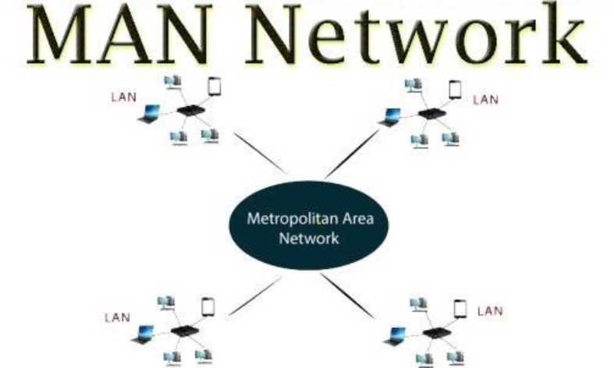
WAN (Wide Area Network)
1. It spans a large geographical area, often a country or a region.
2. WAN links different metropolitan's countries and national boundaries thereby enabling easy communication.
3. It may be located entirely within a state or a country or it may be interconnected around the world.
4. It contains a collection of machines intended for running user (i.e., application) programs. We will follow traditional usage and call these machines hosts.
5. The communication between different users of LAN is established using leased telephone lines or satellite links and similar channels.

Slide 13
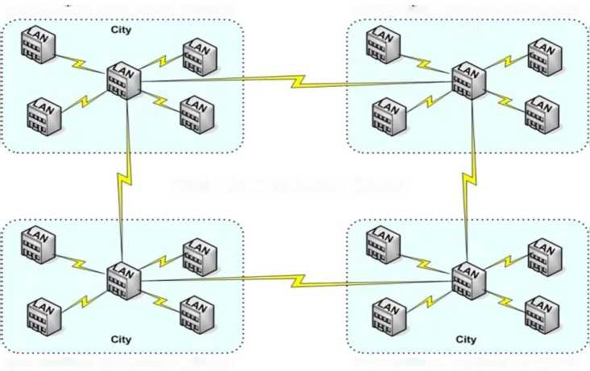
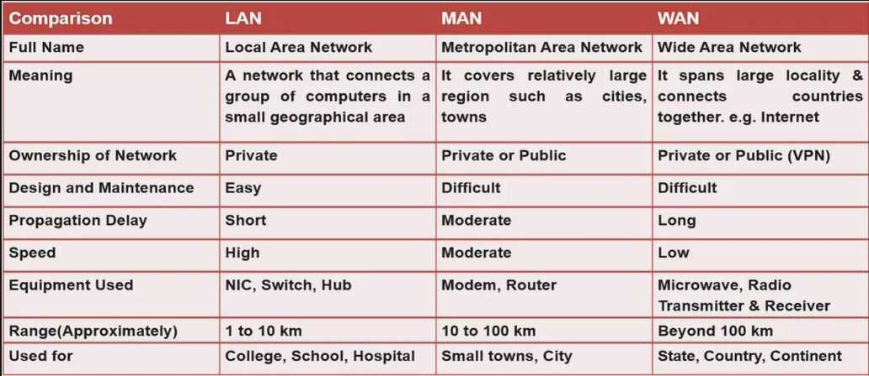
Metropolitan Area Network (MAN)
Metropolitan Area Network (MAN)
City
Wide Area Network (WAN)
Metropolitan Area Network (MAN)
Metropolitan Area Network (MAN)

Slide 14
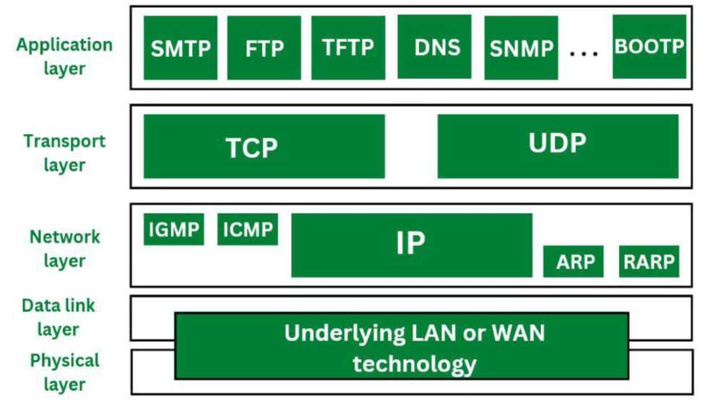
Network Protocol:
A network protocol is a set of rules and conventions that govern communication between devices in a network. Examples include TCP/IP, HTTP, FTP, and SMTP. Protocols ensure standardized communication and data exchange.
5. Layered Network Architecture:
Networks are often organized into layers, each responsible for specific functions. The OSI (Open Systems Interconnection) model and TCP/IP model are examples of layered architectures.
6. OSI Reference Model:
The OSI model consists of seven layers:
Physical Layer: Deals with the physical connection between devices.
Data Link Layer: Manages data transfer between devices on the same network. Network Layer: Handles routing and forwarding of data packets.

Slide 15
Transport Layer: Ensures reliable data delivery.
Session Layer: Manages communication sessions.
Presentation Layer: Deals with data translation, encryption, and compression. Application Layer: Provides network services directly to applications.

Slide 16
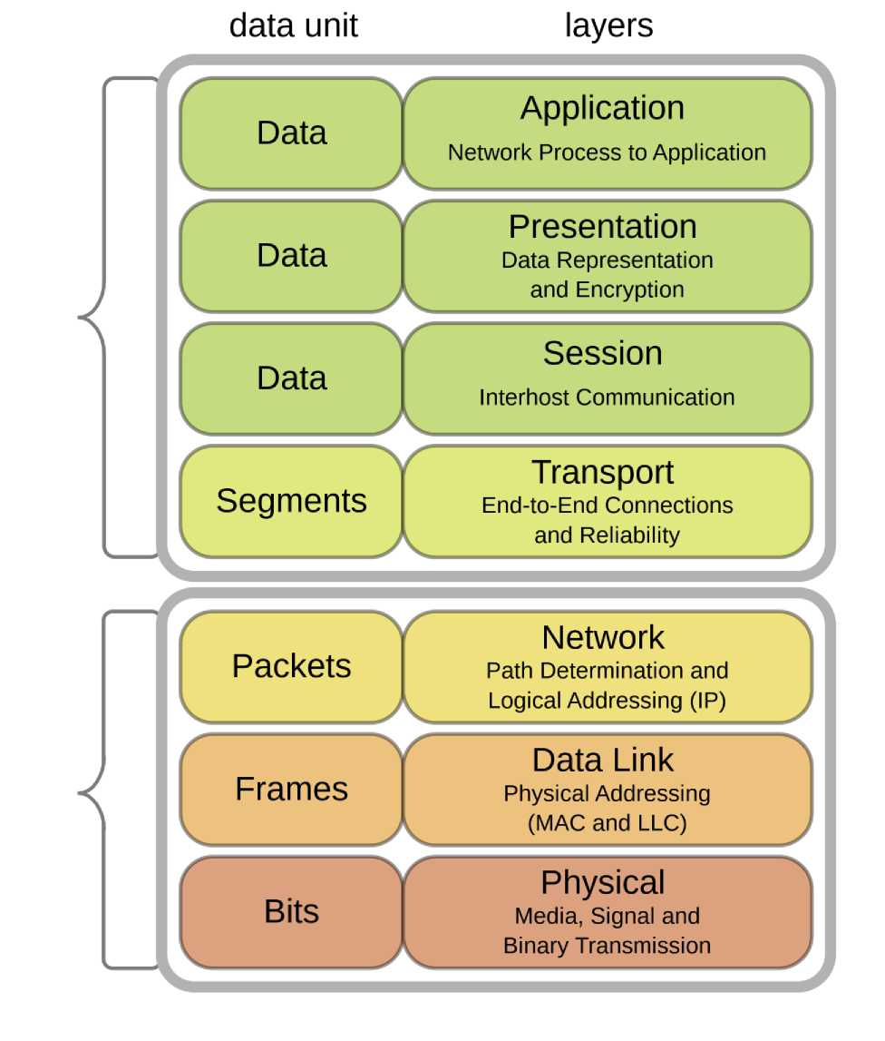

Slide 17
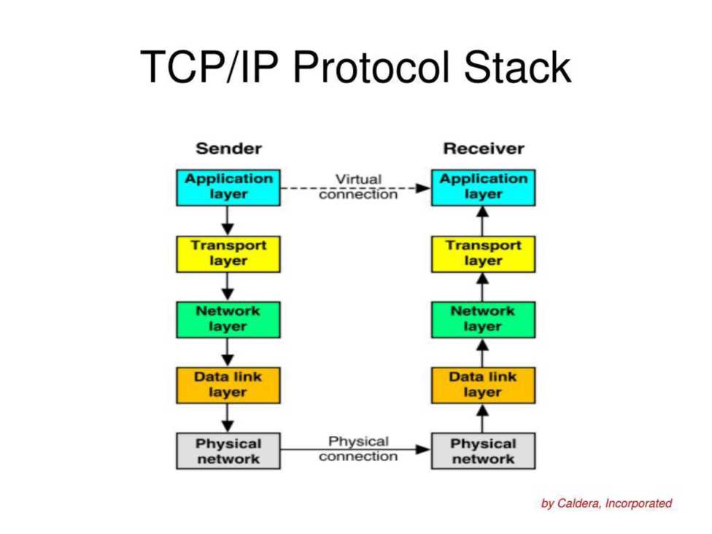
7. TCP/IP Protocol Suite:
The TCP/IP model is a conceptual model used for the internet and consists of four layers:
Application Layer Transport Layer Internet Layer Link Layer

Slide 18
Difference between TCP/IP PROTOCOL STACK AND OSI Model-
Parameters | OSI Model | TCP/IP Model
No. of Layers | There are 7 layers. | There are 4 layers.
Acronyms | OSI stands for open system interconnection. | TCP/IP stands for transmission control protocol/intemet protocol
Developed by | ISO | Department of Defense (DoD)
Layer Separation | OSI model has a separate Presentation layer and Session layer. | TCP/IP does not have a separate Presentation layer or Session layer.
Protocol implementation | Model was defined before implementation takes place. | Model defines after protocol were implemented.
Model Concept | based on three concept i.e. Service, interface and protocol. | It did not distinguish between service, interface and protocol.
Reliable delivery | It gives guarantee of reliable delivery of packet. | It does not give guarantee of reliable delivery of packet.
8. Networking Devices:
Hub: Connects multiple Ethernet devices, broadcasting data to all ports.
Switch (Managed and Unmanaged): Forwards data to specific devices based on MAC addresses, reducing network congestion. Managed switches offer more control and features.
Router: Connects different networks, directing data between them based on IP addresses.
These elements form the fundamental building blocks of computer networks, facilitating communication and data exchange among devices in various configurations and sizes.

