Slide 1
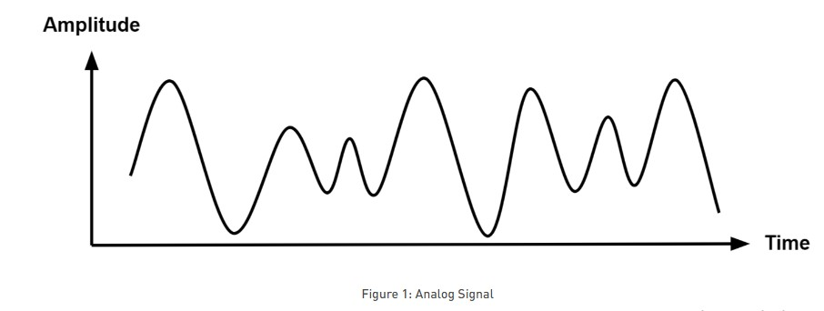
Analog Signals and Digital Signals
Signal is an electromagnetic or electrical current that carries data from one system or network to another.
There are two main types of signals used in electronics: analog and digital signals.
Analog Signal An analog signal is time-varying and generally bound to a range (e.g. +12V to -12V), but there is an infinite number of values within that continuous range.

Slide 2
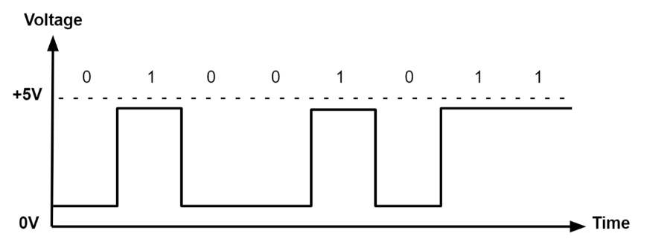
Digital Signal
A digital signal is a signal that represents data as a sequence of discrete values. A digital signal can only take on one value from a finite set of possible values at a given time. With digital signals, the physical quantity representing the information can be many things:
Variable electric current or voltage
Phase or polarization of an electromagnetic field
Acoustic pressure
The magnetization of a magnetic storage media

Slide 3
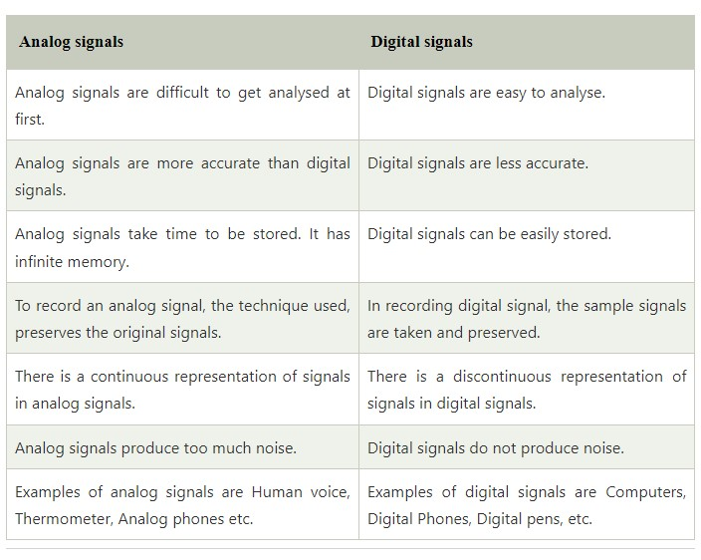
Analog Vs Digital Signal

Slide 4
Data Rate limits
Data rate refers to the speed of data transfer through a channel. It is generally computed in bits per second (bps). Higher data rates are expressed as Kbps ("Kilo" bits per second, i.e.1000 bps), Mbps ("Mega" bits per second, i.e.1000 Kbps), Gbps ("Giga" bits per second, i.e. 1000 Mbps) and Tbps ("Tera" bits per second, i.e. 1000 Gbps).
One of the main objectives of data communications is to increase the data rate. There are three factors that determine the data rate of a channel:
Bandwidth of the channel
Number of levels of signals that are used
Noise present in the channel

Slide 5
Digital to Digital Line Coding Schemes
The process of converting the digital data into digital signal is called as line coding
It helps the receiver to get the original bits.
The data that is in the form of text, numbers, audio, or video is represented internally as series of 1s and 0s.
Line coding therefore transforms a set of bits into a digital signal.
The sender side encrypts digital data into digital signals, while the receiving side decodes the digital signal to regenerate the digital data.
The primary goal of utilizing line coding is to prevent the overlapping of pulses and distortions. The digital signal is discreet in nature. Example is sending data from computer to printer.

Slide 6
Digital to Digital Line Coding Schemes
There are basically three different types of line coding technique:
•Unipolar
•Polar
•Bipolar
Unipolar
In Unipolar encoding, only one polarity is used i.e., bit 1 is used to represent positive voltage and bit 0 is used to represent zero voltage or idle line. It is also known as Unipolar-Non-return-to-zero. Signaling of this kind is also referred to as on-off signaling.

Slide 7
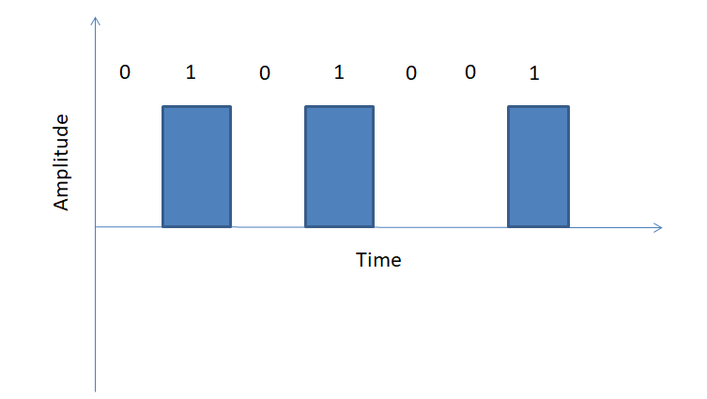
Digital to Digital Line Coding Schemes
Problem in Unipolar
•DC Component: When we find out the average amplitude of a unipolar signal, then the value would always be non-zero because of which it creates DC component. And the signal having DC component is not able to travel through the medium which cannot handle DC component.
•Synchronization: When a signal is constant, the receiver cannot distinguish between the start and finish of each bit. For that the receiver has to rely on a timer to track the starting of each bit.

Slide 8
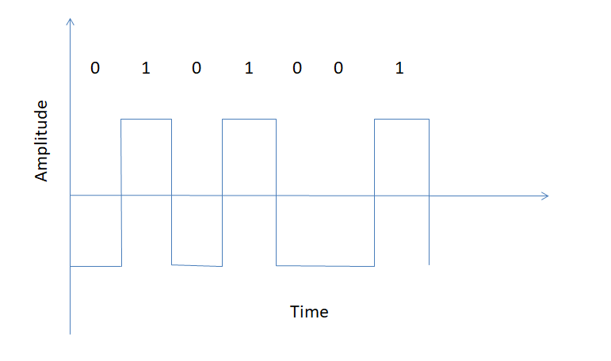
Polar
The polar encoding is of four types.
In polar encoding two levels of voltage amplitude is used. The DC component issue of unipolar encoding is minimized, and the average voltage level on the line is decreased.
•Polar Non-Return to Zero (Polar NRZ): In polar encoding, positive voltage is represented by bit 1 and negative voltage is represented by bit 0. Here two levels of voltage are used to represent binary values. If the line is idle, then there is no transition. With each inversion, the receiver is able to synchronize the timer’s start to the transmission’s real arrival. Again, Polar Non-Return to Zero (Polar NRZ) has two types: NRZ-L and NRZ-I.
NRZ-L: Changes its voltage level when different bit is encountered.

Slide 9
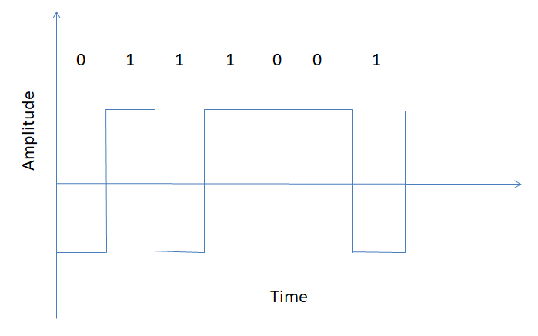
NRZ-I: Changes its voltage level when bit 1 is encountered.
.

Slide 10
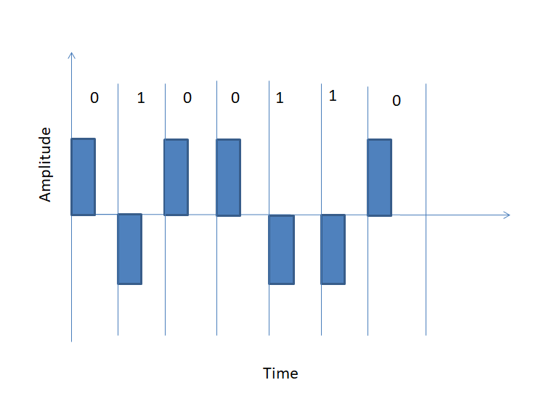
Advantages of Polar NRZ
This provides synchronization as whenever a 1 bit is encountered, the signal changes.
•Return to Zero (RZ): This encoding technique uses three different voltage level to represent binary values. Bit 1 is used to represent positive voltage, bit 0 is used to represent negative voltage and zero voltage for none. During the second half of each bit, this signal enters a resting state(zero).
Problems in Return to Zero
This occupies more bandwidth as it requires two signal changes to encode one bit.
Return to Zero (RZ)

Slide 11
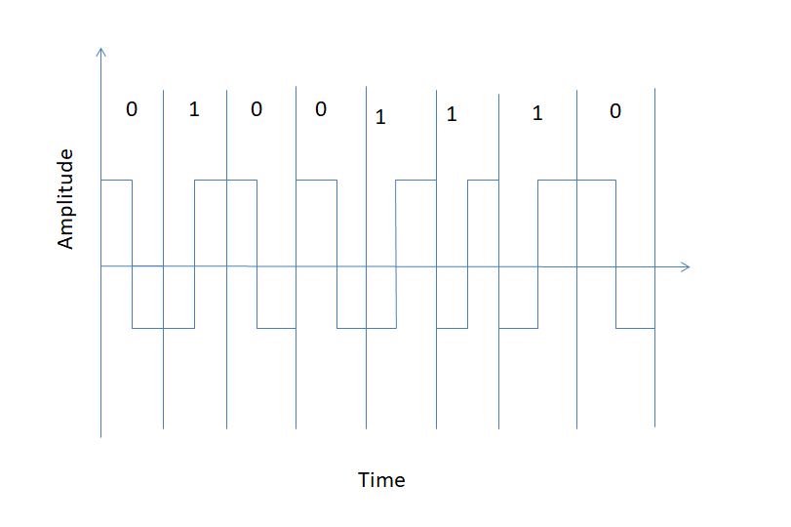
Manchester Encoding:
• In Manchester encoding negative to positive transition represents binary 1 and positive to negative represents binary 0. Use the inversion at the middle of each bit interval. That means bit period is represented by two equal size intervals. Here the logic level of bit is represented by the first interval and the inverse logic level is represented by the second interval.
Manchester encoding

Slide 12
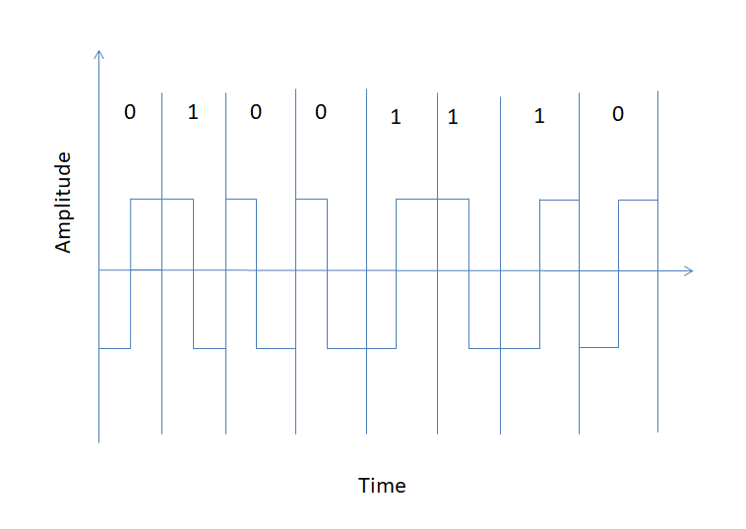
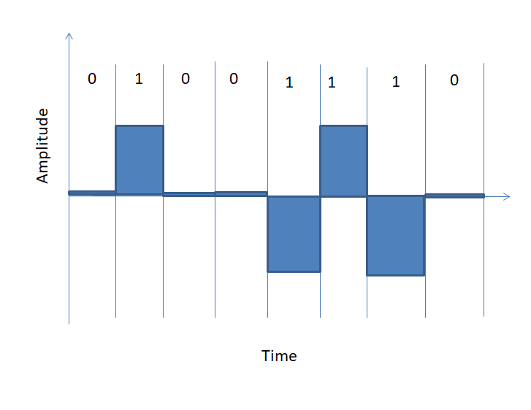
Differential Manchester
In Differential Manchester, the inversion at the middle of the bit is used. Transition is represented by binary 0 and no transition is represented by binary 1.
Bipolar Encodinng Different Manchester
Bipolar Encoding
In Bipolar encoding, three types of different voltage level is used that is positive, negative and zero. The zero level is used to represent binary 0, positive and negative voltage represents alternatives 1’s to prevent DC component. Alternate Mark Inversion (AMI) and Pseudoternary are the types of bipolar encoding.

Slide 13
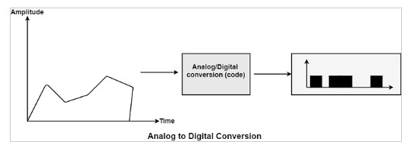
Analog to Digital Conversion
When an analog signal is digitalized, that is known as analog-to-digital conversion. Consider a human address a voice in the structure of an analog signal. We require to digitalize the analog signal that is smaller inclined to noise. It needed a decrease in the several values in an analog message defined in the digital flow.

Slide 14
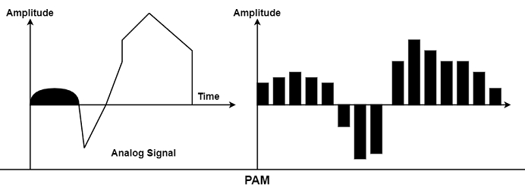
Methods for Analog-To-Digital Conversion
The various methods for Analog-to-Digital conversion are as follows −
PAM
The first phase in analog to digital conversion is known as PAM. PAM represents pulse amplitude modulation. This method creates an analog signal, samples it, and creates digital pulses sequences based on sampling. The sampling method used in PAM is more helpful to other manufacturing fields than data communication. PAM is the infrastructure of an essential analog-to-digital conversion method known as pulse code modulation (PCM).
In PAM, the initial signal is sampled at the same intervals, as display in the figure. PAM uses a method known as a sample and hold.

Slide 15
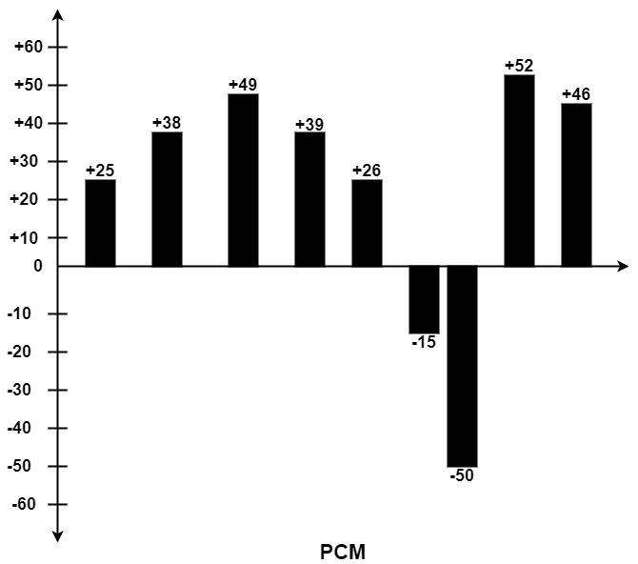
PCM
PCM represents Pulse Code Modulation. PCM method can change the pulses generated by PAM to develop a completely digital signal. To manage this, PCM first measures the PAM pulses. Quantization is a technique of authorizing integral values in a particular area to sampled instances. The outcome of quantization is shown in the figure.

Slide 16

The figure displays a simple method of creating sign and magnitude costs to quantized samples. Each cost is interpreted into a six-bit binary proportionate. The seventh bit denoted the sign. Quantizing using sign and magnitude. +25 0011001 +39 0100111 -50 1110010 +38 0100110 +26 0011010 +52 0110100 +49 0110001 -15 1001111 +46 0101110 Where sign bit for + is 0 and for – is 1. Sampling Rate
As shown in the previous figure, the efficiency of any digital recreation of an analog signal depends on the several samples taken. Using PAM and PCM, we can recreate the waveform precisely by creating infinite samples, or we can make the barest generalization of its direction of change by creating three samples of +24, +48, and +50.

Slide 17
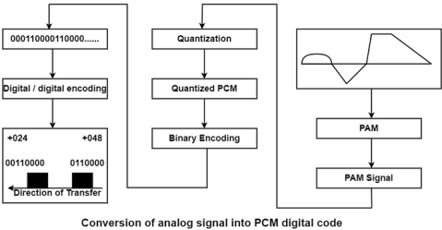
From analog signal to PCM digital code −

Slide 18
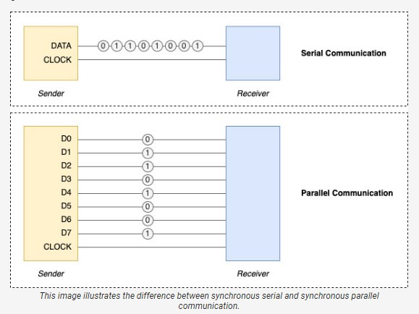
Serial and Parallel Transmission

Slide 19
Serial and Parallel Transmission
Data transmission is the process of data delivery between two or multiple digital devices. The data is transmitted between digital systems using one of two methods: Serial or Parallel Transmission. They have some commonalities and some differences. The main distinction between these transmissions is that the data is transferred bit by bit in Serial Transmission. Still, in Parallel Transmission, the data is sent one byte (8 bits) or character at a time. The main similarity between these transmissions is that both transmissions are utilized to connect and interact with other devices. In addition, parallel transmission is time-sensitive, but serial transmission is not.
What is Serial Transmission?
In Serial transmission, the data is delivered bit by bit from one computer system to another via bi-directional where each bit has its own clock pulse rate. In Serial Transmission, 8 bits are transferred at a time, with a start and stop bit (i.e., referred to as a Parity bit), which are 0 and 1. In this transmission, serial data cables are utilized to send data across extended distances. In this transmission, the data is delivered in proper order. It is made out of a 9-pin cable with a D-shaped that links data in series.

Slide 20
Types of Serial Transmission
There are mainly two types of serial transmission. These are as follows:
1. Asynchronous Serial Transmission
Asynchronous transmission adds an extra bit to every byte to notify the recipient of the appearance of new data. Typically, the start bit is 0, and the stop bit is 1.
2. Synchronous Serial transmission
There is no extra bit added in synchronous transmission; rather, data is conveyed in the form of frames that comprise numerous bytes.
The serial transmission system cannot function without the installation of hardware at the transmitting and receiving ends. The hardware at the sending and receiving ends can transfer data from the device's parallel mode to serial mode.

Slide 21
Advantages and Disadvantages of the Serial Transmission
Advantages
It is very cost-effective.
It can be utilized for long-distance communication.
It is more reliable and stable than other transmissions.
Disadvantages
The transmission rate of data is low.
Its throughput depends on the bit rate.

Slide 22
What is Parallel Transmission?
Parallel Transmission involves the simultaneous transfer of numerous bits from one computer system to another. It is quicker to send the bits and is utilized for short distances. It is also advantageous because it conforms to the underlying hardware, as electronic equipment such as computers and communication systems employ parallel circuits inside. The parallel interface works well in conjunction with the internal hardware.
The installation and problem resolution are simple because it is placed in a single physical cable and utilizes a 25-pin port containing 17 signal lines and 8 ground lines. The 17 single lines are divided into 4 lines for initiating handshaking, 5 lines for communicating and notifying errors, and 8 for data transfer.

Slide 23
Advantages and Disadvantages of the Parallel Transmission
Advantages
It may transmit N bits simultaneously. A parallel interface can perform N times faster than a serial interface.
The data can be sent from a computer to a printer using the parallel transmission. The printer is connected to the computer's parallel port, and a parallel cable with numerous wires can connect the printer to the computer. It is a highly rapid way of data transport.
The data is transmitted significantly more quickly in parallel transmission.
It works well for short-distance communication.
The set of bits is transferred at the same time.
Disadvantages
Multiple communication channels are required in parallel transmission.
N communication lines must be utilized to transfer the data stream, and this n number of wires must be used.
It is costly, so it is usually confined to small distances.
The wire thickness must be raised to reduce signal loss when transmitting data over long distances.

Slide 24
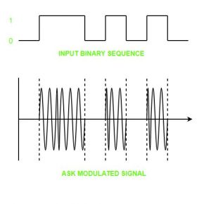
Digital to Analog Modulation
Digital Signal – A digital signal is a signal that represents data as a sequence of discrete values; at any given time it can only take on one of a finite number of values. Analog Signal – An analog signal is any continuous signal for which the time varying feature of the signal is a representation of some other time varying quantity i.e., analogous to another time varying signal. The following techniques can be used for Digital to Analog Conversion: 1. Amplitude Shift keying – Amplitude Shift Keying is a technique in which carrier signal is analog and data to be modulated is digital. The amplitude of analog carrier signal is modified to reflect binary data. The binary signal when modulated gives a zero value when the binary data represents 0 while gives the carrier output when data is 1. The frequency and phase of the carrier signal remain constant.

Slide 25
Advantages of amplitude shift Keying – • It can be used to transmit digital data over optical fiber. • The receiver and transmitter have a simple design which also makes it comparatively inexpensive. • It uses lesser bandwidth as compared to FSK thus it offers high bandwidth efficiency. Disadvantages of amplitude shift Keying – • It is susceptible to noise interference and entire transmissions could be lost due to this. • It has lower power efficiency.

Slide 26
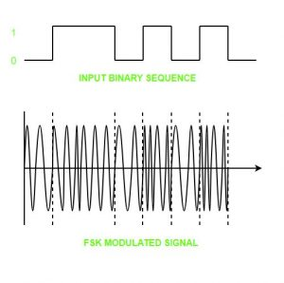
Frequency Shift keying – In this modulation the frequency of analog carrier signal is modified to reflect binary data. The output of a frequency shift keying modulated wave is high in frequency for a binary high input and is low in frequency for a binary low input. The amplitude and phase of the carrier signal remain constant.

Slide 27
Advantages of frequency shift Keying – • Frequency shift keying modulated signal can help avoid the noise problems beset by ASK. • It has lower chances of an error. • It provides high signal to noise ratio. • The transmitter and receiver implementations are simple for low data rate application. Disadvantages of frequency shift Keying – • It uses larger bandwidth as compared to ASK thus it offers less bandwidth efficiency. • It has lower power efficiency.

Slide 28
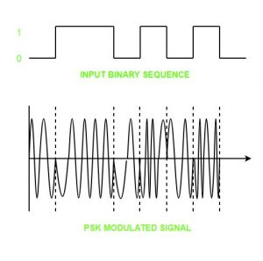
Phase Shift keying – In this modulation the phase of the analog carrier signal is modified to reflect binary data.The amplitude and frequency of the carrier signal remains constant.

Slide 29
It is further categorized as follows: 1. Binary Phase Shift Keying (BPSK):BPSK also known as phase reversal keying or 2PSK is the simplest form of phase shift keying. The Phase of the carrier wave is changed according to the two binary inputs. In Binary Phase shift keying, difference of 180 phase shift is used between binary 1 and binary 0. This is regarded as the most robust digital modulation technique and is used for long distance wireless communication.
2. Quadrature phase shift keying:This technique is used to increase the bit rate i.e we can code two bits onto one single element. It uses four phases to encode two bits per symbol. QPSK uses phase shifts of multiples of 90 degrees. It has double data rate carrying capacity compare to BPSK as two bits are mapped on each constellation points.

Slide 30
Advantages of phase shift Keying – • It is a more power efficient modulation technique as compared to ASK and FSK. • It has lower chances of an error. • It allows data to be carried along a communication signal much more efficiently as compared to FSK.
Disadvantages of phase shift Keying – • It offers low bandwidth efficiency. • The detection and recovery algorithms of binary data is very complex. • It is a non coherent reference signal.

Slide 31
Multiplexing o The transmission medium is used to send the signal from sender to receiver. The medium can only have one signal at a time.
o If there are multiple signals to share one medium, then the medium must be divided in such a way that each signal is given some portion of the available bandwidth. For example: If there are 10 signals and bandwidth of medium is100 units, then the 10 unit is shared by each signal.
o When multiple signals share the common medium, there is a possibility of collision. Multiplexing concept is used to avoid such collision.
o Transmission services are very expensive.

Slide 32
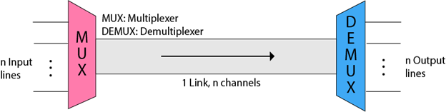
History of Multiplexing
oMultiplexing technique is widely used in telecommunications in which several telephone calls are carried through a single wire.
oMultiplexing originated in telegraphy in the early 1870s and is now widely used in communication.
oGeorge Owen Squier developed the telephone carrier multiplexing in 1910.
Concept of Multiplexing
oThe 'n' input lines are transmitted through a multiplexer and multiplexer combines the signals to form a composite signal.
oThe composite signal is passed through a Demultiplexer and demultiplexer separates a signal to component signals and transfers them to their respective destinations.

Slide 33
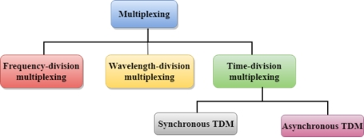
Advantages of Multiplexing: o More than one signal can be sent over a single medium. o The bandwidth of a medium can be utilized effectively.
Multiplexing Techniques Multiplexing techniques can be classified as:

Slide 34
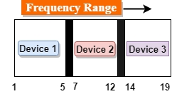
Frequency-division Multiplexing (FDM) o It is an analog technique. o Frequency Division Multiplexing is a technique in which the available bandwidth of a single transmission medium is subdivided into several channels.

Slide 35
o In the above diagram, a single transmission medium is subdivided into several frequency channels, and each frequency channel is given to different devices. Device 1 has a frequency channel of range from 1 to 5. o The input signals are translated into frequency bands by using modulation techniques, and they are combined by a multiplexer to form a composite signal. o The main aim of the FDM is to subdivide the available bandwidth into different frequency channels and allocate them to different devices. o Using the modulation technique, the input signals are transmitted into frequency bands and then combined to form a composite signal. o The carriers which are used for modulating the signals are known as sub-carriers. They are represented as f1,f2..fn.
oFDM is mainly used in radio broadcasts and TV networks.

Slide 36
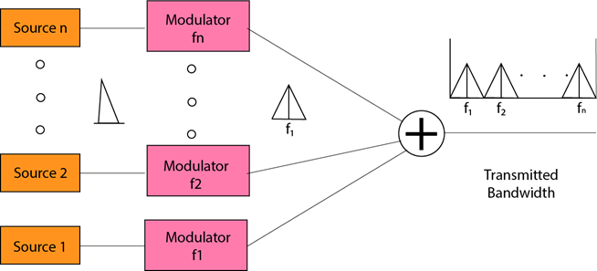

Slide 37
Advantages Of FDM: o FDM is used for analog signals. o FDM process is very simple and easy modulation. o A Large number of signals can be sent through an FDM simultaneously. o It does not require any synchronization between sender and receiver. Disadvantages Of FDM: o FDM technique is used only when low-speed channels are required. o It suffers the problem of crosstalk. o A Large number of modulators are required. o It requires a high bandwidth channel. Applications Of FDM: o FDM is commonly used in TV networks. o It is used in FM and AM broadcasting. Each FM radio station has different frequencies, and they are multiplexed to form a composite signal. The multiplexed signal is transmitted in the air.

Slide 38
Transmission Media
Transmission media is a communication channel that carries the information from the sender to the receiver. Data is transmitted through the electromagnetic signals.
The main functionality of the transmission media is to carry the information in the form of bits through LAN(Local Area Network).
It is a physical path between transmitter and receiver in data communication.
In a copper-based network, the bits in the form of electrical signals.
In a fibre based network, the bits in the form of light pulses.
In OSI(Open System Interconnection) phase, transmission media supports the Layer 1. Therefore, it is considered to be as a Layer 1 component.
The electrical signals can be sent through the copper wire, fibre optics, atmosphere, water, and vacuum.
The characteristics and quality of data transmission are determined by the characteristics of medium and signal.
Transmission media is of two types are wired media and wireless media. In wired media, medium characteristics are more important whereas, in wireless media, signal characteristics are more important.
Different transmission media have different properties such as bandwidth, delay, cost and ease of installation and maintenance.
The transmission media is available in the lowest layer of the OSI reference model, i.e., Physical layer.

Slide 39
Some factors need to be considered for designing the transmission media: o Bandwidth: All the factors are remaining constant, the greater the bandwidth of a medium, the higher the data transmission rate of a signal. o Transmission impairment: When the received signal is not identical to the transmitted one due to the transmission impairment. The quality of the signals will get destroyed due to transmission impairment. o Interference: An interference is defined as the process of disrupting a signal when it travels over a communication medium on the addition of some unwanted signal.

Slide 40

Causes Of Transmission Impairment:
o Attenuation: Attenuation means the loss of energy, i.e., the strength of the signal decreases with increasing the distance which causes the loss of energy. o Distortion: Distortion occurs when there is a change in the shape of the signal. This type of distortion is examined from different signals having different frequencies. Each frequency component has its own propagation speed, so they reach at a different time which leads to the delay distortion. o Noise: When data is travelled over a transmission medium, some unwanted signal is added to it which creates the noise.

Slide 41
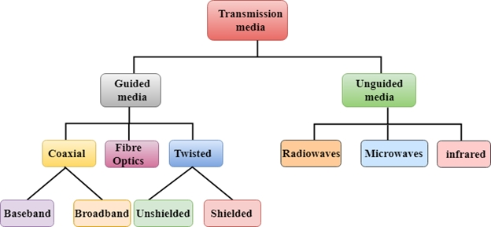
Classification Of Transmission Media:

Slide 42
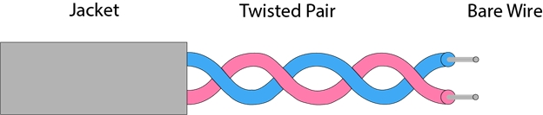
Guided Media It is defined as the physical medium through which the signals are transmitted. It is also known as Bounded media. Types Of Guided media: Twisted pair: Twisted pair is a physical media made up of a pair of cables twisted with each other. A twisted pair cable is cheap as compared to other transmission media. Installation of the twisted pair cable is easy, and it is a lightweight cable. The frequency range for twisted pair cable is from 0 to 3.5KHz. A twisted pair consists of two insulated copper wires arranged in a regular spiral pattern. The degree of reduction in noise interference is determined by the number of turns per foot. Increasing the number of turns per foot decreases noise interference.

Slide 43
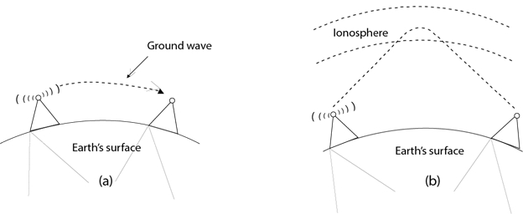
Unguided Media o An unguided transmission transmits the electromagnetic waves without using any physical medium. Therefore it is also known as wireless transmission. o In unguided media, air is the media through which the electromagnetic energy can flow easily. Unguided transmission is broadly classified into three categories: Radio waves o Radio waves are the electromagnetic waves that are transmitted in all the directions of free space. o Radio waves are omnidirectional, i.e., the signals are propagated in all the directions. o The range in frequencies of radio waves is from 3Khz to 1 khz. o In the case of radio waves, the sending and receiving antenna are not aligned, i.e., the wave sent by the sending antenna can be received by any receiving antenna. o An example of the radio wave is FM radio.
Applications Of Radio waves: o A Radio wave is useful for multicasting when there is one sender and many receivers. o An FM radio, television, cordless phones are examples of a radio wave. Advantages Of Radio transmission: o Radio transmission is mainly used for wide area networks and mobile cellular phones. o Radio waves cover a large area, and they can penetrate the walls. o Radio transmission provides a higher transmission rate.

