Slide 1
A SMART QUIZ APPLICATION IN CLOUD ENVIRONMENT USING AWS
NAMAN RAJ SHARMA

Slide 2
ABSTRACT
“Quiz application ” is a collection of different quizzes likes technical, General knowledge, English Grammar, Quantitative Aptitude.
User can access only one quiz at a time.
There will be a limited number of questions and for each correct answer user will be get a credit score.
To develop a user friendly application, our application will contain :
Number of quiz.
Answer to every question.
3. Scores.

Slide 3
INTRODUCTION
This quiz application provide a great platform for practice and solving query, which is having a great user interface.
The proposed work in this field are available on internet in huge amount like ; many application are available for playing quizzes online and query solving of the users.
These application provide a large varieties of questions (Big Domain).
These application provides question and answer for quiz ,query box for query solving .
Also, these application provide hug amount of study material for the users.

Slide 4
PROBLEM DOMAIN
“Our aim is to develop a application for the users in which a user can attempt any number of quiz related to his/her choice”
Firstly, we have to make interface for Home Page, Registration , Login Page, Question Attempting Forum, Result Page and profile of user and as well as for Admin. These all pages have connectivity with the server and database.
Currently, there are applications which only provide limited number of quizzes related to different domain.
Many application do not have a single platform for quizzes related to Technical, G.K , Aptitude, Grammar, etc. And there is not a application where the users can upload his/her question and answer for others.
We have to develop a application which can resolve all the problems.

Slide 5
SOLUTION DOMAIN
In this application firstly the user need to register or login using user-id and password.
Then the user can choose any of the quiz of his/her choice. There is a instruction window.
User can start attaining the quiz.
User can see his/her answers are right or wrong and can also see the answer of each.
If there is any feedback he/she can send.
After completion of the quiz user will get credit score for each of its correct answers.
Admin will submit question, after submission of 10 question in each category the quiz list will increase dynamically.
The user profile will contain it name, age, qualification, gender, mobile number, credit score, etc.

Slide 6
APPLICATION DOMAIN
The project “Quiz Application” can be used for educational purpose by many school and also by coaching institute.
It can also be used by a person for his/her self improvement and knowledge test.
A user can gain knowledge by playing this quiz not only technically but also in various fields like G.K, TECHNICAL and APTITUDE.
This project can also be used by a group for their knowledge sharing among themselves by playing quiz individually.

Slide 7
EXPECTED OUTCOME
User can attempt any type of quiz from the given list.
Result of the quiz attempted by the user will be displayed.
User can know his/her level of knowledge in the current world.

Slide 8
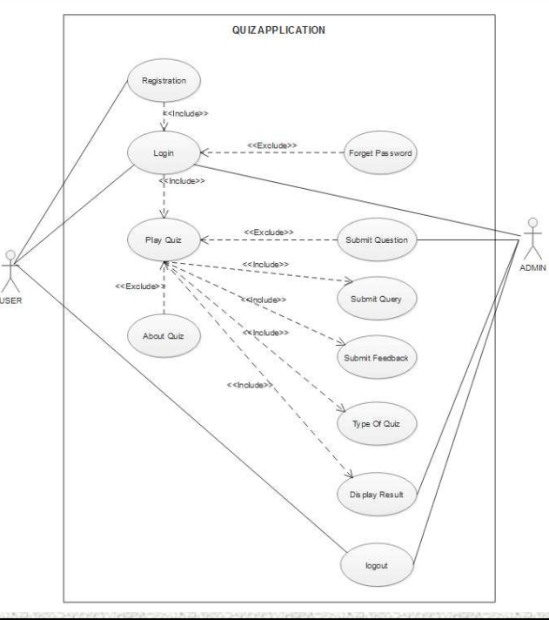
USE CASE DIAGRAM

Slide 9
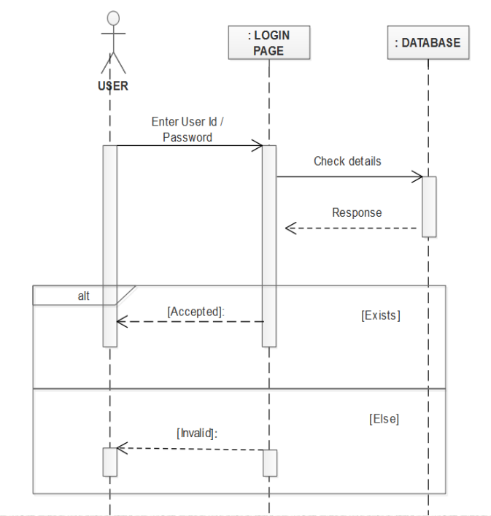
SEQUENCE DIAGRAM FOR LOGIN

Slide 10
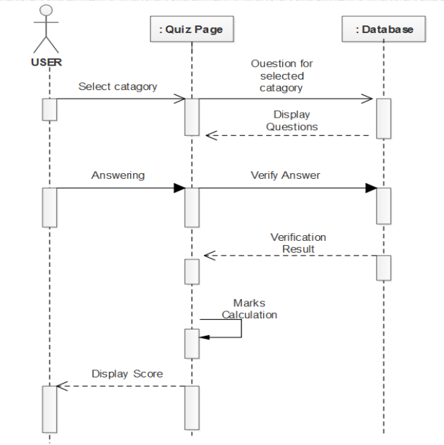
SEQUENCE DIAGRAM FOR PLAY QUIZ

Slide 11
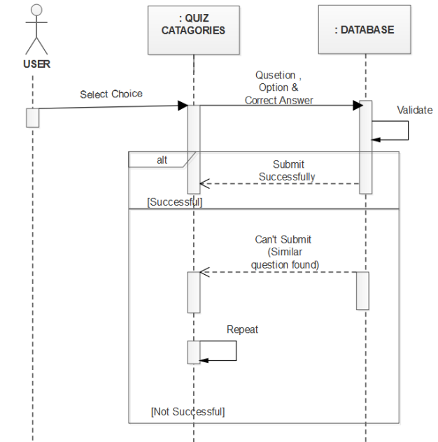
SEQUENCE DIAGRAM FOR SUBMIT QUESTION

Slide 12
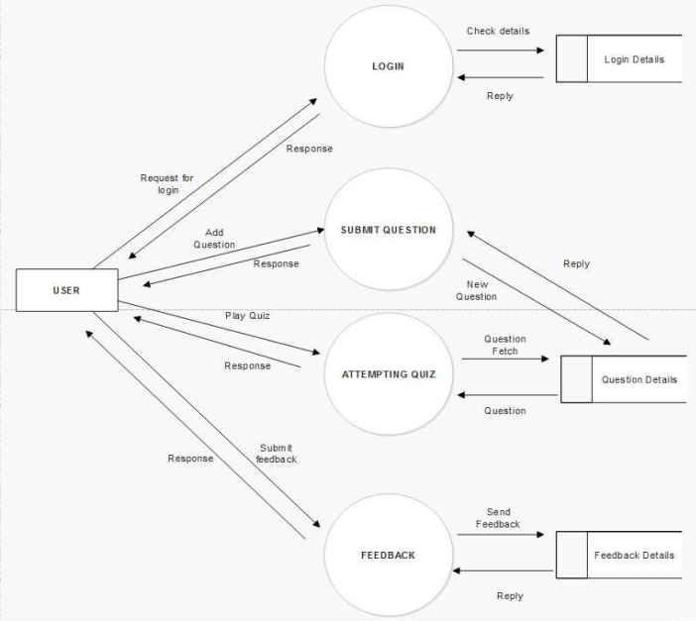
DATA FLOW DIAGRAM

Slide 13
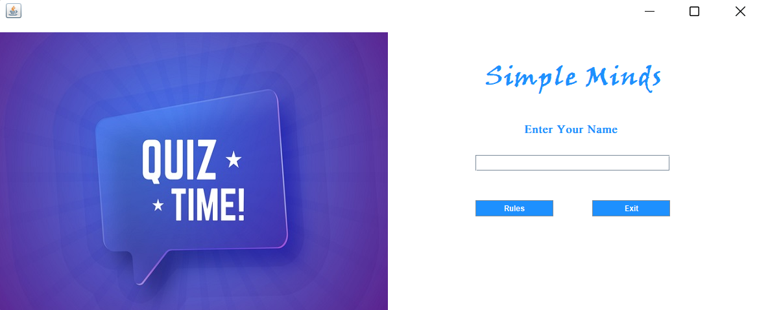
SCREENSHOTS/UI

Slide 14
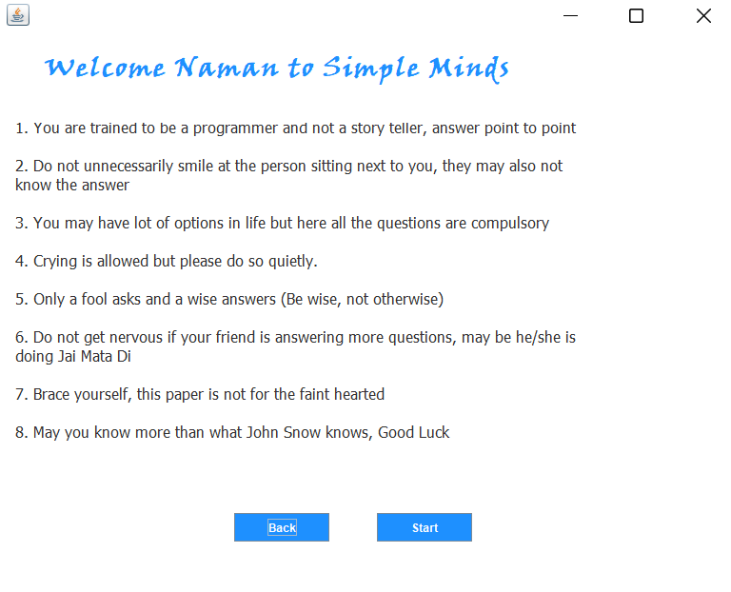
Continued…

Slide 15
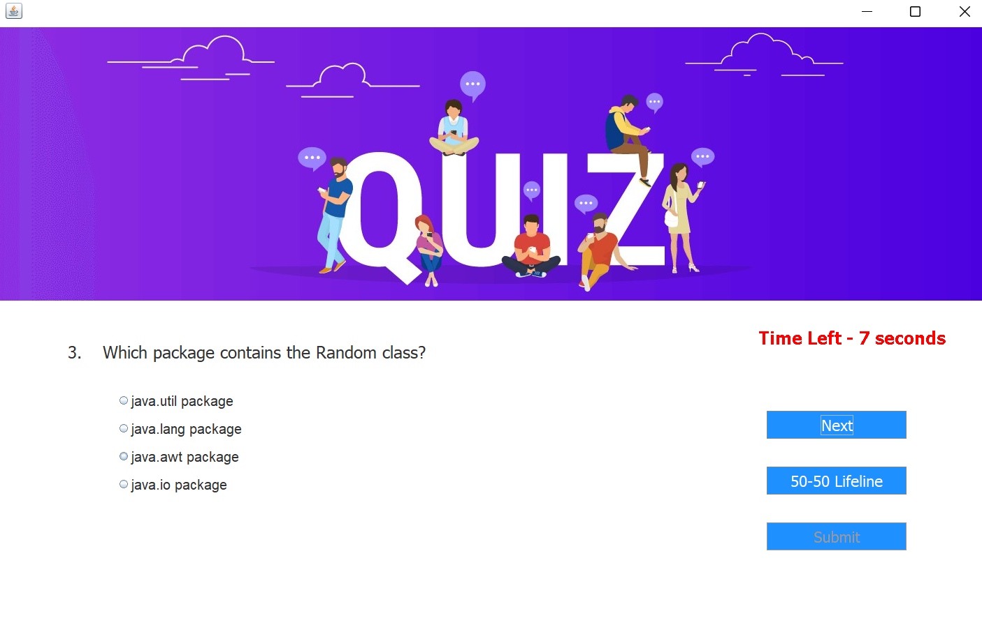
Continued…

Slide 16
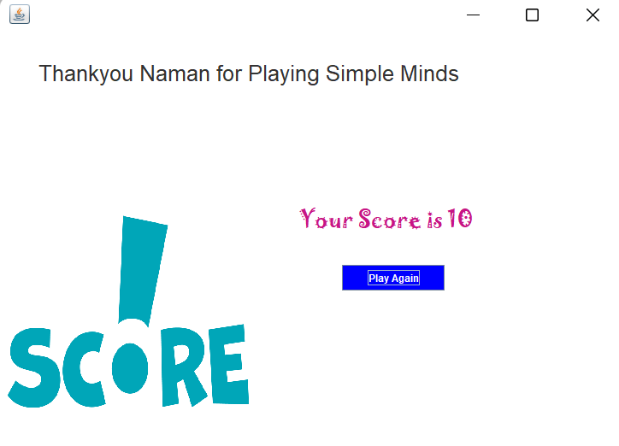
Continued…

Slide 17
THANK YOU

