Slide 1
ADVANCEMENT IN MANAGEMENT SYSTEM
NAMAN RAJ SHARMA

Slide 2
WHY UMS?
A college management system empowers colleges and educators to manage regular tasks such as campaign, student enrollment, admissions, students records, faculty, attendance, fees, assignments, exams, mark sheets, and what not. It reduces workload and Enhanced Productivity with smooth communication & data security. In the coming years, more and more educational institutions will adopt college management software due to its versatility, security, and high-quality performance at each and every level.

Slide 3
ABSTRACT
University Management System is essential for an institution or to a college or to a university, which utilizes computer, also which reduces manpower. Main objective of this study is an important step towards streamlining this effort is to develop a framework and identify necessary properties that a secure and trusted online department working system must satisfy to reduce discovery redundancy. Such a framework will allow us to evaluate as well as compare the merits of existing and future candidate in department. System should support multi-user environment. System should be fully automated. System should provide concrete security features like creating users and assigning privileges to users of the system. System should be capable to keep track of all the detailed descriptions of the client and the whole details of services offered by the client.

Slide 4
INTRODUCTION
UNIVERSITY MANAGEMENT SYSTEM (UMS) is a flagship product of Easy Solution which covers all aspects of Universities, Colleges or Schools. UMS covers every minute aspects of a universities work flow and integrates all processes with user friendly interface. With hundreds of satisfied customers UMS is first choice of several state, governments/semi- government universities and institutions. UMS is an outcome of hard work done by our expert technical team in supervision of several renowned educationists which includes Controller of examination, faculties. UMS is a rare combination of experience and precision. UMS streamline path of information flow in organization by taking care of following departments:
• Fee Department
• Examination Department
• Attendance
• Faculty information portal
• Student information portal

Slide 5
Under existing system, teachers do not have the facility to checking their student’s exam copy online. Students do not have the facility to check their exam copy online and understands where they have make their mistakes. Students have to visit office to get their bonafide certificate, No dues clearance certificate, they do not have the facility to download the e-certificate as per their requirement. Students do not have the facility to read study materials online. Placement department have to issue regular news update for candidates registration to take part in the placement process. The existing University Management system consists of different attendance and mark files maintained by the lecturer. These file have to be verified and collated by an official before it can be entered into the official record. Students often have to pester their lecturers or the academic department to view their attendance details and marks before publication and only then are they able to raise any doubts about the same. There is a whole lot of paper that is wasted in this whole process as well.
EXISTING WORK

Slide 6
The proposed University Management system will be entirely maintained on the college intranet, this will ensure that students will be able to easily access this information at any time. Constant access to this information will enforce accountability both on the lecturer’s part to update the information and on the student’s part to ensure that the data is accurate. End of semester formalities will become easier with access to an automatically collated and verified report. Lecturers will also be able to easily schedule extra classes for students. Students can be ensured that the system will inform them about any extra class.
PROPOSED SYSTEM

Slide 7
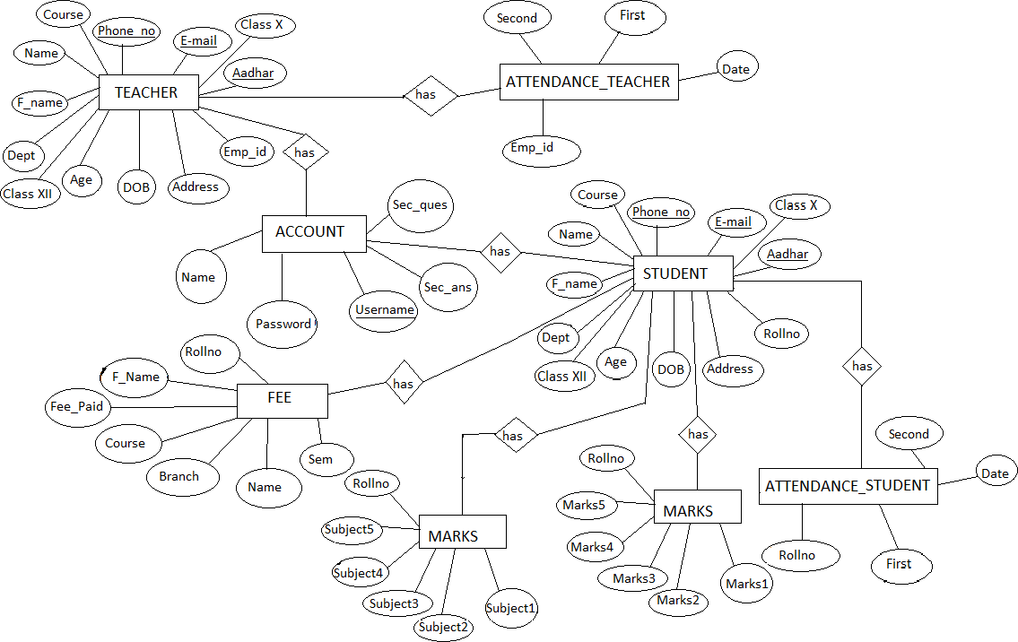
ER DIAGRAM

Slide 8
CONCLUSION
College management system project is developed or implemented in java platform. Main objective of this system or project is to design or develop a software portal for schools or colleges for maintaining lectures details, student’s attendance information, and student’s internal and external marks managing system. Students will use this system from anywhere to know about details on attendance and marks and communicate with respectable members for doubts. Latest data on marks and school or college data are modified or updated by administrator which is available for lecturers and students.

Slide 9
Books and Websites: Internet & World Wide Web: How to Program Deitel, PJ Deitel. Database System Concepts, by Silberschatz, Sudarshan, and Korth. Fundamentals of Database Systems, RamezElmasri and Shamkant B. Navathe, 7th Edition. 2017, Pearson...
REFERENCE

