Slide 1
MUSIC APPLICATION
By
NAMAN SHAH
DEEP SANCHANIYA
SAKSHI BASANTANI

Slide 2
INTRODUCTION
WE ARE BUILDING A HYBRID MUSIC APPLICATION. WHERE USER CAN LISTEN MUSIC ADVERTISEMENT FREE AND CAN ENJOY THEIR MUSIC WITHOUT ANY DISTURBANCE. THIS APPLICATION HAS ALL BASIC FEATURES NEEDED IN A MUSIC APPLICATION

Slide 3
INDEX
COMPANY PROFILE
PROJECT PROFILE
SCREEN LAYOUTS
CONCLUSION
BIBLIOGRAPHY

Slide 4
COMPANY PROFILE

Slide 5
COMPANY PROFILE
Name : Arham Technosoft Pvt. Ltd
Contact : 98988 63554
Website : arhamtechnosoft.com
Email : info@arhamtechnosoft.com
Address : B-406 Synthesis The First, B/h Keshavbaug Party Plot, Vastrapur, Ahmedabad, Gujarat 380015

Slide 6
PROJECT PROFILE

Slide 7
SYSTEM REQUIREMENT
PROJECT PROFILE
FRONT END | IONIC FRAMEWORK,ANGULAR, JAVASCRIPT, HTML, CSS
BACK END | FIREBASE

Slide 8
EXISTING SYSTEM
PROJECT PROFILE
Currently we face problems while listening to music because of advertisements after every song and also advertisement banners on the screen. The experience of enjoying music is disturbed because of the advertisement and to avoid it we need to pay a subscription.

Slide 9
PROPOSED SYSTEM
PROJECT PROFILE
This project will be a Music Streaming Application. Using Ionic Framework for building Hybrid mobile applications . Firebase for making Application Programming Interface (API) and data storage.

Slide 10
SCREEN LAYOUTS

Slide 11
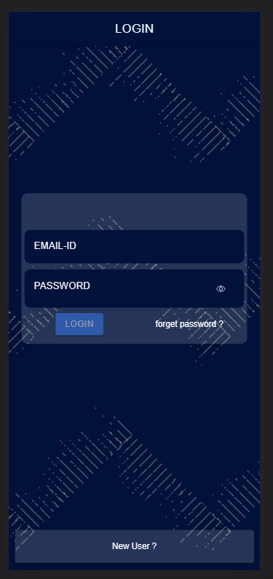
LOGIN AND REGISTRATION SCREEN
The login page will be shown to the user when they install the application or they clear the app data from their phones.

Slide 12
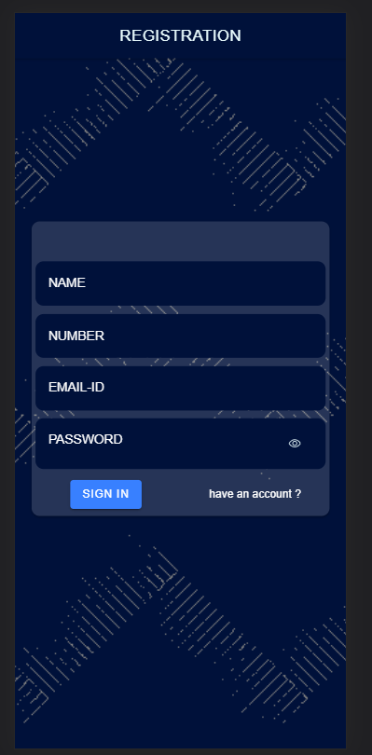
LOGIN AND REGISTRATION SCREEN
The Registration page will only be shown when user clicks on the "new User ?" button on Login page .

Slide 13
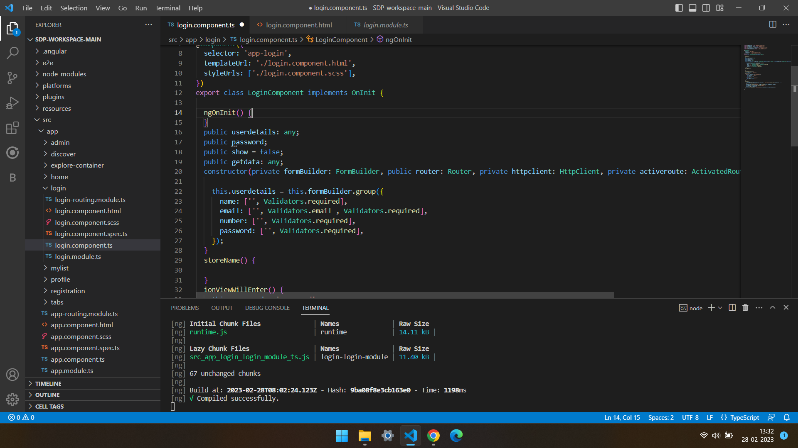
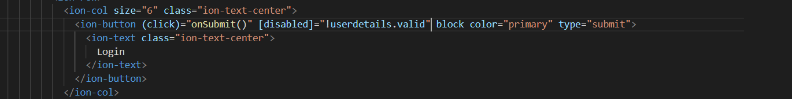
LOGIN AND REGISTRATION SCREEN
This code shows that the submit button of form will be disabled Until the form is filled with valid information .

Slide 14
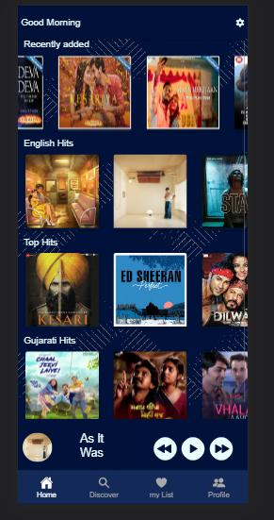
HOME SCREEN
These are list of songs available. The audio controller is made using howler.js library

Slide 15
HOME SCREEN
Logic of how the list of songs is called

Slide 16
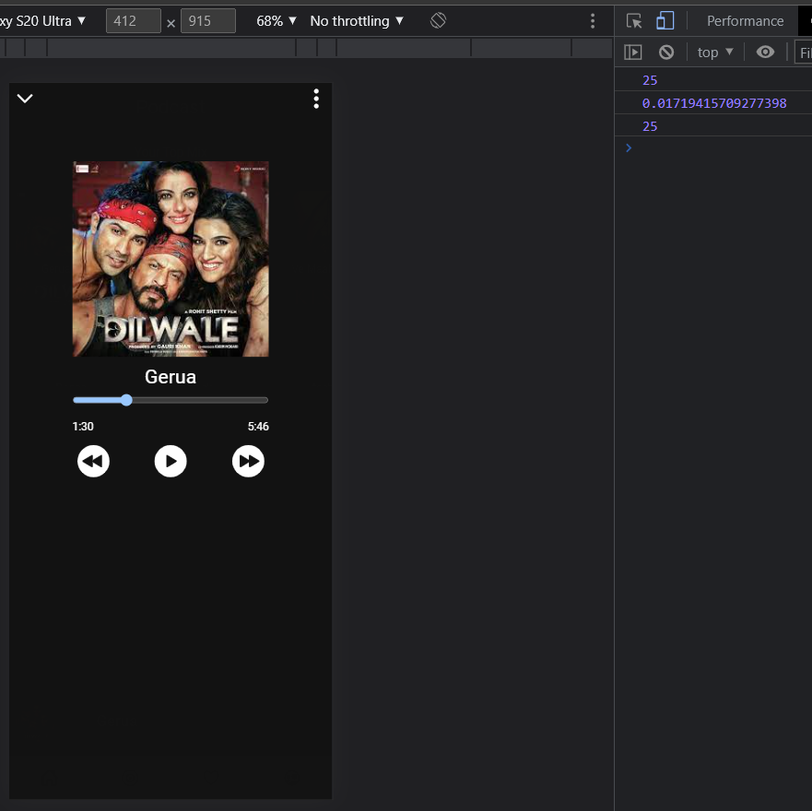
HOME SCREEN
Logic of how the list of songs is called

Slide 17
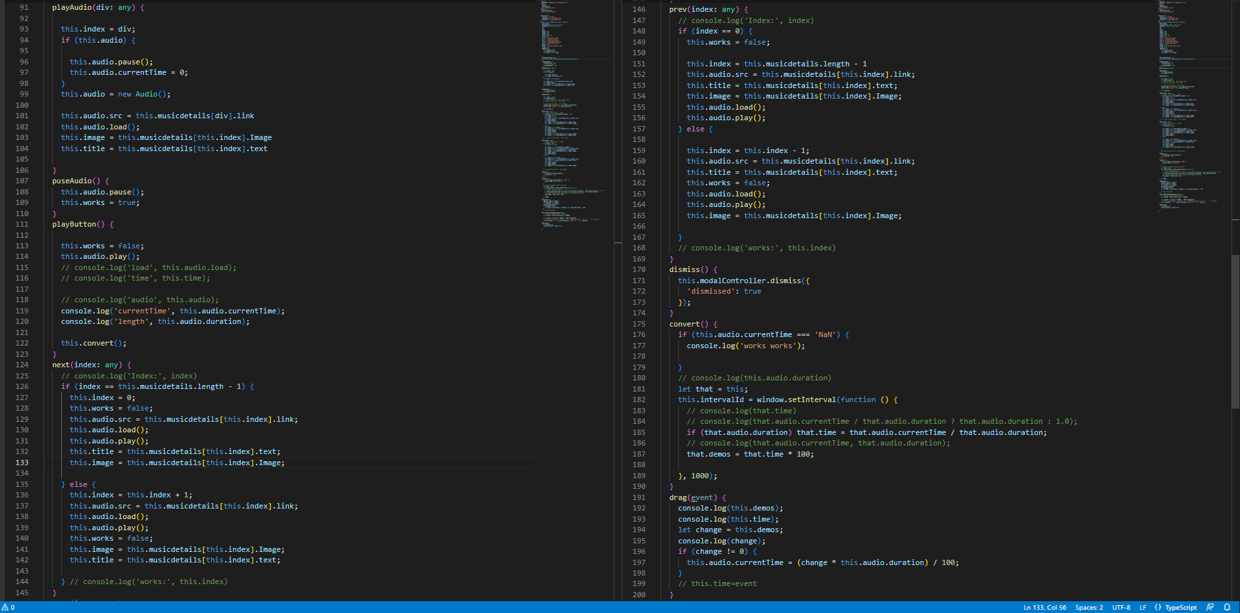
HOME SCREEN
Logic for Music controller

Slide 18
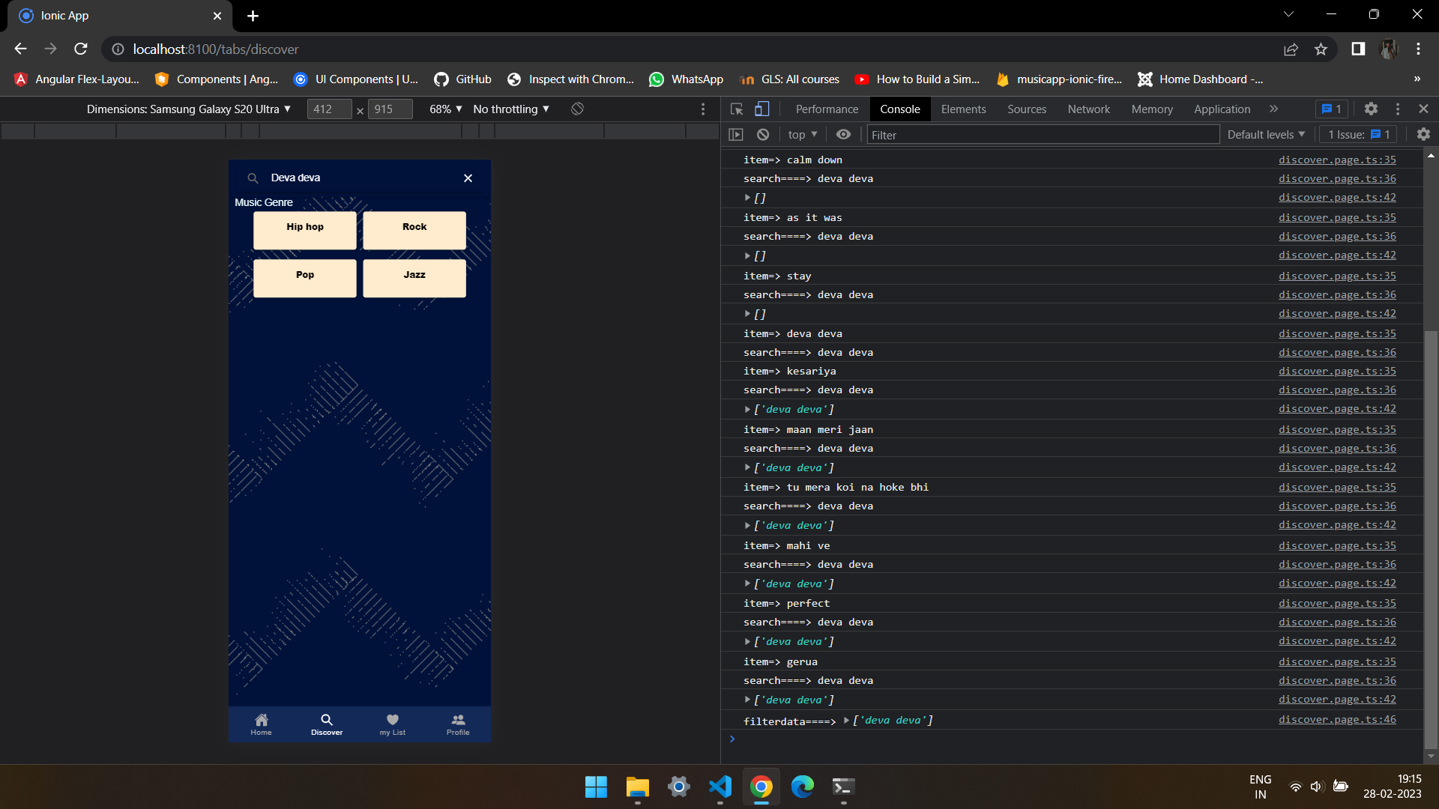
DISCOVER SCREEN
Search bar

Slide 19
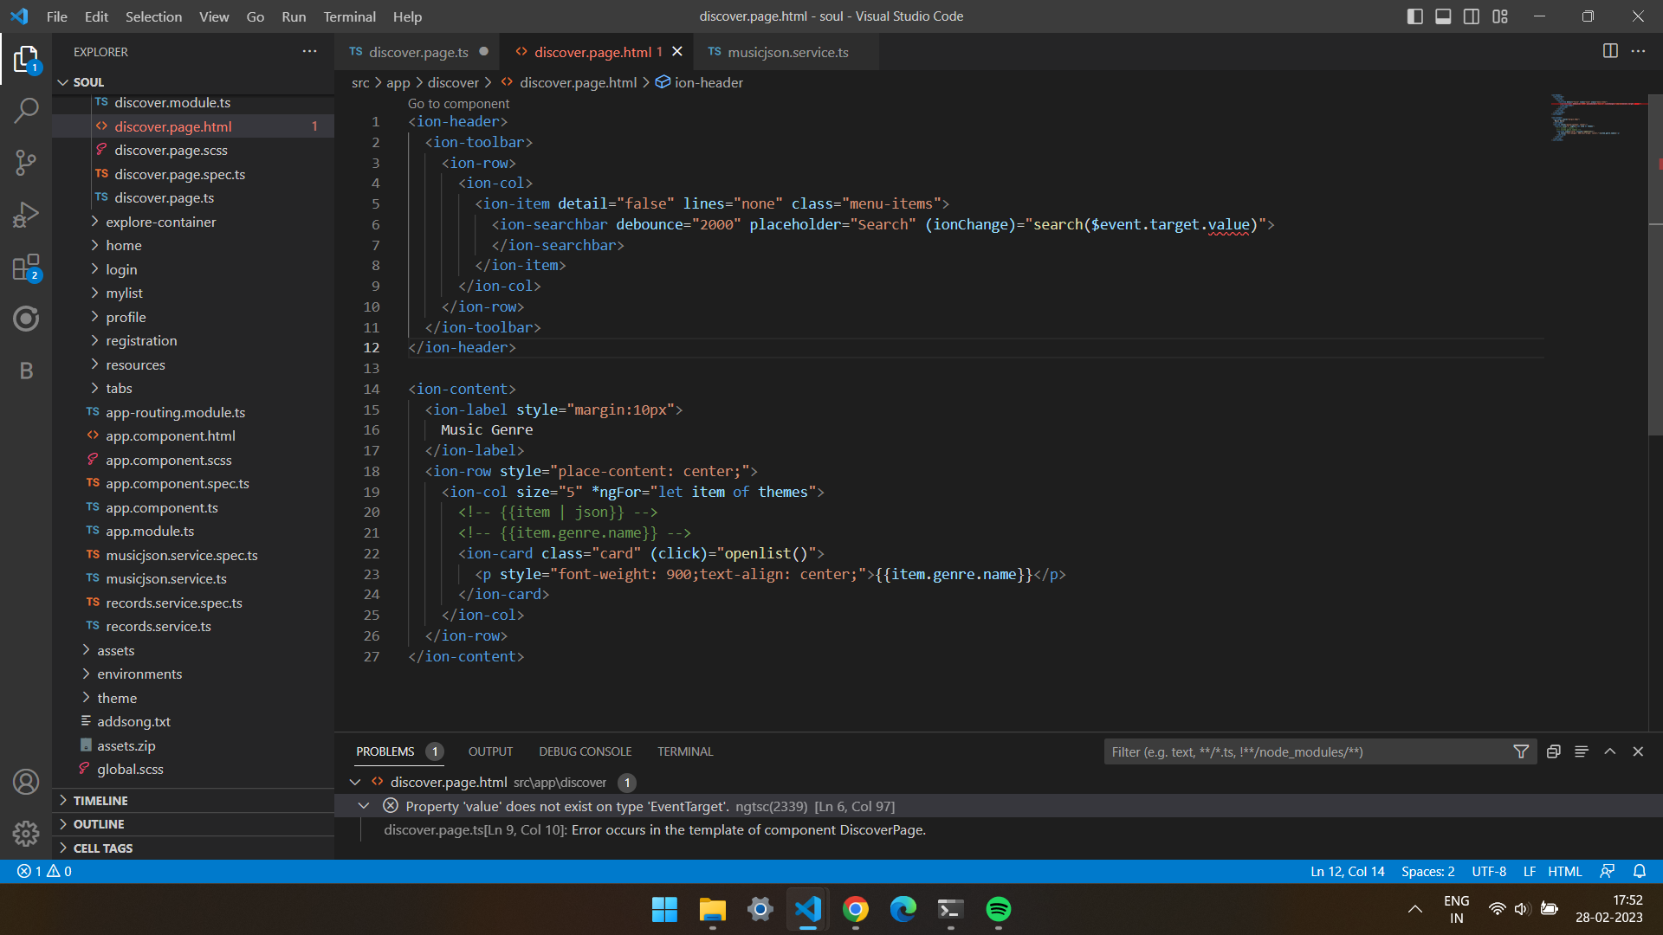
DISCOVER SCREEN
Search bar

Slide 20
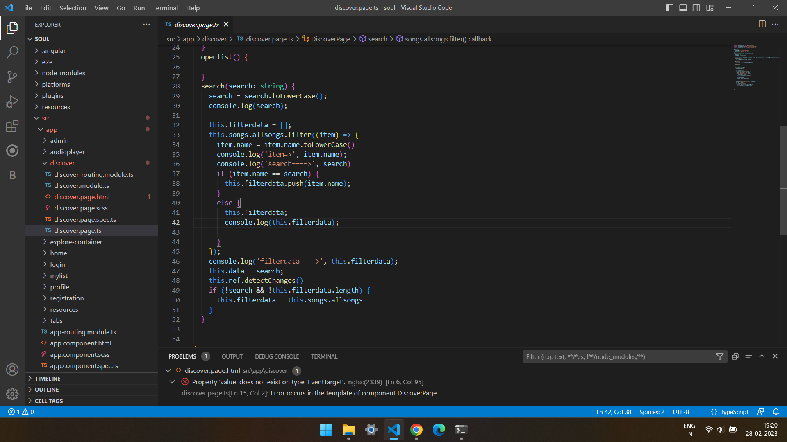
DISCOVER SCREEN
Search bar logic

Slide 21
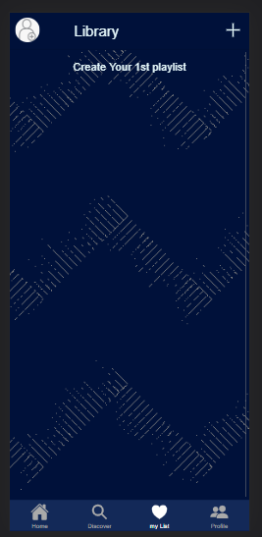
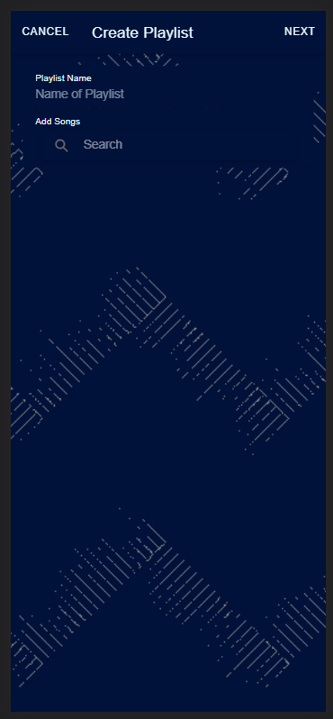
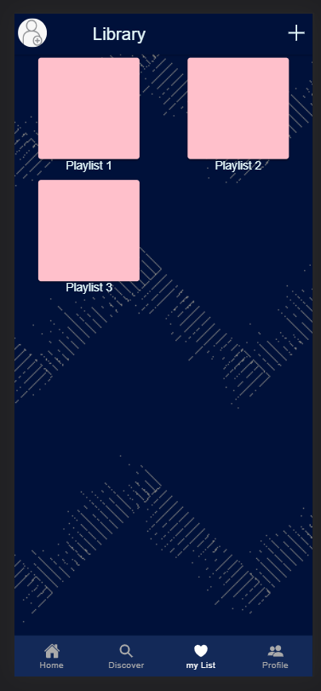
MY-LIST SCREEN
This page is used by user to create their playlist

Slide 22
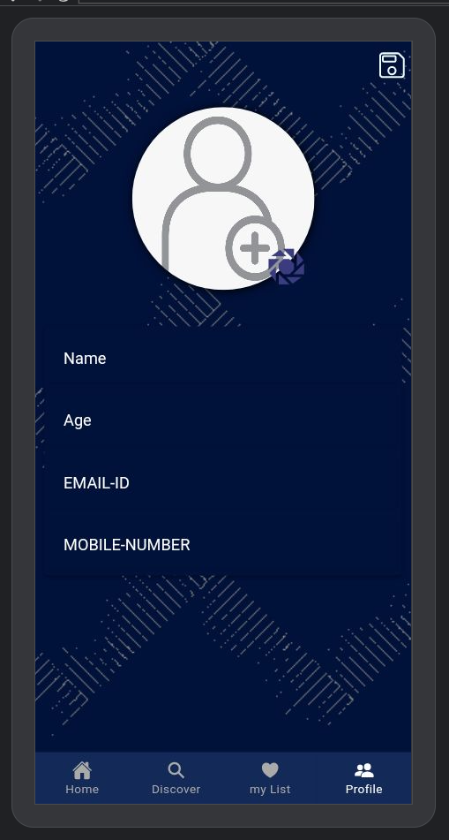
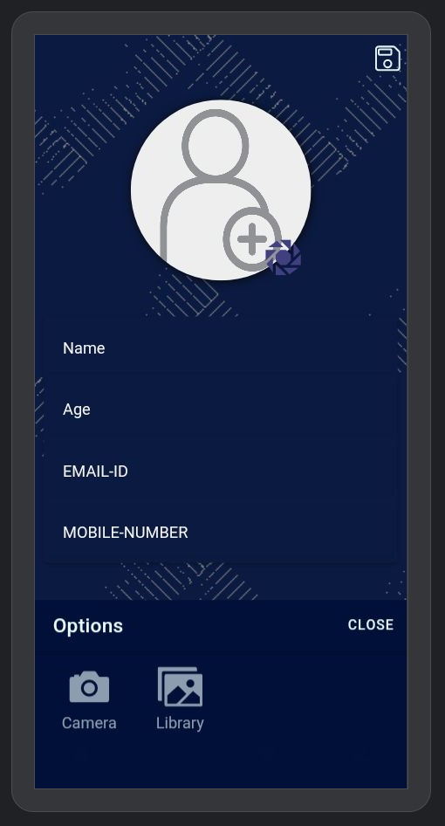
PROFILE SCREEN
Add profile picture to your profile

Slide 23
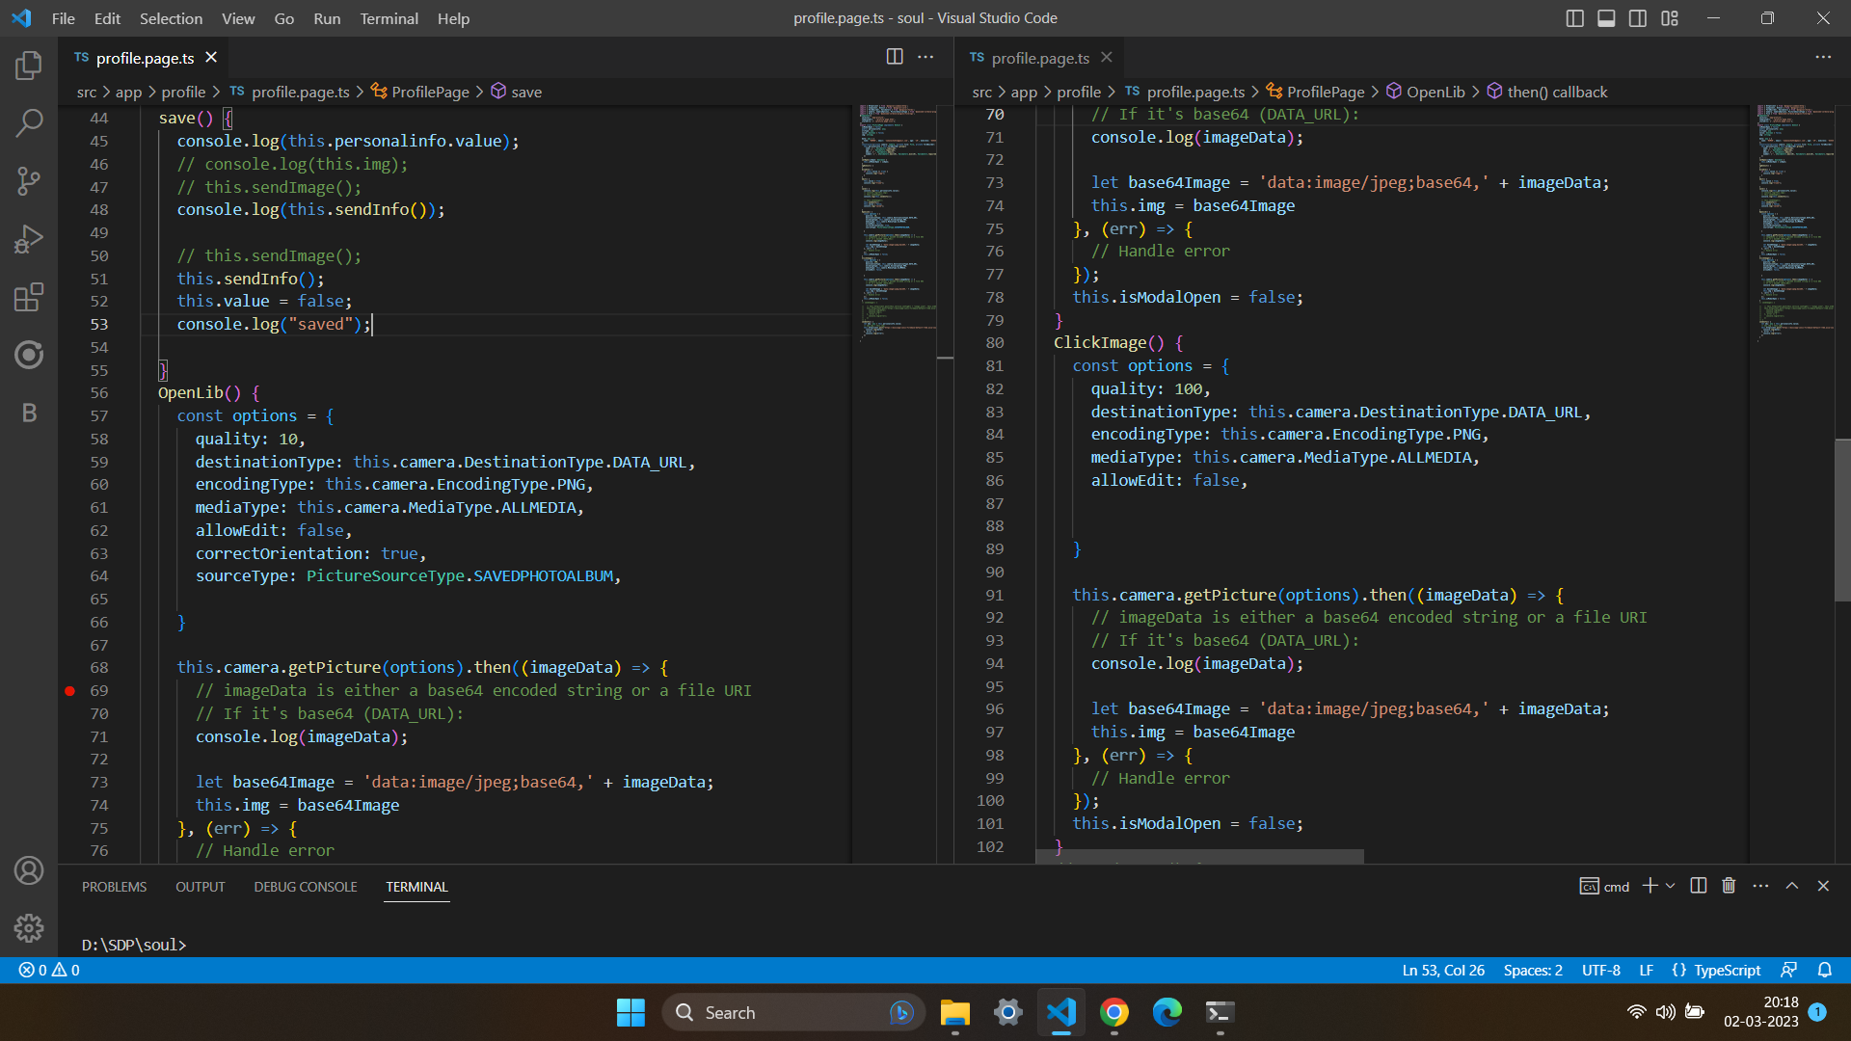
PROFILE SCREEN
Add profile picture to your profile

Slide 24
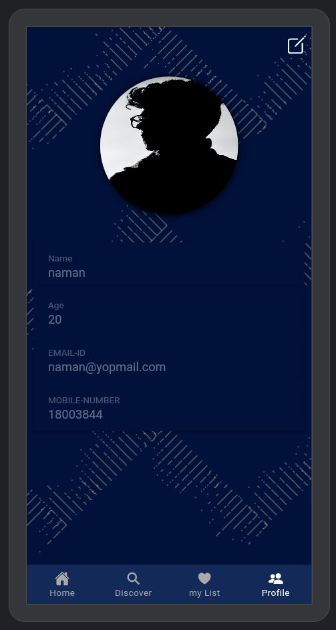
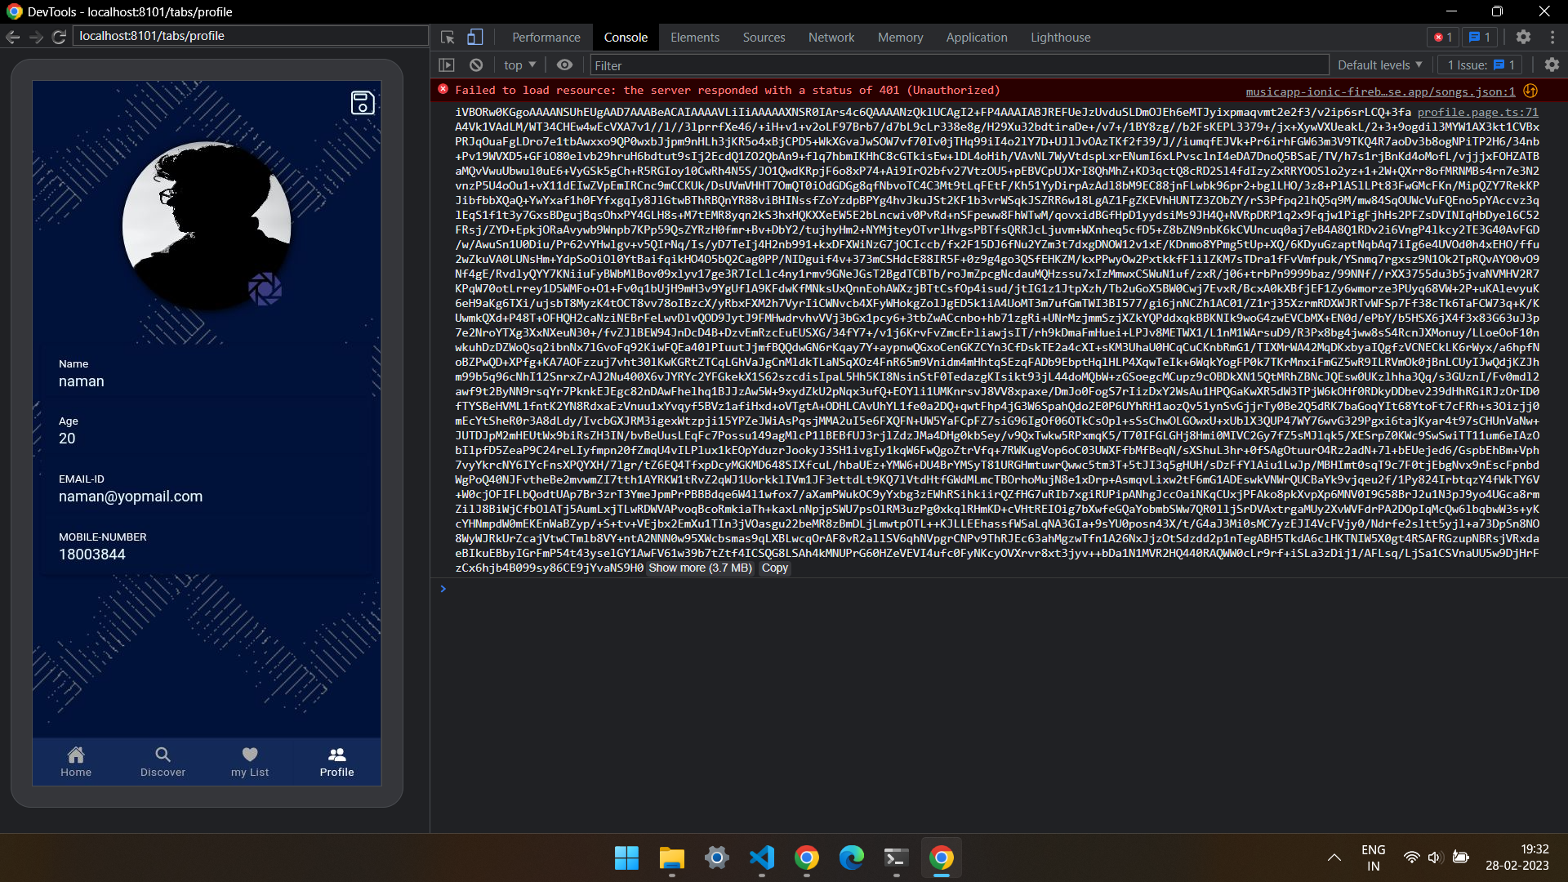
PROFILE SCREEN

Slide 25
CONCLUSION
Our main aim is to provide user experience with a proper user-interface to interact with our music Application . Thus users can enjoy their own choice of music anytime and without any advertisement. Our internal guide Garima mam helped us a lot in improving the quality of our project. As well as our external guide Mr. Aakash Vora helped us a lot in giving suggestions for better functioning of our project.

Slide 26
Bibliography
https://ionicframework.com/docs/components
https://ionicframework.com/docs/cli/commands/cordova-plugin
https://material.angular.io/components/categories
https://tburleson-layouts-demos.firebaseapp.com/#/docs
https://firebase.google.com/docs?authuser=1&hl=en
https://www.npmjs.com/package/howler

Slide 27
Thank you

