Slide 1


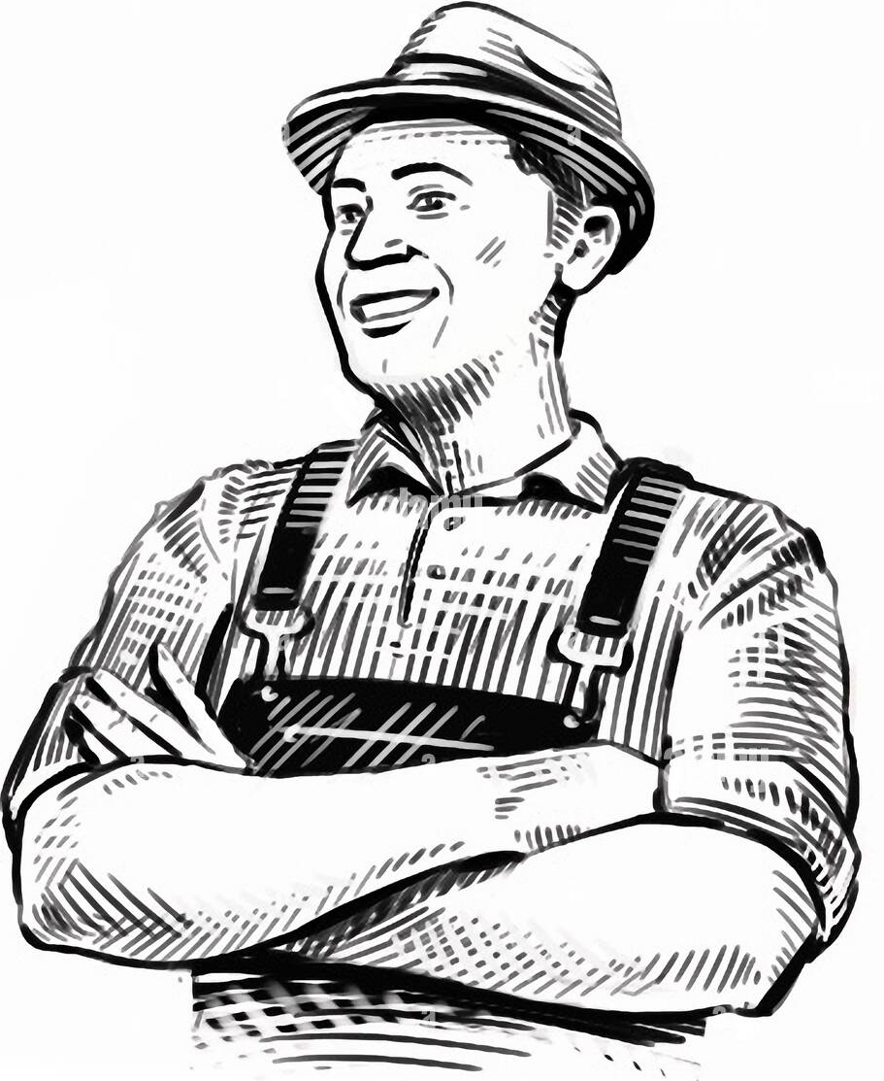
Shri Ramswaroop Memorial University
DCSIS-[2025-2026]
Research Project- II
AI-Powered Kissan Buddy
Bridging the gap between data science and rural farming.
Guided by:-
Dr. Nitya Nand Dwivedi
Presented by:-
Krishna Bahadur
Naman Sharan Yadav
Aakriti Pathak

Slide 2
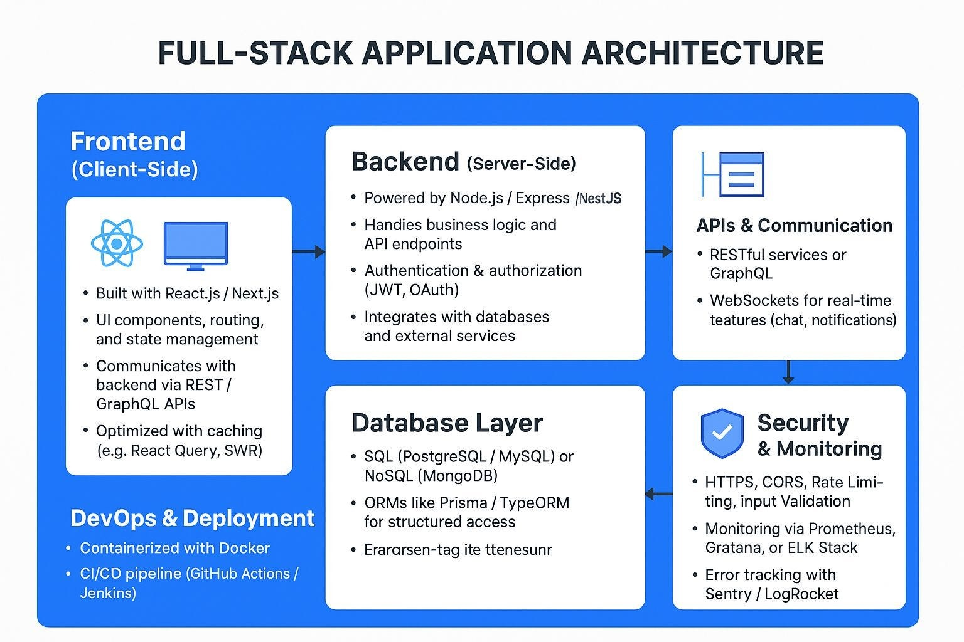



Frontend Strategy: Tools & Rationale
React.js Core
Vanilla JS & AJAX
Chart.js Integration
High-performance, component-based Single Page Application ensuring seamless user experience
Transforms complex market data into simple, visual price trends that farmers can understand instantly
Fast, asynchronous updates without page reloads—critical for low-bandwidth rural internet conditions
Goal: Create a lightweight yet powerful interface that feels modern but remains functional on basic smartphones commonly used by rural farmers.

Slide 3
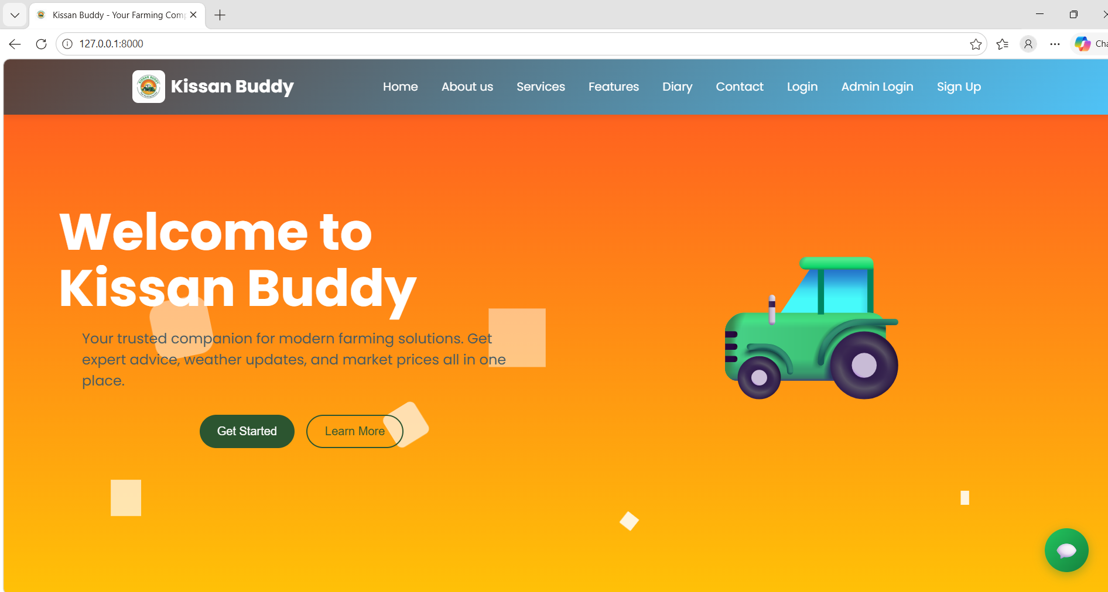
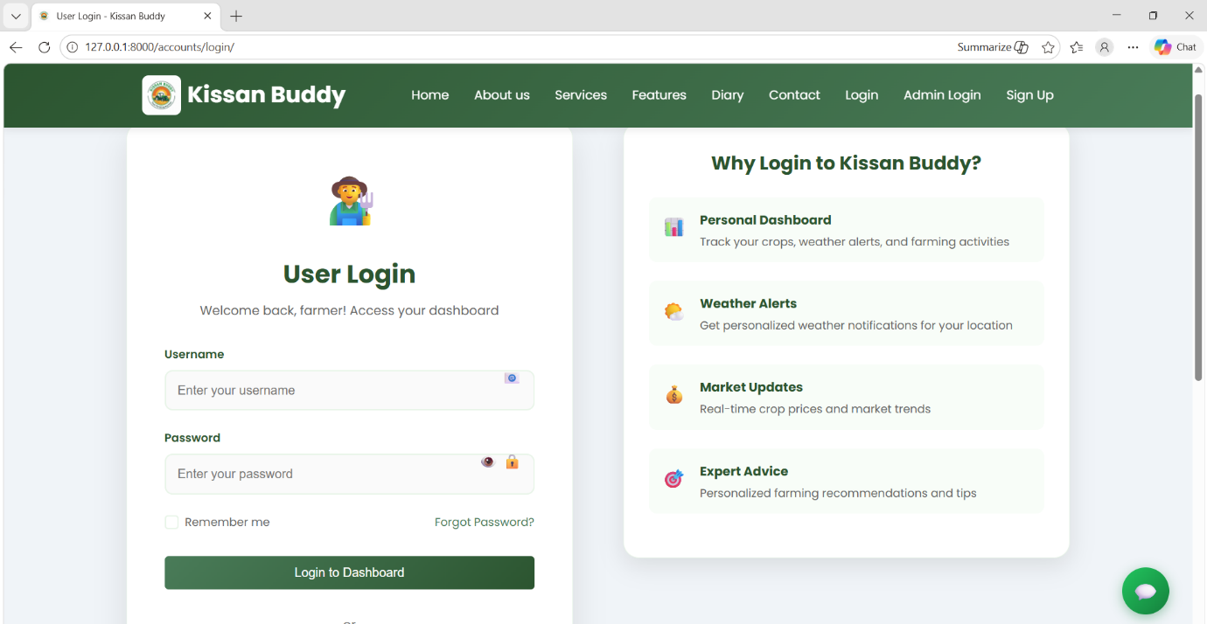
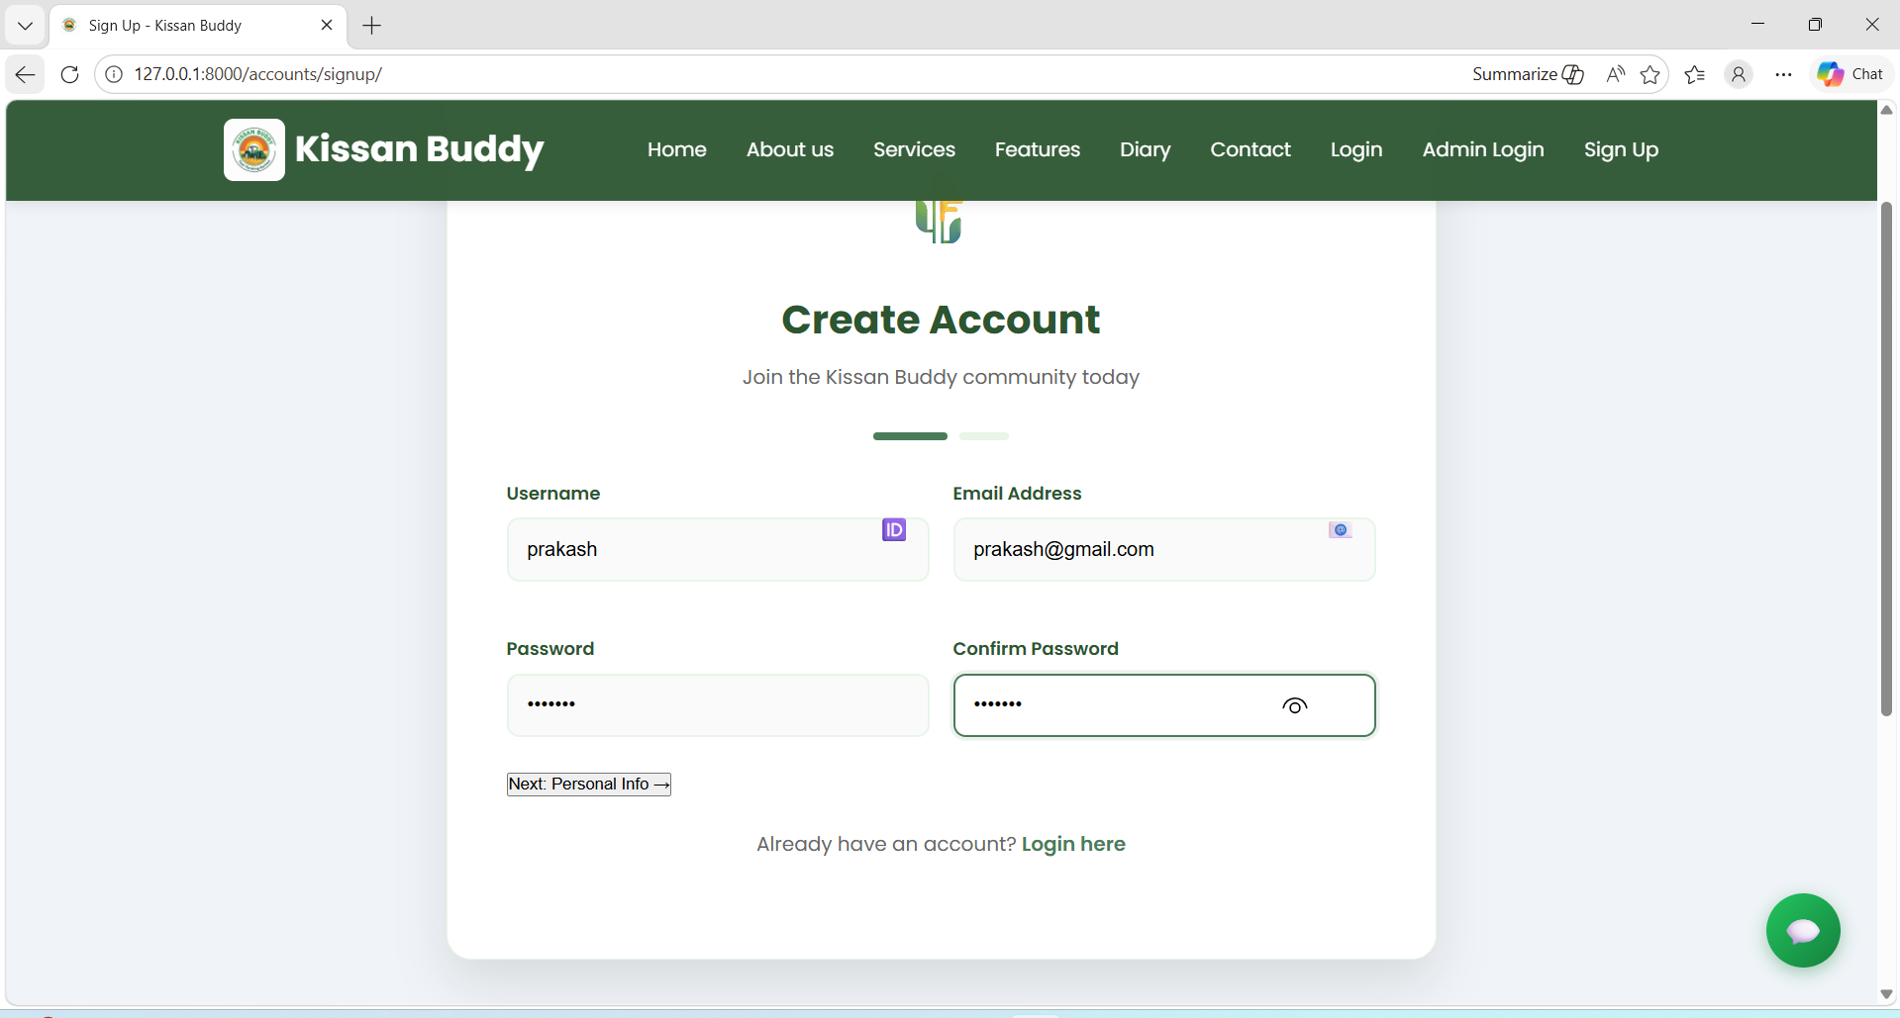
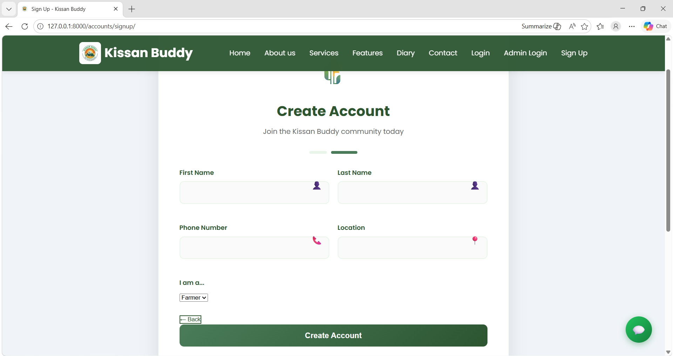
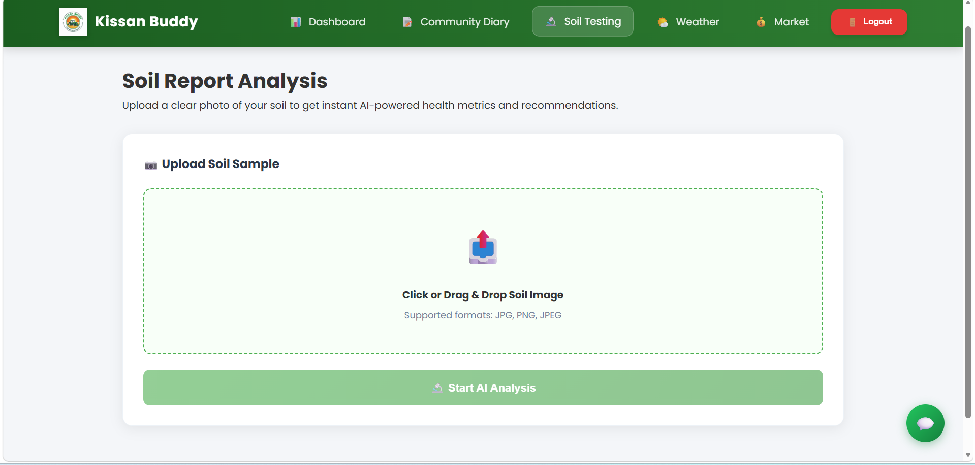
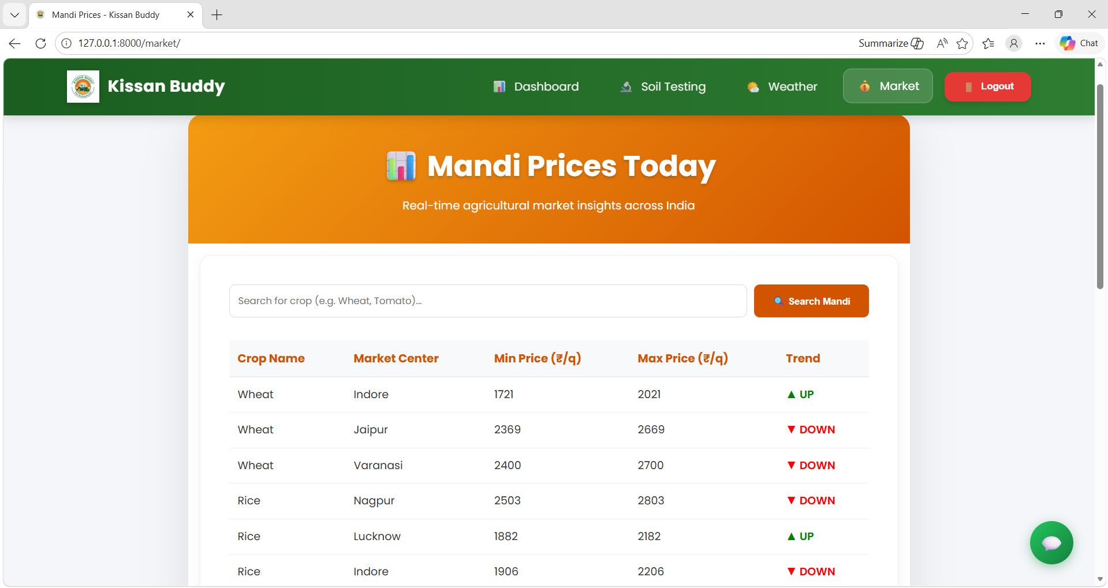
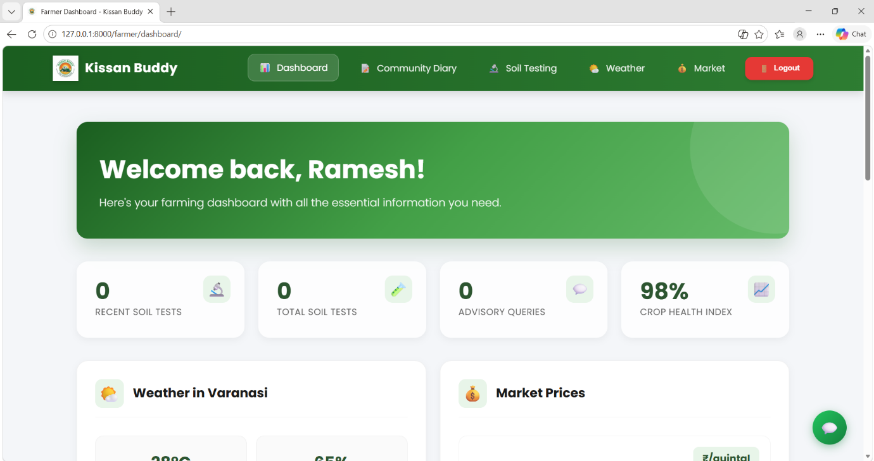
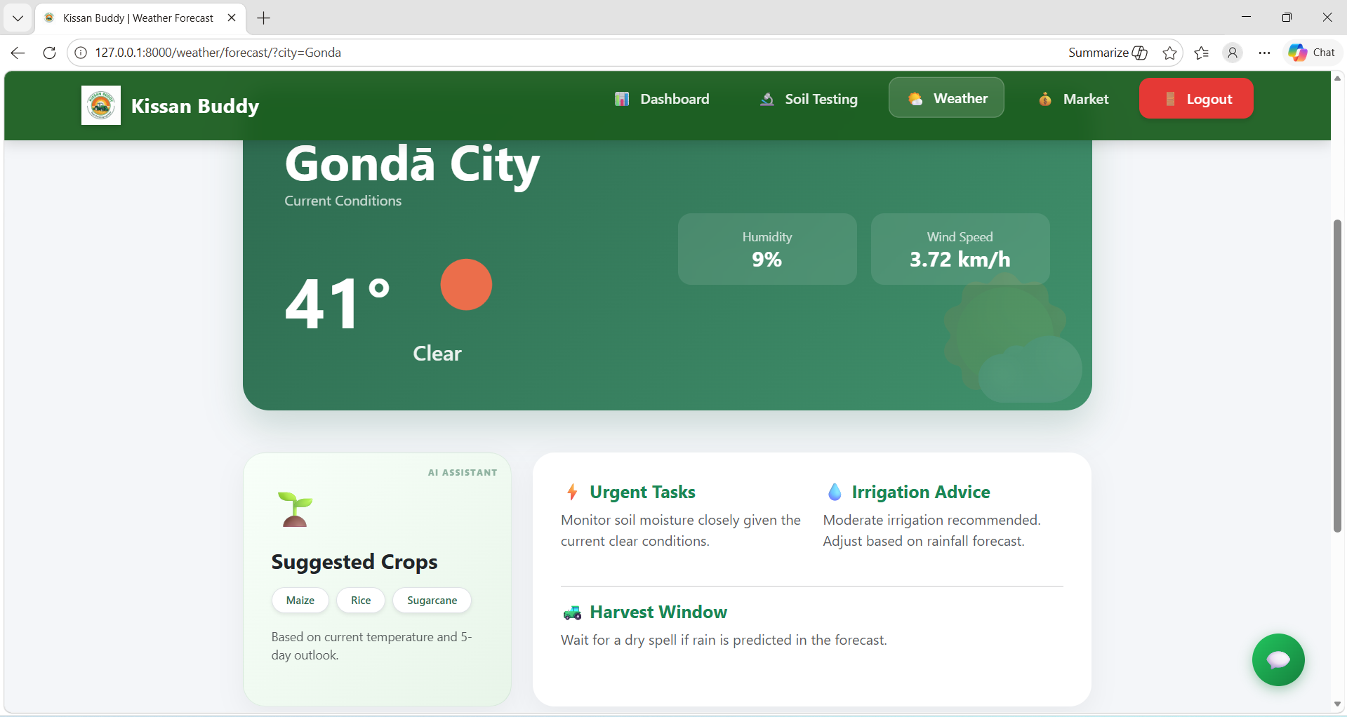
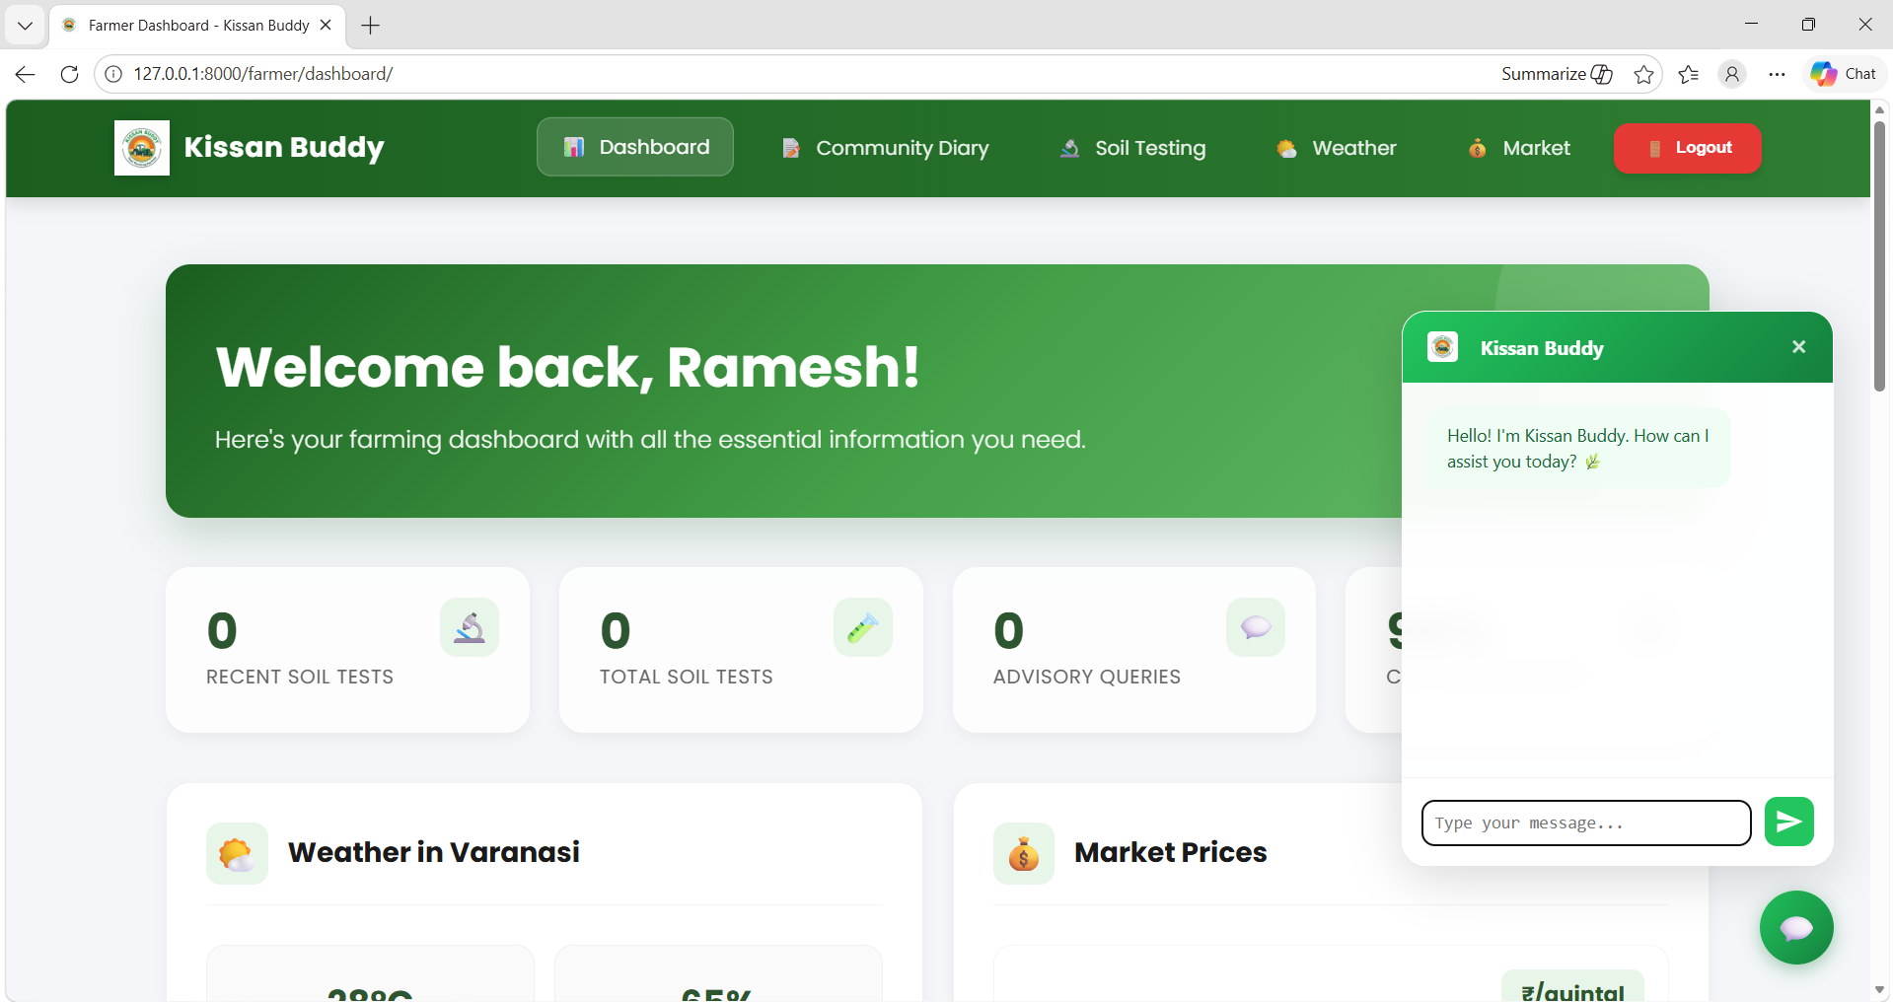
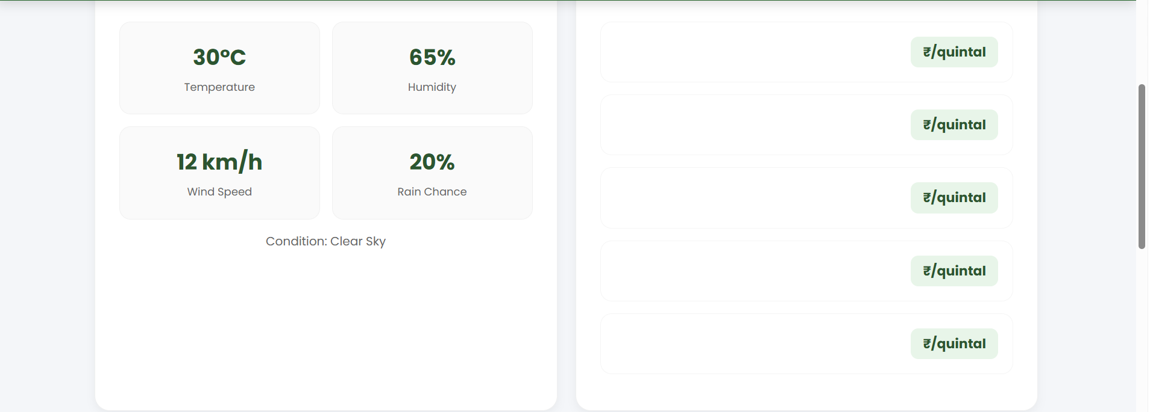
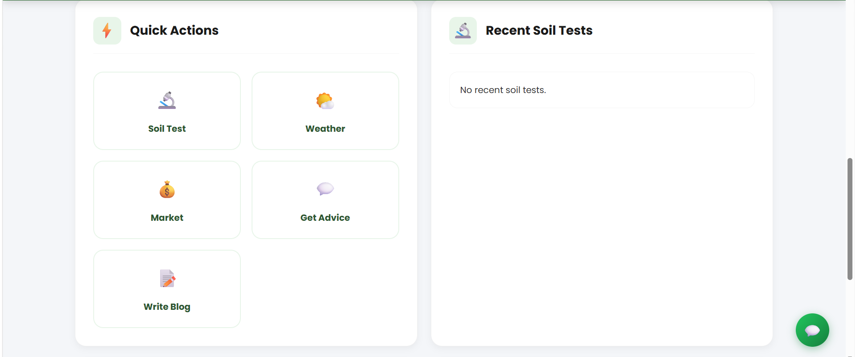
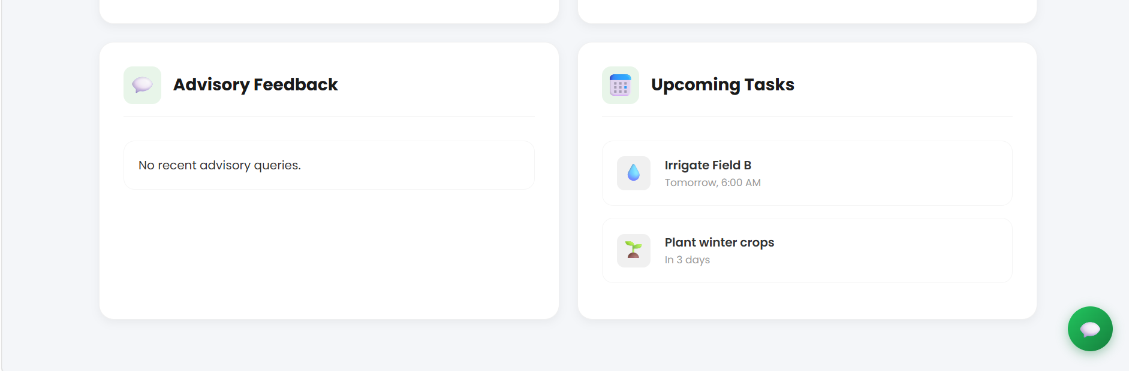
Creating the Experience (Home & Dashboard)
1. UI Design (Glass morphism UI)
The app uses a modern design style called Glass morphism .
Colours: green & brown tones (related to farming 🌱)
Clean, simple, and easy to understand for farmers .
Goal: Make the app attractive + easy to use
2. Central Dashboard (Main Screen)
This is the main control panel for farmers.
Features:
🌦️ Weather forecast (real-time updates)
💰 Market price tracking (mandi rates)
🤖 AI-based farming advice
📍 Location-based services (maps, local data)
👉 Goal: Give all important information in one place

Slide 4
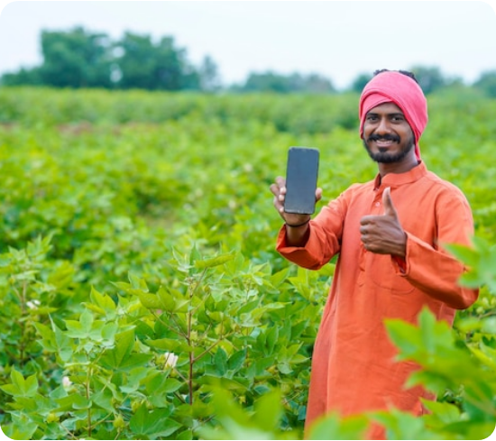
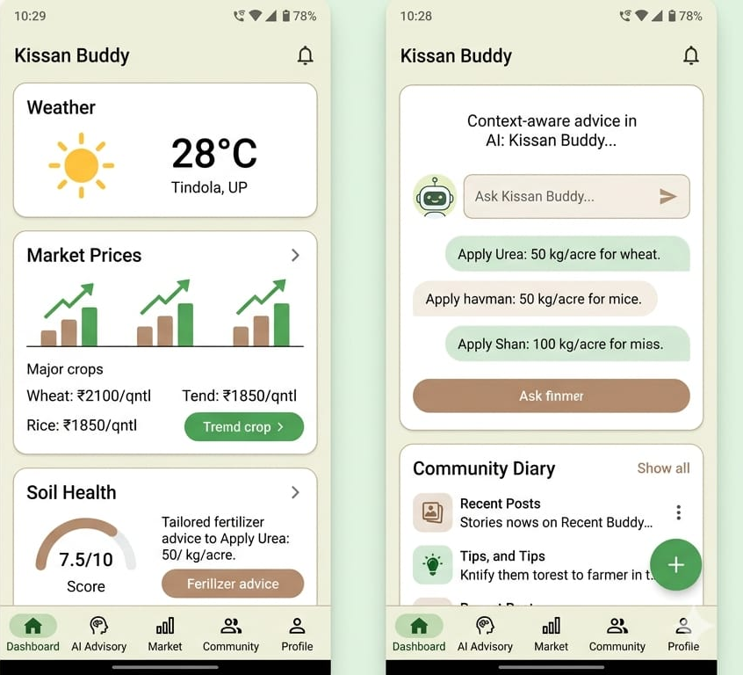
User-Centric Design For Farmers
01
02
Large Touch Targets
Bilingual Support
Oversized buttons and interactive elements designed for easy navigation in field conditions, even with gloves or dirty hands
Integrated Hindi and English interfaces to remove language barriers and ensure widespread accessibility across rural India
03
Visual Indicators
Color-coding system (Red/Yellow/Green) for soil health and weather alerts, enabling semi-literate users to take immediate action
Impact: Empowers smallholder farmers by transforming complex data into an intuitive visual story they can act upon.

Slide 5
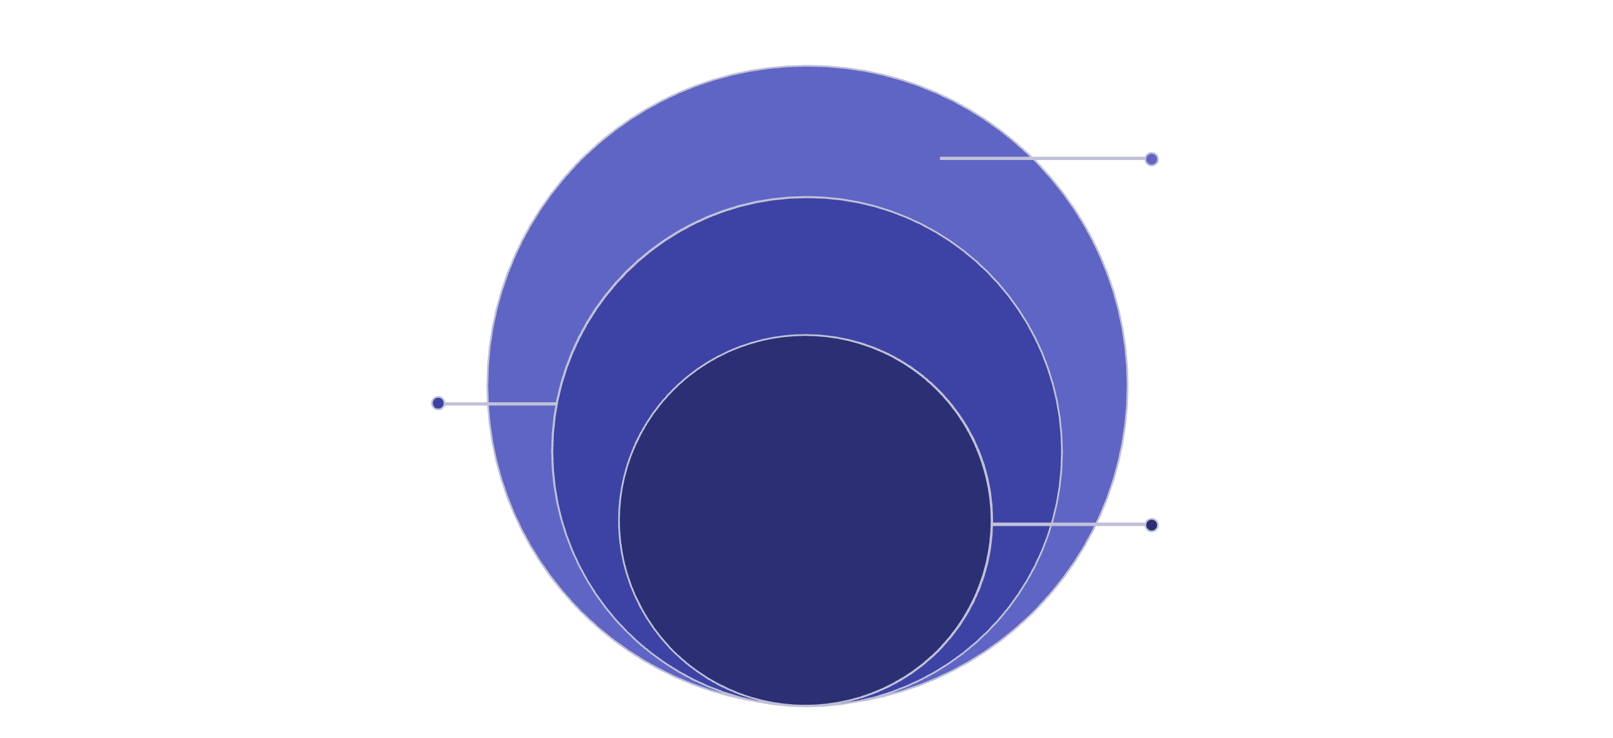
Backend Architecture: The Engine
Data Tier
MySQL for relational data, MongoDB for documents
Application Tier
Node.js Express API with JWT auth and routing
Presentation Tier
React frontend handling UI and user interactions
Node.js & Express.js
API Integration
Cloudinary Storage
Robust server-side framework handling secure JWT-based authentication and API routing
Connects to OpenWeatherMap and AGMARKNET APIs for real-time environmental and market data
Optimized image processing and storage for crop diagnostics and documentation

Slide 6
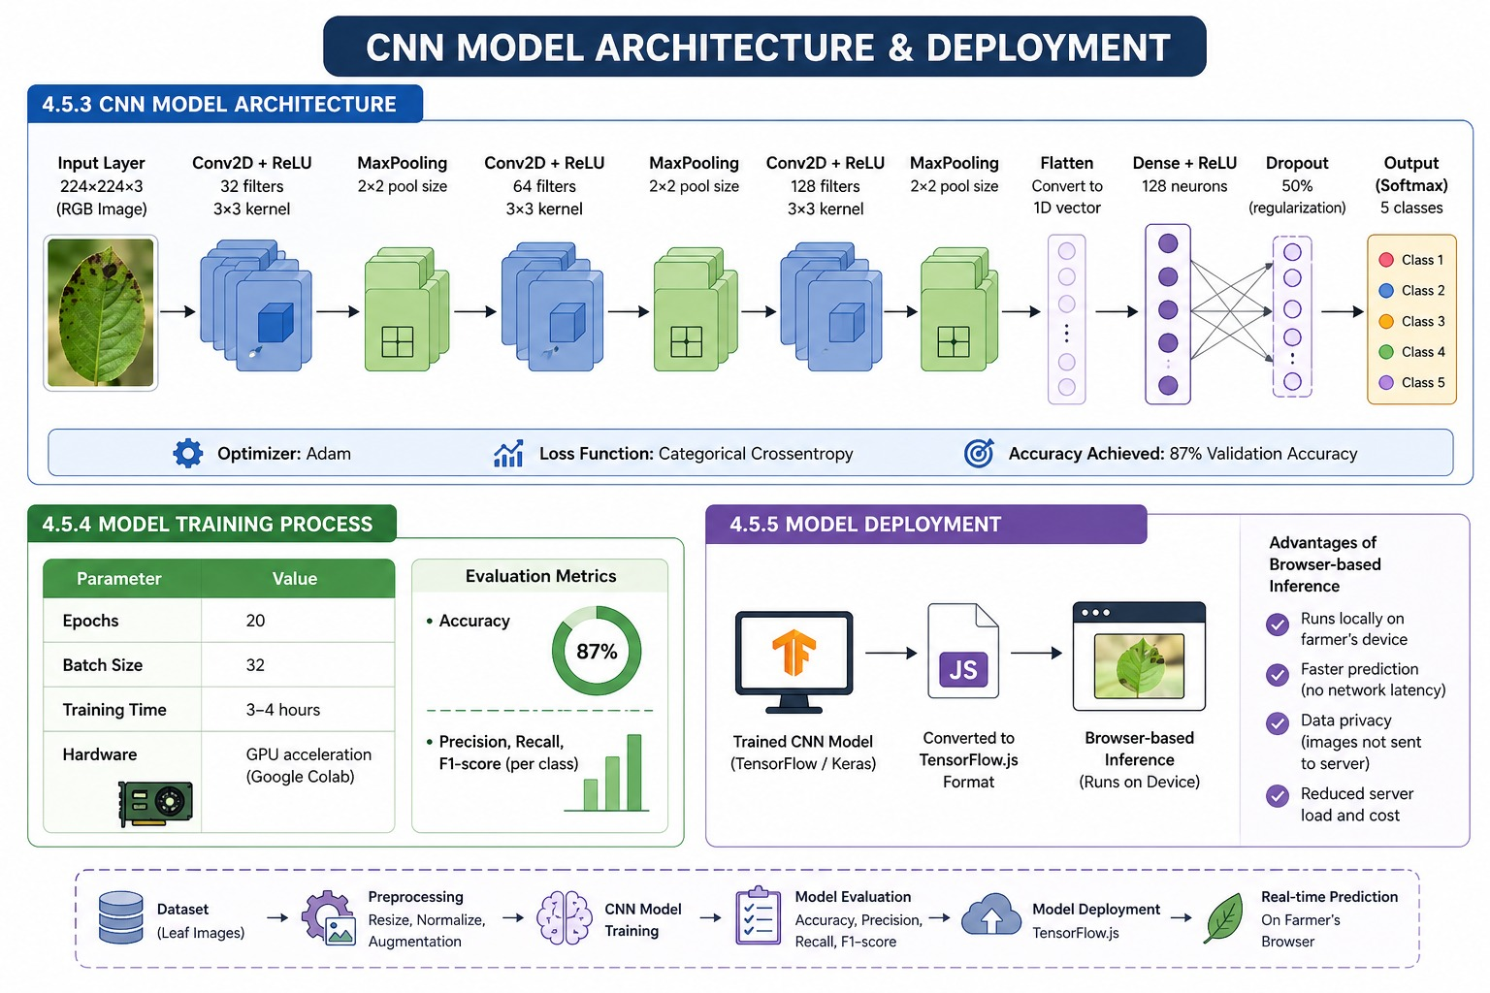
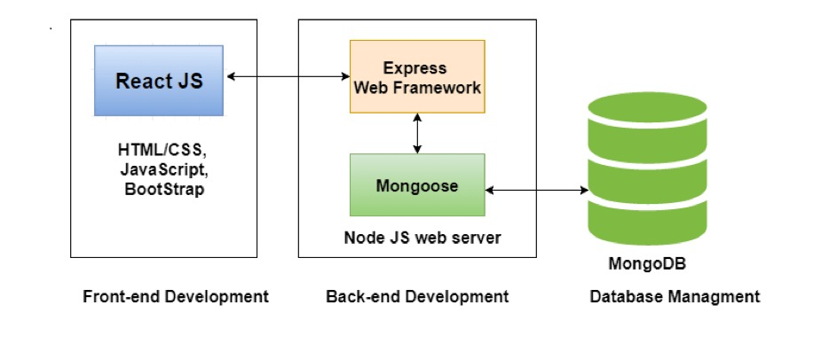
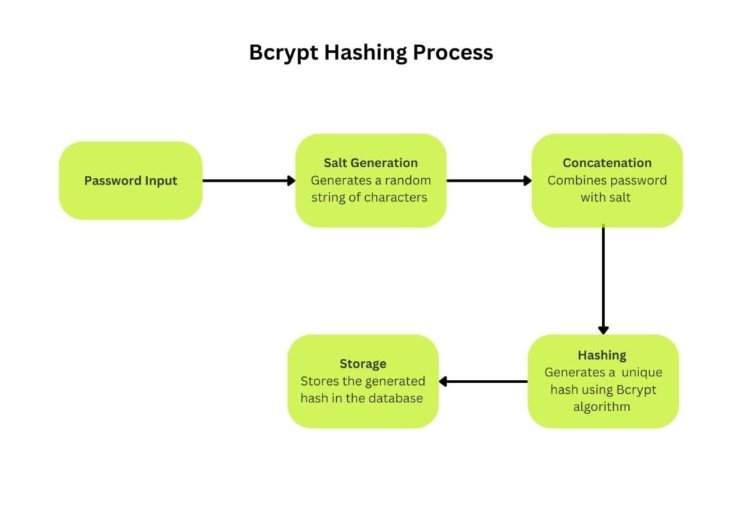
Database & AI Logic Integration
Data Architecture
MySQL: Relational database storing soil history, disease logs, and user profiles
MongoDB: NoSQL storage for agricultural blogs, research documents, and multimedia content
Layer | Technology Used | Benefit to Farmer
Data Management | Firebase Realtime Database | Instant price updates without manual refreshes.
Cloud Backend | Google Cloud Platform (GCP) | 99.9% availability for mission-critical farm tasks.
Navigation | Google Maps API | Accurate path-finding to mandis and storage.
AI Engine | TensorFlow Lite | On-device pest detection for offline areas.

Slide 7



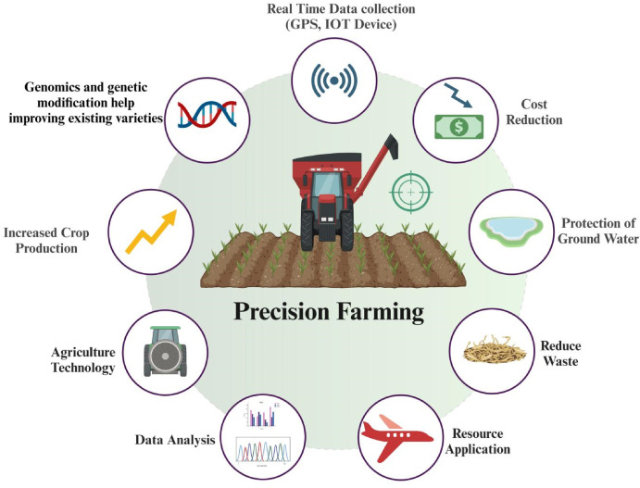
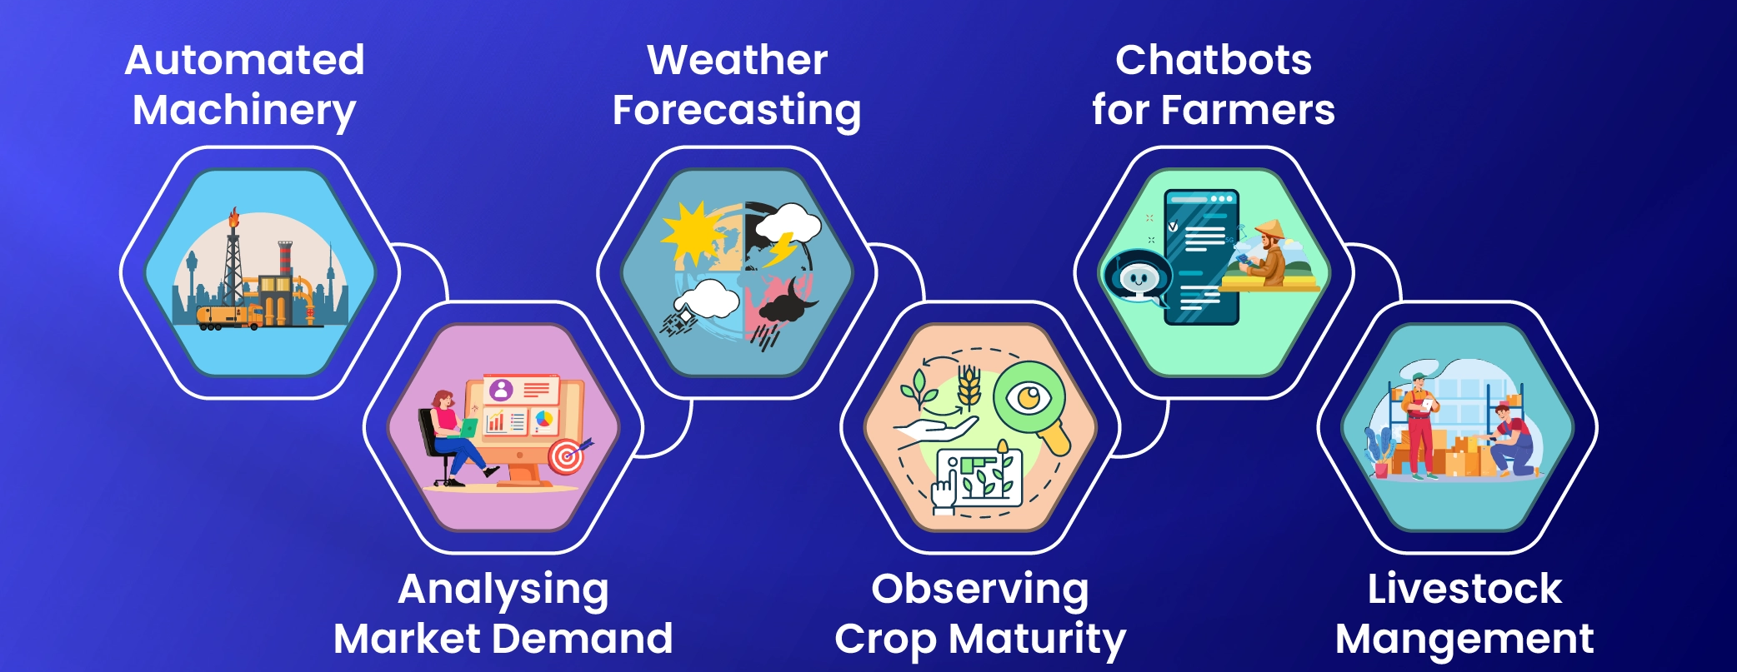
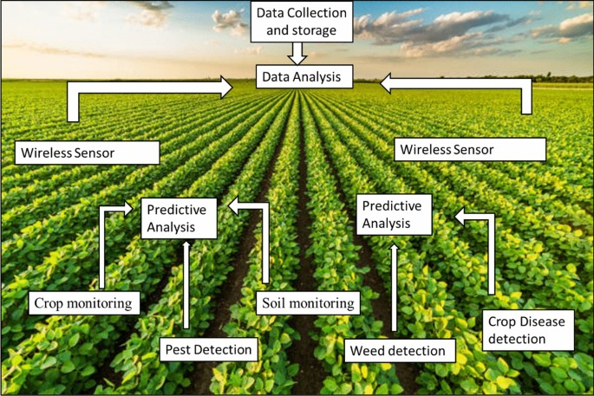

AI/ML Framework: Core Intelligence
Python Foundation
Natural Language Processing
Predictive Analytics
TensorFlow, Keras, and NumPy for building and training sophisticated machine learning models
Intent classification in chatbot enables understanding of farmer queries in natural, conversational language
Uses historical data to suggest optimal crops for specific soil parameters and weather conditions
Innovation: Moving from static information databases to dynamic, context-aware intelligence that learns from each interaction.

Slide 8
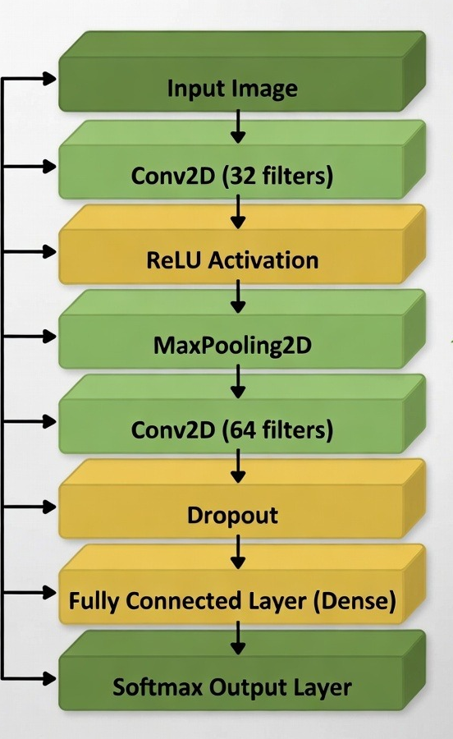
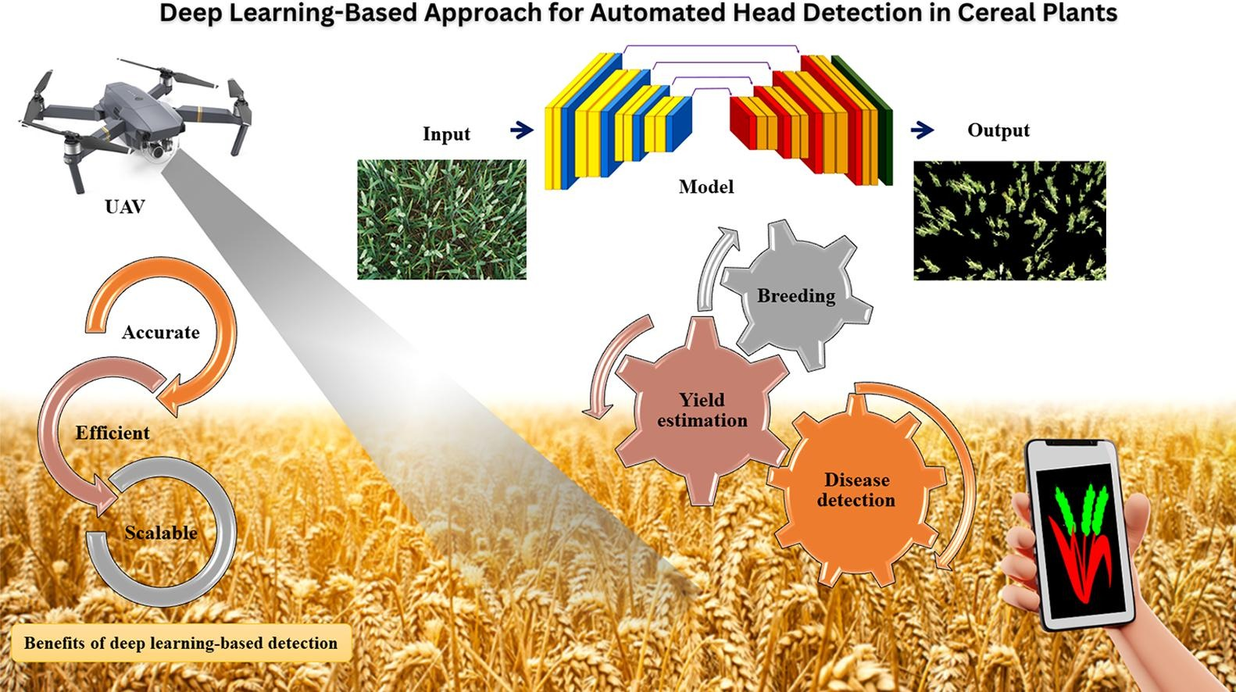
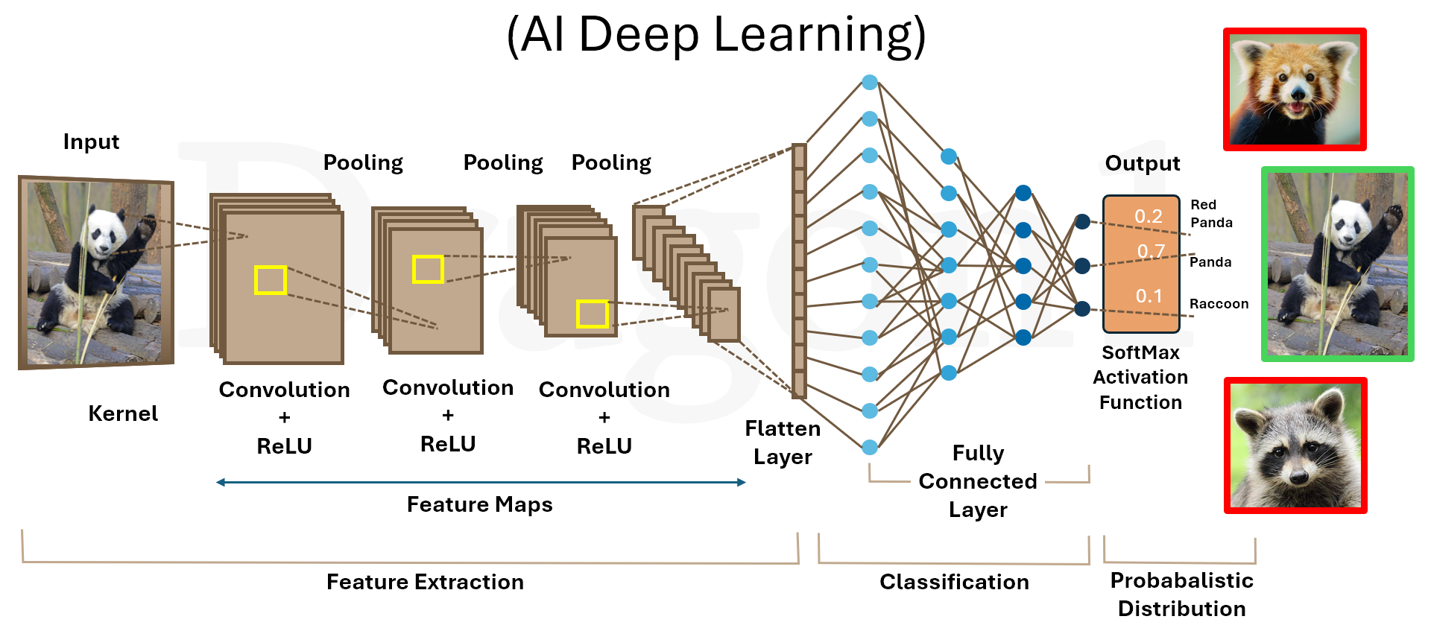
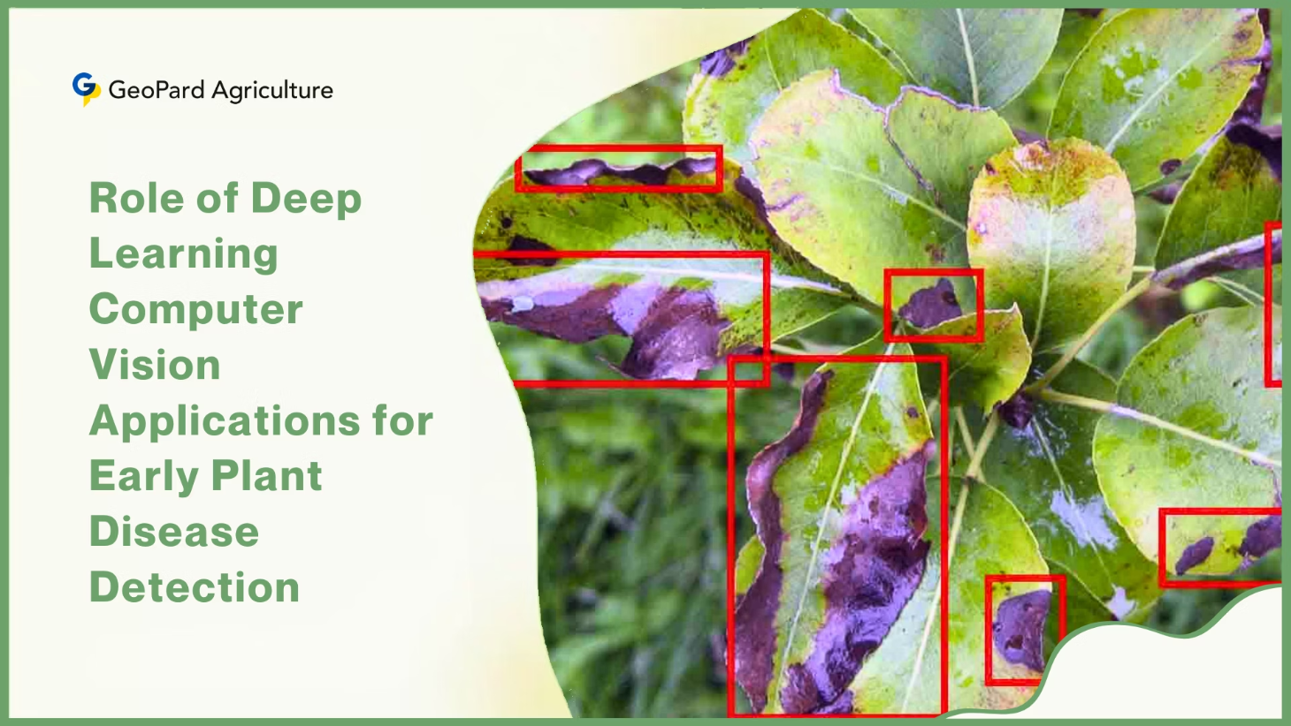
Deep Learning for Crop Diagnostics
Convolutional Neural Network (CNN)
Training Data: 15,000+ images from PlantVillage Dataset covering diverse crop diseases
Network Architecture
Input layer: 224x224 pixel images
Conv2D layers for feature extraction
MaxPooling for dimensionality reduction
Dropout layers preventing overfitting
Softmax output for disease classification
Accuracy: Detects diseases like Early Blight and Leaf Spot with 87%+ precision, enabling early intervention.

Slide 9
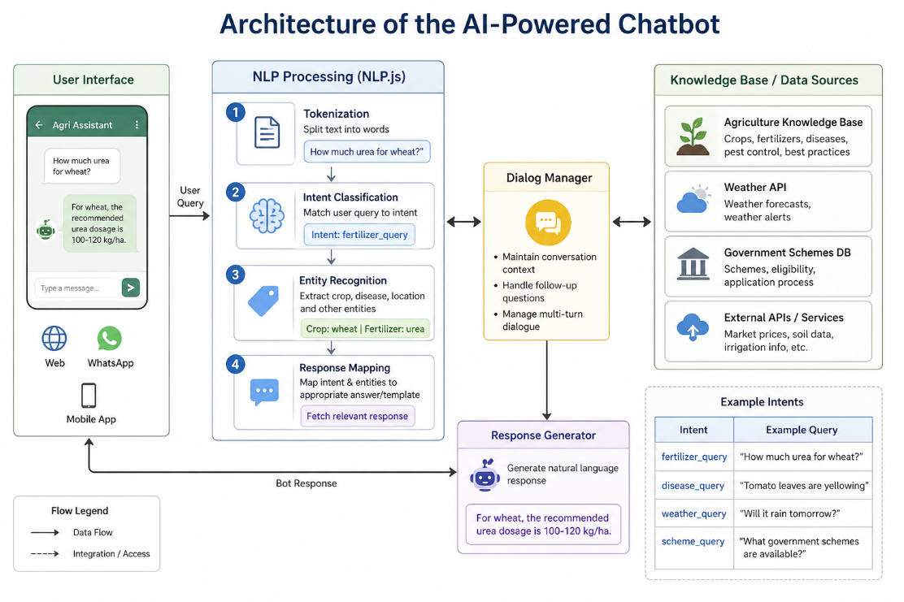
The Kissan Buddy: AI Chatbot
Context-Aware Communication
Multimodal Learning
Beyond text—integrated support for agricultural instructional videos and research PDFs
Powered by Google Gemini API, understands crop-specific queries based on your farm profile and history
Community Diary
Connects farmers to share tips, voice notes, and media for peer learning
USP: A 24/7 virtual agronomist in your pocket, providing expert guidance whenever needed.

Slide 10



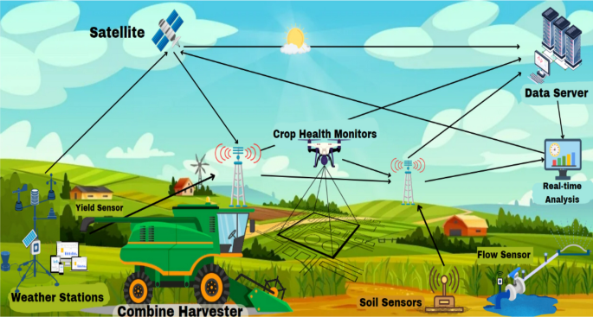
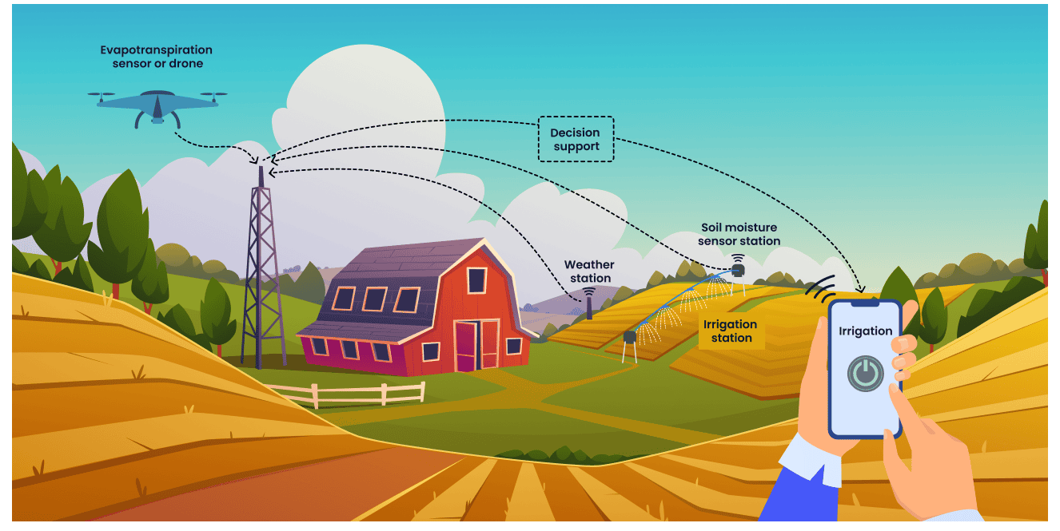
Future Vision: The Agri-Smart Revolution
AI + IoT Integration
Drone Advantage
Machinery Rental
Merging software with hardware: soil sensors and automated irrigation systems
NDVI vegetation mapping to spray pesticides only where needed, reducing costs and environmental impact
Custom system providing expensive precision farming equipment to small farmers at affordable costs

Slide 11


Conclusion & Impact
National Alignment
🌱 Agricultural Impact
Digital India – promoting digital empowerment in rural areas
Atmanirbhar Bharat (especially in agriculture) – reducing dependency and improving self-sustainability
Increased Crop Productivity
Reduced Crop Loss
Smart Resource Utilization
Data-Driven Decision Making
Better Market Access & Profitability
Thank You!
Using Data Science to ensure no farmer has to rely on guesswork again
Kissan Buddy isn't just an app—it's a comprehensive decision-support system directly contributing to Digital India and Atmanirbhar Krishi missions.

