Slide 1
Real Time Intrusion Detection System
Project Group -5
Naman Sharma
Anshika Bhatnagar
Mohd. Mudassir
Arzan Hussain

Slide 2
Introduction
- A security monitoring system utilizing computer vision for detecting unauthorized individuals and weapons.
- Integrates facial recognition and weapon detection using YOLOv3.
- Sends alerts via email and generates PDF reports upon detection.

Slide 3
Objectives
- Develop a real-time video monitoring system.
- Implement facial recognition for authorized personnel.
- Detect weapons using deep learning techniques.
- Notify the owner via email and generate reports for security incidents.

Slide 4
Requirements
Functional Requirements:
- Real-time video streaming from a webcam.
- Facial recognition for authorized users.
- Weapon detection using YOLOv3.
- Alarm system for unauthorized access.
- Email notifications with images and reports.
Non-Functional Requirements:
- Real-time operation with minimal latency.
- User-friendly interface for monitoring and alerts.
- Secure handling of email credentials and data.

Slide 5
Methodologies
Technologies Used:
- Flask, OpenCV, YOLOv3, Pygame, ReportLab
Development Process:
- Requirement analysis and design.
- Implementation of video streaming and detection algorithms.
- Testing and validation of the system.

Slide 6
System Architecture
- Diagram showing the flow from video capture to detection, notification, and reporting.
- Components:
Webcam → Flask Server → Detection Algorithms → Email Notification System → PDF Report Generation.

Slide 7
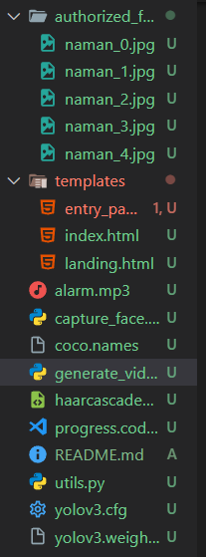
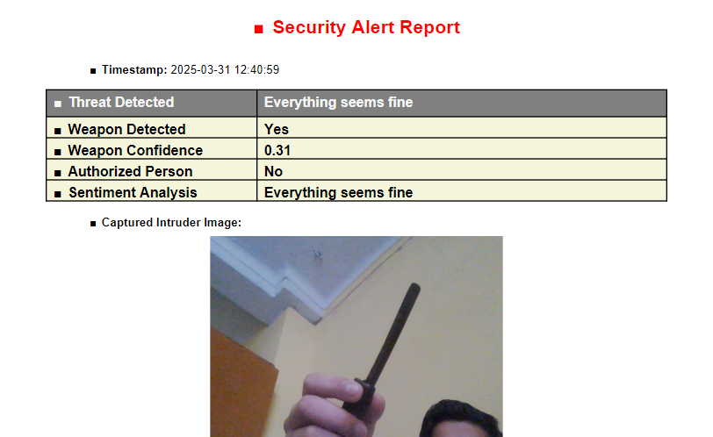

Slide 8
Key Features
- Real-time video monitoring.
- Facial recognition using LBPH.
- Weapon detection using YOLOv3 (guns, knives, swords).
- Alarm system for unauthorized access.
- Email alerts with images and reports.

Slide 9
Conclusion
- Successfully developed a security monitoring system.
- Achieved real-time detection and alerting.
- Potential for future enhancements and real-world applications.

Slide 10
Q&A
Open the floor for questions and discussions.

