Slide 1
LDPC Error Correction Code
Naman Singh

Slide 2
Headline Arial Bold 24 pt Table of contents, option 1
1 | Chapter 1 Introduction
2 | Chapter 2 Problem statement, Arial Regular 18 pt Setup , Modbus
3 | Chapter 3 Need, Error correction
4 | Chapter 4 Encoding || Decoding Evaluation: AWGN
5 | Chapter 5 Next steps

Slide 3
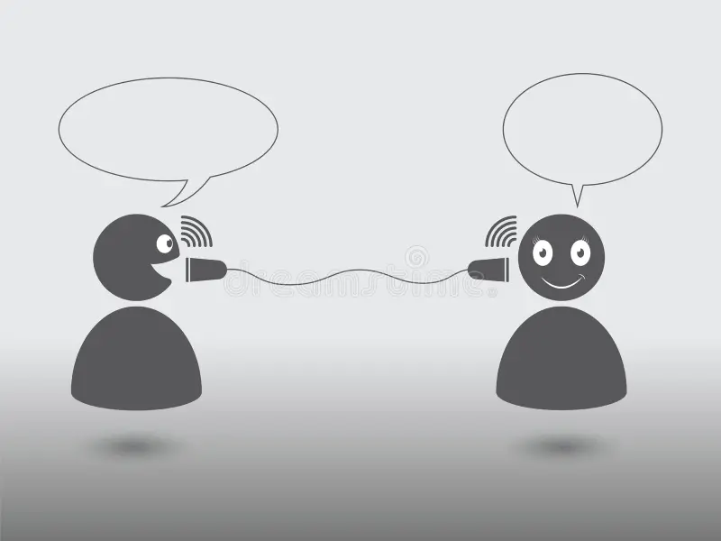
Problem Statement
In real world communication system, the transmitted signals may experience significant degradation due to noise (Received bits !=Emitted bits). This interference is leading to errors in the received data, hindering the reliability and efficiency of our communication.
10001010
10011010

Slide 4



Problem Setup :
Real Scenario Experiment Setup
MODBUS MASTER
MODBUS
SLAVE
MODBUS POLL Simulator
MODBUS
SLAVE Simulator
Channel Noise
AWGN Noise
Encoder
Decoder Error Correcting Codes
.

Slide 5
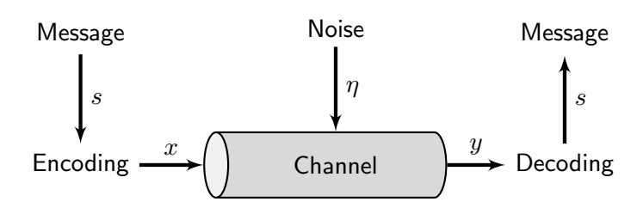
Channel Noise
In simulation using AWGN

Slide 6
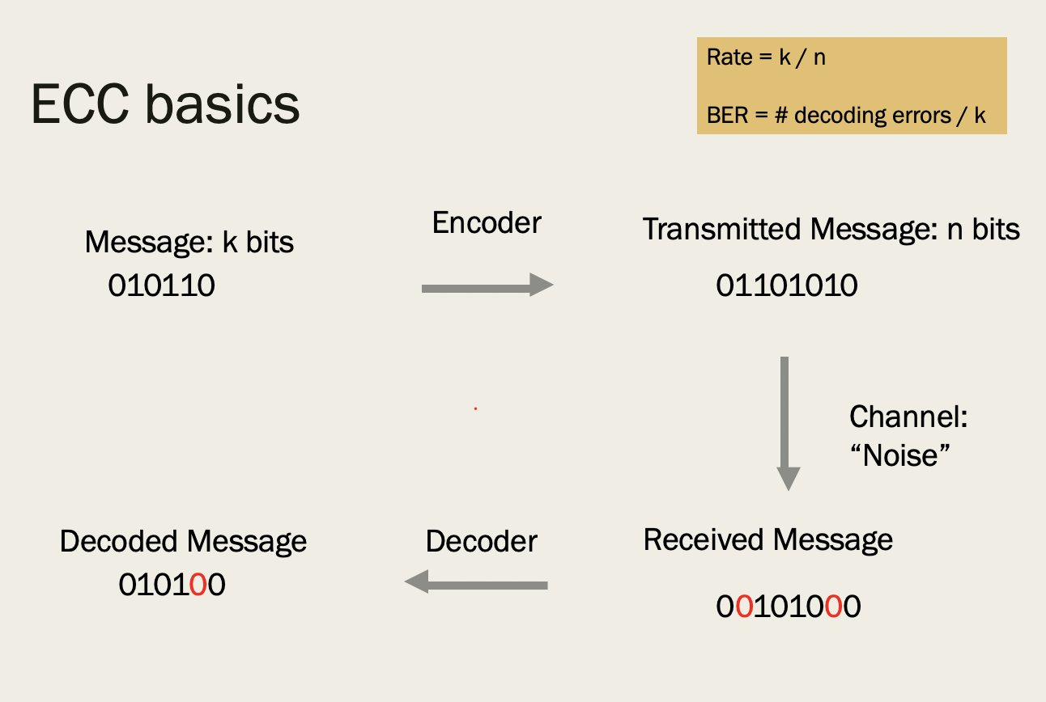
Error Correcting Codes

Slide 7
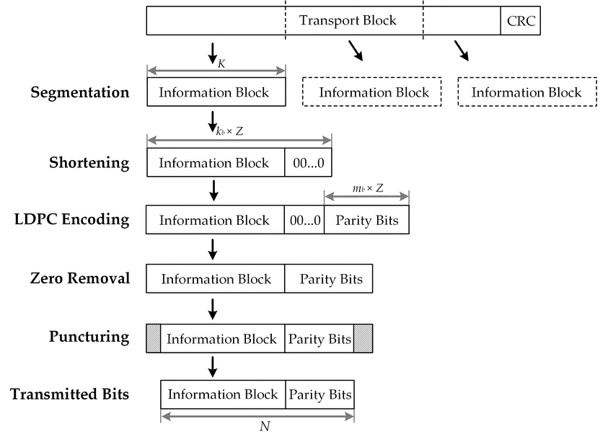
Low Density Parity Check

Slide 8
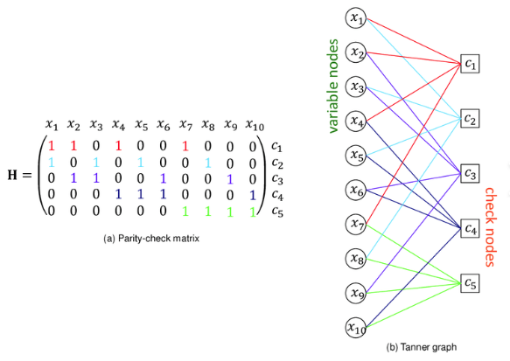
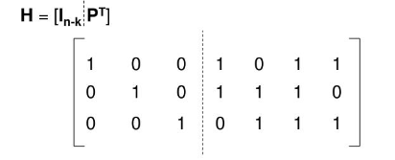
LDPC Requirements
Sparse Parity-Check Matrix : Defines the relationship between the codewords and their corresponding syndromes.

Slide 9
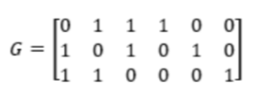

Encoding I(not encryption)
->Message Vector
->Generator matrix (Hamming Codes)
->Parity (this is the technique )
number of 1s: Even == 0
Odd == 1
[1, 0, 1, 1]

Slide 10
Decoding (Iterative)
Syndrome : A common Technique used to decode linear error-correcting codes
S = H⋅rTa
S = Syndrome
H = Parity-check matrix
r = Received vector
r^T = Transpose of r

Slide 11





Why LDPC ?
High Performance
Flexible Design
Flexible Design
Iterative Decoding
Low-Complexity Implementation
Wide Range of Applications

Slide 12
Decoding II
Belief Propagation(Sum-Product)

Slide 13
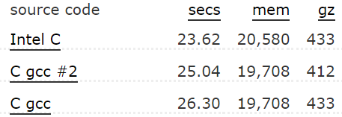
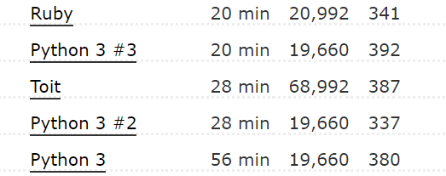
Code Design
Program in C language
C for fast computation
Approximately 6-8 GigaBytes of daily data in C would take around 5 seconds

Slide 14
Next Steps
For Choice of algorithm :-
Latency
Throughput
Application Requirements
Error Rate
For Implementation :-
Evaluate LDPC with AWGN
Belief propagation
Notes:
The desired bit error rate (BER) should be considered when selecting LDPC code parameters. Higher-performance LDPC codes may be required for applications that demand extremely low error rates.
: For applications with strict latency requirements, the decoding algorithm's computational complexity and convergence speed should be carefully evaluated.
: The code's throughput, which is the rate at which data can be transmitted, is another important factor to consider.

Slide 15
Extras
-Primitive Polynomials
-Golomb Rulers
-Minimum Distance
-Rate-Compatibility

