Slide 1
Time Series and Regression Final Project “Analyzing delivery lead time using Regressive Techniques”
Kenil Patwa
Nihil Kottal
Naman Singh
GROUP 5

Slide 2
Index
Goal
Regressors
Data Cleaning
Running Base Model
Base Model Results Discussion
Removing Outliers
Feature Engineering
Checking for outlier and normality
Running Backward model
Removing Outliers
Final Model
Comparison

Slide 3
Goal
The goal of this project is to predict the delivery time of food orders based on various factors including weather conditions, road traffic density, type of vehicle used, and the geographic coordinates of the restaurant and delivery locations. This analysis will help optimize delivery operations and improve customer satisfaction.
General perception is that the delivery time depends on the traffic, however, based on our analysis we found out that the delivery time depends on other factors as well.

Slide 4
Regressors
Delivery Person Age: Numeric range from 15 to 50.
Delivery Person Ratings: Categorical data ranging from 1 to 5.
Weather Conditions: Categories include Sunny, Stormy, Sandstorms, Cloudy, Fog, and Windy.
Road Traffic Density: Categorical levels are High, Jam, Low, and Medium.
Vehicle Condition: Categorical scale from 0 (poor) to 3 (good).
Type of Order: Categories are Snack, Drinks, Buffet, and Meal.
Type of Vehicle: Includes motorcycle, scooter, electric scooter, and bicycle.
Multiple Deliveries: INT 0, 1, 2, 3.
Festival: Binary categorical, YES or NO.

Slide 5
Data Cleaning
Extract Delivery Time to numeric format: Convert Time_taken(min) to numeric format, stripping unnecessary text.
Normalize Weather Conditions: Remove the extra text "conditions " from the `Weatherconditions` field for uniformity.
Date Conversion: Convert `Order_Date` from string format to a date object.
Add Day of the Week: Create a new variable `day` to represent the day of the week for each order date.
Filter Non-Numerical Entries: Remove entries where categorical variables (`Festival`, `City`, `Weatherconditions`, `Road_traffic_density`) incorrectly contain "NaN ".
Categorize Variables: Convert variables (`Weatherconditions`, `Road_traffic_density`, `Vehicle_condition`, `Type_of_order`, `Type_of_vehicle`, `multiple_deliveries`, `Festival`, `City`) to categorical data types.

Slide 6
Running the Base Model
We ran the base model with the following factors keeping Time taken in mins as Dependent variable:
Delivery_person_Age
Delivery_person_Ratings
Weatherconditions
Road_traffic_density
Vehicle_condition
Type_of_order
Type_of_vehicle
multiple_deliveries
Festival
City

Slide 7
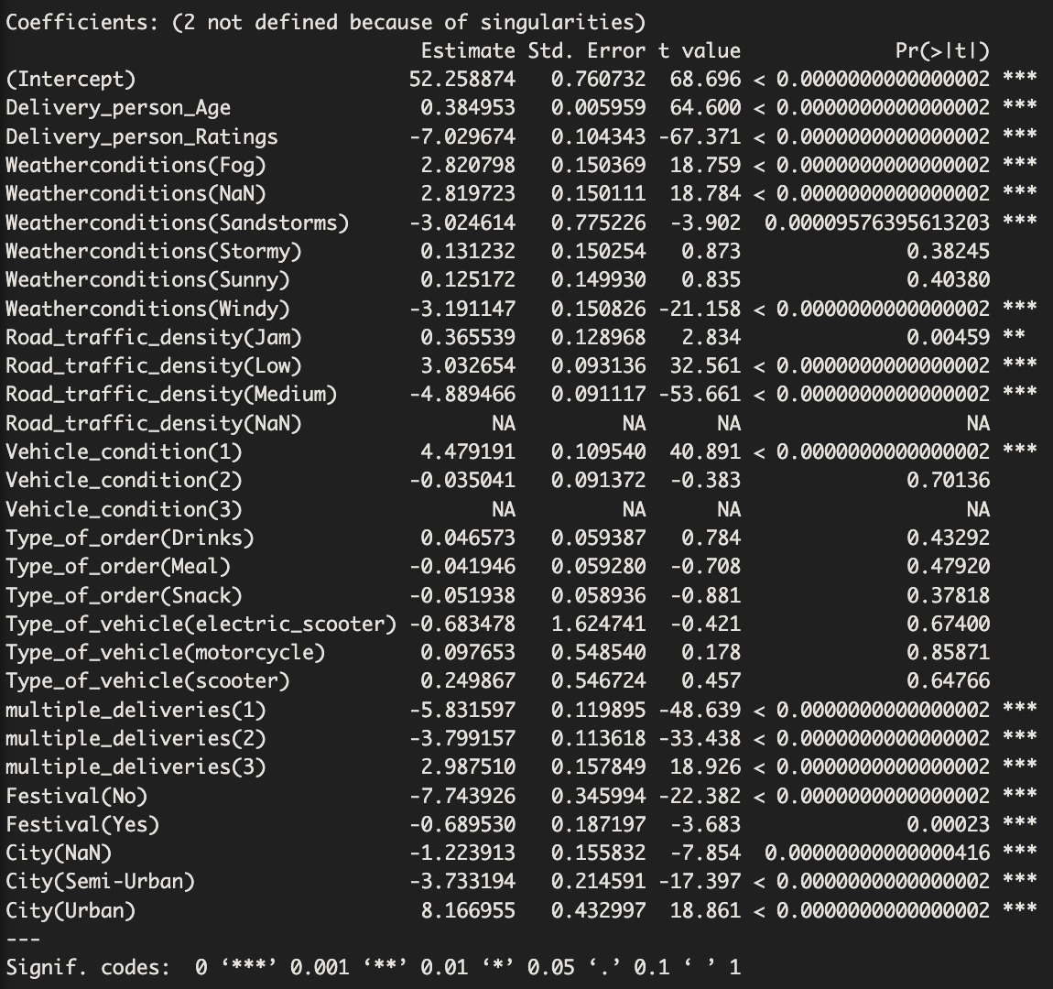

Slide 8
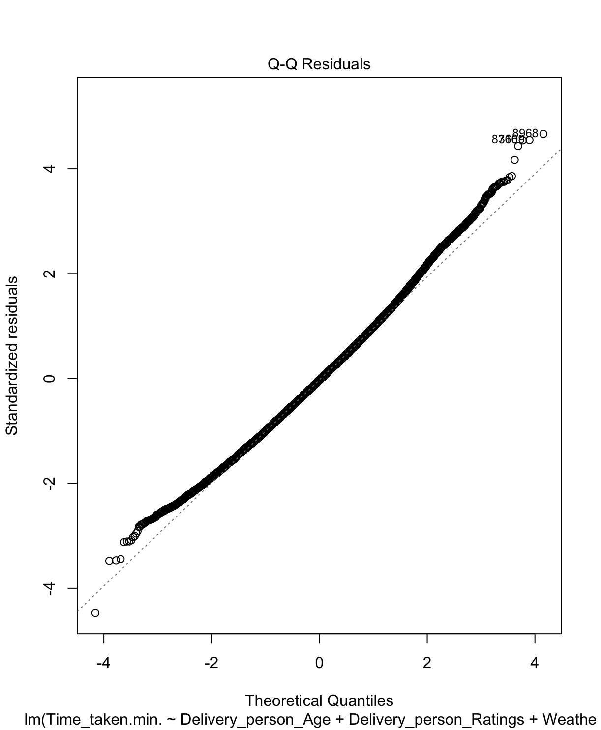
Base Model Results
Multiple R-squared: 0.5907,
Adjusted R-squared: 0.5903
F-statistic: 1657 on 27 and 30998 DF,
p-value: < 0.00000000000000022
QQ PLOT ADD
MSE: 35.86135
Notes:
ADD PLOT FOR THIS MODEL

Slide 9
Removing Outliers
After using the DFFITS to find potential outliers, we were able to remove 13748 entries from the dataset.
Rejection region: > 2/sqrt(n) = 0.01174359
After removing the outliers, we had 29004 entries.

Slide 10
Feature Engineering
Calculate Delivery Latency:
Create a binary variable LateDelivery indicating if the delivery time exceeded 30 minutes (1 if true, 0 otherwise).
Evaluate Employee Efficiency:
Categorize Delivery_person_Ratings into four efficiency levels:
Excellent: Ratings above 4.5
Good: Ratings above 3.5
Average: Ratings above 2.5
Poor: Ratings 2.5 or below
Distance Calculation Using Haversine Formula:
Implement the Haversine formula to calculate the geographic distance between the restaurant and delivery locations:
- Convert latitude and longitude from degrees to radians.
- Apply the Haversine formula to compute distance based on latitudinal and longitudinal differences.
- Result is provided in kilometers using the Earth’s approximate radius.

Slide 11
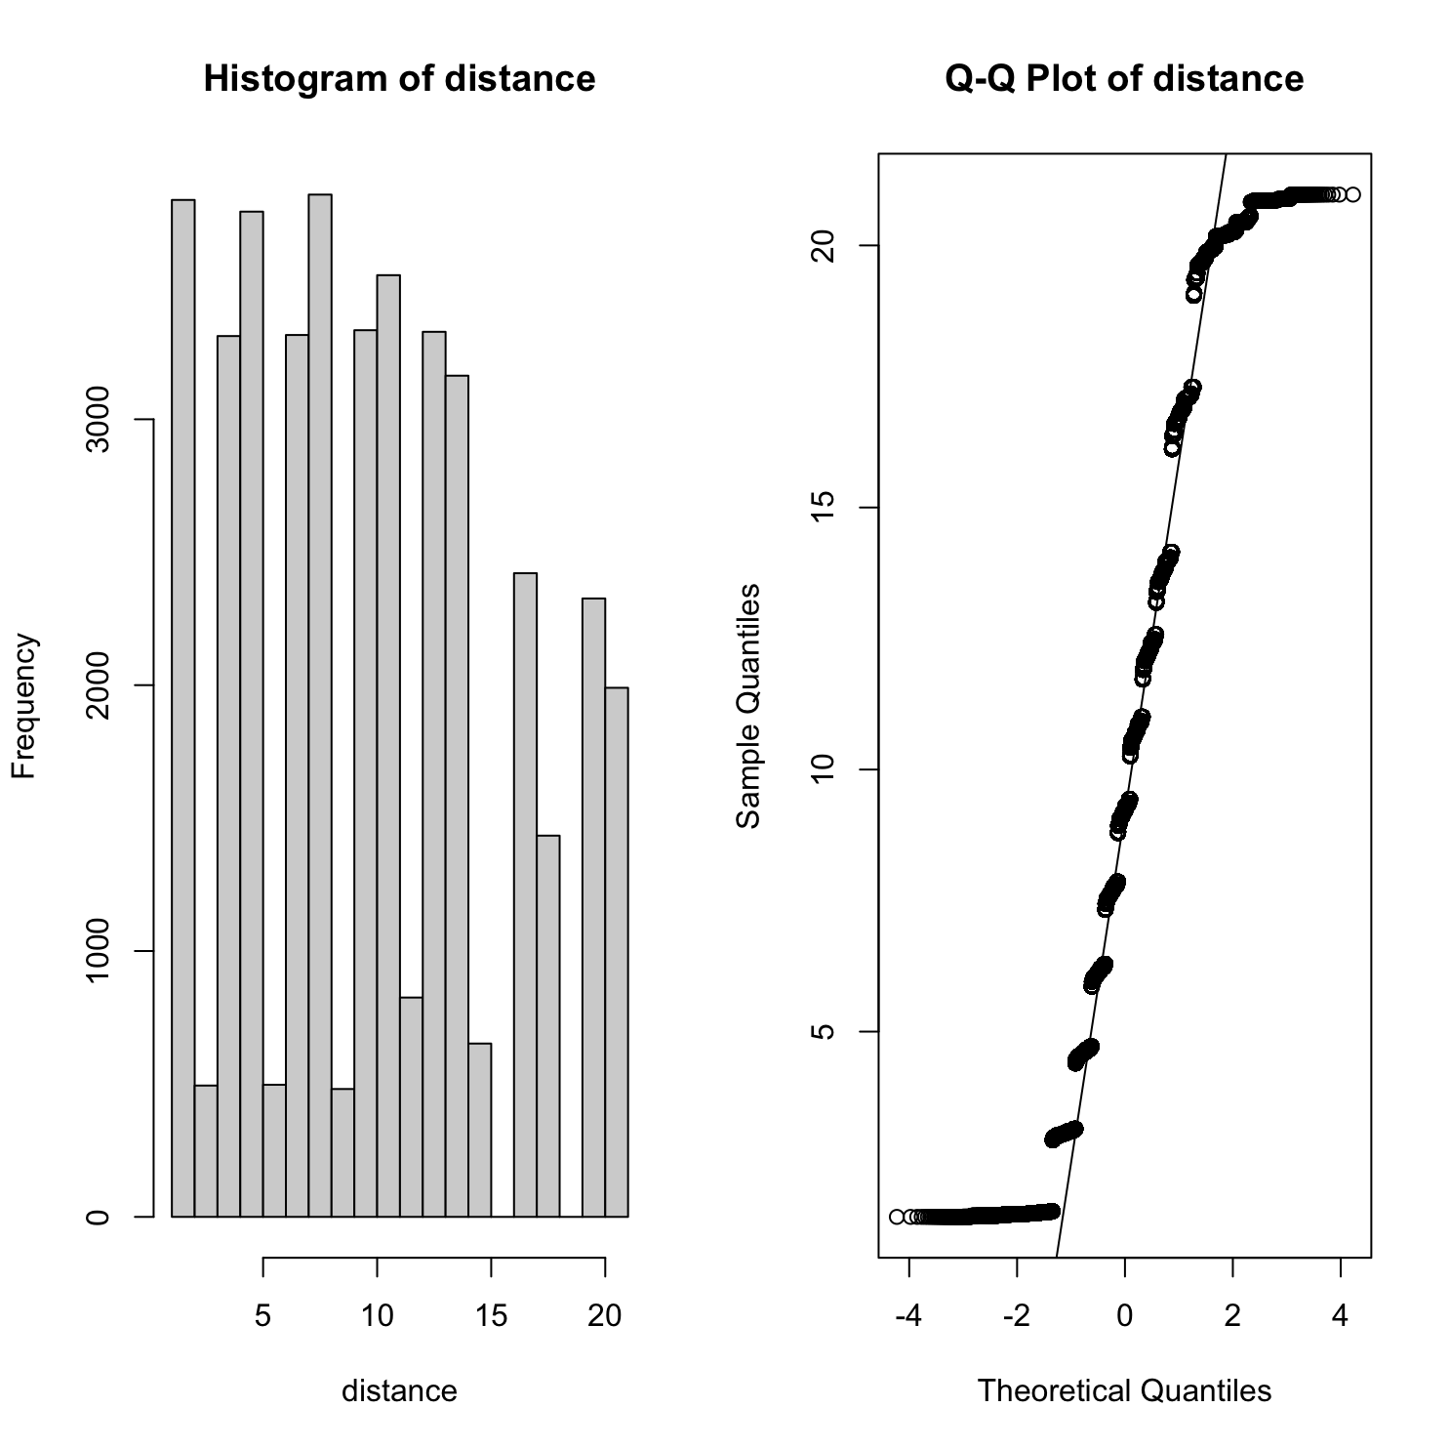
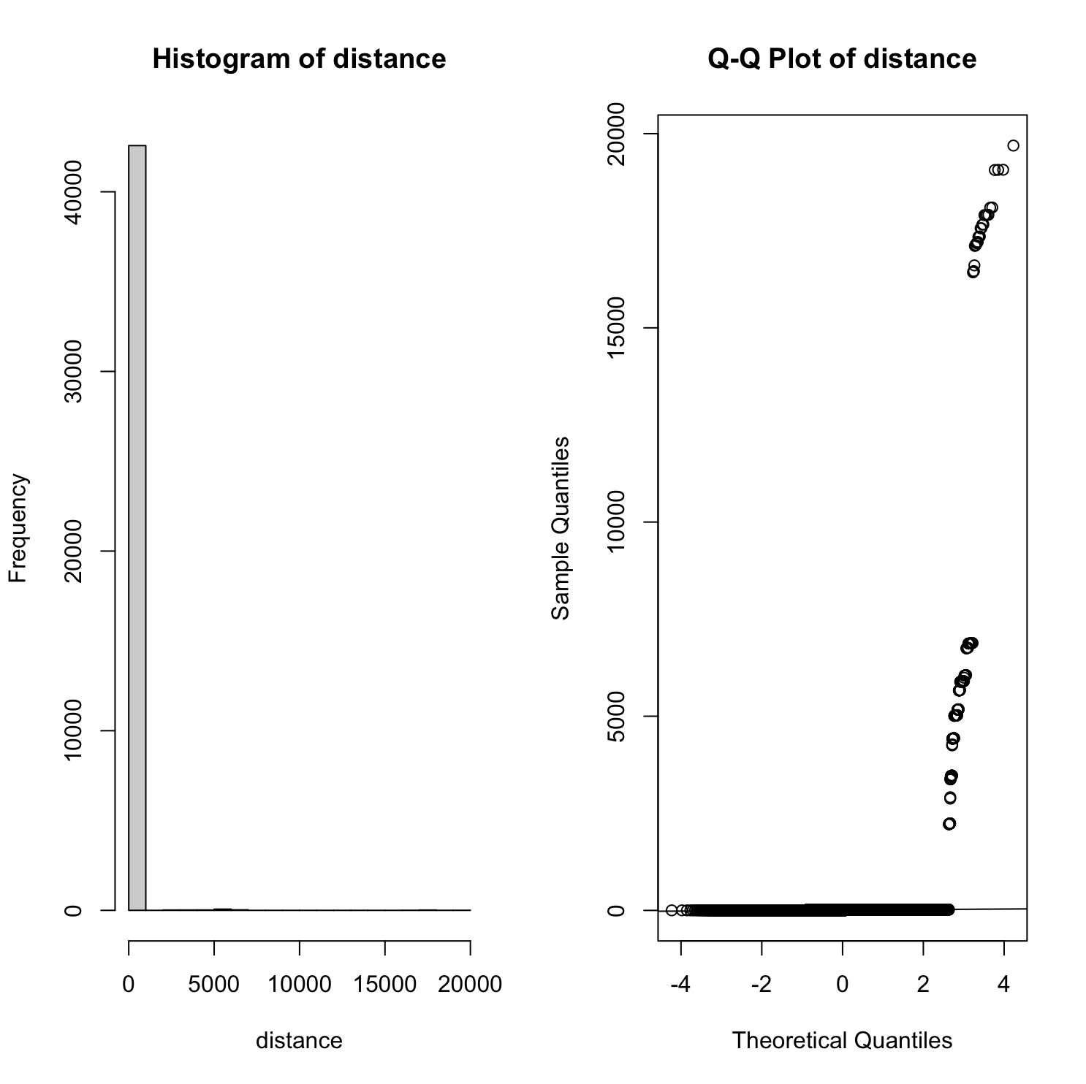
Checking for outliers and Normality
We wanted to analyze the distance parameter for normality.
We plotted the histogram and QQ plot.
We removed the outliers and we were able to see heavy-tailed distribution - Above the line in lower percentile and below the line in higher percentile.

Slide 12
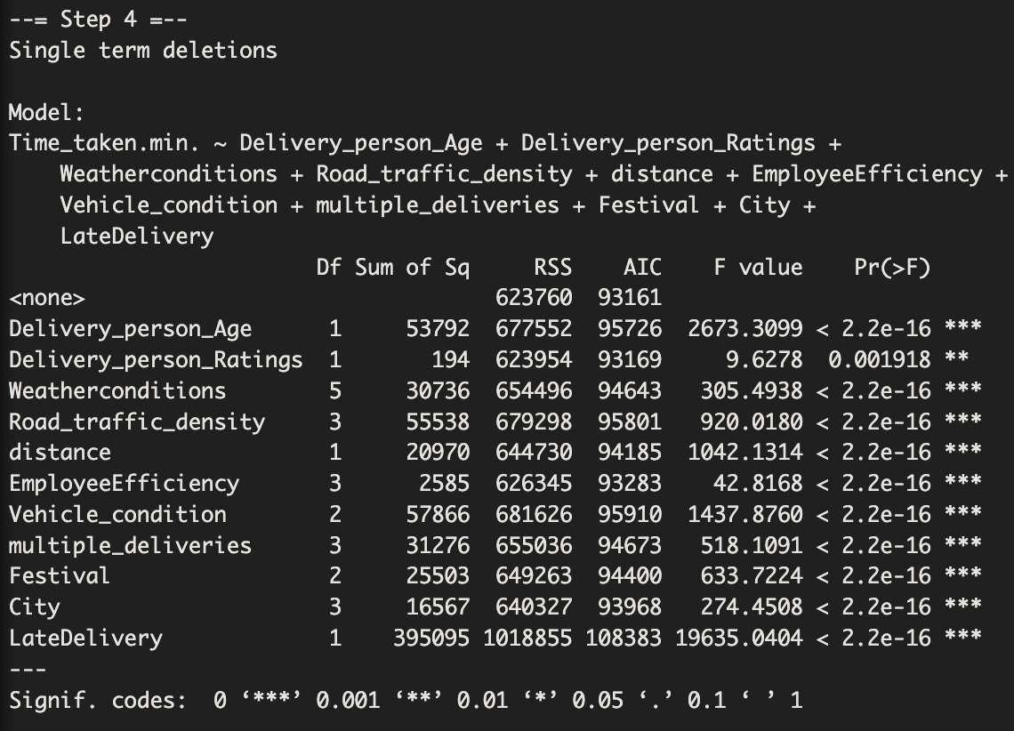
BACKWARD ELEMINATION
After 4th Step we go the final model as:
Regressors:
Delivery_person_Age
Delivery_person_Ratings
Weatherconditions
Road_traffic_density
distance
EmployeeEfficiency
Vehicle_condition
multiple_deliveries
Festival
City
LateDelivery

Slide 13
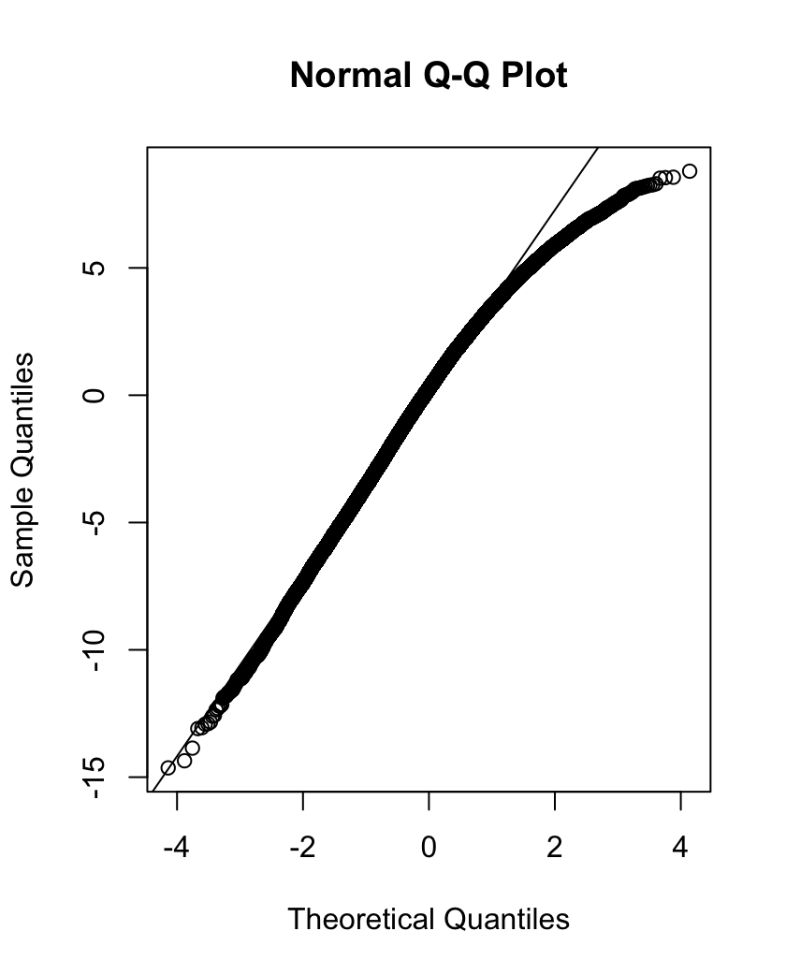
BACKWARD MODEL RESULTS
Multiple R-squared: 0.8076,
Adjusted R-squared: 0.8074
F-statistic: 4660 on 26 and 28863 DF
p-value: < 2.2e-16
MSE: 11.6725

Slide 14
Removing outlier from the Backward Model
After using the DFFITS to find potential outliers, we were able to remove 10456 entries from the dataset.
Rejection region: > 2/sqrt(n) = 0.01176674
After removing the outliers, we had 18434 entries.

Slide 15
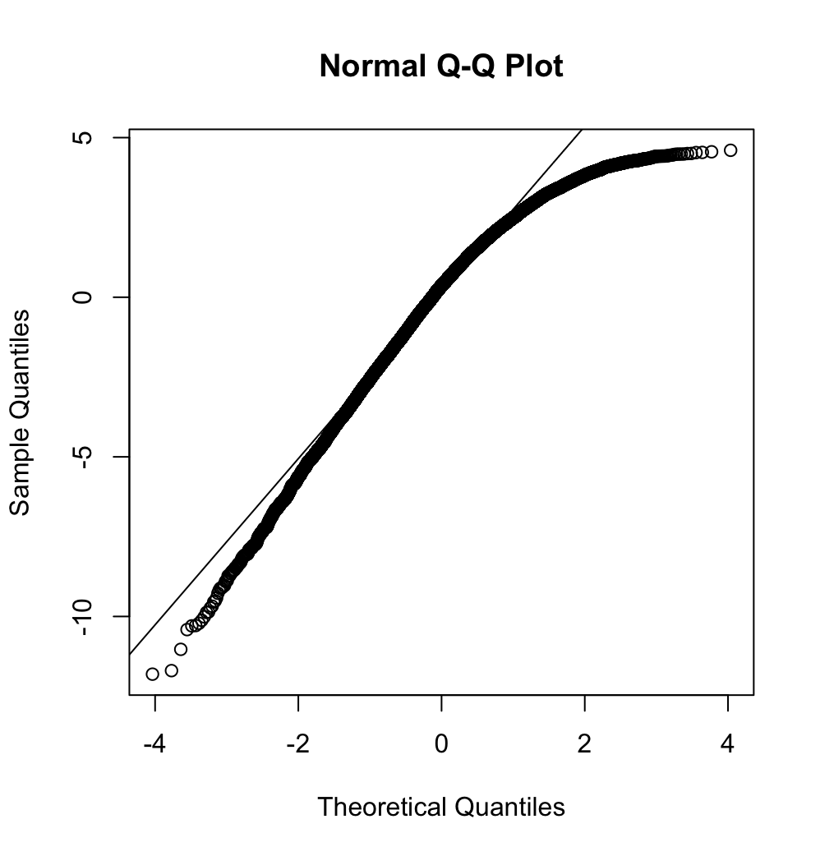
BACKWARD MODEL RESULTS AFTER REMOVING OUTLIERS
Multiple R-squared: 0.8959,
Adjusted R-squared: 0.8958
F-statistic: 6095 on 26 and 18407 DF
p-value: < 2.2e-16
MSE: 6.14284

Slide 16
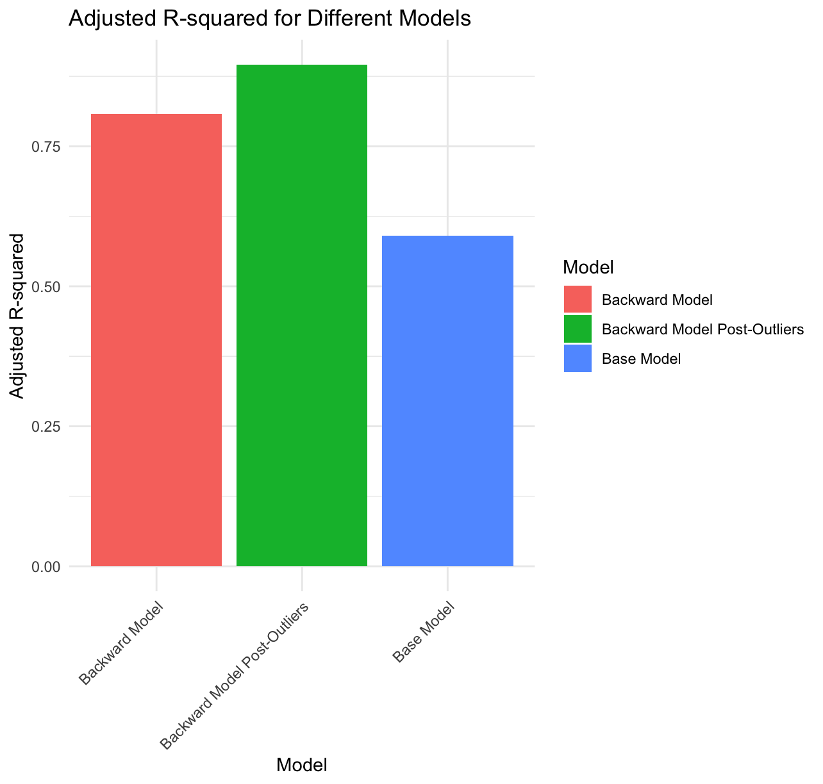
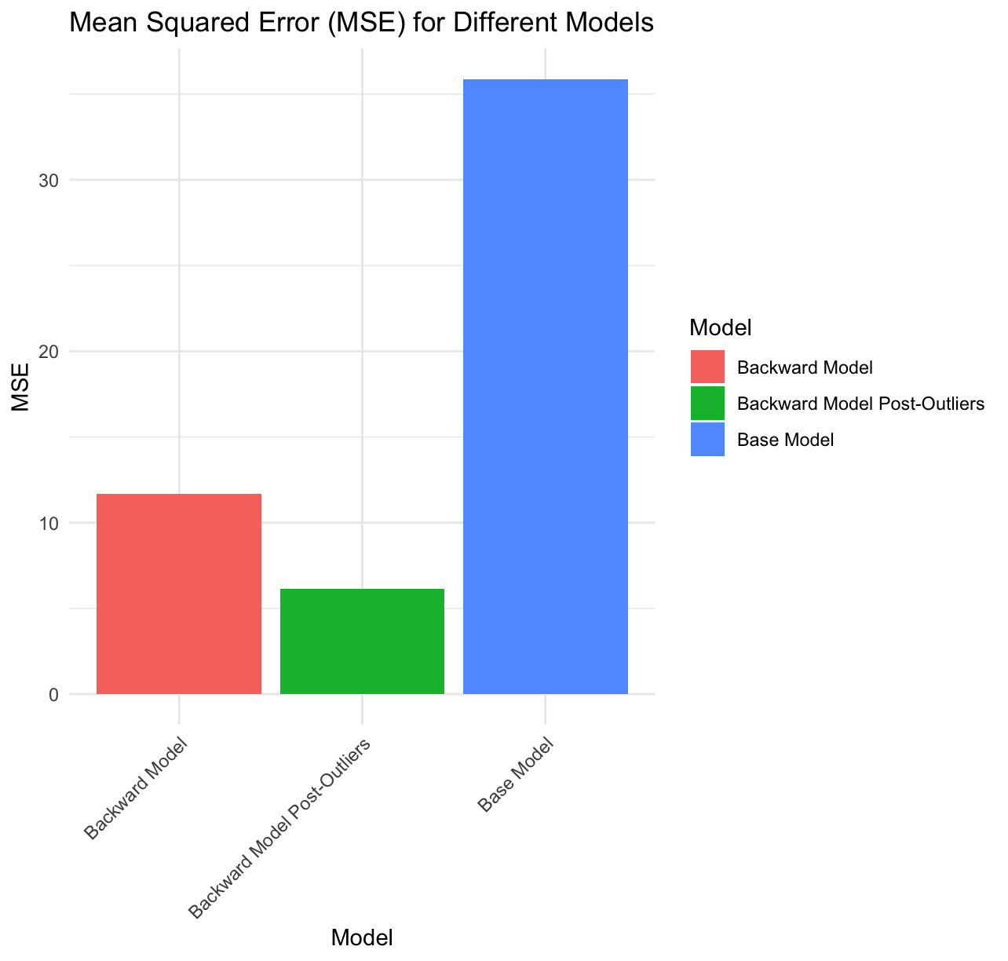
COMPARISION

Slide 17
Thank you

