Slide 1
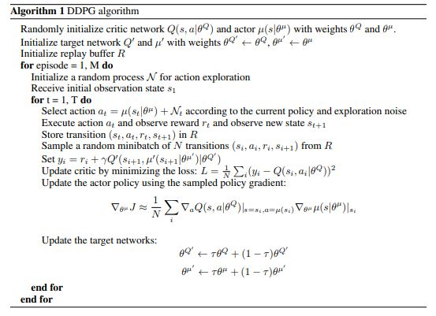
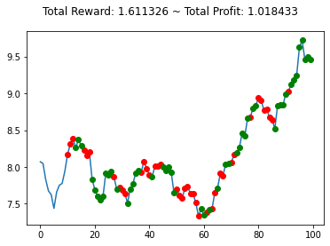
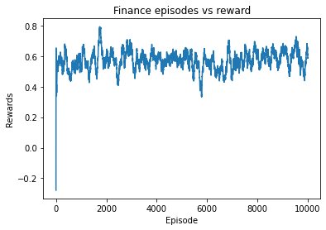

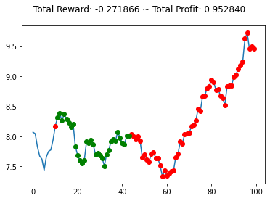
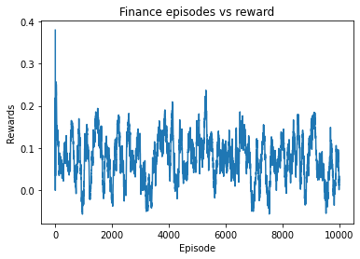
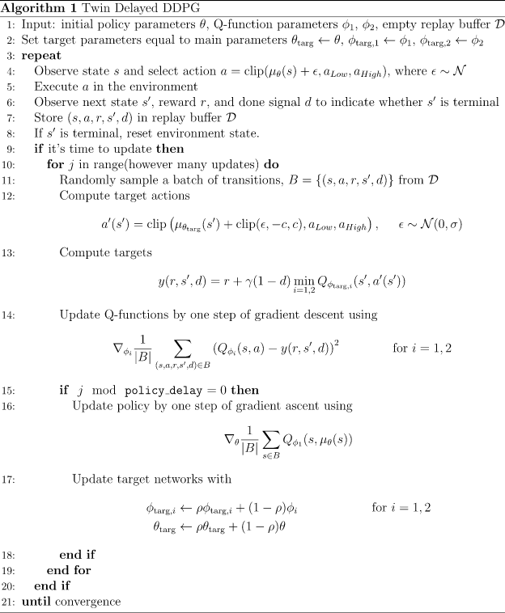
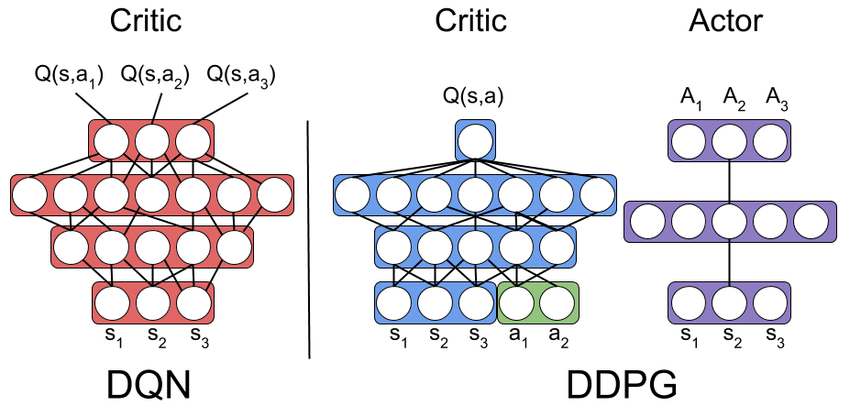
Stock Trading using Reinforcement Learning
Reinforcement Learning Project
Naman Tejaswi and Arshabh Semwal
Introduction
Reinforcement Learning is one of the machine learning paradigm, supervised, unsupervised and reinforcement learning.
A typical RL environment follows the Markov property and is modeled using a Markov Decision Process (MDP).
The Markov property states that the future is independent of the past given present.
Objective
We aim to maximize the long-term cumulative trading returns of our Agent by trading a particular stock. This seems a daunting task given all the hedge funds in the world (with much more sophistication) are competing for the same thing.
Traditionally deep neural networks with LSTM which capture long term relationship have been used for stock trading we have tried to apply reinforcement learning and have used DDPG (Deep Deterministic Policy Gradient) and TD3 (Twin Delayed Deep Deterministic Policy Gradient)
Environment Setting
The observation space is the daily price and volume of the stock, we have taken it as a continuous action space by considering each trading day as a timestep.
The reward function is proportional to the absolute return and takes into account the drawdown periods.
We have assumed the efficient market hypothesis meaning that we are able to buy at the quoted price without any slippages. We also haven’t taken transaction cost into account for now.
DDPG Deep Deterministic Policy Gradient
DDPG is similar to DQN but for continuous spaces instead of discrete spaces. DDPG combines the policy gradient method with DQN.
DDPG at a time learns both the Q function using bellman equation and a policy using policy gradient. DDPG uses 2 target networks like Actor Critic.
DDPG is an off-policy algorithm which can be used only in a continuous action space in the vanilla version.
DDPG does soft updates (“conservative policy iteration”) on the parameters of both actor and critic θ ′ ← τθ + (1 − τ )θ ′
In this way, the target network values are constrained to change slowly, different from the design in DQN that the target network stays frozen for some period of time.
Results
The Red scatter indicates a sell action by our DDPG model, and the Green action indicates a Buy action by our agent on the AAPL and AMZN Stock over 100 trading days..
TD 3
Total Cumulative Returns on 100 trading Days
DDPG 1.84% TD3 -0.5%
TD3 Twin Delayed DDPG
Twin Delayed DDPG is an is an extension to DDPG and has 3 additional techniques to DDPG which are:
Clipped Double-Q Learning. TD3 learns two Q-functions instead of one (hence “twin”) and uses the smaller of the two Q-values to form the targets in the Bellman error loss functions.
. “Delayed” Policy Updates. TD3 updates the policy (and target networks) less frequently than the Q-function
Target Policy Smoothing. TD3 adds noise to the target action, to make it harder for the policy to exploit Q-function errors by smoothing out Q along changes in action.
Since TD3 uses 2 different critic networks it selects the smaller value of the two networks.TD3 reduces the overestimating bias and is more stable than DDPG.
Future Works and Improvements
We were expecting better results with TD3 but DDPG in this case DDPG performs better as the delayed update to the model policy is slowing down the policy learning. In addition, we need to further refine our models
We also tried working with options with black Scholes model, but we only had free data for 5-minute interval.
Our long-term goal is to o use RL for portfolio optimization by hedging our positions using options and we hope to take this up as a project next semester.
Environment Setting
We have selected a random time period of 100 trading days to evaluate our model and we have used the publicly available yahoo finance data. The model is given the input as the open close low and high prices along with the daily volume for 3000 trading days ~12 years.
References
https://www.coursera.org/learn/advanced-methods-reinforcement-learning-finance
https://spinningup.openai.com/en/latest/
https://github.com/AI4Finance-Foundation
https://web.stanford.edu/class/psych209/Readings/SuttonBartoIPRLBook2ndEd.pdf
https://www.cs.princeton.edu/courses/archive/fall09/cos323/papers/black_scholes73.pdf
Computer Science Department CSE 546 Reinforcement Learning by Dr. Alina Vereshchaka
namantej@buffalo.edu asrshabhs@buffalo.edu

