Slide 1

Nethikes IT Solutions
Mobile Phone Dataset Analysis
Comprehensive exploratory data analysis of 541 smartphone specifications across 12 features including brand, memory, camera, battery, and pricing
By Namrata Farmer

Slide 2
Dataset Overview
541
10
Smartphone Models
Features Examined
Unique devices analyzed
Technical specifications
187
Unique Models
Across various brands
The dataset contains comprehensive smartphone specifications with no duplicate entries or missing values. Data cleaning included removing unnecessary columns, converting prize values to integers, and standardizing camera specifications by removing "MP" suffixes.

Slide 3
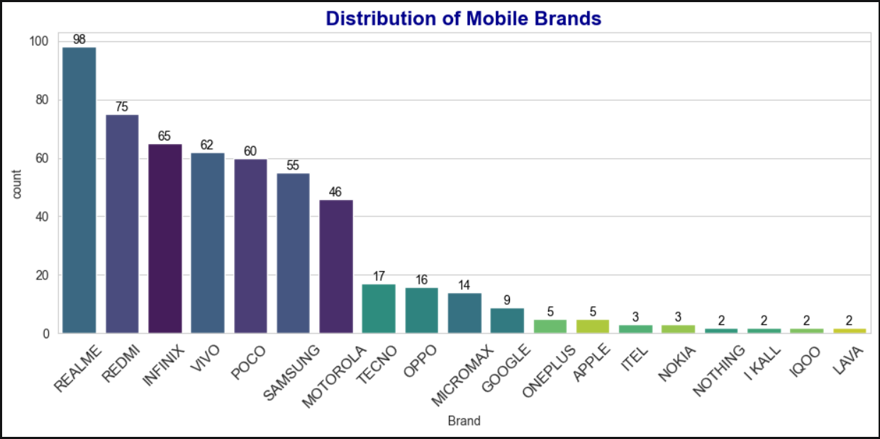
Brand Distribution Analysis
Market Leaders
Premium Presence
REALME and REDMI dominate the dataset with the highest model representation, indicating strong market presence in the mid-range segment.
APPLE and ONEPLUS have limited presence, while NOTHING, I KALL, IQOO, LAVA, ITEL, and NOKIA have negligible representation.
Mid-Range Players
INFINIX, VIVO, and POCO show significant representation, reflecting competitive positioning in their respective segments.

Slide 4
Processor Category Distribution
Mediatek Helio
Qualcomm Snapdragon
170 entries - Budget/mid-range focus
130 entries - Performance tier
Mediatek Dimensity
Unisoc
109 entries - Mid-range emphasis
64 entries - Moderate presence
Processor distribution shows Mediatek (Helio + Dimensity combined) holds largest share, highlighting strong presence in budget and mid-range devices. Exynos appears in 26 entries with limited usage. Tensor processors show minimal representation at 8 times, limited to specific premium devices.

Slide 5


Memory and Storage Analysis
110.55
128
1.03
Average Memory (GB)
Median Memory (GB)
Skewness
Memory ranges from 16 GB to 256 GB with 541 observations. Distribution shows slight left-skew as mean is lower than median. IQR shows 50% of devices have memory between 64-128 GB. Strong clustering at 128 GB indicates it as most common configuration. Multiple peaks suggest market segmentation: budget (64 GB), mid-range (128 GB), and premium (256 GB).

Slide 6



RAM Configuration Insights
4 GB RAM
6 GB RAM
8 GB RAM
Highest frequency - Mid-range standard
Second most common - Balanced performance
Performance tier - Premium segment
Mean RAM at ~5.4 GB with median at 6 GB shows nearly symmetric distribution. Values range from 2-8 GB with IQR of 4-8 GB. KDE plot shows multiple peaks suggesting market segmentation with highest density around 4 GB and 8 GB configurations.
Key Finding
4 GB RAM variant has highest frequency, followed by 8 GB and 6 GB, indicating strong usage of mid-range configurations.

Slide 7
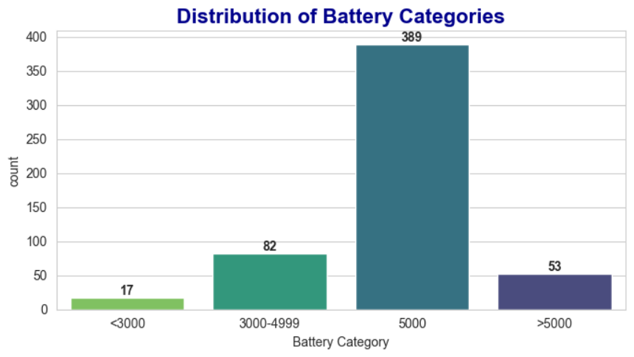
Battery Capacity Distribution
4872
Average Battery (mAh)
5000
Median Battery (mAh)
Battery capacity shows highly left-skewed distribution with strong concentration at 5000 . Minimum battery is 800 while maximum reaches 7000 .
The dataset shows a highly concentrated distribution around 5000 .
Lower battery categories are minimal and largely represent outdated or less relevant devices.”

Slide 8

Camera Specifications
Rear Camera
Mean 46.11 MP with median 50 MP. Strong concentration at 50 MP (260 devices). Values range 0-200 MP with positive skewness 1.80.
Front Camera
Mean and median show mainstream cluster at 16 MP. Higher resolutions (>32 MP) appear in premium devices as niche strategy.
Camera analysis reveals 50 MP as most common rear camera configuration with 260 devices. Ultra-high resolutions (108-200 MP) represent premium differentiation. Front camera shows weaker correlation with memory, suggesting selfie cameras capped at mid-range resolutions across devices.

Slide 9
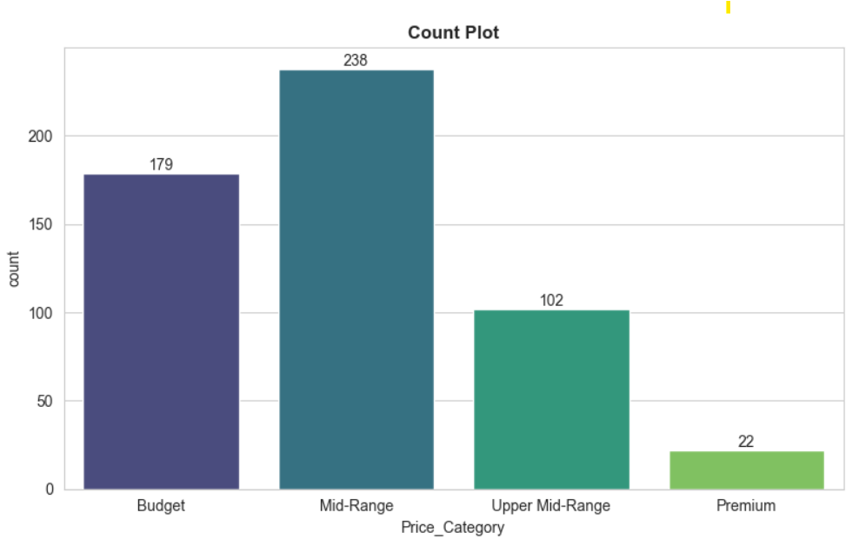
Price Distribution and Segmentation
Budget
179 devices under ₹10,000
Mid-Range
238 devices ₹10,000-₹20,000
Upper Mid-Range
102 devices ₹20,000-₹35,000
Premium
22 devices above ₹35,000

Slide 10
Key Correlation Insights
Memory ↔ RAM (0.63)
Memory ↔ Prize (0.57)
Strong positive relationship indicates higher RAM devices tend to come with higher storage capacity
Storage is key pricing factor with higher storage variants positioned as premium offerings
RAM ↔ Prize (0.52)
Rear Camera ↔ Prize (0.41)
Higher RAM devices generally priced higher, reflecting performance-oriented positioning
Moderate correlation shows better camera capabilities associated with higher-priced devices
Battery capacity shows weak correlation with most features, suggesting standardization (5000 mAh trend) rather than premium differentiator. Mobile height has minimal impact on pricing, indicating physical dimensions are not major pricing factor. AI Lens shows negligible correlation with all variables, suggesting supplementary or marketing-driven feature.

Slide 11
Key Correlation Insights
Front Camera ↔ Memory (0.48)
Battery ↔ RAM (0.55)
Devices with higher front camera specs often pair with larger memory configurations, suggesting a more feature-rich tier.
Higher battery capacity tends to align with higher RAM, indicating devices built for longer, more intensive usage.
Processor Type ↔ Price (0.71)
Brand ↔ Price (0.46)
Processor choice shows a strong pricing effect, with more advanced chipsets pushing devices into premium segments.
Brand strength has a moderate relationship with price, reflecting premium positioning and perceived value.
Display Size ↔ Price (0.33)
Larger displays are somewhat associated with higher prices, but the effect is weaker than core performance features.

Slide 12
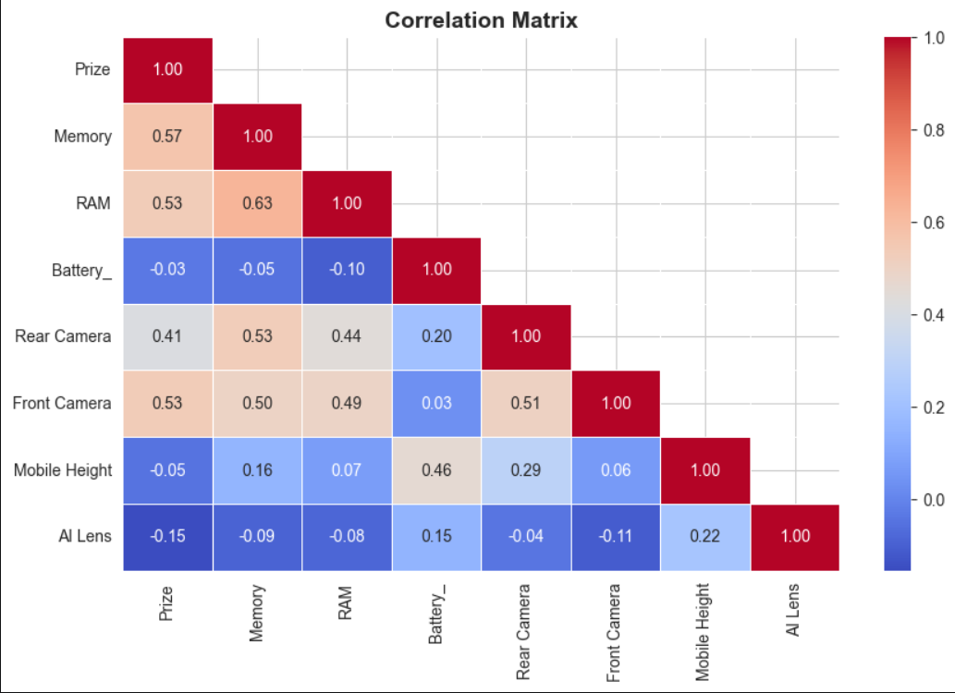
Thank You!!!

