Slide 1
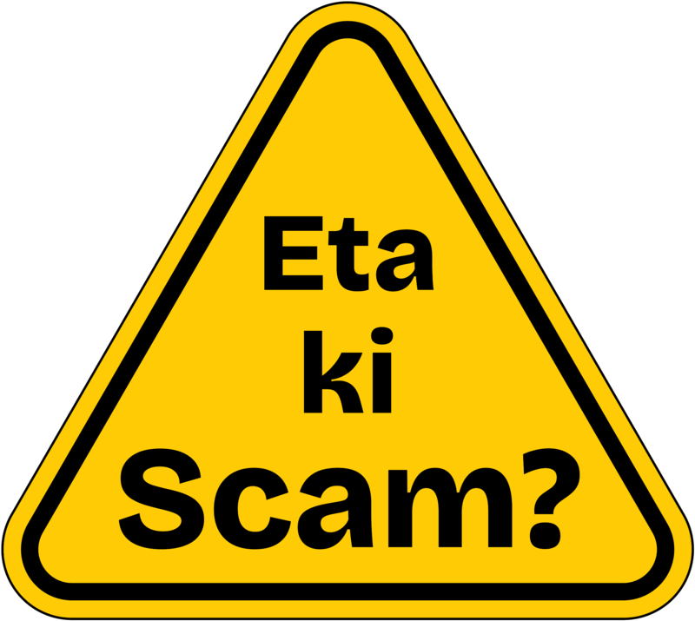
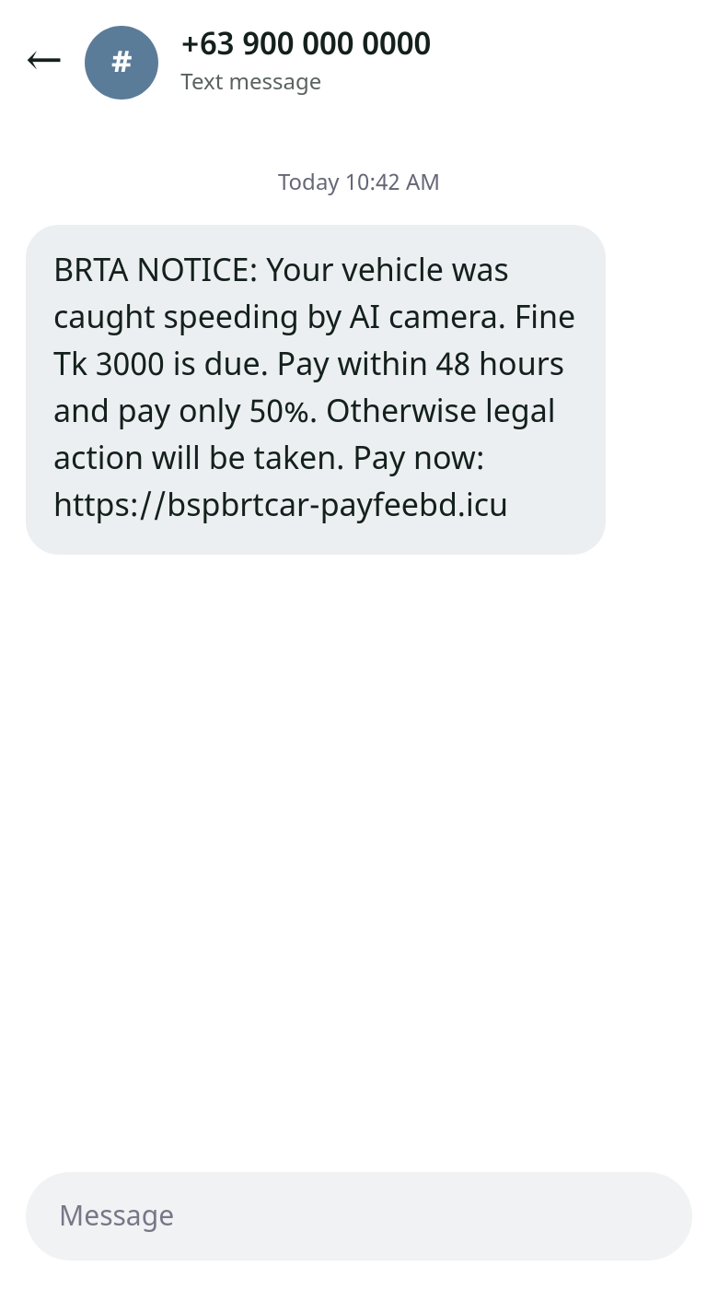
Scam messages catch people when they’re scared and rushed
The problem
Tk 72.6 lakh
allegedly moved by one gang using fake BRTA fine messages. CID arrested three people.
The SMS threatens legal action and offers half off if you pay within 48 hours. Most people have no simple way to check before they tap.
Source: The Financial Express, June 2026. The screenshot is our own example, based on reported scams.
Notes:
Imagine you’re heading to work and your phone says your car broke a traffic rule. There’s a fine, a deadline and a threat of legal action. This is a real scam in Bangladesh. CID arrested three people who allegedly moved about 72.6 lakh taka using fake BRTA messages and a copy of the BRTA website. The scam works because fear makes people act before they check. Eta Ki Scam means “Is this a scam?”, and it gives people that check.

Slide 2
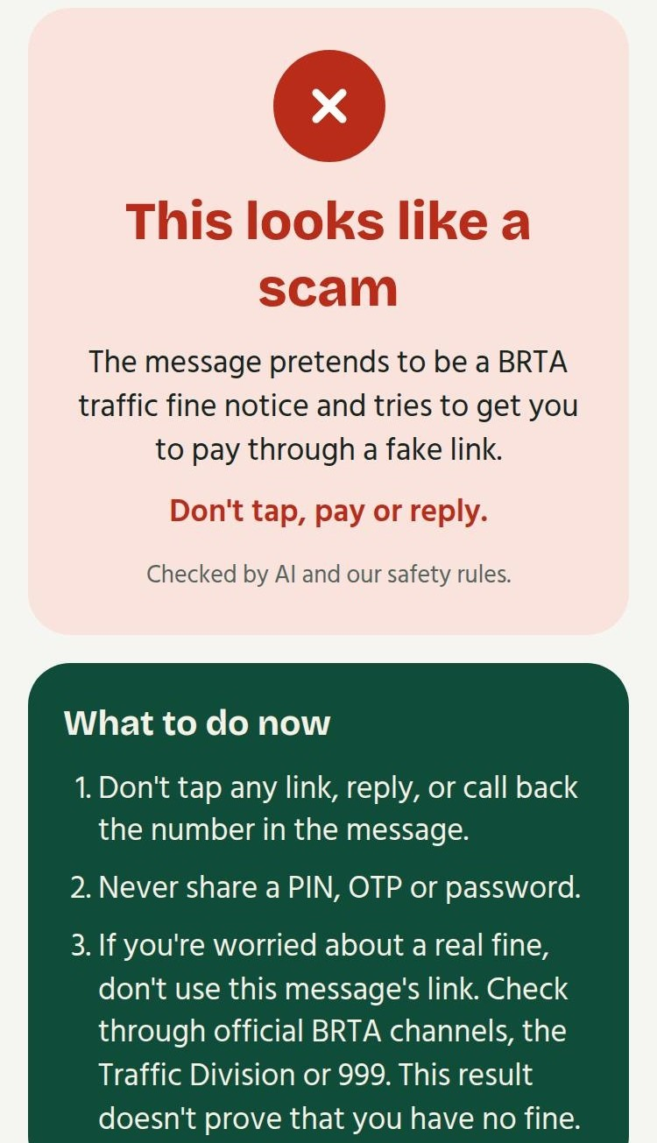
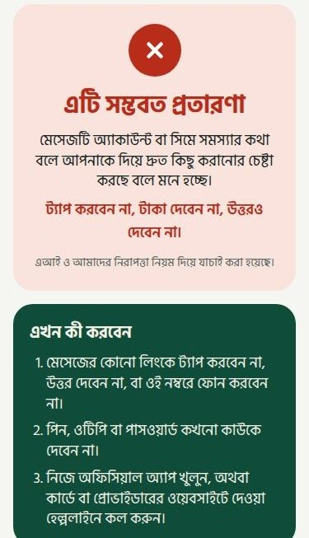
Send a screenshot. Get a clear answer.
The solution
A verdict in plain words
“This looks like a scam”, in Bangla or English.
The reasons behind it
The risky link, sender and pressure tactics are marked in the message.
What to do now
Next steps, helplines if you’ve already paid, and a warning to share with family.
No app to install and no login. It works in a phone browser.
Live app: eta-ki-scam.vercel.app. Screens are from the live app, checking our example messages.
Notes:
You don’t need to understand links or domains. Take a screenshot and upload it. In a few seconds, the app gives a verdict, explains the reasons and tells you exactly what to do, including who to call if you’ve already paid. It works in Bangla and English, with nothing to install and no account. If it’s a scam, you can warn your family with one tap, and that warning never includes your private message.

Slide 3
Safety rules and AI check every message
How it works
1. Read
2. Check
3. Understand
4. Decide
AI vision reads the text, link and sender from the screenshot.
Rules test the link, sender, PIN or OTP requests and the website’s age.
AI reads Bangla, English and Banglish, using labelled examples to spot tactics.
Both results become one verdict, with next steps for that type of scam.
AI can’t clear a rule finding
We never say “safe”
Good spelling isn’t a pass
It can raise the risk, but it can’t overrule a safety rule.
The best result is “No warning signs found”.
A polite, correctly spelled fake fine notice still gets flagged.
Built with Next.js on Vercel, the Vercel AI SDK and open models on Groq.
Notes:
There are four steps. AI vision reads the screenshot. Safety rules check facts that should give the same answer every time, such as whether a link really belongs to BRTA, and how old the website is. Then a second AI model reads for tactics that rules can miss, in Bangla, English and Banglish. Finally, both results become one verdict. Three design choices build trust. The AI can raise the risk, but it can’t clear a rule finding. We never say a message is safe, because nobody can promise that. And a scam can’t pass just by having good spelling, which matters now that scammers can use AI too.

Slide 4
Built for the messages people here receive
Why it stands out
Works on new scams
Local by design
Respects privacy
It checks the message itself, so it can warn you before anyone has reported that number or link.
It knows BRTA, DMP, bKash and Nagad, plus local scam patterns, in Bangla, English and Banglish.
The app doesn’t store messages, and family warnings never include the original message.
What comes next
Test on real messages, shared with permission
Cover more types of scam
Let people check directly from their phone’s share button
Notes:
Three things make this different. It reads the message itself, so it doesn’t have to wait for someone else to report that number or link. It’s built around Bangladesh, including the organisations people trust and the mixed Bangla and English people really use. And it respects privacy: the app doesn’t store messages. Next, I want to test it on real messages, shared with permission, cover more types of scam, and make checking possible straight from the phone’s share button.

Slide 5
Namare Shakib Angkon
About me
Final Trimester Student, United International University
Fake BRTA fine messages have been spreading since AI traffic cameras were introduced. I’ve seen people get scammed by them, so I built this to let anyone check a message instantly instead of asking on Facebook.
Try it now
Solo entry for Ostad Presents YUNet AIgnite Buildathon 2026.
eta-ki-scam.vercel.app
namare.shakib@gmail.com
Notes:
I’m Namare Shakib Angkon, a final-trimester student at United International University. I built Eta Ki Scam? on my own because fake BRTA fine messages have been spreading since AI traffic cameras were introduced, and I’ve seen people get scammed by them. People shouldn’t have to ask on Facebook and wait for an answer. You can try it right now at eta-ki-scam.vercel.app. Choose one of the examples or upload your own screenshot. Thank you.

