Slide 1
Encoding

Slide 2
Machine learning
Input
model
Output
Parameters

Slide 3
Machine learning
Tensor
Array of numbers
model
Output
Parameters → weights
Notes:
The model will interact with the tensor through the weights

Slide 4
Vocabulary
The model has a predefined vocabulary →
Embedding matrix
→
Trained by data

Slide 5
Goal
0.5
predict
0.1
sing
The goal of our model is to …
0.2
search
…
0.01
pose

Slide 6
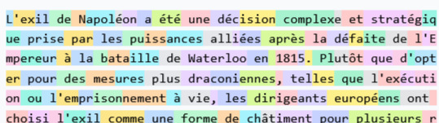
Tokens

Slide 7
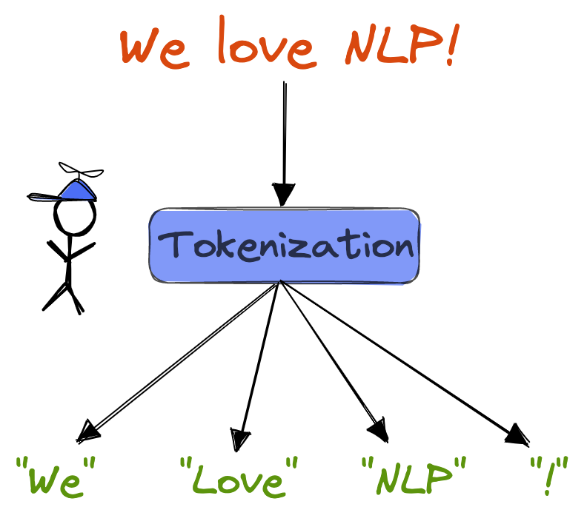
Tokens

Slide 8
Tokenization
The goal of our model is to …

Slide 9
Word embeddings → encoding
The goal of our model is to …
embedding
0.5
0.5
0.5
0.5
0.5
0.5
0.5
5.2
5.2
5.2
5.2
5.2
5.2
5.2
4.8
4.8
4.8
4.8
4.8
4.8
4.8
…
…
…
…
…
…
…
2.1
2.1
2.1
2.1
2.1
2.1
2.1

Slide 10
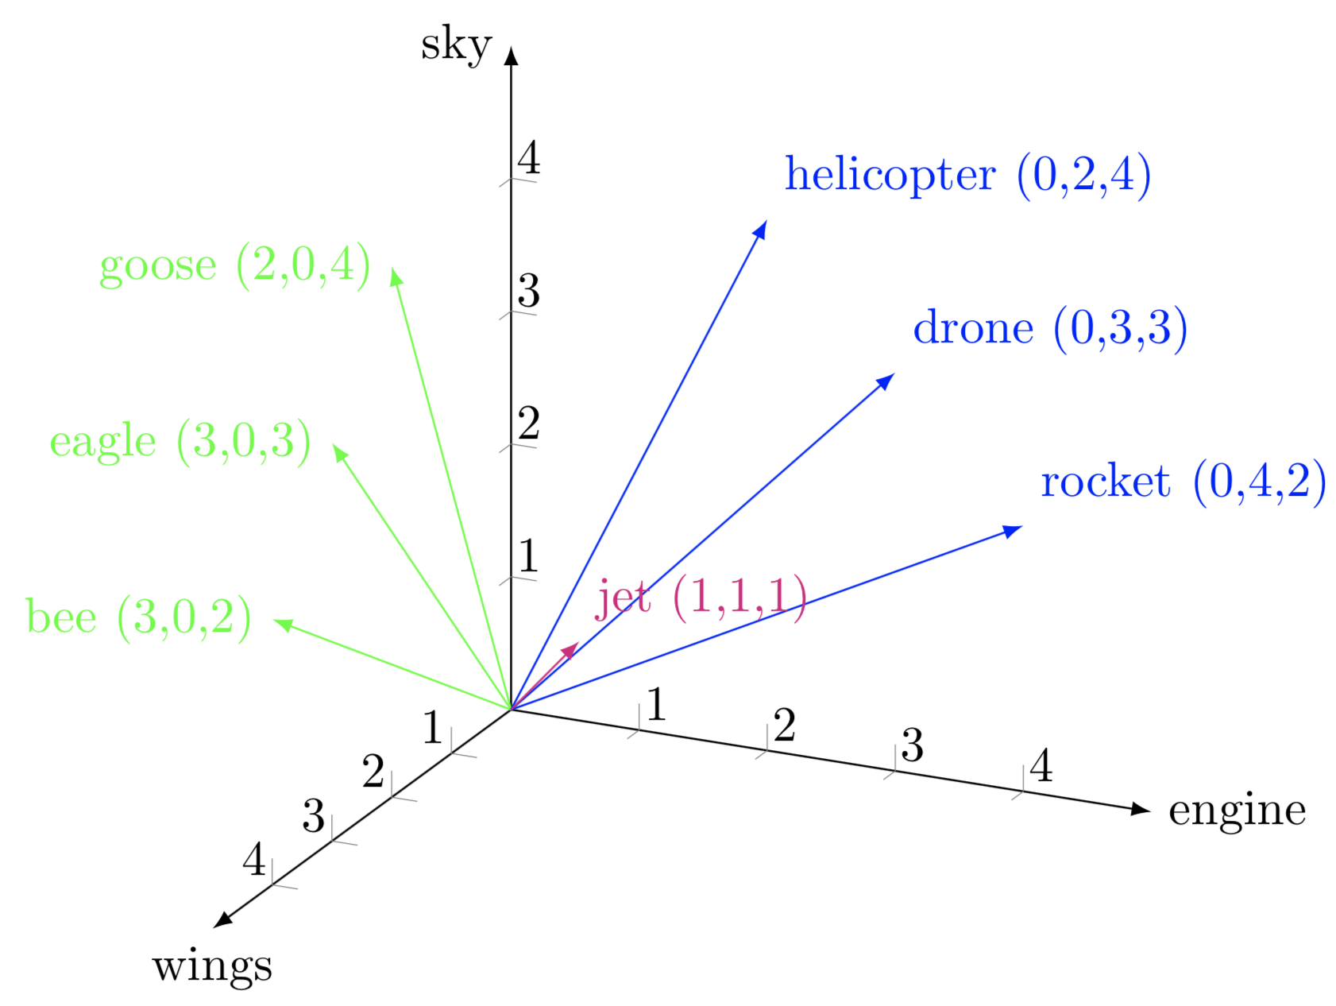
Vector space

Slide 11
Word embeddings
Position
1
2
3
4
5
6
7
The goal of our model is to …
0.5
0.5
0.5
0.5
0.5
0.5
0.5
embedding
5.2
5.2
5.2
5.2
5.2
5.2
5.2
4.8
4.8
4.8
4.8
4.8
4.8
4.8
…
…
…
…
…
…
…
2.1
2.1
2.1
2.1
2.1
2.1
2.1
Notes:
What the word means and where it is positioned

Slide 12
Query
Is there any verb before me?
The goal of our model is to …
0.5
5.2
Query vector
4.8
…
2.1

Slide 13
Matrices
Query matrix → query weights
Key matrix → key weights
Value matrix → value weights

Slide 14
Query
Are there any adjectives before me?
A fluffy blue creature
0.5
5.2
Query vector
= Embedding * Query matrix
4.8
…
2.1

Slide 15
Matrices – Query + Key
Query = Question
Key = Answer
1.2
…
0.8
1.2
…
0.8
…
…
…
…
…
…
4.7
1.3
0.6
4.7
1.3
0.6
Smaller dimensions for both

Slide 16
Matrices – Query
Query weights
Embedding
1.2
…
0.8
0.5
5.2
…
…
…
4.8
Q
…
4.7
1.3
0.6
2.1

Slide 17
Matrices – Key
Key weights
Embedding
1.2
…
0.8
0.5
5.2
…
…
…
4.8
K
…
4.7
1.3
0.6
2.1

Slide 18
Attention pattern – Are there any adjectives?
A
fluffy
blue
creature
Queries = Question
A
fluffy
blue
creature
1
Keys = answers

Slide 19
Vector space - query
Are there any adjectives before position 4?
Adjective at position 3

Slide 20
Attention – dot product
A
fluffy
blue
creature
Q
Q
Q
Q
A
Dot product =
K * Q
Dot product =
K * Q
Dot product =
K * Q
Dot product =
K * Q
k
fluffy
Dot product =
K * Q
Dot product =
K * Q
Dot product =
K * Q
Dot product =
K * Q
k
blue
Dot product =
K * Q
Dot product =
K * Q
Dot product =
K * Q
Dot product =
K * Q
k
creature
Dot product =
K * Q
Dot product =
K * Q
Dot product =
K * Q
Dot product =
K * Q
k

Slide 21
Attention pattern
Are there any adjectives before me?
A
fluffy
blue
creature
A
YES!
fluffy
YES!
blue
creature
1

Slide 22
Attention pattern
A
fluffy
blue
creature
A
0.3
fluffy
9.8
blue
4.7
creature
0

Slide 23
Softmax
Logits
Softmax
Probabilities
0.5
0.1
5.2
0.05
4.8
0.5
…
…
2.1
0.02

Slide 24
Attention pattern
A
fluffy
blue
creature
A
0.01
fluffy
0.5
blue
0.42
creature

Slide 25
Context
Context size
The goal of our model is to …
0.5
0.5
0.5
0.5
0.5
0.5
0.5
5.2
5.2
5.2
5.2
5.2
5.2
5.2
4.8
4.8
4.8
4.8
4.8
4.8
4.8
…
…
…
…
…
…
…
2.1
2.1
2.1
2.1
2.1
2.1
2.1

Slide 26
Attention
blue
creature
1.2
0.5
4.7
5.2
1.3
4.8
…
…
0.6
2.1
E
E

Slide 27
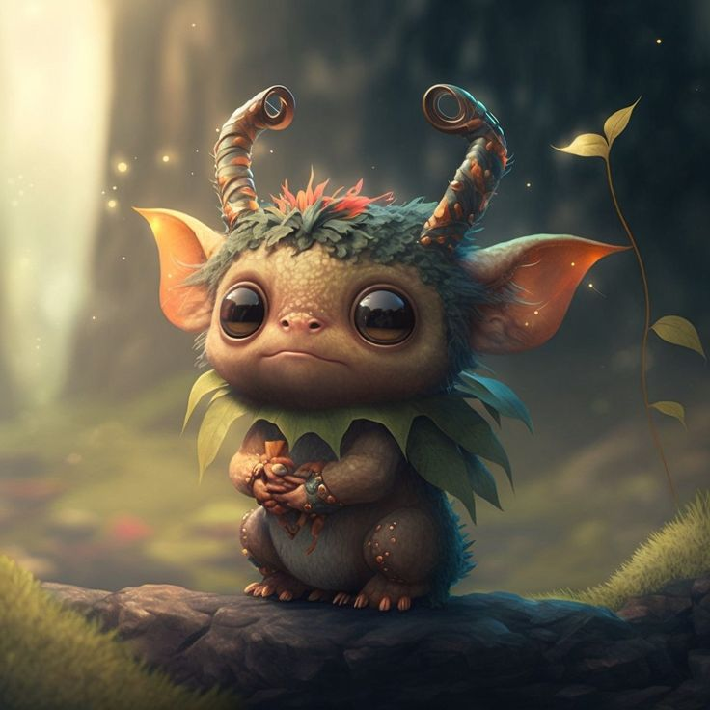
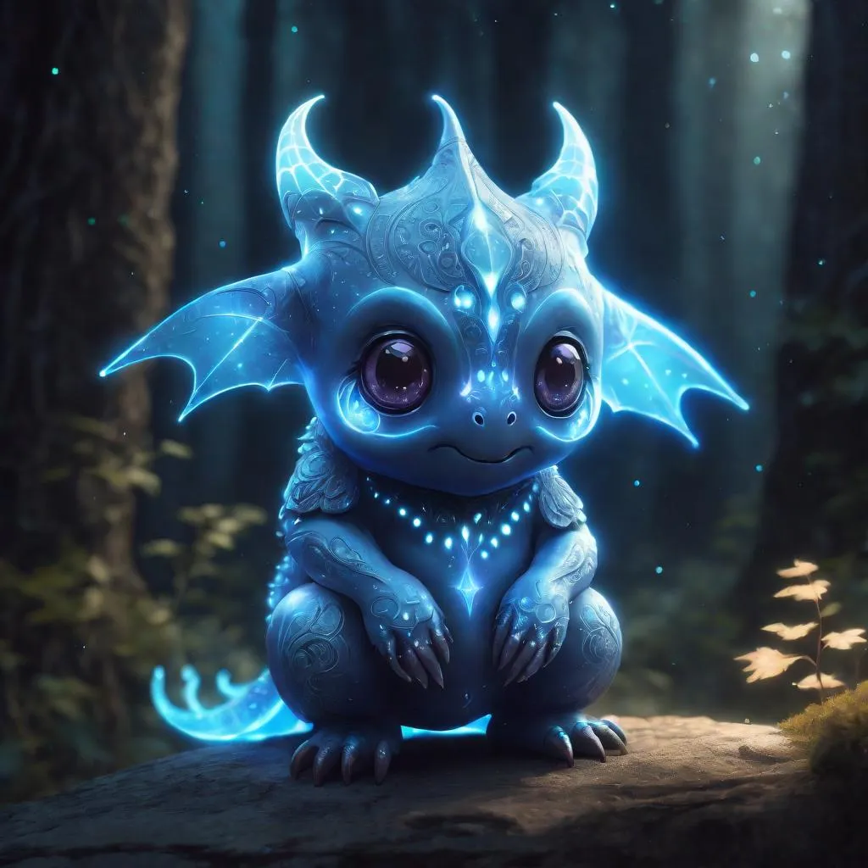
Attention
creature
Blue creature

Slide 28
Attention - context
blue
creature
1.2
0.5
4.7
5.2
1.3
4.8
…
…
0.6
2.1
Value matrix
Value vector
1.2
…
0.8
1.2
1.3
4.7
9.8
…
…
…
1.3
3.2
…
…
4.7
1.3
0.6
0.6
2.1

Slide 29
Attention – value matrix
Value vector

Slide 30
Attention - context
fluffy
blue
creature
1.2
0.5
1.3
4.7
5.2
9.8
1.3
4.8
3.2
…
…
…
0.6
2.1
2.1
Value matrix
Value vector
1.2
…
0.8
1.2
1.3
4.7
9.8
…
…
…
1.3
3.2
…
…
4.7
1.3
0.6
0.6
2.1

Slide 31
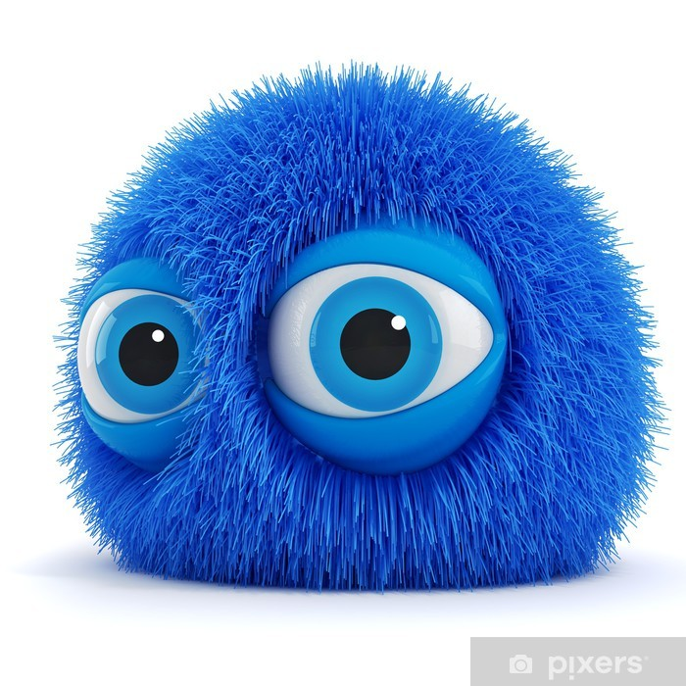
Attention – value matrix
Value vector
Value vector

Slide 32
Attention
A
fluffy
blue
creature
A
0
fluffy
0.5 x v2
blue
0.42 x v3
creature
0
E

Slide 33
One head of Attention
creature
E
E

Slide 34
Attention
A
fluffy
blue
creature
A
fluffy
blue
creature

Slide 35
Attention
A
A fluffy
A fluffy blue
A fluffy blue creature

Slide 36
Masking
A
A fluffy
A fluffy blue
A fluffy blue creature

Slide 37
Encoding
We
Love
NLP/…
0.5
0.5
0.5
4.2
4.2
4.2
…
…
…
2.1
2.1
2.1

Slide 38
GPT - 3
175… billion parameters
28’000 thousand matrices
50’000 thousand words (tokens)
12’000 dimension
2’000 context size

Slide 39
Unembedding
The goal of our model is to …
0.5
5.2
4.8
…
2.1

Slide 40
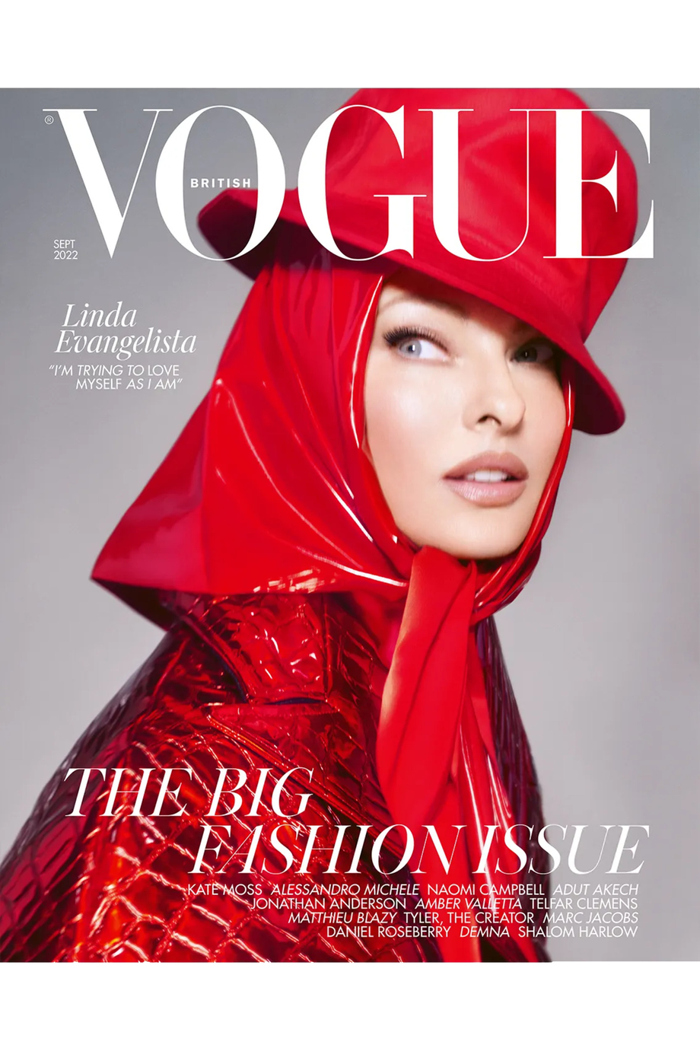
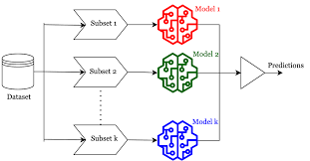
Attention part
model
0.5
0.5
5.2
5.2
4.8
4.8
…
…
2.1
2.1

Slide 41
Query – Are there any adjectives?
A
fluffy
blue
creature
Key
A
fluffy
blue
creature

