Slide 1
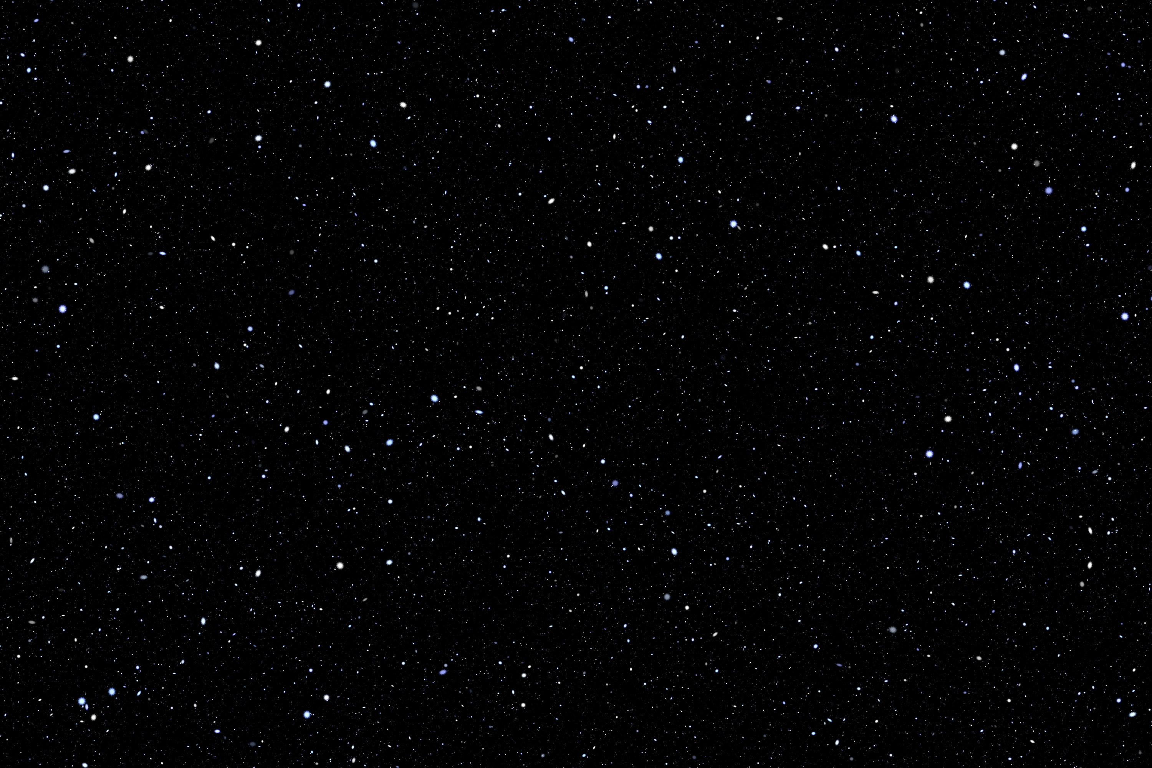
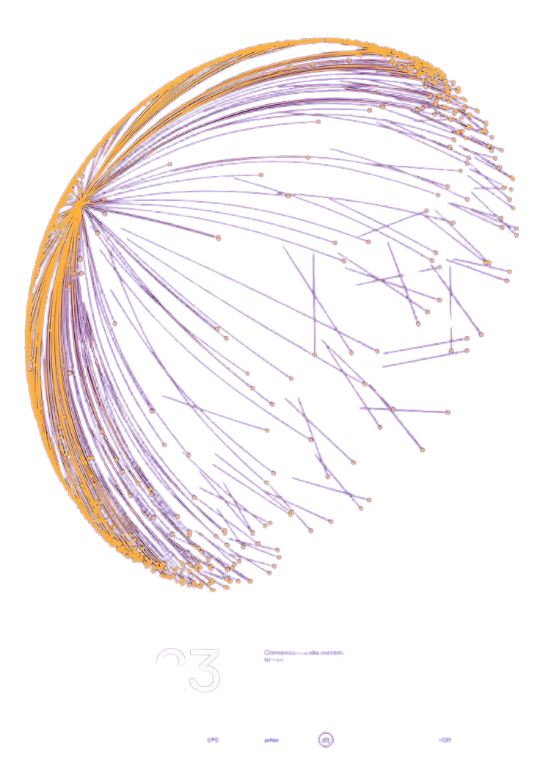

MUSIC THEORY TIMELINE EXPLORER
Visualizing Citation and Thematic Networks
Siddharth Yalamanchili
sy8966

Slide 2
INTRODUCTION
• Motivation
– Music Theory Online (MTO) dataset has nearly 1,000 papers over three decades, but understanding the evolving thematic and citation relationships by eye is challenging.
– Interactive visualization can reveal how ideas propagate, cluster, and influence one another over time.
• Project Goal
– Build a full‐stack pipeline that converts raw JSON metadata into an interactive, browser‐based timeline.
– Enable users to explore three types of scholarly links—semantic similarity, bibliographic coupling, and author lineage—in a unified view.

Slide 3
Plotting The Nodes
Data Source
Nodes loaded directly from nodes.json (Processed By Backend)
Each record ⇢ one paper with fields: ID, title, authors, date, yPx
X-Axis: Publication Date
Uses the paper’s date property (YYYY-MM-DD)
Rendered as a Plotly date axis (type='date')
Interactive range-slider for easy zoom & pan

Slide 4
Plotting The Nodes
Continued...
Y-Axis: Semantic Coordinate
Embedding
Paper text (abstract + keywords) ⇒ SentenceTransformer vectors
Dimensionality Reduction
PCA on all embeddings ⇒ 1st principal component scores
Scaling to Pixels
Min–max normalize scores ⇒ full vertical canvas range
Jitter
Tiny random offset (±3 px) to avoid exact overlap
Node Style
Search Highlight: turns orange if title/author matches search term
Hover: shows title & authors tooltip

Slide 5
Building the Edge Types
Semantic Similarity
Text Embedding
SentenceTransformer all-MiniLM-L6-v2 vectors (384 D) for each abstract+keywords
Similarity Computation
Pairwise cosine similarity between all paper embeddings
Retain edges for similarity ≥ threshold (e.g. top 5% of scores) or top K neighbors per node
Edge Weight & Style
Weight = raw cosine similarity (0…1)
Thickness = weight × 12 px (thicker for more similar)
Color = semantic palette (rgba(78,121,167,0.6))
Dash = solid
Semantic Similarity
Solid blue lines whose thickness grows with cosine similarity, visually clustering papers that share closely related topics or terminology.

Slide 6
Building the Edge Types
Shared References
Bibliographic Coupling
Extract each paper’s reference list from its JSON metadata
For every paper pair, count common citations ⇒ shared-ref weight
Edge Weight & Style
Weight = number of shared references (integer ≥1)
Thickness = max(2 px, weight × 4 px)
Color = shared-ref palette (rgba(227,119,194,0.6))
Dash = dotted
Visual representation
Dotted pink lines scaled by the number of common citations, indicating pairs of papers that draw on the same bibliography and hinting at methodological or theoretical overlap.

Slide 7
Building the Edge Types
Author Lineage
Shared Authorship
For any two papers, if they have at least one identical author name, we draw an edge
Edge Weight & Style
Weight = 1 (all author‐link edges are equal)
Thickness = 1 px
Color = lineage palette (rgba(214,39,40,0.6))
Dash = dashed
Author Links
Dashed red lines of constant width, marking papers with an Indentical author. Helps us visually understand areas of work.

Slide 8
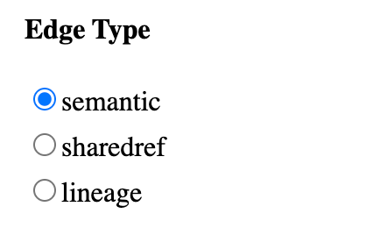
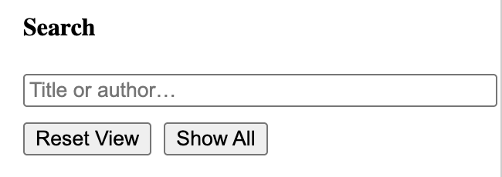
UI Snapshots
Search: highlights matching nodes in orange (all partial matches or a single exact match
Reset View: clears edges, showing only nodes
Show All: displays every edge (and its nodes) of the chosen type
Radio Buttons to toggle between edge types

Slide 9
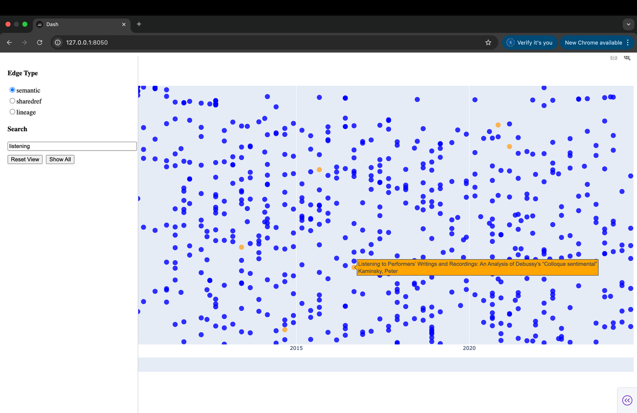
UI Snapshots
Search Functionality Demonstration(Orange Node Represent Matches)

Slide 10
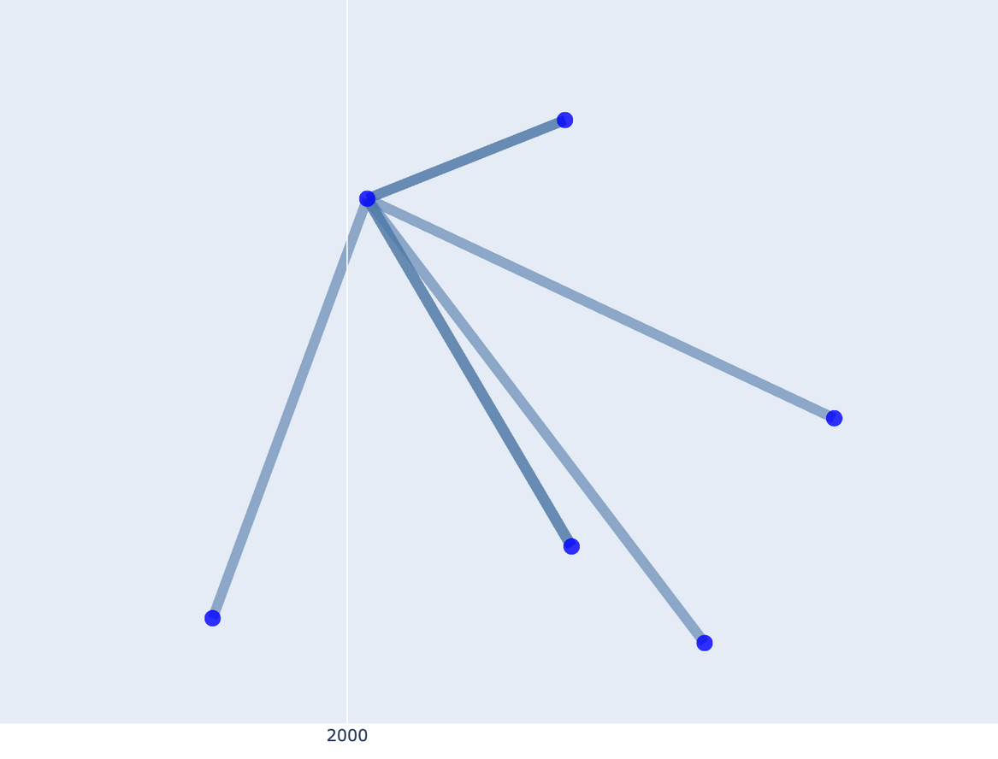
UI Snapshots
Semantic edges (Cick To Reveal)

Slide 11
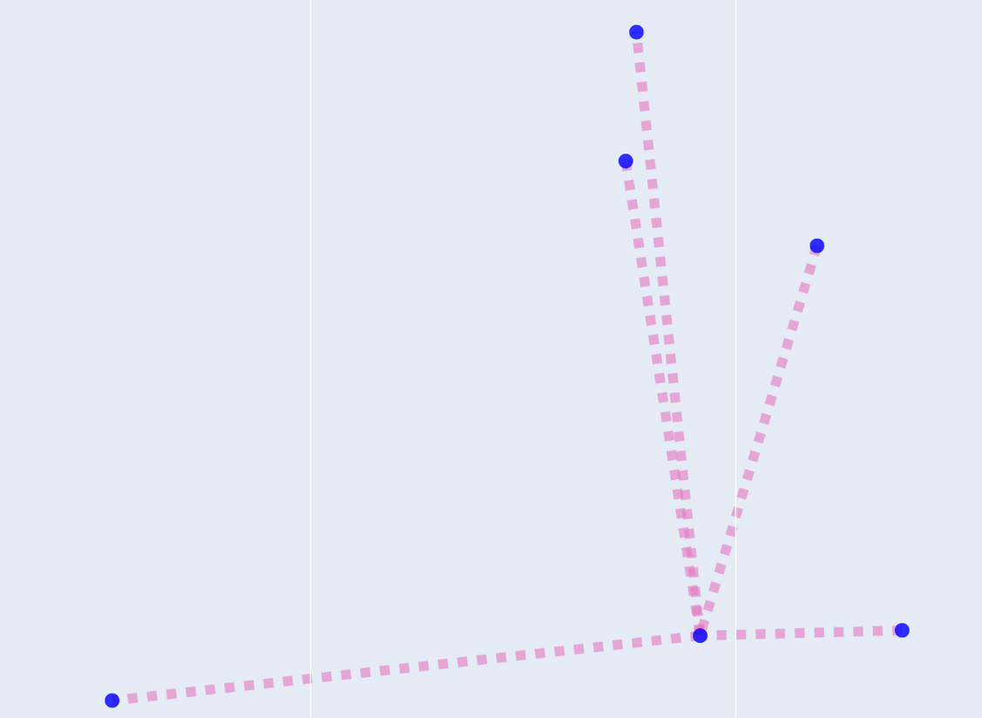
UI Snapshots
Sharedref Edges (Cick To Reveal)

Slide 12
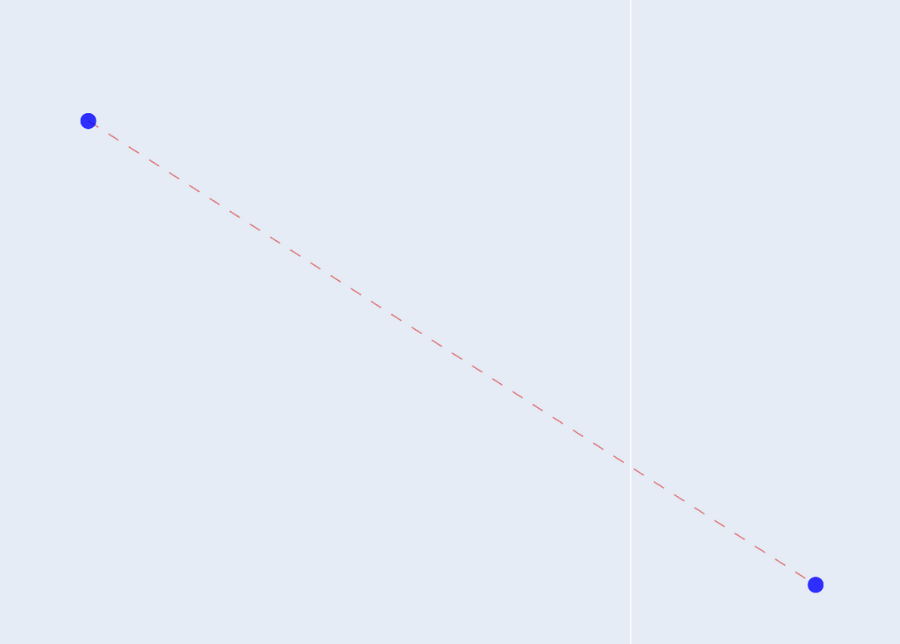
UI Snapshots
Same Author Edges (Cick To Reveal)

Slide 13
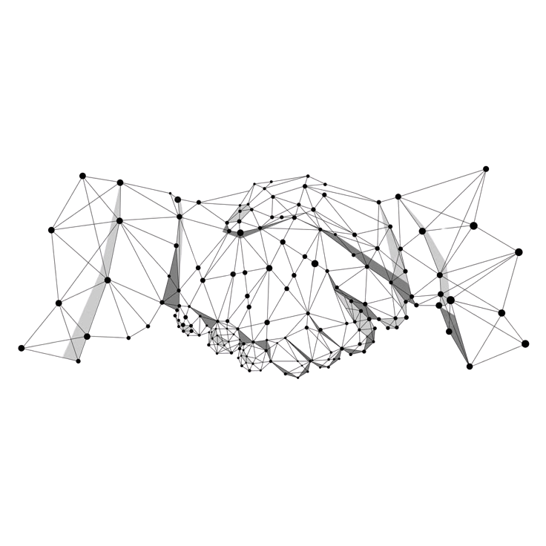
Thank You

