Slide 1
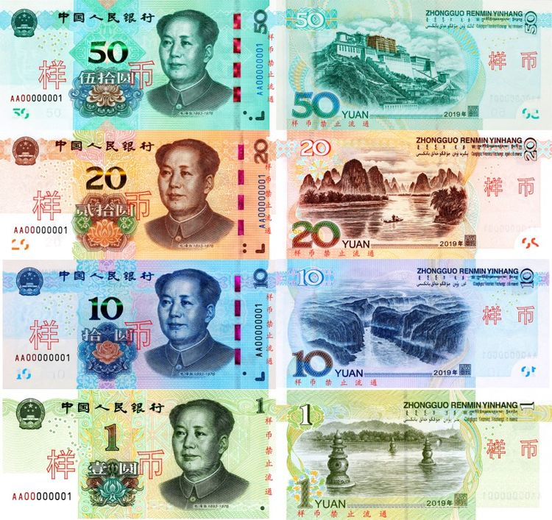
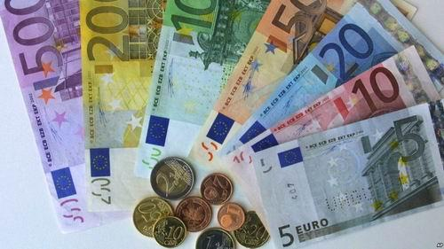
Picture description: Please choose one of the pictures and describe it.
Picture A Picture B

Slide 2
Key words for reference
Launch the euro
The European Union
Adopt the euro
Currency
The euro zone
CNY (RMB)
Exchange rate

Slide 3

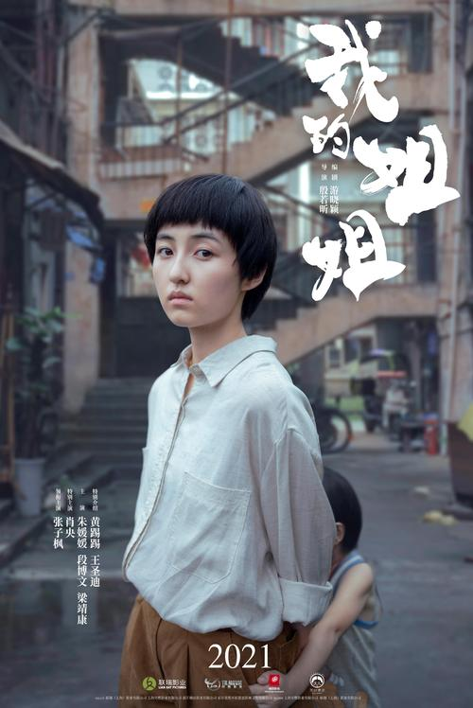
Please describe one of the posters: Picture A Picture B

Slide 4
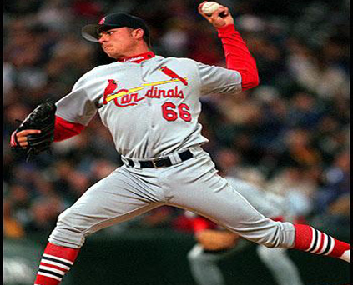
Describe the picture below
a sportsman playing baseball, use his left hand to throw the ball, many left-handed athletes, have a special talent for the games, sometimes they even have an advantage over those right-handed athletes, take the table tennis player Wang Tao for example, hit the ball in a way that is uncomfortable to his rivals (竞争对手)

Slide 5
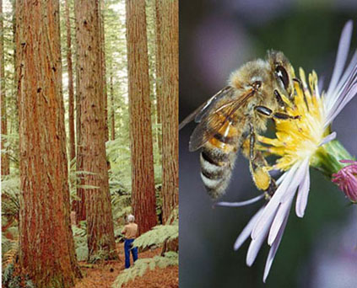
Describe the picture below
A: American redwood trees, the tallest tree in the world, over 100 metres tall, 9 metres in diameter (直径), hollow at the base, so wide a truck can drive through, as old as over 2000 years, living witnesses to the human history
B: honey bees (蜜蜂), tiny compared with the redwood trees, close to a flower, very busy, the idiom “as busy as a bee” (像蜜蜂一样忙碌), social animals, amazing organizational ability

