Slide 1
[
{
isbn: “9783406758935”,
title: “Sapiens: A Brief History”,
category: {
name: “Non-fiction”
}
},
...
]
Book ID | Name | Category
9783406758935 | Sapiens: A Brief History | Non-fiction

Slide 2
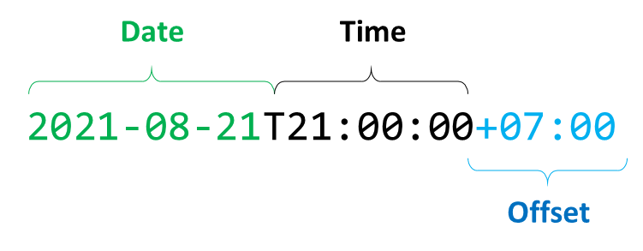
Date
Time
2021-08-21T21:00:00+07:00
Offset
Zone ID

Slide 3
Date
rtime
timezone (App)
App Backend
Database
TIMESTAMP
(date + time only)

Slide 4




is
being so underrated?

Slide 5
HTML
CSS
JS
WebApp
WebView
Ionic Application

Slide 6
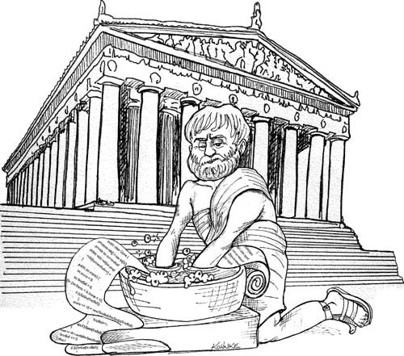


Slide 7
1
2
1
2
3
4
3
4
1
2
1
2
mq
mq
5
3
4
3
4

