Slide 1


Presentation
Assignment Final
Data Structure & Algorithms
Student Name: Phan Hoai Nam
Student ID: BH01294
Class: SE06304
Assessor Name: Dinh Van Dong

Slide 2
Introduction
In this presentation, we will delve into the design specification process for data structures by examining the valid operations through practical examples. We will start by exploring the Stack Abstract Data Type (ADT), detailing its design and operations, and comparing it with a concrete implementation of a First In First Out (FIFO) queue. This comparison will emphasize the behavioral and usage differences between a stack, which adheres to the Last In First Out (LIFO) principle, and a FIFO queue. Additionally, we will analyze two different sorting algorithms, discussing their design specifications and operations on data structures to achieve ordered data. Our evaluation will focus on various sorting algorithms for managing student information within our application, covering their strengths and weaknesses in terms of efficiency and suitability for our requirements. Benchmarking results will provide empirical evidence of performance differences, supplemented by theoretical analysis to support our findings. This comprehensive review aims to identify the most effective algorithm to enhance the application's performance and reliability.

Slide 3

Stack ADT (Abstract Data Type)
Definition
A linear data structure that follows the Last In First Out (LIFO) principle. Elements are added and removed from the same end, known as the "top" of the stack.
The Operations
· Push(x): Add an element x to the top of the stack.
· Pop(): Remove and return the top element of the stack.
· Peek(): Return the top element without removing it.
· IsEmpty(): Check if the stack is empty.
· IsFull(): Check if the stack is full (for fixed-size stacks).

Slide 4
Stack ADT (Abstract Data Type)
Specify Input Parameters
· Push(x): x is the element to be added.
· Pop(): No input parameters.
· Peek(): No input parameters.
· IsEmpty(): No input parameters.
· IsFull(): No input parameters.
Time and Space Complexity
· Push(x): O(1) time, O(1) space.
· Pop(): O(1) time, O(1) space.
· Peek(): O(1) time, O(1) space.
· IsEmpty(): O(1) time, O(1) space.
· IsFull(): O(1) time, O(1) space.

Slide 5
Pre- and Post-conditions
· Push(x):
  Pre-condition: The stack is not full.
  Post-condition: Element x is added to the top of the stack.
· Pop():
  Pre-condition: The stack is not empty.
  Post-condition: The top element is removed and returned.
· Peek():
  Pre-condition: The stack is not empty.
  Post-condition: The top element is returned without being removed.
· IsEmpty():
  Pre-condition: None.
  Post-condition: Returns true if the stack is empty, false otherwise.
· IsFull():
  Pre-condition: None.
  Post-condition: Returns true if the stack is full, false otherwise.

Slide 6
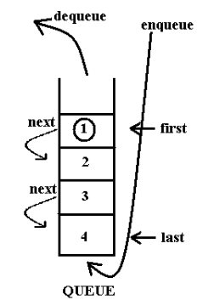
Queue
A FIFO queue is a fundamental data structure that follows the First In, First Out principle, meaning the first element added to the queue will be the first one to be removed. This structure is crucial in various real-world applications like scheduling processes in operating systems, handling requests in web servers, and managing tasks in print queues.
Introduction
Queue is a data structure where the first element added is the first one to be removed. It ensures that elements are processed in the order they were added.
Define the Structure
Queue can be implemented using arrays or linked lists. The primary operations are enqueue (add to the rear) and dequeue (remove from the front).

Slide 7
In an array-based implementation, we use a circular buffer to efficiently manage the queue. This approach allows the queue to wrap around to the beginning of the array when the end is reached.
Pros:
  Simple to implement.
  Provides direct access to elements via indexing.
Cons:
  Fixed size, which can lead to overflow if not managed properly.
  Inefficient use of space if the queue size is not optimal.
Array-Based Implementation

Slide 8
In a linked list-based implementation, we use nodes to represent elements, with each node pointing to the next node in the queue. This dynamic structure allows the queue to grow and shrink as needed.
Pros:
  Dynamic size, which can grow or shrink as needed.
  Efficient memory usage.
Cons:
  Slightly more complex to implement.
  Additional memory overhead for storing pointers.
Linked List-Based Implementation

Slide 9
Sorting Algorithms
Selection Sort and Quick Sort
- Selection Sort: A simple comparison-based sorting algorithm that divides the input list into two parts: a sorted part and an unsorted part. It repeatedly selects the smallest (or largest) element from the unsorted part and moves it to the sorted part.
- Quick Sort: An efficient divide-and-conquer sorting algorithm that works by selecting a 'pivot' element from the array and partitioning the other elements into two sub-arrays, according to whether they are less than or greater than the pivot.

Slide 10
Performance of Two Sorting Algorithms
Selection Sort
Quick Sort
  Algorithm: Iteratively finds the minimum element from the unsorted part and swaps it with the first unsorted element.
  Time Complexity: O(n^2) for all cases.
  Space Complexity: O(1), as it sorts in place.
  Stability: Not stable, because it swaps elements that may not preserve the original order of equal elements.
  Algorithm: Divides the array into smaller sub-arrays around a pivot and recursively sorts the sub-arrays.
  Time Complexity: O(n log n) on average, but O(n^2) in the worst case (e.g., when the smallest or largest element is always picked as the pivot).
  Space Complexity: O(log n) due to the recursion stack.
  Stability: Not stable by default, but can be made stable with modifications.

Slide 11
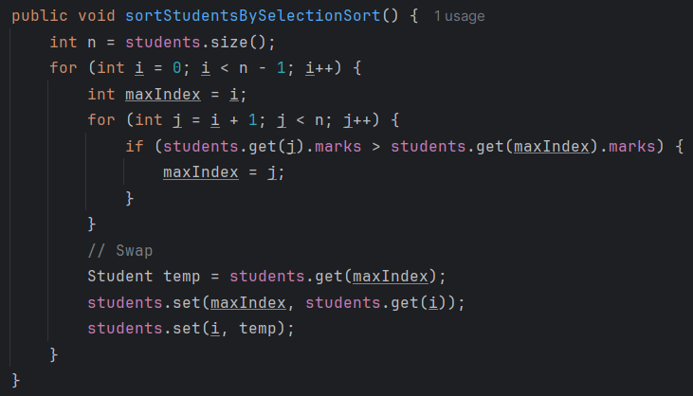
Selection Sort Method
  Method: sortStudentsBySelectionSort
  Loop through students: Iterate over the list of students.
  Find the maximum: For each student, find the student with the highest marks in the remaining list.
  Swap: Swap the student with the highest marks to the current position.

Slide 12
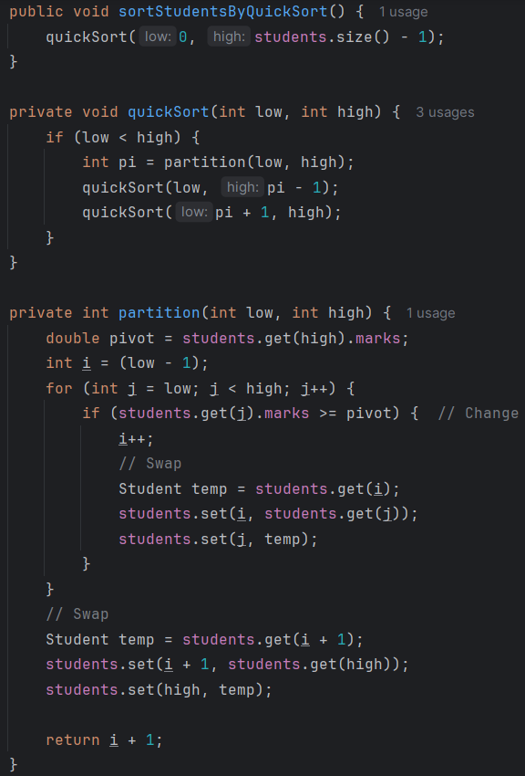
Quicksort Method
Method: sortStudentsByQuickSort
  Initialize: Call quickSort(0, students.size() - 1).
Method: quickSort
  Recursive sorting: If the sublist has more than one element:
  Partition the list and get the pivot index.
  Recursively sort the sublists before and after the pivot.

Slide 13
Quicksort Method
Method: partition
  Select pivot: Choose the last element as the pivot.
  Partition: Reorganize the list so students with marks greater than or equal to the pivot are on the left.
  Swap pivot: Place the pivot in its correct position.

Slide 14
Algorithms

Slide 15
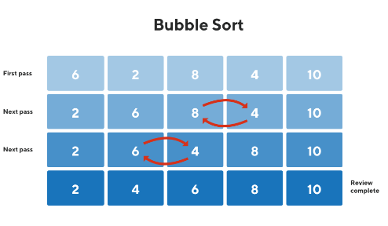
Algorithms Description
Bubble Sort
Description: Bubble Sort is a straightforward sorting algorithm that repeatedly steps through the list, compares adjacent elements, and swaps them if they are in the wrong order. This process is repeated until the list is sorted.
Algorithm Steps:
  Compare the first two elements of the list.
  Swap them if they are in the wrong order.
  Move to the next pair of elements and repeat the process until the end of the list is reached.
  Repeat the entire process for the entire list until no swaps are needed in a complete pass.

Slide 16
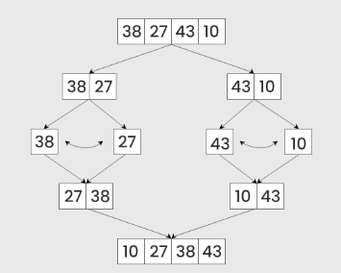
Algorithms Description
Merge Sort
Description: Merge Sort is an efficient, stable, and comparison-based sorting algorithm that follows the divide-and-conquer paradigm. It divides the list into halves, sorts each half recursively, and then merges the sorted halves to produce a sorted list.
Algorithm Steps:
  Divide the list into two halves.
  Recursively sort each half.
  Merge the two sorted halves into a single sorted list.

Slide 17
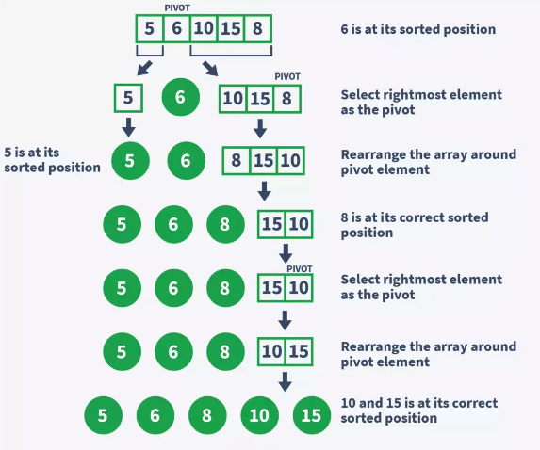
Algorithms Description
Quick Sort
Description: Quick Sort is an efficient, in-place, comparison-based sorting algorithm. It selects a 'pivot' element, partitions the array around the pivot, and recursively sorts the partitions.
Algorithm Steps:
  Choose a pivot element from the list.
  Partition the list into two sublists: elements less than the pivot and elements greater than the pivot.
  Recursively apply Quick Sort to the sublists.

Slide 18
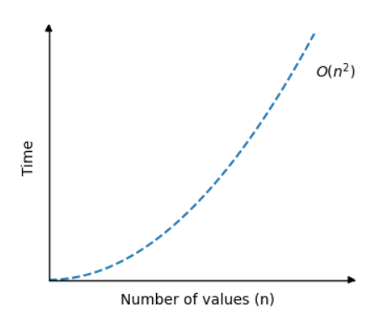
Performance
Bubble Sort
  Time Complexity: O(n^2) in the worst and average cases, as it requires n-1 passes through the list with n comparisons each.
  Space Complexity: O(1), since it sorts in place and requires only a constant amount of additional memory.

Slide 19
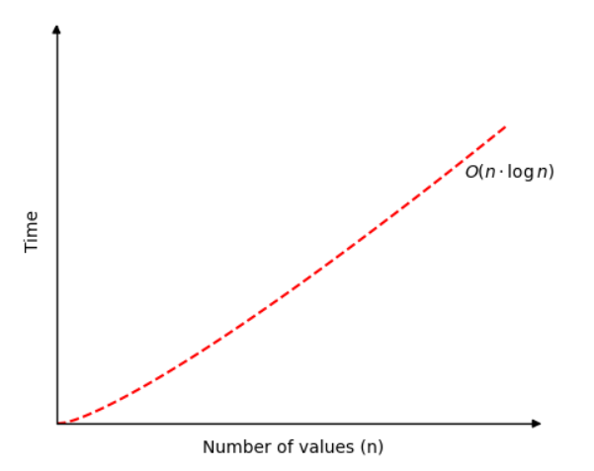
Performance
Merge Sort
  Time Complexity: O(n log n) for all cases, as it always divides the list in half and requires log n levels of recursion with n comparisons at each level.
  Space Complexity: O(n), as it requires additional space for the temporary arrays used in merging.

Slide 20
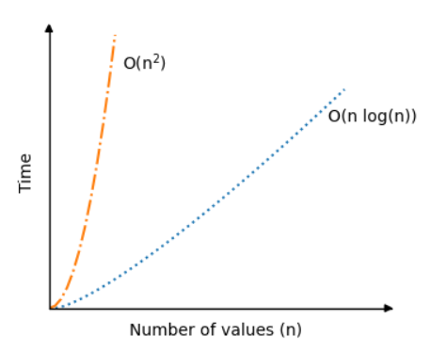
Performance
Quick Sort
  Time Complexity: Average-case is O(n log n); worst-case is O(n^2), usually avoided with good pivot selection strategies (e.g., random pivot, median-of-three).
  Space Complexity: O(log n) in the best case with tail recursion; O(n) in the worst case due to the stack depth.

Slide 21
Use Cases and Avoidance
Bubble Sort:
  Use For: Teaching and very small datasets.
  Avoid For: Large datasets due to poor performance.
Merge Sort:
  Use For: Large datasets needing stable sorting, such as linked lists or external sorting.
  Avoid For: Memory-constrained environments.
Quick Sort:
  Use For: Large, unsorted datasets with good pivot selection strategies.
  Avoid For: Nearly sorted datasets to prevent worst-case performance.

Slide 22
Binary Search Tree ( BST )
and Prim’s/Dijkstra’s Algorithms

Slide 23
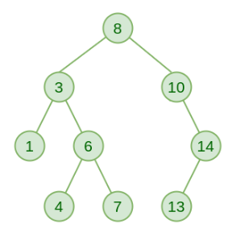
Binary Search Tree
Description: A Binary Search Tree (BST) is a node-based data structure in which each node has at most two children, referred to as the left and right child. Each node contains a key, and the left subtree of a node contains only nodes with keys less than the node's key, while the right subtree contains only nodes with keys greater than the node's key.
Properties of BST:
  Left Subtree: All nodes have values less than the parent node.
  Right Subtree: All nodes have values greater than the parent node.
  No Duplicate Nodes: Each node has a unique value.
Operations on BST:
  Insertion: Add a node in a manner that preserves the BST property.
  Deletion: Remove a node and rearrange the tree to maintain the BST property.
  Search: Find a node with a specific value.
  Traversal: Visit all nodes in a specific order (inorder, preorder, postorder).

Slide 24
Advantages of BST:
  Efficient Searching: Average-case time complexity for search, insert, and delete operations is O(log n), making it efficient for lookups.
  Dynamic Set Operations: Supports insertion and deletion operations efficiently.
  Sorted Order: Inorder traversal of a BST gives nodes in ascending order, which can be useful for operations that need sorted data.
Disadvantages of BST:
  Unbalanced Trees: The performance degrades to O(n) in the worst case when the tree becomes unbalanced (e.g., if elements are inserted in sorted order).
  Overhead: Additional memory overhead due to the storage of pointers for each node.
  Complexity: Implementation and maintenance can be more complex compared to simpler data structures like arrays or linked lists.
Use Cases:
  Database Indexing: Efficient lookup, insertion, and deletion of records.
  Network Router Algorithms: For quick route lookup.
  Dynamic Set Operations: Such as maintaining a sorted list of elements with frequent insertions and deletions.
Avoidance:
  Highly Unbalanced Data: When the input data is highly skewed, leading to unbalanced trees. In such cases, self-balancing trees like AVL trees or Red-Black trees might be preferred.
Advantages/Disadvantages and Use Case/Avoidance

Slide 25
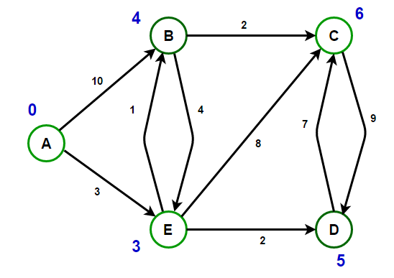
Dijkstra’s Algorithms
Description: Dijkstra's Algorithm finds the shortest paths from a single source vertex to all other vertices in a weighted graph. It works only for graphs with non-negative weights.
Steps:
  Initialize the distance to the source vertex to 0 and all other vertices to infinity.
  Set the source vertex as the current vertex.
  For the current vertex, update the distances to its adjacent vertices.
  Mark the current vertex as visited.
  Select the unvisited vertex with the smallest distance as the new current vertex.
  Repeat steps 3-5 until all vertices are visited or the smallest distance among unvisited vertices is infinity.

Slide 26
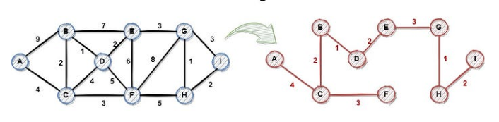
Prim’s Algorithms
Description: Prim's Algorithm is used to find the Minimum Spanning Tree (MST) for a weighted undirected graph. The MST is a subset of the graph's edges that connect all vertices without any cycles and with the minimum possible total edge weight.
Steps:
  Initialize the MST with a starting vertex.
  Find the edge with the minimum weight that connects a vertex in the MST to a vertex outside the MST.
  Add this edge to the MST.
  Repeat steps 2 and 3 until all vertices are included in the MST.

Slide 27
Advantages/Disadvantages and Time Comflexity
Prim’s Algorithms
Time Complexity: O(V^2) with adjacency matrix representation or O(E log V) with adjacency list and a priority queue.
Advantages:
  Efficient for dense graphs.
  Simple to implement.
Disadvantages:
  Less efficient for sparse graphs compared to Kruskal's algorithm.
Dijkstra’s Algorithms
Time Complexity: O(V^2) with an adjacency matrix or O(E log V) with an adjacency list and a priority queue.
Advantages:
  Efficient for graphs with non-negative weights.
  Provides the shortest path from the source to all other vertices.
Disadvantages:
  Cannot handle graphs with negative weight edges.
  Inefficient for very large graphs with dense connectivity.

Slide 28
Project

Slide 29
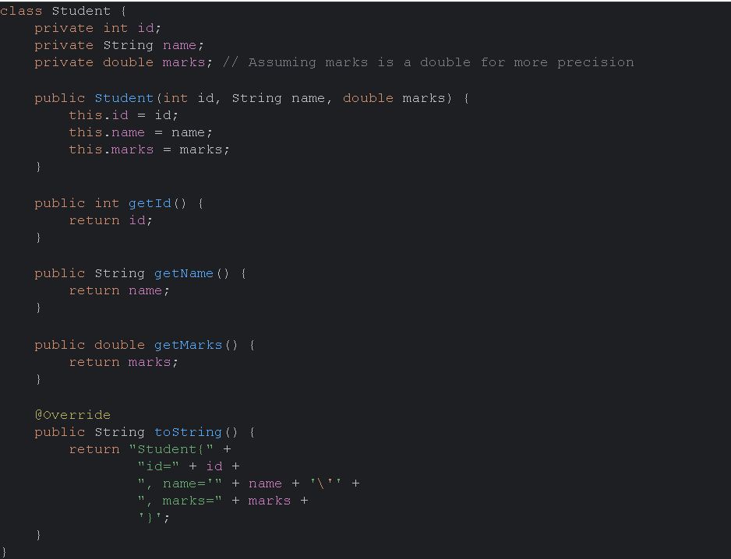
ADT

Slide 30
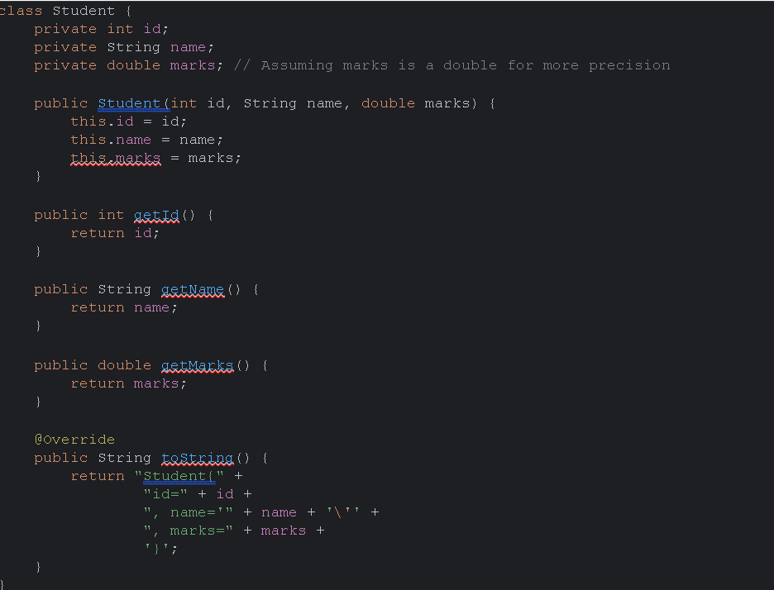
Implement the ADT

Slide 31
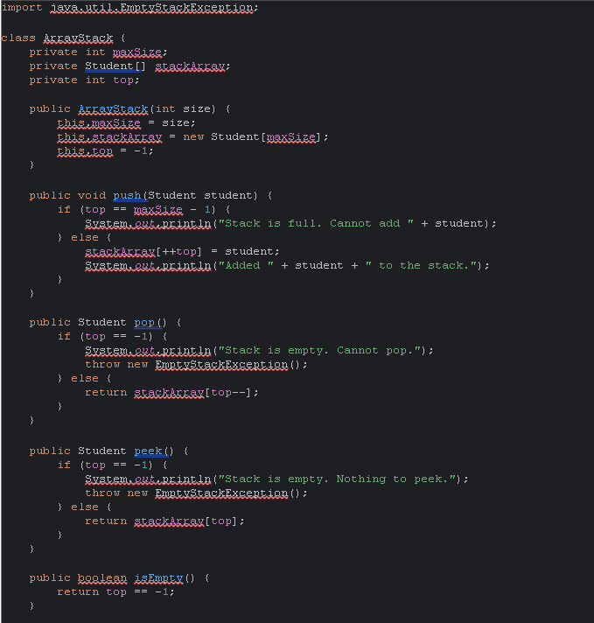
Array Stack

Slide 32
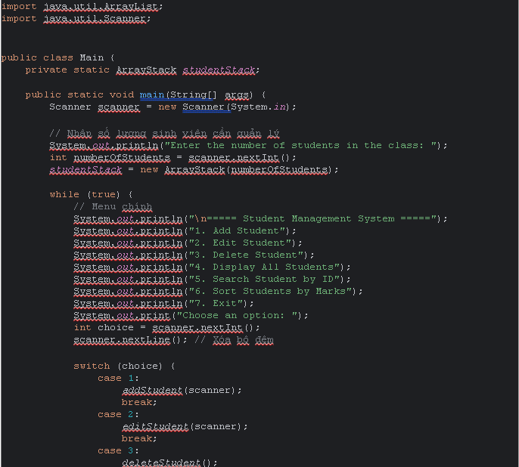
Class Main

Slide 33
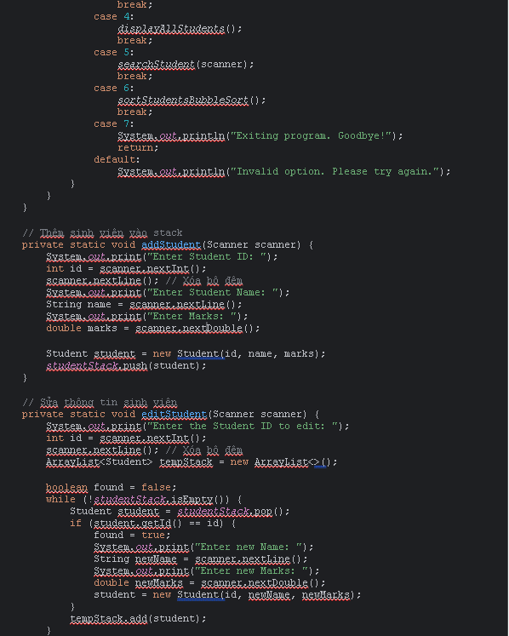
Class Main 2

Slide 34
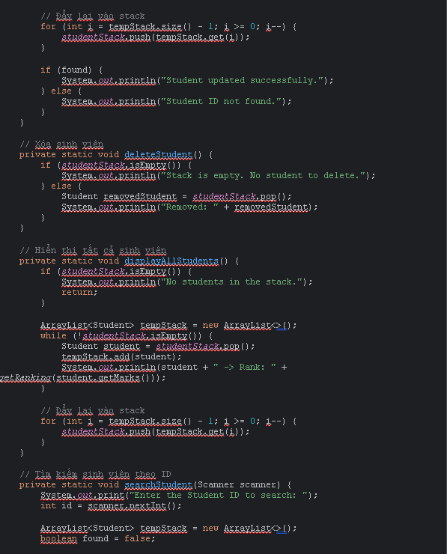
Class Main 3

Slide 35
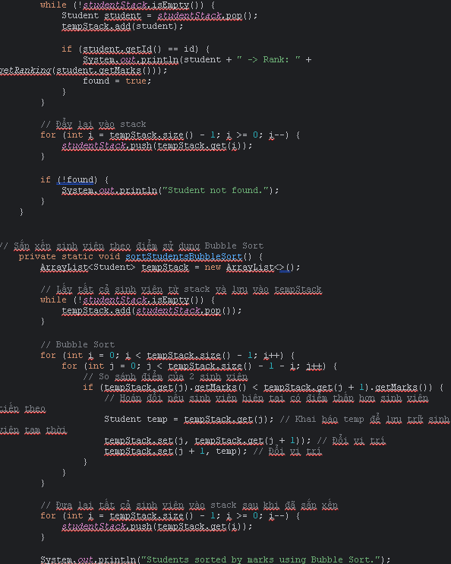
Class Main 4

Slide 36
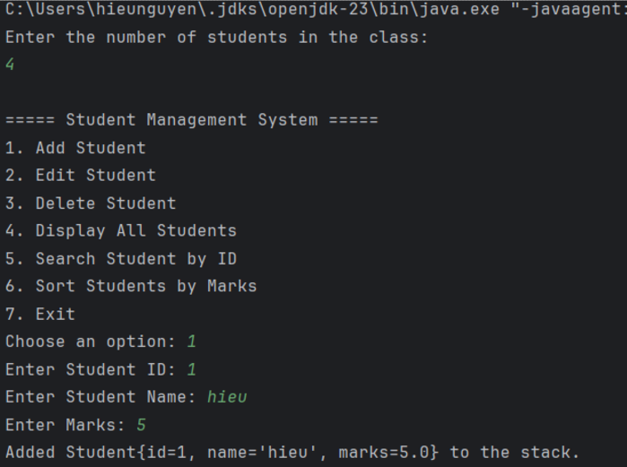
Project-review

Slide 37
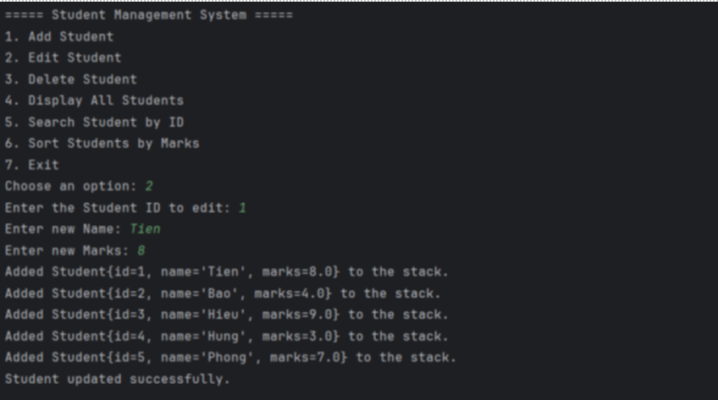
Project-review

Slide 38
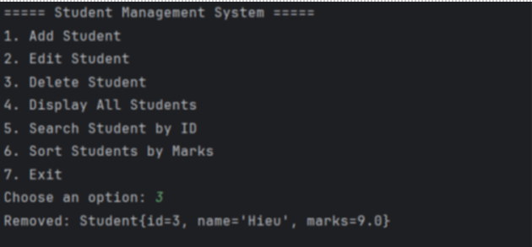
Project-review

Slide 39
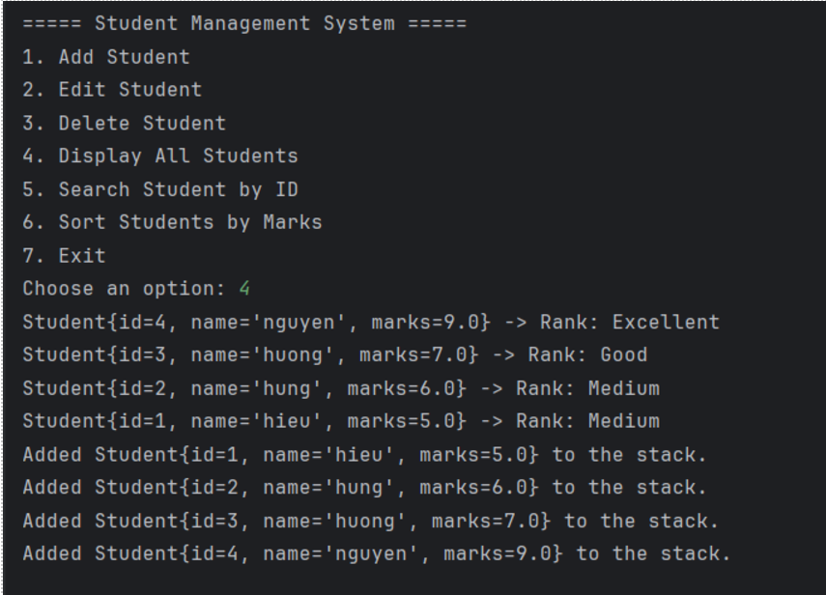
Project-review

Slide 40
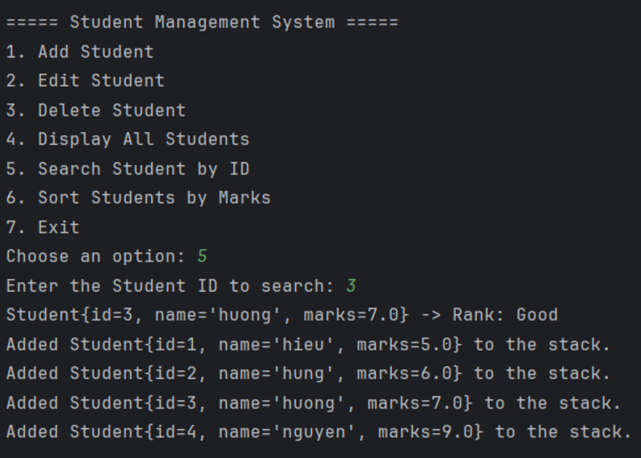
Project-review

Slide 41
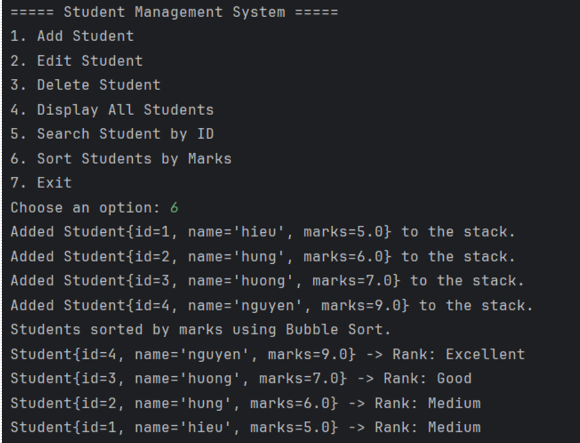
Project-review

Slide 42
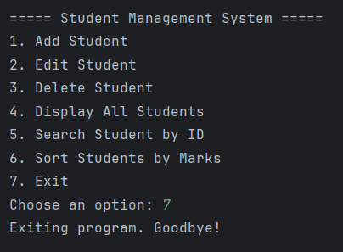
Project-review

Slide 43

Conclusion
Mastering algorithms like Bubble Sort, Merge Sort, and Quick Sort, along with data structures such as Binary Search Trees (BSTs), is essential for optimizing software performance. Additionally, understanding algorithms like Prim's and Dijkstra's underscores the importance of efficiency in network problems. These tools and techniques not only enhance software performance but also improve scalability and maintainability, which are crucial for high-quality software development. Equally important is the ability to create precise design specifications for data structures and algorithms, as demonstrated by examining the stack ADT, FIFO queue, and various sorting algorithms. This knowledge is fundamental for defining valid operations, steps, efficiency, and use cases, ultimately leading to more effective problem-solving and software solutions.

Slide 44

Thanks For Watching !

