Slide 1
Processes
Notes:
‹#›

Slide 2
OS
Kernel
Functionalities
User space and kernel space

Slide 3
Processes
Process Concept
Process Scheduler
Operations on Processes

Slide 4
Outcomes
Learn the basic concepts of Process and its components.
State the Process life cycle.
Explain operation on process

Slide 5
Process Concept
An operating system executes a variety of programs:
  Batch system – jobs
  Time-shared systems – user programs or tasks
Textbook uses the terms job and process almost interchangeably
Process – a program in execution; process execution must progress in sequential fashion
Multiple parts
  The program code, also called text section
  Current activity including program counter, processor registers
  Stack containing temporary data
    Function parameters, return addresses, local variables
  Data section containing global variables
  Heap containing memory dynamically allocated during run time

Slide 6
Process Concept (Cont.)
A process is basically a program in execution.
The execution of a process must progress in a sequential fashion.
A process is defined as an entity which represents the basic unit of work to be implemented in the system
Program is passive entity stored on disk (executable file), process is active
  Program becomes process when executable file loaded into memory
Execution of program started via GUI mouse clicks, command line entry of its name, etc
One program can be several processes
  Consider multiple users executing the same program

Slide 7
Process Concept (Cont.)
A process is basically a program in execution.
The execution of a process must progress in a sequential fashion.
A process is defined as an entity which represents the basic unit of work to be implemented in the system
Program is passive entity stored on disk (executable file), process is active.
  Program becomes process when executable file loaded into memory
Execution of program started via GUI mouse clicks, command line entry of its name, etc
One program can be several processes
  Consider multiple users executing the same program

Slide 8
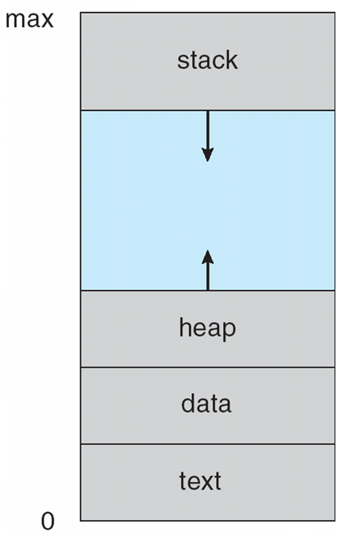
Process in Memory
Component & Description
Stack-The process Stack contains the temporary data such as method/function parameters, return address and local variables.
Heap-This is dynamically allocated memory to a process during its run time.
Text-This includes the current activity represented by the value of Program Counter and the contents of the processor's registers.
Data-This section contains the global and static variables.

Slide 9
Program
A program is a piece of code which may be a single line or millions of lines.
A computer program is usually written by a computer programmer in a programming language.
For example, here is a simple program written in C programming language −
#include <stdio.h>
int main() {
printf("Hello, World! \n");
return 0;
}
A computer program is a collection of instructions that performs a specific task when executed by a computer.
When we compare a program with a process, we can conclude that a process is a dynamic instance of a computer program.

Slide 10
Process States
1 | Start:-This is the initial state when a process is first started/created.
2 | Ready:-The process is waiting to be assigned to a processor. Ready processes are waiting to have the processor allocated to them by the operating system so that they can run. Process may come into this state after Start state or while running it by but interrupted by the scheduler to assign CPU to some other process.
3 | Running:-Once the process has been assigned to a processor by the OS scheduler, the process state is set to running and the processor executes its instructions.
4 | Waiting:-Process moves into the waiting state if it needs to wait for a resource, such as waiting for user input, or waiting for a file to become available.
5 | Terminated or Exit:-Once the process finishes its execution, or it is terminated by the operating system, it is moved to the terminated state where it waits to be removed from main memory.

Slide 11
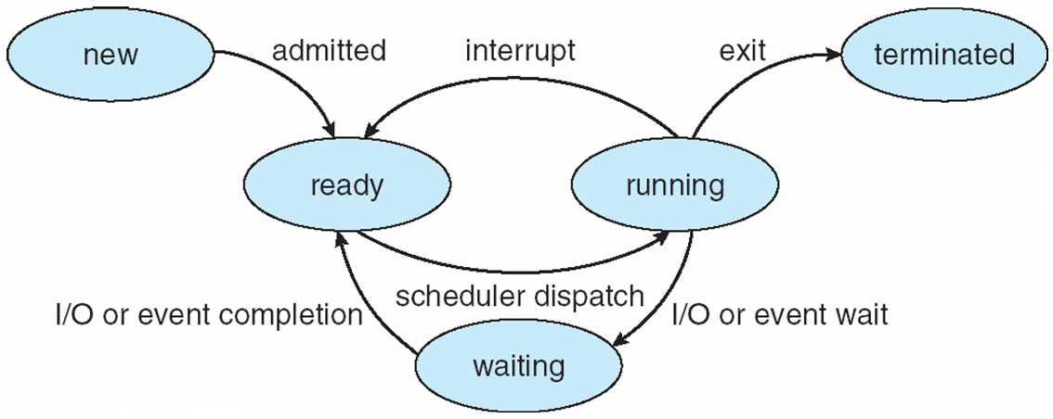
Diagram of Process State

Slide 12
Interrupt
Interrupts are signals sent to the CPU by external devices, normally I/O devices.
They tell the CPU to stop its current activities and execute the appropriate part of the operating system.
Interrupts are important because they give the user better control over the computer.
Without interrupts, a user may have to wait for a given application to have a higher priority over the CPU to be ran.
This ensures that the CPU will deal with the process immediately.

Slide 13
Types of interrupts
There are three types of interrupts:
Hardware Interrupts are generated by hardware devices to signal that they need some attention from the OS.
Software Interrupts are generated by programs when they want to request a system call to be performed by the operating system.
Traps are generated by the CPU itself to indicate that some error or condition occurred for which assistance from the operating system is needed.

Slide 14
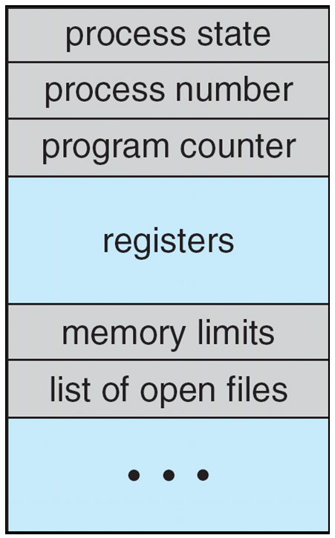
Process Control Block (PCB)
Information associated with each process
(also called task control block)
Process state – running, waiting, etc
Program counter – location of instruction to next execute
CPU registers – contents of all process-centric registers
CPU scheduling information- priorities, scheduling queue pointers
Memory-management information – memory allocated to the process
Accounting information – CPU used, clock time elapsed since start, time limits
I/O status information – I/O devices allocated to process, list of open files

Slide 15
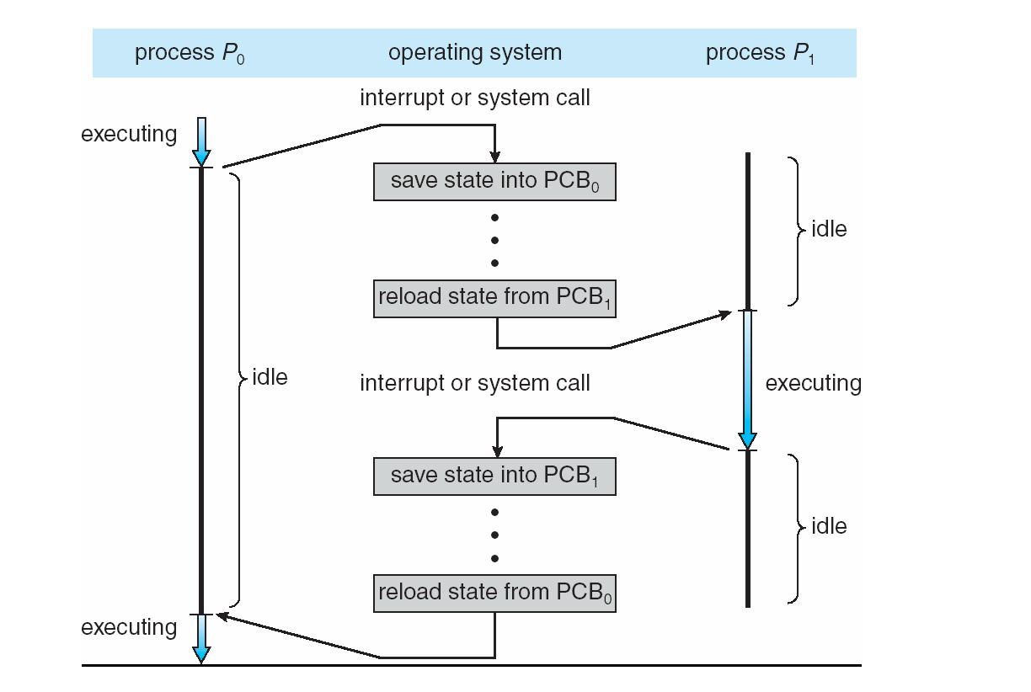
CPU Switch From Process to Process

Slide 16
Context Switch
A context switch occurs when a computer’s CPU switches from one process or thread to a different process or thread.
Context switching allows for one CPU to handle numerous processes or threads without the need for additional processors.
A context switch is the mechanism to store and restore the state or context of a CPU in Process Control block so that a process execution can be resumed from the same point at a later time.
Any operating system that allows for multitasking relies heavily on the use of context switching to allow different processes to run at the same time.

Slide 17
Context switch
Typically, there are three situations that a context switch is necessary, as shown below.
Multitasking – When the CPU needs to switch processes in and out of memory, so that more than one process can be running.
Kernel/User Switch – When switching between user mode to kernel mode, it may be used (but isn’t always necessary).
Interrupts – When the CPU is interrupted to return data from a disk read.

Slide 18
Context Switch
The steps in a full process switch are:
Save the context of the process, including program counter and other registers.
Update the process control block of the process that is currently in the Running state.
This includes changing the state of the process to one of the other states (Ready; Blocked; Ready/Suspend; or Exit).
Other relevant fields must also be updated, including the reason for leaving the Running state and accounting information.
Move the process control block of this process to the appropriate queue (Ready; Blocked on Event i ; Ready/Suspend).

Slide 19
Context switch cont…..
Select another process for execution.
Update the process control block of the process selected. This includes changing the state of this process to Running.
Update memory management data structures. This may be required, depending on how address translation is managed.
Restore the context of the process to that which existed at the time the selected process was last switched out of the Running state, by loading in the previous values of the program counter and other registers.

Slide 20
Process Scheduling
Maximize CPU use, quickly switch processes onto CPU for time sharing.
Process scheduler selects among available processes for next execution on CPU.
Maintains scheduling queues of processes
  Job queue – set of all processes in the system
  Ready queue – set of all processes residing in main memory, ready and waiting to execute
  Device queues – set of processes waiting for an I/O device
  Processes migrate among the various queues

Slide 21
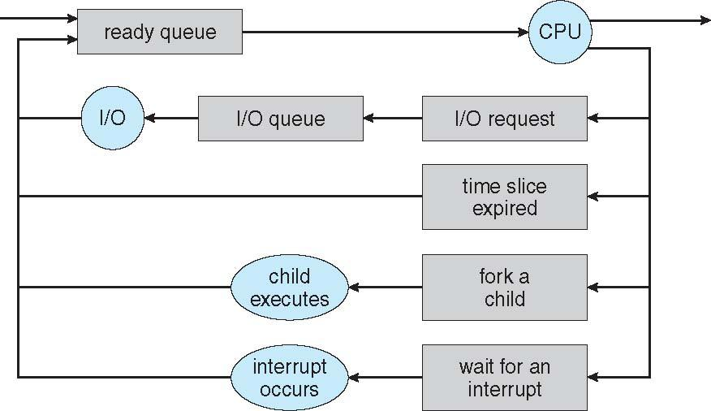
Representation of Process Scheduling
Queuing diagram represents queues, resources, flows

Slide 22
Process Scheduling
A new process is initially put in the ready queue.
It waits there until it is selected for execution, or dispatched.
Once the process is allocated the CPU and is executing, one of several events could occur:
The process could issue an I/O request and then be placed in an I/O queue.
The process could create a new child process and wait for the child’s termination.
The process could be removed forcibly from the CPU, as a result of an interrupt, and be put back in the ready queue.

Slide 23
Schedulers
Schedulers are special system software which handle process scheduling in various ways.
Their main task is to select the jobs to be submitted into the system and to decide which process to run.
Schedulers are of three types −
Long-Term Scheduler
Short-Term Scheduler
Medium-Term Scheduler

Slide 24
Short Term Scheduler(Ready to running)
It is also called as CPU scheduler.
Its main objective is to increase system performance in accordance with the chosen set of criteria.
CPU scheduler selects a process among the processes that are ready to execute and allocates CPU to one of them.
It is the change of ready state to running state of the process.
Short-term schedulers, also known as dispatchers, make the decision of which process to execute next.
Short-term schedulers are faster than long-term schedulers.

Slide 25
Medium Term Scheduler
Medium-term scheduling is a part of swapping.
It removes the processes from the memory. It reduces the degree of multiprogramming.
The medium-term scheduler is in-charge of handling the swapped out-processes.
A running process may become suspended if it makes an I/O request.
A suspended processes cannot make any progress towards completion.
In this condition, to remove the process from memory and make space for other processes, the suspended process is moved to the secondary storage.
This process is called swapping, and the process is said to be swapped out or rolled out. Swapping may be necessary to improve the process mix.

Slide 26
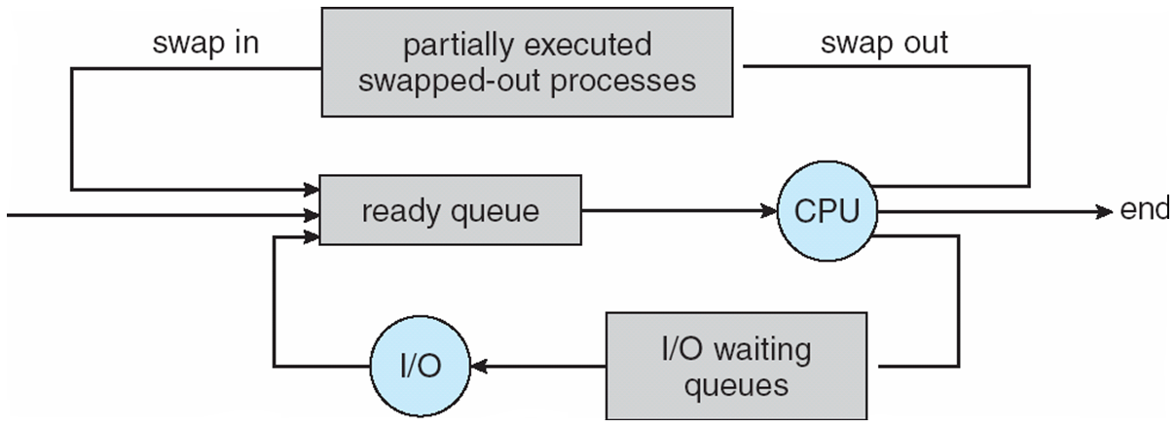
Addition of Medium Term Scheduling
Medium-term scheduler can be added if degree of multiple programming needs to decrease
  Remove process from memory, store on disk, bring back in from disk to continue execution: swapping

Slide 27
Long Term Scheduler(New to ready)
It is also called a job scheduler.
A long-term scheduler determines which programs are admitted to the system for processing.
It selects processes from the queue and loads them into memory for execution.
Process loads into the memory for CPU scheduling.
The primary objective of the job scheduler is to provide a balanced mix of jobs, such as I/O bound and processor bound.
It also controls the degree of multiprogramming.
If the degree of multiprogramming is stable, then the average rate of process creation must be equal to the average departure rate of processes leaving the system.
When a process changes the state from new to ready, then there is use of long-term scheduler.

Slide 28
Comparison among Scheduler
Long-Term Scheduler | Short-Term Scheduler | Medium-Term Scheduler
It is a job scheduler | It is a CPU scheduler | It is a process swapping scheduler.
Speed is lesser than short term scheduler | Speed is fastest among other two | Speed is in between both short and long term scheduler.
It controls the degree of multiprogramming | It provides lesser control over degree of multiprogramming | It reduces the degree of multiprogramming.
It is almost absent or minimal in time sharing system | It is also minimal in time sharing system | It is a part of Time sharing systems.
It selects processes from pool and loads them into memory for execution | It selects those processes which are ready to execute | It can re-introduce the process into memory and execution can be continued.

Slide 29
Multitasking in Mobile Systems
Some mobile systems (e.g., early version of iOS) allow only one process to run, others suspended
Due to screen real estate, user interface limits iOS provides for a
  Single foreground process- controlled via user interface
  Multiple background processes– in memory, running, but not on the display, and with limits
  Limits include single, short task, receiving notification of events, specific long-running tasks like audio playback
Android runs foreground and background, with fewer limits
  Background process uses a service to perform tasks
  Service can keep running even if background process is suspended
  Service has no user interface, small memory use

Slide 30
Operations on Processes
System must provide mechanisms for:
  process creation,
  process termination,

Slide 31
Process Creation
Parent process create children processes, which, in turn create other processes, forming a tree of processes
Generally, process identified and managed via a process identifier (pid)
Resource sharing options
  Parent and children share all resources
  Children share subset of parent’s resources
  Parent and child share no resources
Execution options
  Parent and children execute concurrently
  Parent waits until children terminate

Slide 32
fork() in C
Fork system call use for creates a new process, which is called child process, which runs concurrently with process (which process called system call fork) and this process is called parent process.
After a new child process created, both processes will execute the next instruction following the fork() system call.
A child process use same pc(program counter), same CPU registers, same open files which use in parent process.
It take no parameters and return integer value.
Notes:
‹#›

Slide 33
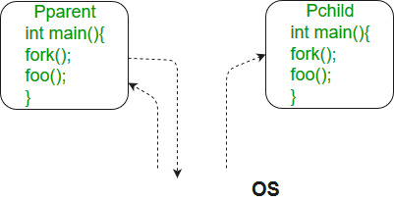
fork() in C
Below are different values returned by fork().
Negative Value: creation of a child process was unsuccessful.
Zero: Returned to the newly created child process.
Positive value: Process id of child process Returned to parent or caller.
The value contains process ID of newly created child process.

Slide 34
#include<stdio.h>
#include<sys/types.h>
#include<unistd.h>
int main() {
// make two process which run same
// program after this instruction
fork();
printf("Hello world!\n");
return 0;
}
Output:
Hello world!
Hello world!

Slide 35
Calculate number of times hello is printed.
#include <stdio.h>
#include <sys/types.h>
int main()
{
fork();
fork();
fork();
printf("hello\n");
return 0;
}

Slide 36
Calculate number of times hello is printed.
#include <stdio.h>
#include <sys/types.h>
int main()
{
fork();
fork();
fork();
printf("hello\n");
return 0;
}
Output:
hello
hello
hello
hello
hello
hello
hello
hello

Slide 37
Number of times hello printed is equal to number of process created. Total Number of Processes = 2n where n is number of fork system calls. So here n = 3, 23 = 8.
Let us put some label names for the three lines:
fork (); // Line 1
fork (); // Line 2
fork (); // Line 3
L1 // There will be 1 child process
/ \ // created by line 1.
L2 L2 // There will be 2 child processes
/ \ / \ // created by line 2
L3 L3 L3 L3 // There will be 4 child processes
// created by line 3
So there are total eight processes (new child processes and one original process).

Slide 38
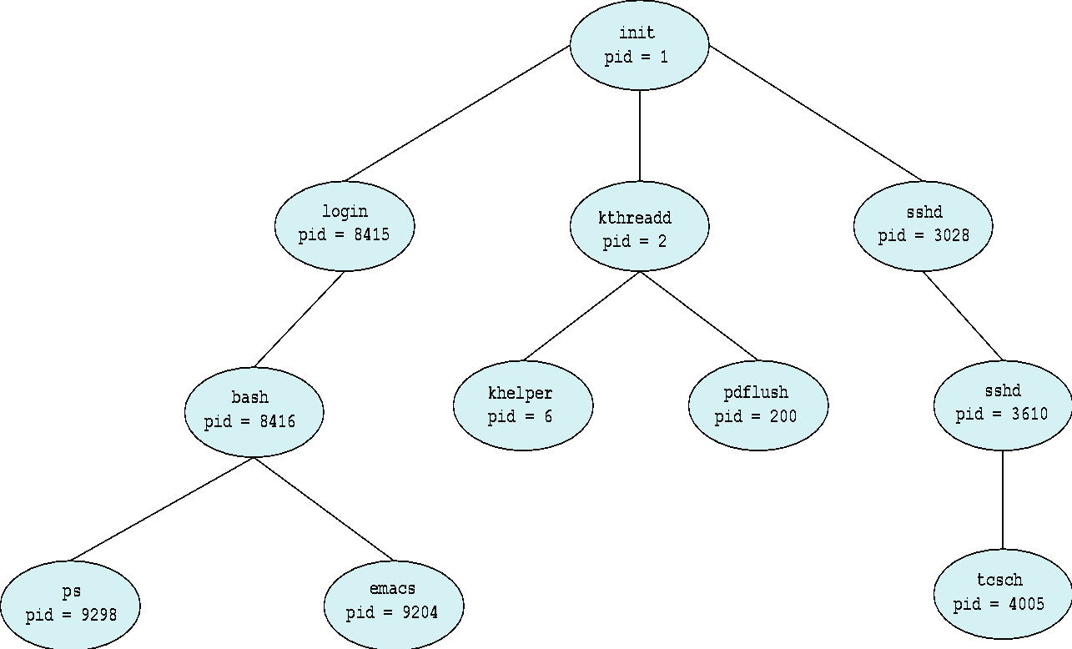
A Tree of Processes in Linux

Slide 39
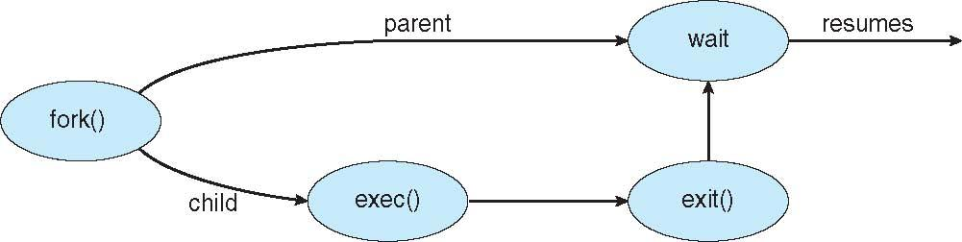
Process Creation (Cont.)
After fork(), both parent and child continue execution independently.
Use exec() to load a new program in the child.
exec() Replaces current process image with new program
Use wait() in the parent to wait for child to finish.
Memory is shared using Copy-on-Write, so no actual memory is duplicated until it’s written to.

Slide 40
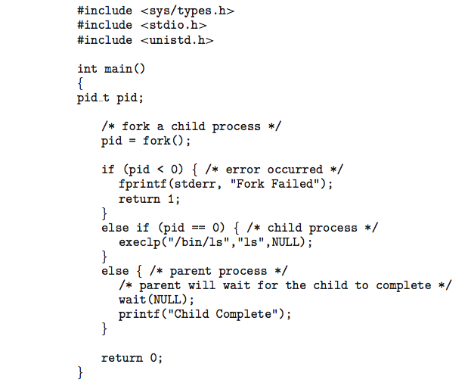
C Program Forking Separate Process

Slide 41
Example Code
#include <stdio.h>
#include <unistd.h>
int main() {
pid_t pid = fork();
if (pid < 0) {
perror("Fork failed");
} else if (pid == 0) {
printf("Child Process: PID = %d\n", getpid());
} else {
printf("Parent Process: PID = %d, Child PID = %d\n", getpid(), pid);
}
return 0;
}

Slide 42
Process Termination
Process executes last statement and then asks the operating system to delete it using the exit() system call.
  Returns status data from child to parent (via wait())
  Process’ resources are de-allocated by operating system
Parent may terminate the execution of children processes using the abort() system call. Some reasons for doing so:
  Child has exceeded allocated resources
  Task assigned to child is no longer required
  The parent is exiting and the operating systems does not allow a child to continue if its parent terminates

Slide 43
Process Termination
Some operating systems do not allow child to exists if its parent has terminated. If a process terminates, then all its children must also be terminated.
  cascading termination. All children, grandchildren, etc. are terminated.
  The termination is initiated by the operating system.
The parent process may wait for termination of a child process by using the wait()system call. The call returns status information and the pid of the terminated process
pid = wait(&status);

Slide 44
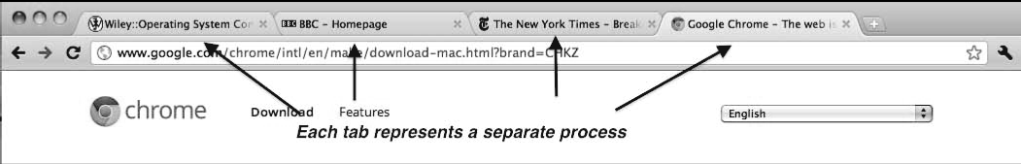
Multi Process Architecture – Chrome Browser
Many web browsers ran as single process (some still do)
  If one website causes trouble, entire browser can hang or crash
Google Chrome Browser is multiprocess with 3 different types of processes:
  Browser process manages user interface, disk and network I/O
  Renderer process renders web pages, deals with HTML, Javascript. A new renderer created for each website opened
    Runs in sandbox restricting disk and network I/O, minimizing effect of security exploits
  Plug-in process for each type of plug-in

Slide 45
Think-Ink-Solve Activity
Group | Topic | Number Of Students | Task
1 | Process and Process in Memory, Interrupts |  | Student in each group discuss the topic and share their views in terms of some examples.(4M) Prepare the list of Subjective(2)and objectives questions(5).(4M) Present their topic in front of all students.(4M)-in a group. Solve the any subjective questions (excluding question of parent group) circulated by all group.(6M) Solve Quiz (11/8/2018) on moodle (12M)
2 | Process States
3 | Process Control Blocks
4 | Process Context Switch
5 | Process Scheduler

