Slide 1

Face Mask Detection using Transfer Learning
Kirtana Nambiar

Slide 2
Introduction
The proposed model determines if a person is wearing mask or not.
WHO recommended as simple as wearing a mask to stop the spread of virus. Face mask detection can be used for monitoring for face masks, which can be further used to alert the person.
To detect face mask during Facial Recognition.

Slide 3
The proposed model
AlexNet
Dataset
Data Preprocessing
GoogleNet
Majority Vote
With Mask
Without Mask
VGG16
ResNet

Slide 4
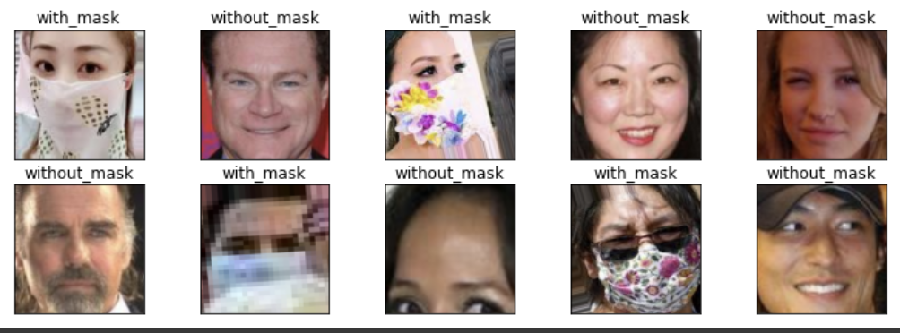
Data descriptions
Classification with two class labels: WithMask and WithoutMask.
Dataset collection and after processing:
Train set: 10000
Validation set: 800
Test set: 992

Slide 5
Convolutional Neural Networks
CNN is a neural network that processes image data based on grid-like topology.
3 Layers of CNN:
Convolution Layer: Detects meaningful information.
Pooling Layer: Reduces dimensionality by statistics.
Fully connected Layer: Maps input to output by matrix multiplication

Slide 6
Transfer Learning Models used:
1. AlexNet:
Consists of 8 input CNN layers.
2. GoogLeNet:
Consists of 22 deep CNN layers and reduced the input parameters from 60(AlexNet) to 4 Million.
3.Resnet:
Consists of 18 CNN layers. It solves Vanishing gradient by skipping layers.
4. VGGNet:
Consists of 16 CNN layers but has a high number of input parameters(136M)

Slide 7
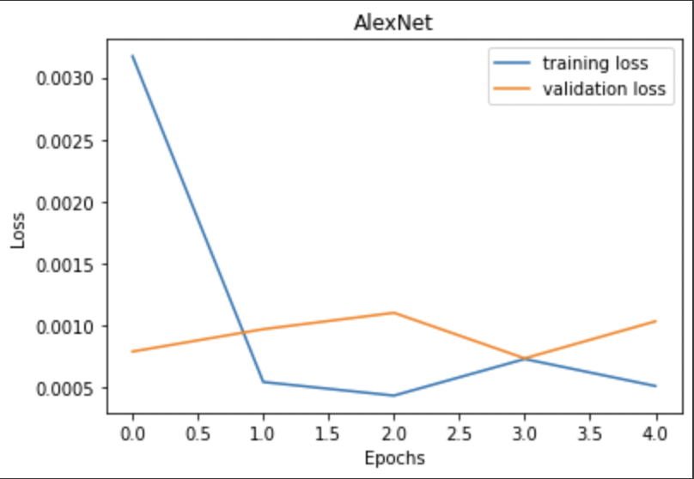
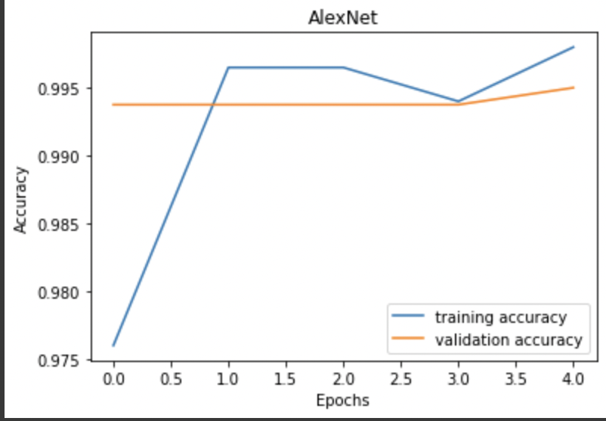
Results:
1.Using AlexNet :
Training and Validation Loss with Epochs
Training and Validation Accuracy with Epochs
Model accuracy: 99.60%

Slide 8
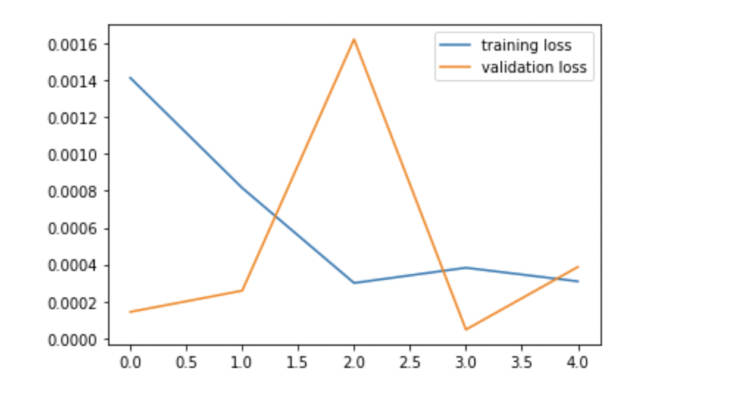
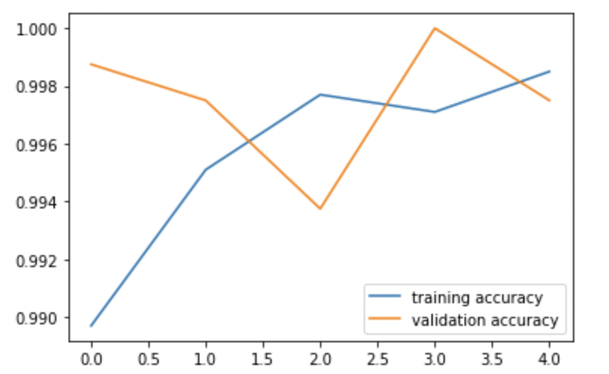
Results:
2. Using GoogleNet. :
Training and Validation Loss with Epochs
Training and Validation Accuracy with Epochs
Loss
Accuracy
Epochs
Epochs
Model accuracy: 98.19%

Slide 9
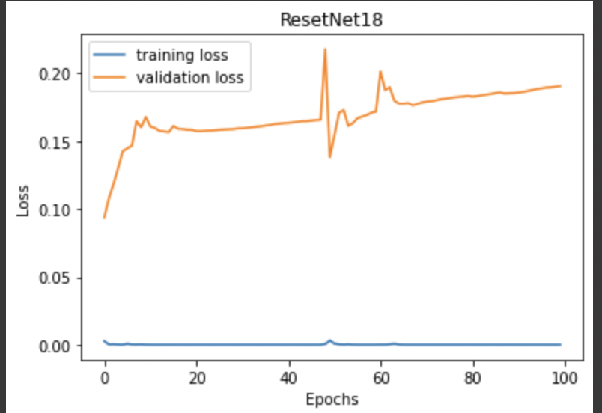
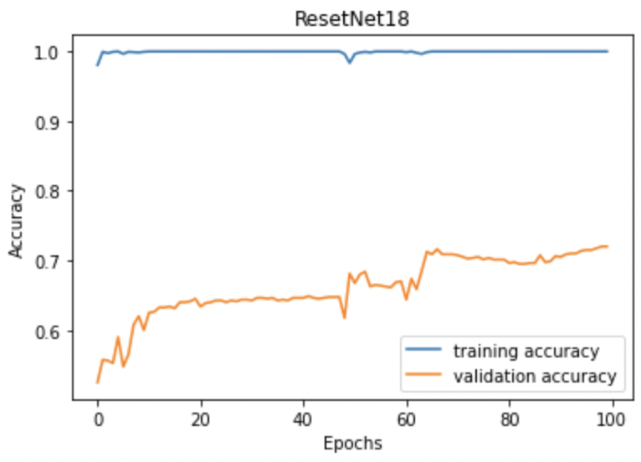
Results:
2. Using ResNet18 :
Model accuracy 71.37%

Slide 10
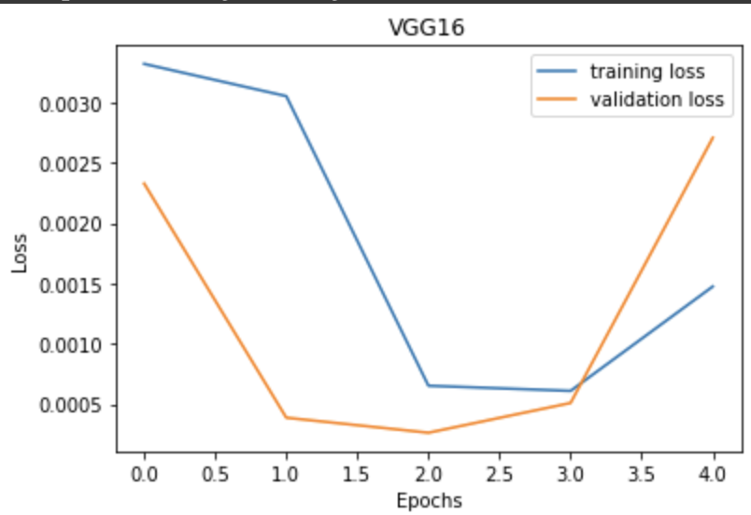
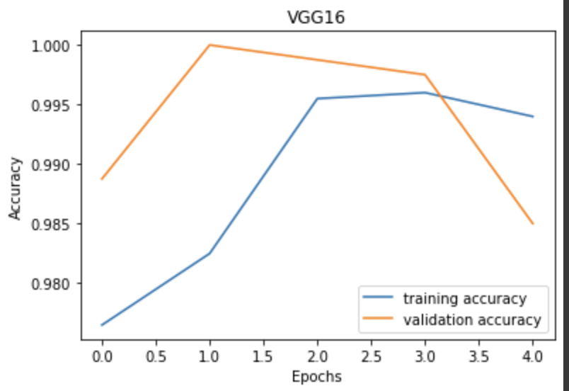
Results:
4. Using VGG16 :
Model accuracy: 98.89%

Slide 11
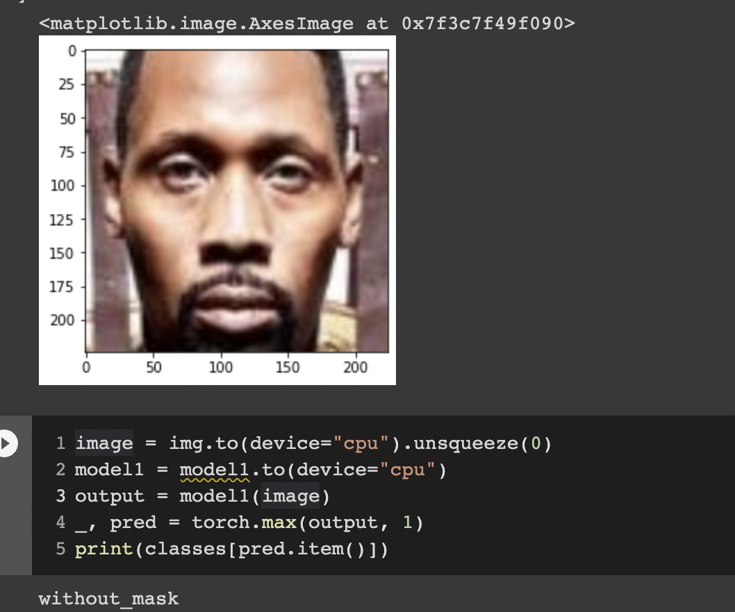
Output:

Slide 12
Experiment Results
Model | Test Accuracy | ValidationAccuracy
Alexnet | 99.7% | 99.60%
GoogleNet | 99.3% | 98.19%
Vgg6 | 74% | 98.89%
RESNET | 47.61% | 71.37%
Ensemble | - | 99.89%
AlexNet and GoogleNet exhibited better accuracy than the rest.

Slide 13
Confusion Matrix
Model1
Actual/Predicted | 1 | 0
1 | 236 | 0
0 | 1 | 253
Model2
Actual/Predicted | 1 | 0
1 | 225 | 3
0 | 0 | 262

Slide 14
Thank you

