Slide 1
Sentiment Analysis on RateMyProfessors Website

Slide 2
Problem & Motivation

Slide 3





Notes:
Clearly set up the problem that is motivating the work​:
The website we are tackling in our project, and which I think most of the students are familiar with, is ratemyprofessors website. It is a website where the students put their opinions about professors, so that other students can come and check them before they register for a course with a specific instructor.

Slide 4
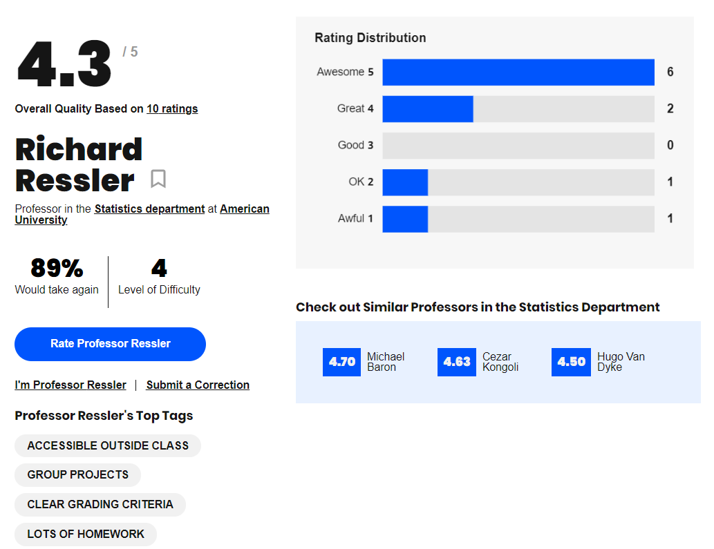
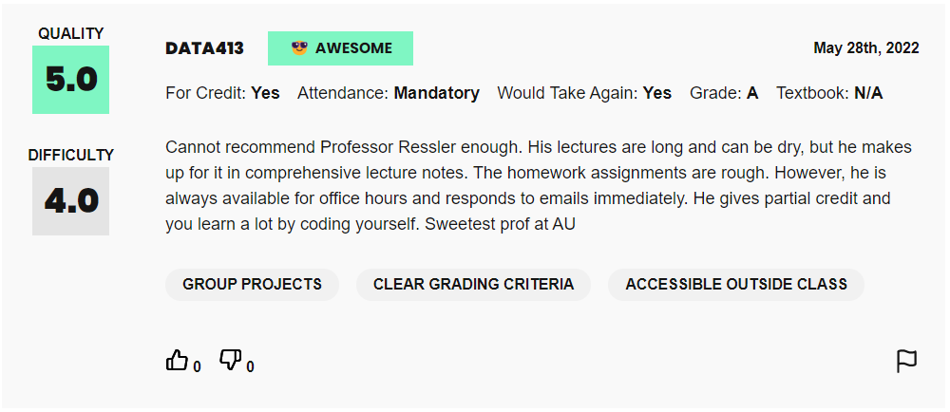
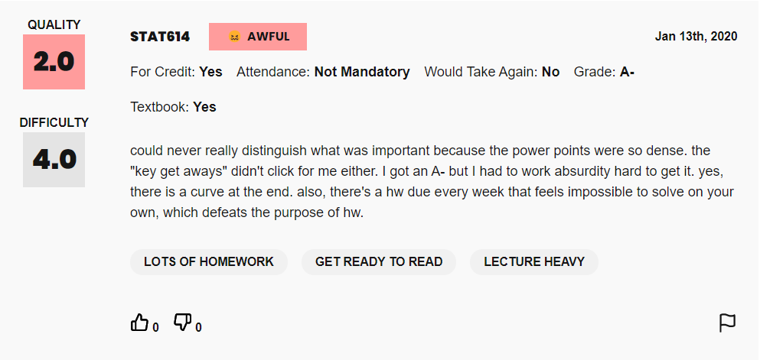
Notes:
Include a natural language example or examples to help the audience understand the problem​
An example of this would be that me as a student, for instance, browse one of the professors. Lets say Professor Richard Ressler, a very dear professor that taught me. This is one of the results that show up. From the review, when I read that the student strongly recommends the professor and that he has comprehensive lecture notes, I realize that this is a positive review. On the other hand, when i read this review, where it says that the student couldn't tell what is important, and that the homeworks were impossible to solve, I realize that this is a negative result.Then as a student, based on these comments I make my decision of registering with this professor.
Describe the NLP task you are pursuing​
One component of this professor assessment is textual, in the form of comments as we saw. In our project, the NLP task we are performing is conducting sentiment analysis on these comments to deduce whether they are negative or positive.

Slide 5
Data

Slide 6
Data Source
Scraping of ratemyprofessors website shared by Dr. Jibo from Tsinghua University
20000
https://data.mendeley.com/datasets/fvtfjyvw7d/2
Number of rows
Professor’s name
Difficulty index
School’s name
Tag professor
Star rating
Grade
Comments

Slide 7
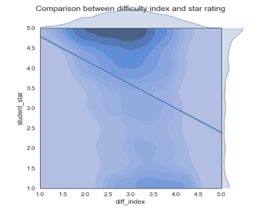
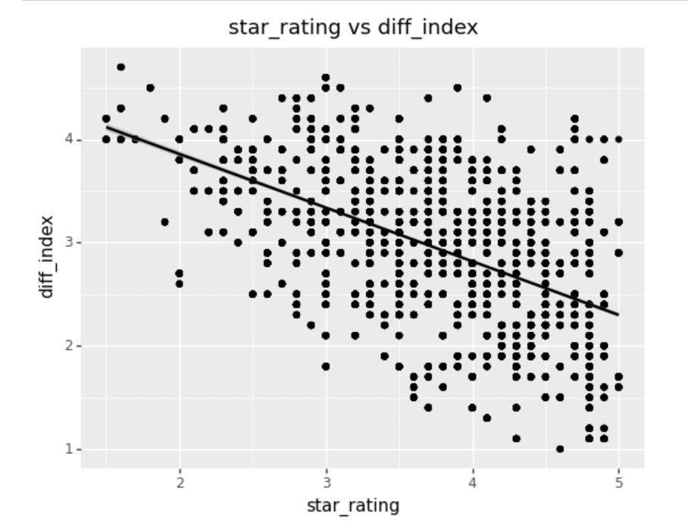
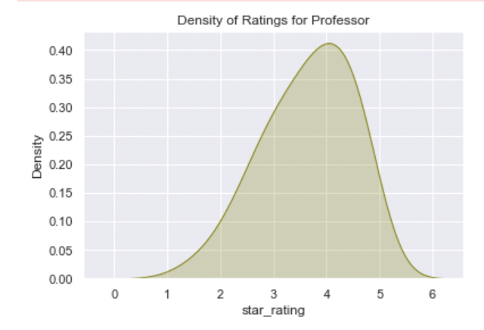
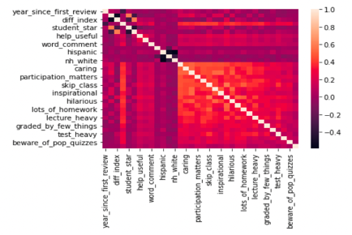
EDA

Slide 8
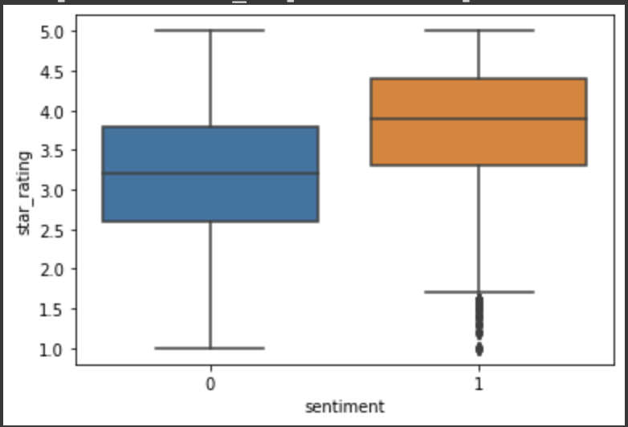
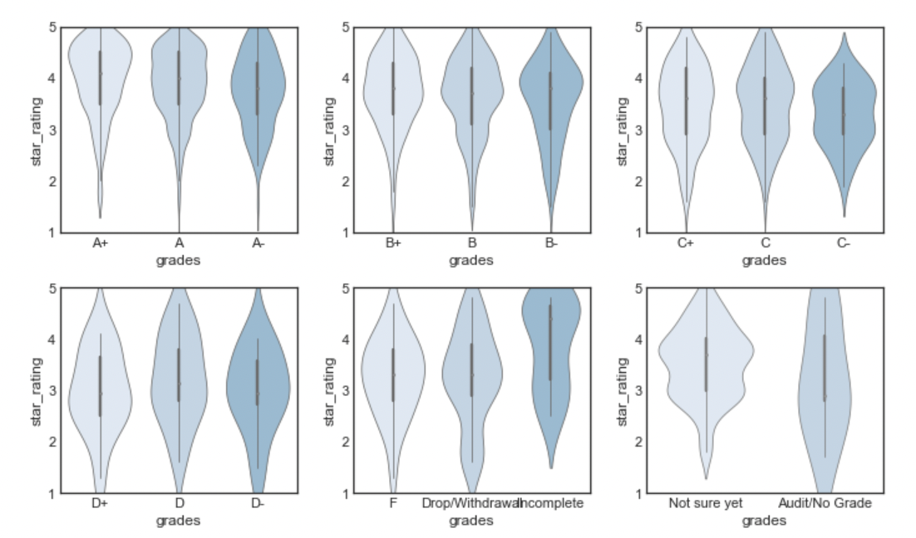
EDA
Positive and Negative responses from the data.
Star rating given by students based on their corresponding grades.

Slide 9
Methods

Slide 10
Architecture 1.1:
Tokenization
Remove Stopwords
IMDB/
Amazon
reviews
Vader
Evaluate
Apply
Sentiment
Lemmatize
Input
Predict Sentiment
F1-score
Test on unlabelled RMF data
Pre-Processing
Notes:
Previous methods used labelled data or active learning for sentiment analysis.
We use Vader to generate labels as it was trained on Social media texts and compare it with star rating in the data.(rule-based sentiment analysis tool).

Slide 11
Architecture 1.2:
Labelled Imdb/Amazon
Review
Tokenization
Classifier
Train & eval on labelled data
Remove Stopwords
Labelled RMF
Review
Count -Vectorizer
Apply
Sentiment
Lemmatize
Word embedding
Test on unlabelled data
Input
Pre-Processing
Notes:
We used Logistic Regression, Random Forest , KNN, and RNN as this is a classification problem.

Slide 12
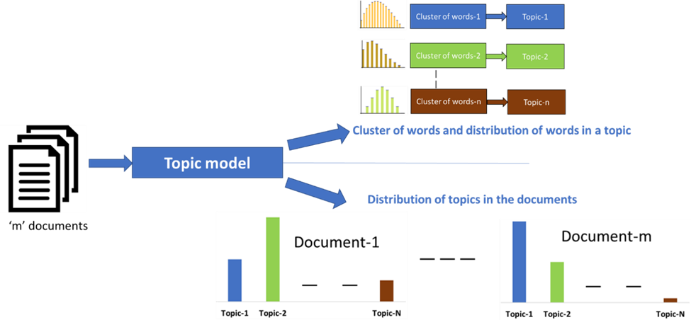
Topic Modeling using Latent Dirichlet Allocation
- Why Topic Modelling using LDA?
- Architecture of LDA Model
- Python libraries used

Slide 13
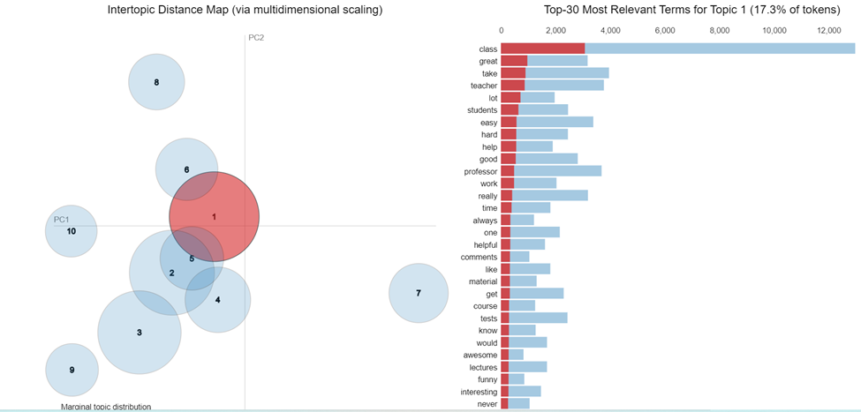
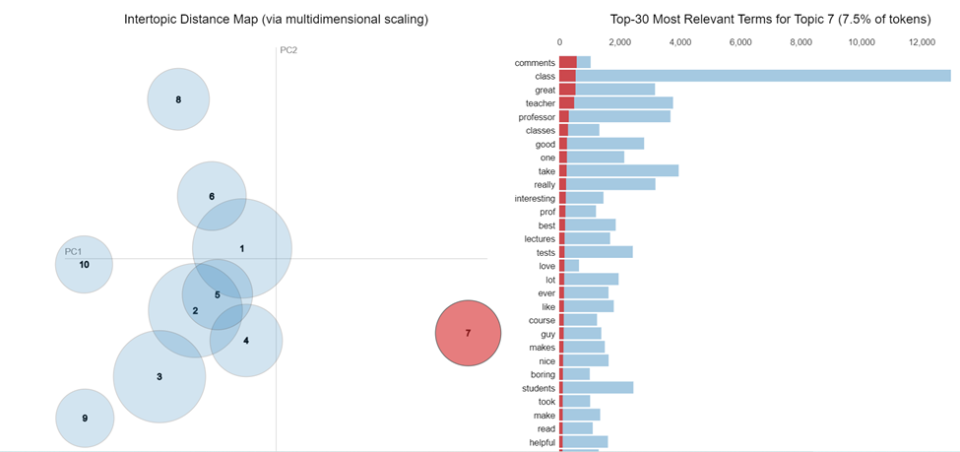
Results - Topic Modeling
Topic Modelling initially performed on ‘Comments’ column of the dataset which includes the reviews
Obtained visualizations of clusters which demonstrate the most relevant terms for the topics

Slide 14
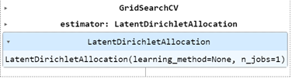
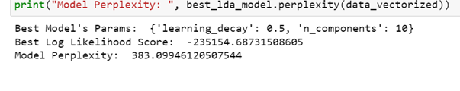
Results - Topic Modeling
Implemented the LDA to identify the topic keywords for each professor corresponding to the reviews

Slide 15
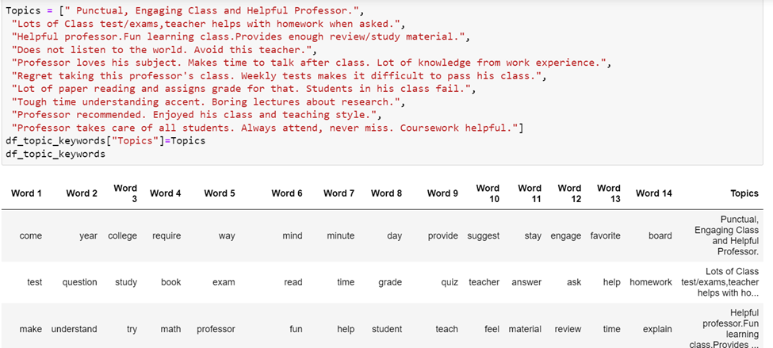
Results - Topic Modeling
Topic Keyword Matrix

Slide 16
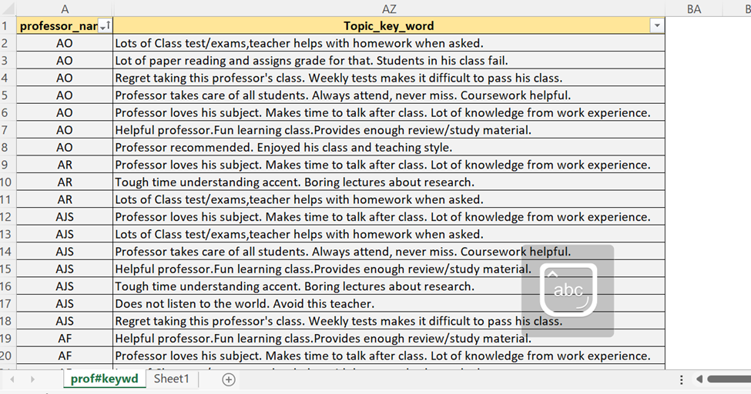
Results - Topic Modeling
LDA model predicting to assign the topic keywords based on the reviews/comments received corresponding to each professor
Professor names redacted to name initials.

Slide 17
Results

Slide 18
Results:
Algorithm | F1-score
KNN | 0.63
Vader | 0.73
Logistic Regression | 0.78
Random Forest | 0.83
RNN | 0.90

Slide 19
Conclusion

Slide 20
Conclusion:
We were able to predict the overall sentiment associated with each professor.
- summarized sentiment on the different teaching methods.
- take necessary actions to make the learning experience a holistic.
Topic handling to provide summarised keywords.
Used comments/reviews to generate topics using the LDA model.
Enhance assigning topic keywords to know more about the subject
Future Work:
Fine-tune models to get better accuracy,
Balance the dataset using techniques like SMOTE.
Extract more features to improve model prediction.
Sentiment Analysis are predicted to be expanded into approaches that utilise scalability, possess high adaptability for source variation.

Slide 21
Thanks!
Do you have any questions?

