Slide 1
Chapter 6
Use of memory
Summer course: Embedded Linux

Slide 2
Content:
6.1. Memory Storage.
6.2. Memory Allocation.
6.3. Questions.
Summer course: Embedded Linux

Slide 3
Content:
6.1. Memory Storage.
6.2. Memory Allocation.
6.3. Questions.
Summer course: Embedded Linux

Slide 4
6.1. Memory Storage
Summer course: Embedded Linux

Slide 5
6.1. Memory Storage:
6.1.1. Storage Considerations.
6.1.2. Flash memories.
6.1.3. Memory Management.
6.1.4. Questions.
Summer course: Embedded Linux

Slide 6
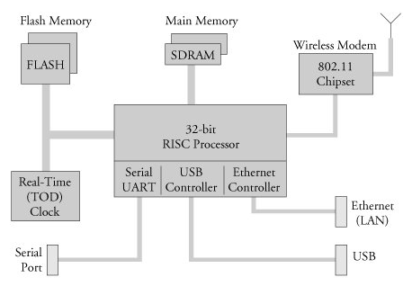
An example embedded system
Flash memory is used for nonvolatile program and data storage.
Main memory is random-access memory (for example: DRAM, SRAM, SDRAM).
Summer course: Embedded Linux
Notes:
For lecture:
- The Figure 1 shows a block diagram of a typical embedded system. This is a very simple example of a high-level hardware architecture that might be found in a wireless access point. The system is centered on a 32-bit RISC processor. Flash memory is used for nonvolatile program and data storage. Main memory is synchronous dynamic random-access memory (SDRAM) and might contain anywhere from a few megabytes to hundreds of megabytes, depending on the application. A real-time clock module, often backed up by battery, keeps the time of day (calendar/wall clock, including date). This example includes an Ethernet and USB interface, as well as a serial port for console access via RS-232. The 802.11 chipset implements the wireless modem function.
- Often the processor in an embedded system performs many functions beyond the traditional CPU. The hypothetical processor in Figure 1 contains an integrated UART for a serial interface, and integrated USB and Ethernet controllers. Many processors contain integrated peripherals

Slide 7
6.1.1. Storage Considerations:
Embedded systems have limited physical resources.
Compare price, performance, power consumption when deciding upon specific memory characteristics.
If memory has to run twice as fast to maintain a desired bandwidth, then the memory power requirement may be higher.
Summer course: Embedded Linux
Notes:
For lecture:
The comment for sentence: “Embedded systems have limited physical resources.” - One of the most challenging aspects of embedded systems is that most embedded systems have limited physical resources. Although the Pentium 4 machine on your desktop might have 180GB of hard drive space, it is not uncommon to find embedded systems with a fraction of that amount. In many cases, the hard drive is typically replaced by smaller and less expensive nonvolatile storage devices. Hard drives are bulky, have rotating parts, are sensitive to physical shock, and require multiple power supply voltages, which makes them unsuitable for many embedded systems.

Slide 8
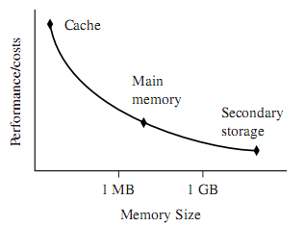
Memory trade – offs:
The closer memory is to the processor core, the more it costs and and the smaller its capacity.
Cache is place between main memory and core.
Secondary storage is lagerest and slowest form of memory
Summer course: Embedded Linux
Notes:
For the lecture:
The fastest memory cache is physically located nearer the ARM processors core.
The slowest secondary memory is set futher way.

Slide 9
6.1. Memory Storage:
6.1.1. Storage Considerations.
6.1.2. Flash memories.
6.1.3. Memory Management.
6.1.4. Questions.
Summer course: Embedded Linux

Slide 10
6.1.2. Flash memories:
Used in a wide variety of consumer devices, such as digital cameras and PDAs.
Can be written to and erased under software control.
divided into nonuniform erase block sizes, to facilitate flexible data-storage layout.
Summer course: Embedded Linux
Notes:
For lecture:
The comment for sentence “Is used in a wide variety of consumer devices, such as digital cameras and PDAs.” : Flash memories can be thought of as solid-state hard drives, capable of storing many megabytesand even gigabytesof data in a tiny footprint. They contain no moving parts, are relatively rugged, and operate on a single common power supply voltage.
The comment for “Can be written to and erased under software control”: In a typical Flash memory chip, data can be changed from a binary 1 to a binary 0 under software control, 1 bit/word at a time, but to change a bit from a zero back to a one, an entire block must be erased.

Slide 11
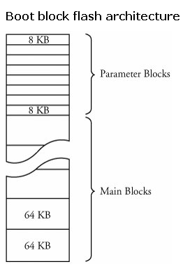
6.1.2. Flash memories (2):
Top of Flash
8KB for erase blocks
One of limitations of Flash memory that must be considered is Flash memory cell write lifetime.
Bottom of Flash
64KB for erase blocks
Summer course: Embedded Linux
Notes:
For lecture:
- The comment for “One of limitations of Flash memory that must be considered is Flash memory cell write lifetime.”: A Flash memory cell has a limited number of write cycles before failure. Although the number of cycles is fairly large (100K cycles typical per block), it is easy to imagine a poorly designed Flash storage algorithm (or even a bug) that can quickly destroy Flash devices. It goes without saying that you should avoid configuring your system loggers to output to a Flash-based device.

Slide 12
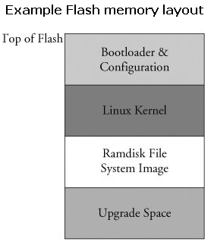
Flash Usage:
The bootloader is often placed in the top or bottom of the Flash memory array.
Following, space is allocated for the Linux kernel image and the ramdisk file system image.
Summer course: Embedded Linux
Notes:
For the lecture:
The bootloader is often placed in the top or bottom of the Flash memory array. Following the bootloader, space is allocated for the Linux kernel image and the ramdisk file system image, which holds the root file system. Typically, the Linux kernel and ramdisk file system images are compressed, and the bootloader handles the decompression task during the boot cycle.
For dynamic data that needs to be saved between reboots and power cycles, another small area of Flash can be dedicated, or another type of nonvolatile storage can be used. This is a typical configuration for embedded systems with requirements to store configuration data, as might be found in a wireless access point aimed at the consumer market, for example.

Slide 13
6.1. Memory Storage:
6.1.1. Storage Considerations.
6.1.2. Flash memories.
6.1.3. Memory Management.
6.1.4. Questions.
Summer course: Embedded Linux

Slide 14
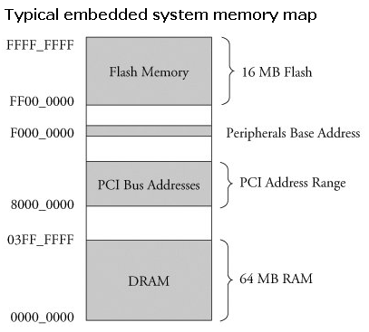
6.1.3. Memory management:
Figure Typical embedded system memory map: 24 physical address lines.
Virtually all legacy embedded OSs view and manage system memory as a single large, flat address space.
Summer course: Embedded Linux
Notes:
For the lecture:
- The comment for the figure example “Typical embedded system memory map”: if a microprocessor had 24 physical address lines, its top of memory would be 16MB (WHY???). Therefore, its hexadecimal address would range from 0x00000000 to 0x00ffffff.
- Lecture can give for student a question: why there is 16 MB?

Slide 15
6.1.3. Memory management (2):
Non protected memory, Memory Protection Unit (MPU) and Memory Management Unit (MMU).
ARM OSs: RTOSs and platform OSs (Linux OS is a typical example).
Platform OSs need a memory management unit (MMU) to manage large, non-real time applications and tends to have secondary storage.
Summer course: Embedded Linux
Notes:
For the lecture:
- The comment for first line: There are ARM’s three different types of memory management hardware: Non protected memory, Memory Protection Unit (MPU) and Memory Management Unit (MMU).
ARM OSs can be divided into two types: RTOSs and platform OSs (Linux OS is a typical example).
The comment for “Platform OSs … non-real time applications”: There are operating systems that use ARM core with a memory management unit and have real-time characteristics. ARM has developed a set of processor cores that specifically target each categorary. (ARM Developer’s Guide: p29)

Slide 16
Memory Management Unit:
Help OS control over its address space and the address space it allocates to processes.
Benefits: access rights vs memory translation.
The Linux kernel takes advantage of hardware MMUs to create a virtual memory.
Summer course: Embedded Linux
Notes:
For the lecture:
The comment for “access rights vs memory translation.”: Access rights allow an operating system to assign specific memory-access privileges to specific tasks. Memory translation allows an operating system to virtualize its address space, which has many benefits.
The comment for last line: One of the biggest benefits of virtual memory is that it can make more efficient use of physical memory by presenting the appearance that the system has more memory than is physically present. The other benefit is that the kernel can enforce access rights to each range of system memory that it allocates to a task or process, to prevent one process from errantly accessing memory or other resources that belong to another process or to the kernel itself.

Slide 17
Process Virtual memory
The kernel allocates memory for the process and assigns a range of virtual-memory addresses to it.
No direct correlation between the physical memory addresses on the board and the virtual memory as seen by the process.
Example "Hello World”, was run on the AMCC Yosemite board contains 256MB of DRAM memory.
Summer course: Embedded Linux

Slide 18
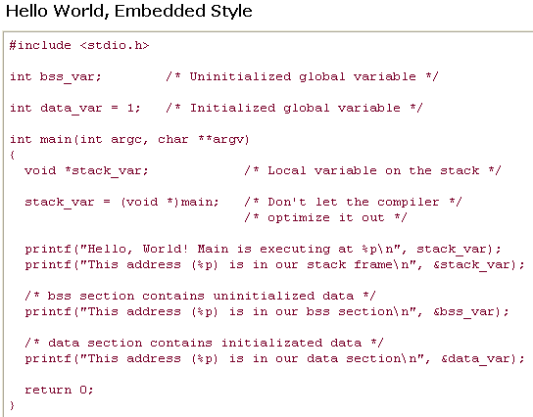
Summer course: Embedded Linux

Slide 19
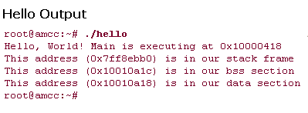
Hello Output
the stack address is roughly halfway into a 32-bit address space, well beyond 256MB of RAM
256 MB boundary
These virtual addresses were assigned by the kernel and
are backed by physical RAM somewhere within the 256MB
range of available memory on the Yosemite board.
Summer course: Embedded Linux

Slide 20
6.1.4. Questions
Question 1: Which of the following memory hierarchies that many small embedded systems do not require the performance of benefits?
A. Main memory. | B. Cache.
C. Secondary memory | D. Other.
Summer course: Embedded Linux
Notes:
For lecture:
Answer B.
Of course A (Main memory) is not answer. The secondary memory is also not answer because its benefit is capacity, not performance.
The correct answer is B: Cache
(You can see the answer at page 24 of ARM System developer’s Guide: Design and Optimizing System Sofware)

Slide 21
6.1.4. Questions
Question 2: What is the problem with Flash memory cell write lifetime?
Question 3: Why Flash memory cells are used for dynamic data that needs to be saved between reboots and power cycles?
Summer course: Embedded Linux
Notes:
For the lecture:
Note: If student explain the Question 2, he/she can know the explaination for Question 3.
A Flash memory cell has a limited number of write cycles before failure. Although the number of cycles is fairly large (100K cycles typical per block), it is easy to imagine a poorly designed Flash storage algorithm (or even a bug) that can quickly destroy Flash devices. It goes without saying that you should avoid configuring your system loggers to output to a Flash-based device.

Slide 22
Content:
6.1. Memory Storage.
6.2. Memory Allocation.
6.3. Questions.
Summer course: Embedded Linux

Slide 23
6.2. Memory Allocation
Summer course: Embedded Linux

Slide 24
6.2. Memory Allocation:
6.2.1. Static memory allocation.
6.2.2. Dynamic memory allocation.
6.2.3. Memory Map.
.
Summer course: Embedded Linux

Slide 25
6.2.1. Static memory allocation
Usage:
  Static is a method here different from the method which dynamically allocates memory by the malloc() etc.
  It is an array with a static memory allocation in case of almost.
Summer course: Embedded Linux

Slide 26
+ Merit of array
After finish using memory, not to manage the memory release as for the local array declared in the function.
+ Demerit of array
The array size cannot be extended.
When allocating too much, the array is useless.
It is not possible to release memory even if becoming unnecessary when the array is global.
When too much array is allocated in local, the stack is consumed.
Summer course: Embedded Linux
Notes:
・Merit of array
As for the local array (auto variable) declared in the function, when run of the function terminates, the allocated area is released automatically.

Slide 27
Cautions
■Cautions for size
Do not allocate too much array in local carelessly.
int func(int flag)
{
int array_buff[10000];
if(flag) {
return(-1);
}
/* Process of using array_buff */
return(0);
}
Summer course: Embedded Linux
Notes:
・If too much memory is allocated in the local, the memory is allocated in the stack area when the function is called, there is a possibility that the function overhead increases.

Slide 28
■Cautions for memory allocate position
Do not put out the pointer of the local variable outside.
int func(int val)
{
char string[512];
sprintf(string, “string = %d”, val);
return(string);
}
Summer course: Embedded Linux
Notes:
・As for the local variable, when the function terminates, the allocated memory is released.
・The content is not guaranteed when the variable of the local declaration is referred from the outside, and the intended processing cannot be done.

Slide 29
■Buffer overflow
Do not access it exceeding the size of the array.
char string[5];
strcpy(string, “01234”);
Do not allow anyone to access it exceeding the size of the array.
void func_if(char string[])
{
char buff[5];
strcpy(buff, string);
/* Process of using buff */
}
char buff[10];
gets(buff);
Summer course: Embedded Linux
Notes:
・The programmer should take care because you can access it by exceeding the size of the array in C language.
・The problem on security occurs if you do not care the buffer overflow when you provide I/F to the public.
・strcpy() copies data from the copy source to the copy destination without considering the size.
Therefore, when the data of the copy source is larger than that of the array size at the copy destination, the buffer overflow occurs.
・gets() gets data without the size limitation from a standard input.
Therefore, when the input data size exceeds the receive buffer, the buffer overflow occurs.

Slide 30
Practice exercise
■Array of large size
[1-1]
int func(int flag){
int array_buff[10000];
if(flag)
{
return(-1);
}
/* Process of using array_buff */
return(0);
}
Summer course: Embedded Linux

Slide 31
■Exercise overview
There is a case which processing terminates without using the allocated array in [1-1] func().
In this case, the overhead of function call increases.
Improve it to processing that considers the overhead.
■Process
(1) Do not allocate the array of large size unconditionally.
Summer course: Embedded Linux

Slide 32
■Scope of local variable
[1-2]
char* func(int val)
{
char string[512];
sprintf(string, “string = %d”, val);
return(string);
}
int func_prac(int a, int b)
{
printf(“%s,%s\n”, func(a), func(b));
return(0);
}
Summer course: Embedded Linux

Slide 33
■Exercise overview
The pointer of local variable string is returned to the caller in [1-2] func(). But the contents of string are not guaranteed on the caller as for the scope of string in func().
Improve it to refer to correct contents on the caller.
■Precondition
・Do not use the static declaration for the local variable of func().
(note) Static occupy one address, and can store only one contents.
When you use static for the local variable of the function,
It is necessary to care it so that the function may not be
reentrant function.
■Process
(1) Do not return the pointer of local variable string of func().
■Run result: a=5, b=10
Summer course: Embedded Linux

Slide 34
■Buffer overflow avoiding
[1-3]
void func_if(char string[])
{
char buff[5];
strcpy(buff, string);
printf(“%s”, buf);
}
Summer course: Embedded Linux

Slide 35
■Exercise overview
When the data size of argument string is larger than that of local variable buff, the buffer overflow occurs in [1-3]func_if().
Considering the data size, improve it so that the buffer overflow should not occur.
■処理
(1) Check the data size of argument string in func_if().
(2) Pass func_if() character string “abcdefg".
(3) Pass func_if() character string “abc".
■Run result
abcd
abc
Summer course: Embedded Linux

Slide 36
Summary
A static memory is easy to use and is convenience.
Easy to use a static memory when the stored data size is decided and it keeps global.
if local, enough in a static memory when the stored data size is decided and the size is small.
Be careful about the buffer overflow for the program that receives the access from the outside.
Summer course: Embedded Linux

Slide 37
6.2. Memory Allocation:
6.2.1. Static memory allocation.
6.2.2. Dynamic memory allocation.
6.2.3. Memory Map.
.
Summer course: Embedded Linux

Slide 38
6.2.2. Dynamic memory allocation
Usage:
  A dynamic memory allocation is a method of allocating the memory if necessary while executing the program.
  Generally, malloc(), calloc(), free() are used.
Summer course: Embedded Linux

Slide 39
■Merit of dynamic memory allocation
While running, you can allocate a necessary memory size for a dynamic allocation.
A dynamic allocation can extend the size.
A dynamic allocation is maintained as long as the programmer doesn't release the memory regardless of scope.
■ Demerit of dynamic memory allocation
When it is unnecessary, the programmer should release the memory.
Summer course: Embedded Linux
Notes:
・Merit of dynamic memory allocation
The memory size can be extended by the realloc() function.

Slide 40
void main(void)
{
int* ptr;
ptr = (int*)malloc(100 * sizeof(int));
memset(ptr, 0, (100 * sizeof(int)));
printf(“malloc: [%x]\n”, ptr);
free(ptr);
ptr = NULL;
ptr = (int*)calloc(200 * sizeof(int));
printf(“calloc: [%x]\n”, ptr);
free(ptr);
ptr = NULL;
return;
}
Summer course: Embedded Linux
Notes:
・The programmer should have the responsibility and release the memory that is allocated by malloc(), calloc().
Otherwise, the memory dynamically allocated is never released and causes the memory leak.
When the memory leak is repeated, the program drives out of control and the system run into fatal status.
・Difference between malloc() and calloc()
-As for the content of the memory allocated with malloc(), indefinite values are set.
Therefore, the content of the memory allocated with malloc() is initialized before using by 0.
-Calloc() initializes the content of the allocated memory by 0.
・The return value returns by NULL when the error occurs by malloc(), calloc().
Do the error check in an important program though it doesn't do the error check of malloc() and calloc() in the sample.

Slide 41
Summary
The programmer should release the memory dynamically allocated.
Do the error check when you dynamically allocate the memory.
When the programmer makes large program, you should make the memory management function by yourself, and manage the memory allocation and the error check consistently.
Summer course: Embedded Linux

Slide 42
6.2. Memory Allocation:
6.2.1. Static memory allocation.
6.2.2. Dynamic memory allocation.
6.2.3. Memory Map.
Summer course: Embedded Linux

Slide 43
6.2.3. Memory map
Usage:
The memory map is a mechanism that the mapping is done to the memory as for the file.
If it is necessary to change the memory size dynamically allocated, the memory map is suitable.
The memory map is suitable for processing large data.
Summer course: Embedded Linux
Notes:
・When you repeat the processing resize by realloc() for the memory allocated by malloc(), the memory fragmentation is generated, and the memory efficiency worsens.
・Because the memory map extracts data on RAM as much as possible, it can access large data speedily.

Slide 44
・map files into memory
・mmap()
・unmap
・munmap()
・synchronize a file with a memory map
・msync()
Summer course: Embedded Linux

Slide 45
■ map files into memory
#include <sys/mman.h>
void *mmap(void *addr, size_t length, int prot, int flags,
int fd, off_t offset);
- *addr: When addr is NULL, the kernel selects the address
where mapping is started.
- length: Map size
- prot: The prot describes the desired memory protection.
- flags: The flags specifies the type of the mapped object.
- fd: File descriptor
- offset: Starting position that reads file
- Return value Success: Pointer to the mapped area / Error: -1
Summer course: Embedded Linux

Slide 46
■ unmap
#include <sys/mman.h>
int munmap(void *addr, size_t length);
- *addr: Pointer to the mapped area
- length: Map size
- Return value Success: 0
Error: -1
Summer course: Embedded Linux

Slide 47
■ synchronize a file with a memory map
#include <sys/mman.h>
int msync(void *addr, size_t length, int flags);
- *addr: Pointer to the mapped area
- length: Map size
- flags: MS_ASYNC, MS_SYNC and MS_INVALIDATE is set
- Return value Success: 0
Error: -1
Summer course: Embedded Linux

Slide 48
■Sample
/* mapping file open */
if((fd=open("/tmp/MapFile",O_RDWR|O_CREAT,0666))=
=-1){
perror("open");
exit(-1);
}
/* Calculate size in which boundary match is done by page
size. */
psize=sysconf(_SC_PAGE_SIZE);
size=(NUMBER*sizeof(TestData)/psize+1)*psize;
/* Seek and write 0 value */
/* To make the size of file a size that is mapped. */
if(lseek(fd,size,SEEK_SET)<0){
perror("lseek");
exit(-1);
}
if(read(fd,&c,sizeof(char))==-1){
c='\0';
}
if(write(fd,&c,sizeof(char))==-1){
perror("write");
exit(-1);
}
#include <stdio.h>
#include <stdlib.h>
#include <string.h>
#include <fcntl.h>
#include <sys/types.h>
#include <unistd.h>
#include <sys/mman.h>
typedef struct{
char str[128];
long lval;
double dval;
}TestData;
#define NUMBER (10)
int main()
{
int fd;
char c;
long psize,size;
TestData *ptr;
long i,lval;
double dval;
char buf[512],*p;
Summer course: Embedded Linux
Notes:
This is a sample source that makes memory map and writes value to memory map.

Slide 49
/* Map */
ptr = (TestData *)
mmap(0,size,PROT_READ|PROT_WRITE,MAP_SHARED,fd,0);
if((int)ptr==-1){
perror("mmap");
exit(-1);
}
/* Synchronize a file with a memory map */
msync(ptr,size,MS_ASYNC);
/* Unmap */
if(munmap(ptr,size)==-1){
perror("munmap");
}
/* File close */
close(fd);
return(0);
}
Summer course: Embedded Linux

Slide 50
Practice exercise
Make the program that uses the memory map and processes it as follows.
Make the memory map that can store 100 structures of TestData.
Write and read data to the made memory map.
Divide the process written in the memory map and the read process separately.
Read data from a standard input to the writing process. The writing process sets the value to TestData, and writes data in the memory map.
Read data from the memory map, and output data to the console in the reading process.
typedef struct{
char str[128];
long lval;
double dval;
}TestData;
[TestData structure]
Summer course: Embedded Linux

Slide 51
■Making program concept chart
Writing process
Reading process
make memory map
read data
read data from standard
input
Memory map
out put data to console
write data
Summer course: Embedded Linux

Slide 52
Summary
When you access the file, the memory map can be accessed by it doesn't access by fgets() line by line but doing the mapping with a pointer just like the memory.
The memory map can be shared in two or more processes.
Summer course: Embedded Linux

