Slide 1
Integrated practice ⑤
Vending machine remote management system
Requirement specification
Notes:
Copyright Act Brain Co.

Slide 2
1. Outline
We develop the vending machine remote management system (Thereafter, it is described, "System").
The main function of the system is as follows.
Two or more vending machines (Thereafter, it is described, "Vending machine") are connected with the system. The system records the commodity sales history of each vending machine.
  The system manages the commodity in the vending machine stock. When the stock in the vending machine decreases, the system delivers the commodity to the vending machine to replenish it with the commodity.
Figure 1 shows the system outline chart.
Notes:
Copyright Act Brain Co.

Slide 3
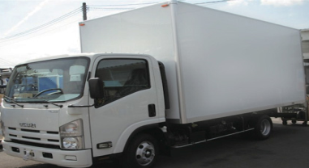
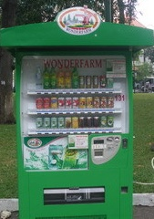
Figure 1 system outline chart
System
Sales history
Inventory information
Delivering goods
Commodity sales information
Vending machine 1
Vending machine 2
Vending machine 3
Notes:
Copyright Act Brain Co.

Slide 4
2. Vending machine specification
The vending machine is selling three kinds of commodities free of charge. The vending machine can save each commodity up to ten severally as a stock in the vending machine.
As for the vending machine, unique vending machine ID is set.
The vending machine sells the commodity selected by the user. Afterwards, the vending machine notifies the system the following as commodity sales information.
  Sales date
  Sales brand name
  Number of sales commodity stocks
Notes:
Copyright Act Brain Co.

Slide 5
2. Vending machine specification
The commodity is delivered to the vending machine by the system.
(The detailed condition of the delivery is explained by by the item of "3. system specification C) "Delivering goods")
After the commodity is delivered, the vending machine replenishes the commodity into the vending machine. It takes five seconds at the time of the replenishment work. Meanwhile, the user cannot buy the commodity.
When inventory figures of the commodity become 0, the vending machine cannot sell the commodity. At that time, the vending machine displays sold out of the commodity.
The vending machine is expressed with the console in the program. The connection of the vending machine to the system uses the TCP communication.
Notes:
Copyright Act Brain Co.

Slide 6
3. System specification
The system can manage vending machines connected with the system up to three.
The system receives commodity sales information that each vending machine transmitted.
In the program, use one Internet Protocol address with the system. And, use one Internet Protocol address with the entire vending machine.
Notes:
Copyright Act Brain Co.

Slide 7
3. System specification
A) Sales history
The system preserves the sales history in the file based on commodity sales information.
Sales date
  Vending machine name
  Sales brand name
Notes:
Copyright Act Brain Co.

Slide 8
3. System specification
B) Inventory information
The system is managing the number of commodity stocks in each vending machine. The system maintains the inventory information based on commodity sales information. The item that the system maintains is as follows.
  Vending machine name
  Sales brand name
  Number of commodity stocks
Notes:
Copyright Act Brain Co.

Slide 9
3. System specification
C) Delivering goods
The system delivers the commodity for the replenishment of stock to the vending machine.
Delivering goods confirm inventory figures of the inventory information on all commodities. Delivering goods confirm inventory figures repeatedly in ten seconds interval.
When there are three commodities or less as inventory figures of the commodity, delivering goods deliver the commodity to the vending machine. Delivering goods deliver the commodity to the vending machine.
Deliver delivering goods bringing each vending machine together.
It takes five seconds to the delivery preparation before the commodity is delivered.
Delivering goods are expressed by transmitting data in the program.
Notes:
Copyright Act Brain Co.

