Slide 1

OUTLINE OF EMBEDDED SYSTEM
Summer course: Embedded Linux

Slide 2
1.1 What is the embedded system?
1.2 Industrial profile
1.3 Characteristics of embedded system
1.4 What is the embedded software?
1.5 Embedded software industry profile
1.6 Feature of embedded software development
1.7 Questions.
Summer course: Embedded Linux

Slide 3
1.1 What is the embedded system?
  1.1.1 Embedded system
  1.1.2 Special purpose computer system
  1.1.3 Overview of system
Summer course: Embedded Linux

Slide 4

Electronic system that integrated as device and equipment (embedded/built in).
It is for a specific usage and a wide-ranging market segment.
The scale and range is wide from part level to rocket/robot level.
Examples:
Fields | Embedded System
Transport machine | Car, Railway, Aircraft, Ship, Signal
Personal Information Instruments | PDA, NAVI, and electronic note
A V equipment | Digital TV, DVD, video, digital camera, and audiovisual equipment
Home electric equipment | Microwave oven, refrigerator, rice cooker, washing machine, air conditioner, dryer, and clock
Computer equipment | Printer, hard disk, optical disk, scanner, and DVD/CD-R drive
Summer course: Embedded Linux

Slide 5
Fields | Embedded System
Business/administration | Vending machine, machine of issuing tickets, and ATM, dispenser, copy, fax, calculator, POS, touch panel, RFID tag reader writer, security equipment, lightning display device, projector, and handy terminal
Telecommunications equipment | Cellular phone, answering machine, router/hub, portable base station, and switchboard
Amusement/Education | Amusement equipment, game machine, electronic musical instruments, Karaoke equipment, and pachinko
Industrial control/FA equipment | Plant control equipment, NC control equipment, and industrial robot
Measurement equipment | Synchro scope, IC tester, and electric power meter
Others | IC card, camera, robot, rocket, various monitoring hardware, medical equipments and the broadcasting equipment, etc.
All are embedded systems excluding the general-purpose computer system (embedded computer system and specific usage system).
Summer course: Embedded Linux

Slide 6

Special purpose
Function, price, safety, real time, power saving, weight, size, solidity, and beauty and portability・・・
(Basic computer system)
MPU, memory, power supply,
and communication
OS, driver, and middle ware
Hardware
Embedded system
Software
(Embedded system)
(Embedded equipment/device)
IEEE : Embedded computer system
A computer system that is part of a larger system and performs some of the requirements of that system; for example, a computer system used in an aircraft of rapid transit system.
Summer course: Embedded Linux

Slide 7

(Various view point of system)
○ It is different depending on the person (user, designer, developer, and operator).
★ITS
Car
Information
center
Information
AV
NAVI
Operation
Engine control
Road monitor
Operation support
Vehicle monitor
Door monitor control
★ Multi-purpose machine ・・・・・・ telephone + fax + printer
★ Multi CPU equipment: Cellular phone ・・・・
telecommunication control + MIMI control
★ Parts system of equipment・・・・ CPU, LAN cards, and FPGA
★ PC embedded equipment system ・・・・ PC mother board with / in the system
Summer course: Embedded Linux
Notes:
ITS: Intelligent Transportation System

Slide 8
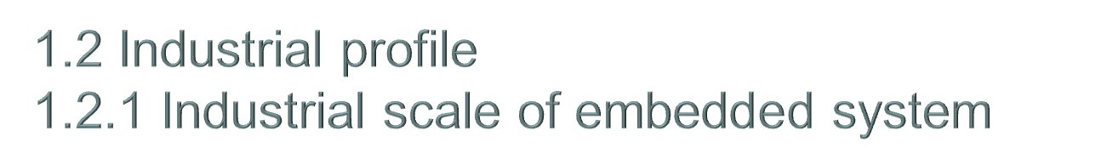
Embedded system industry in Japanese industry
Industry related to the embedded system is the following positions according to “The office and the corporate statistical investigation of whole country in 2004 ” by the Ministry of Public Management, Home Affairs, Posts and Telecommunications.
Number of all industrial engaging person 52 million people
Number of engaging the entire manufacturing people 8.44 million people
Number of corporate related to embedded system employees 4.71 million people All industry ratio 9%
Manufacturing industry ratio 56%
Industry related to the embedded system becomes the following positions according to Ministry of Public Management, Home Affairs, Posts and Telecommunications “National economic calculation report in 2004 and standard final confirmed report in 2000”
Gross domestic product (2005) 501 trillion yen
Embedded system industrial scale 62 trillion yen
Gross domestic product ratio 12%
Summer course: Embedded Linux

Slide 9

Unit = Yen
 | 2006 |  | 2009 | Increase
Embedded processor | 1,886.6 billion |  | 2,413.0billion | 28%
Embedded board | 24.26 billion |  | 28.05billion | 16%
Embedded OS | 8.86 billion |  | 10.83billion | 22%
Embedded middleware | 28.29 billion |  | 49.93billion | 76%
Development tool | 8.65 billion |  | 11.03billion | 28%
Embedded SI | 720.0 billion |  | 940.0billion | 31%
Total | 2,676.7 billion |  | 3,452.84billion
Summer course: Embedded Linux

Slide 10
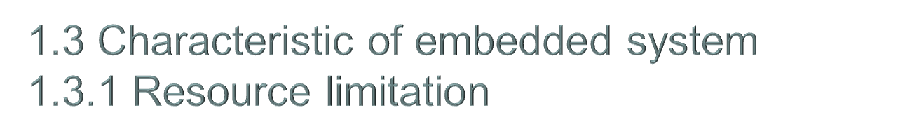
（What is the resource limitation? ）
Requirement
Hardware countermeasure
Software countermeasure
Cost reduction
Small size/lightening
Power saving
Maintainability
improvement
Performance/Function/
Low reliability processor/
IO devices
A little amount of memory
Deletion of area of board
Simple hard interface
Performance improvement
of software
Reduction of software use
memory space
Function achievement
by software
(Example
of factor)
Use of cheap low performance processor and deletion of memory space for the purpose of cost reduction
Action of software of hard bug that requires cost/hour
Small size, lightening, and low operation clock frequency for the power saving purpose
Use of processor that did not have trouble for the purpose of cost / reliability.
Hardware status monitoring method change by hard pin deletion
Summer course: Embedded Linux

Slide 11

Meet the provided time requirement
○ Time requirement of operation ・・・ Response time
○ Start-up time requirement ・・・ Ready status from telephone on
○ Time requirement of device longevity ・・・ Operation requirement
of 10 years/20 years
○ Time requirement in abnormal circumstances ・・・ Prior detection
and immediate notification
Summer course: Embedded Linux

Slide 12

While it is effective/profitable
Nuclear power generation
Airplane
Car
Nursing-care robot
ATM・・・
Problem by system malfunction
Problem by system operation stop
Problem by incompleteness of
system specification
Situation that involves human
lives
Situation related to property
Situation related to human rights
Possibility of having ruined influence by it
(Background)
The user of an embedded system from the child to the elderly person.
Diversification of use environment. (It is not clear where, how they are used. )
The regulations system of the networked society is weak.
Most systems are connected to the network.
Summer course: Embedded Linux

Slide 13
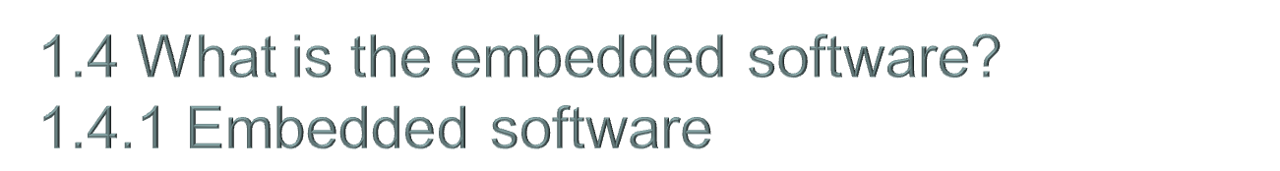
○Definition : Change is so often and dramatic and there is no definition that matches to the current state. Here,
It is embedded in the device/equipment, and it is the software that works only for the device/equipment.
★JIS firmware
It is the combination with the computer instructions and data .They are embedded as a reading dedicated software with hardware or on the hardware
This software cannot be changed under the programmed control.
★IEEE: Embedded Software
Software that is part of a larger system and performs some of the requirements of that system； for example, software used in an aircraft of rapid transit system.
★IEEE: Firmware The combination of a hardware device and computer instructions and data that reside as read only software on that device.
Notes（1）This term is sometimes used to refer only to the hardware device or only to the computer instructions or data, but these meaning are deprecated.
(2)The confusion surrounding this term has led some to suggest that it be avoided altogether.
○How to call
Our company: Firmware (control firmware and mecha-con firmware), and only software
METI/SEC: Embedded software
Summer course: Embedded Linux

Slide 14

○System (equipment/device) function is achieved together with other components.
System (equipment/device)
Software
Hardware
Mechanism
External system
★Design/develop the software component while seeing interface/performance of hardware.
★Request the change in the hardware specification if there is a problem.
○Compose the software component including hardware control program and application program.
★ Which OS is used?
★ How shall we make the game application program of mobile by Java?
★ Which personal computer driver is used?
○Software is usually ROM in the equipment.
Summer course: Embedded Linux

Slide 15
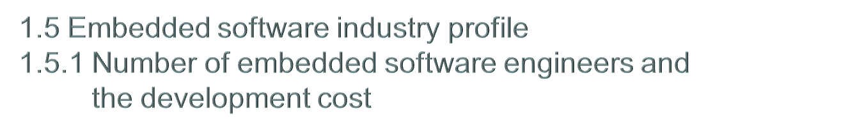
In 2007
Number of embedded software engineers: 235,000 people
Embedded software development cost: 3.27 trillion yen
46.2% of the product development cost
Summer course: Embedded Linux

Slide 16
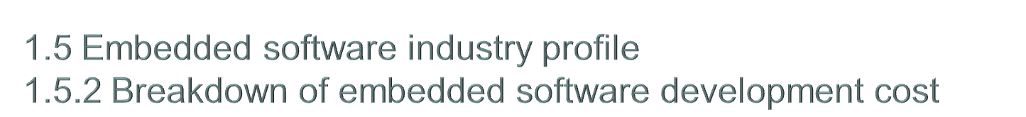
46% of the system development cost is the soft development cost.
34% of the software development cost depends on an external man-hour.
The development cost other than related to embedded
Hardware purchase cost
8.2%
Software purchase cost
22.7%
9.7%
Software development cost
In-house cost
Other development cost related to embedded
46.4%
5.9%
46.2%
Outsourcing development cost
9.2%
27.2%
Hardware development cost (mechanical system)
16.0%
8.5%
The hardware development cost (electronic system)
Temporary staffing cost
Summer course: Embedded Linux

Slide 17
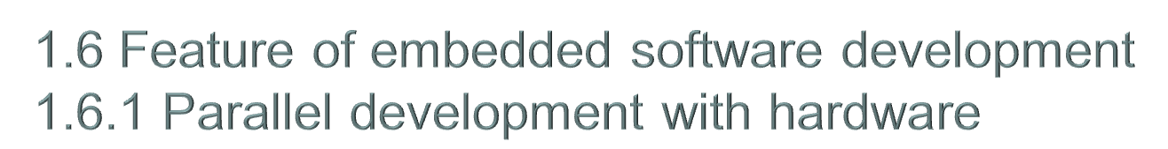
○Flow of development
Hard design, development, and test
Integration
System design
Integration test
Verification and result
Soft design, development, and test
○Issues
Hardware test is done under the functional restriction and an imperfect quality.
Interface change under development
○Countermeasure
Increase of software development cost ----> Decrease the change of hardware interface
Summer course: Embedded Linux

Slide 18
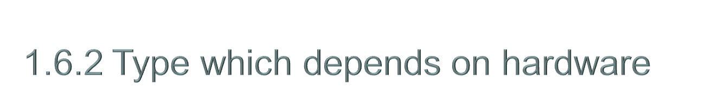
○ Start the development based on hardware and follows the development of software
Focus on hardware architecture first from the point of cost performance
Relieve by software at last.
(Relieve with software against the hardware bug. )
Remake of LSI
From several million to several ten million
○Require the hardware knowledge
Device specification
Understanding of hardware specifications
Grasp of the relations between hardware modules
Timing dependence of hardware control
We can‘t understand until we operate it.
○Others
It is work of software engineer to point out hardware bug.
Pseudo occurrence of hardware trouble in debug/test
Performance measurement technology
Analyze and solve the trouble
Summer course: Embedded Linux

Slide 19
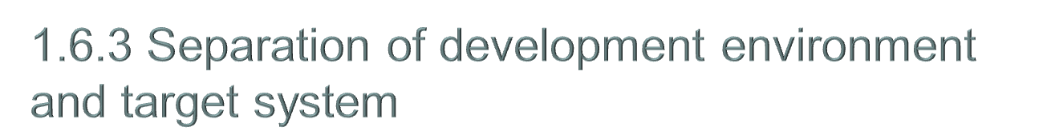
○ Cross development
Development system (PC base)
Target system
System development
(editor/cross compiler/assembler)
debug
Debug
(execution/Stop, one-line execution,
memory R/W, and instruction/memory break/
one line assembler)
(on chip DBG)
○Issues
ICE
Environmental equipment cost
Visualization of hardware operation
Hard breakdown person in charge/timer control
Debug in multi core CPU/ASIC
Integrated development environment
(300,000-1,500,000/license)
Advanced data controls MULTI
WindRiver TORNADO
eSOL eBinder
ICE/emulator (500,000-1,200,000)
Yokokawa DC, Computex, MC, and Sofia
○Countermeasure
Common development platform of each domain of Eclipse base
Rental of ICE
ICE is indispensable for the development of OS etc.
APL development is an integrated development environment.
Summer course: Embedded Linux

Slide 20
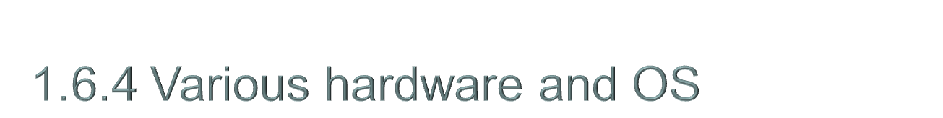
○Processor
MPU（8,16,32 bits）
ARM、MIPS、PowerPC、AMD、SH、IA、F²MC
DSP
Type FPGA、ASIC、ASSP、SoC、Multi core CPU、Multi CPU
○OS
Linux （Embedded Linux、Real time Linux）
★ There is a hybrid with RTOS, too.
RTOS（Itron、T-kernel、VxWorks、QNX、original）
Windows（Windows E、Windows Embedded）
Trend（From a technological road map of NEDO）
  Real time Operating System for multi core
  Power saving
Summer course: Embedded Linux

Slide 21

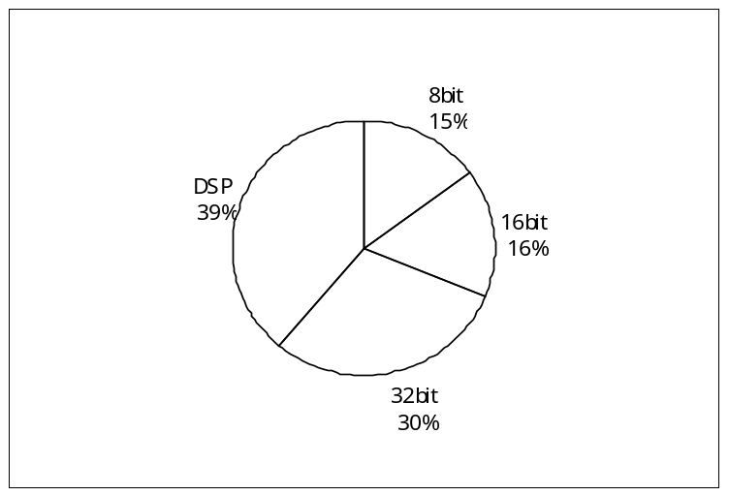
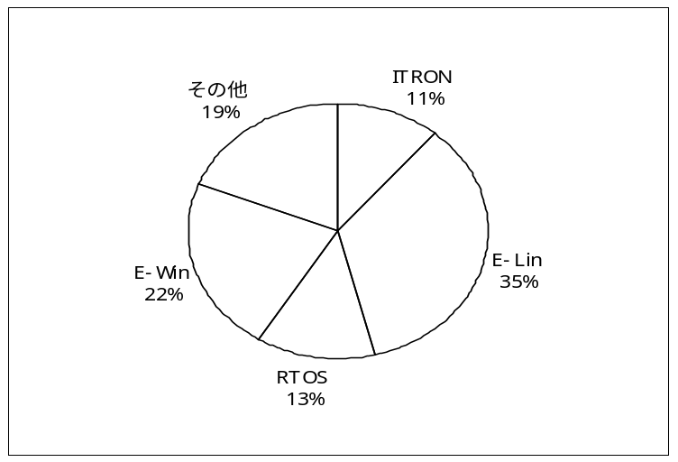
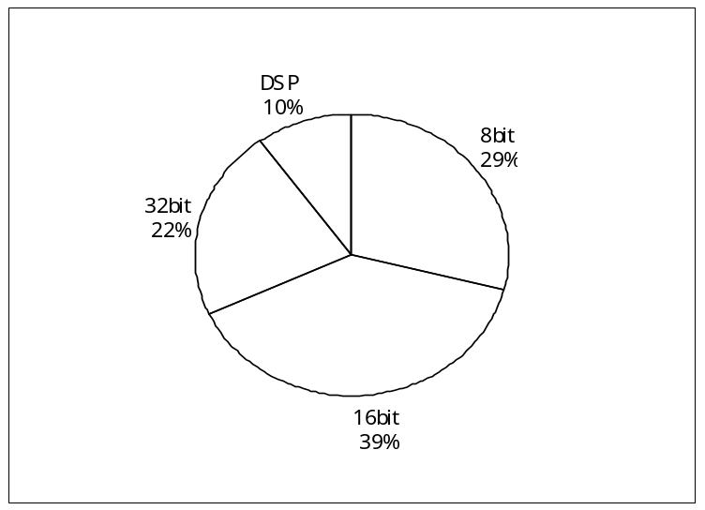
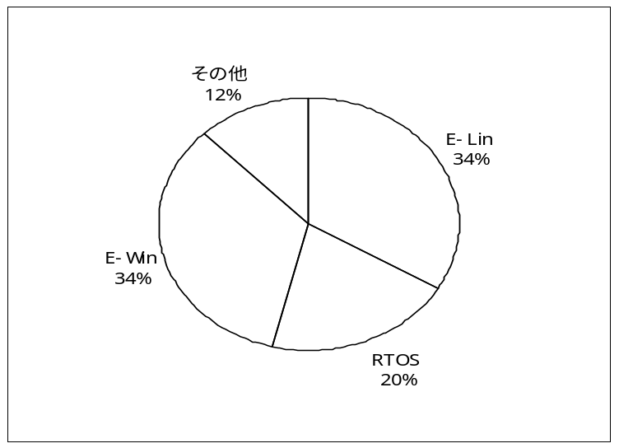
Household use field (white goods, information appliances, portable AV related, cellular phone related, and game machine related)
Industrial/business field (OA business use, communication/network related, security related, medical equipment related, FA/control equipment, amusement related, and car related)
Others
Summer course: Embedded Linux
Notes:
Picture 1
8bit 15%
ITRON 11% ITRON 11%
E-Lin 30% 16bit 16% E-Lin 35%
RTOS 18% 32bit 30% RTOS 13%
E-Win 30% DSP 39% E-Win 22%
その他 11% その他 19%
8bit 29%
16bit 39%

Slide 22
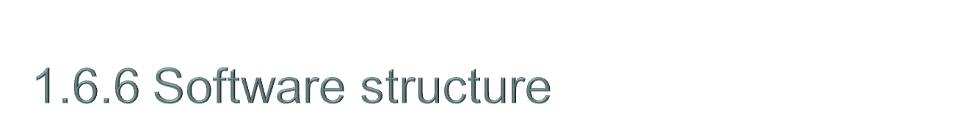
○General structure
【 The main middleware】
Communication
-TCP/IP
-Wireless LAN（IEEE802.11)
- Short distance wireless（Bluetooth/IrDA）
Voice
-SIP
- Voice synthesis and recognition
Security：Ipsec/SSL
USB
DLNA
File system/DB
Image compression and expansion
Web browser
Japanese input system
Embedded JAVA
Hardware
Communication
APL
Abnormal detection/log mechanism
Disk
Panel
Middle
Voice
Button /SW
Embedded OS
CDR/DVD
Timer Lock
Driver
Printer
･･･
Note:There are many small and super high speed equipment which don‘t have OS.
Summer course: Embedded Linux

Slide 23

○ Interrupt driven control
There is the interruption level to each hardware
Accept high-ranking interrupt from the level processing interrupt.
The interrupt of lower-ranking than the level processing interrupt waits.
Secure the real time cf. Polling control
○ Task (process) division type concurrent processing
Prevent a hard waiting
Effective use of hardware resource
★ “Hardware interruption level/task priority” setting suitable for the system purpose is important.
What do you guarantee?
To what do you give priority?
Hard interrupt
Interrupt
vector
Interrupt processing part
OS
Task
Output
Output
Hardware
resource
Summer course: Embedded Linux

Slide 24
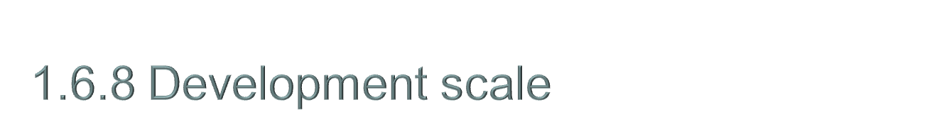
○ Recent feature
Large scale
Middle ware/application program layer: Rapid increase
OS/hardware control: It is not too much either.
★General-purpose OS is a large scale.
Reference: Linux 2.6.22
-The source number of lines: 8.5M
-Operation memory: 128MB
-ROM sizeﾞ：2MB
Summer course: Embedded Linux

Slide 25
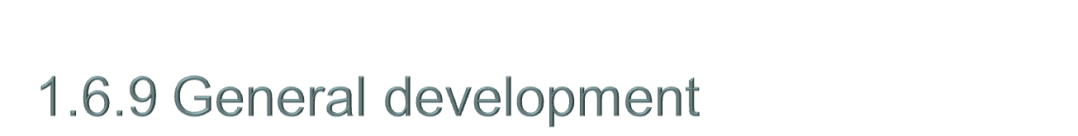
○Development process:
  There is not many definition.
  It is likely not to follow it even if there is a definition.
○Estimate:
  LOC is a main current. FP might be difficult.
○Development language:
  C/C++ is a main current. ASM doesn't disappear.
○Design method:
  Especially, there is no decided one.
  UML still has a long way to go.
○Software purchase:
  Increasing tendency because of short-term development
Summer course: Embedded Linux

Slide 26
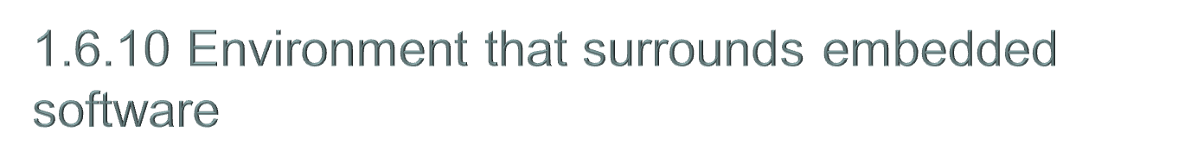
Development to sell equipment
Change under development
(time/function/cost)
Timely delivery
Hardware dependency
Cooperation with hardware architecture
(hardware specification priority)
Hardwareﾞ
Aim to new technology
Experimental phase/Prototyping
/Spiral development
・Mounting if possible
Many and unspecified users
・Use environment/user culture is
unspecified.
Way of use is diversified.
Quality securing that corresponds
to diversification use
Development based on product strategy
Long-term software architecture
Steady environment
Release one by one
Rapidly apply the advanced function
Increase of scale
Expansion of OSS use
Quality securing of reuse/purchase
thing
Mass production
Cost increase to repair by trouble
Low cost maintenance function
in the field
Quality securing that corresponds
to mass production
The development platform is weak.
It depends on MPU.
Complicate because of ASIC
There is no common platform/tool.
Culture of the site
Elite/superman group
Technology and development power
priority
Weakness management
Summer course: Embedded Linux

