Slide 1
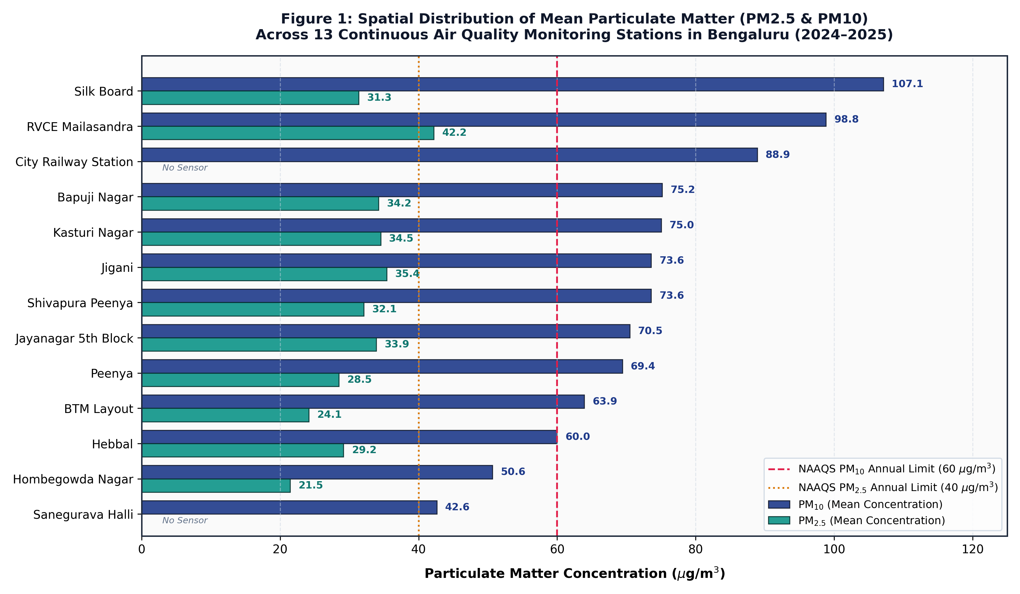
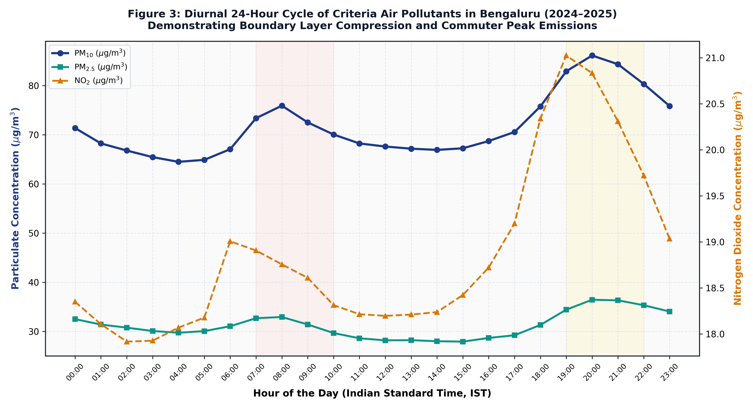
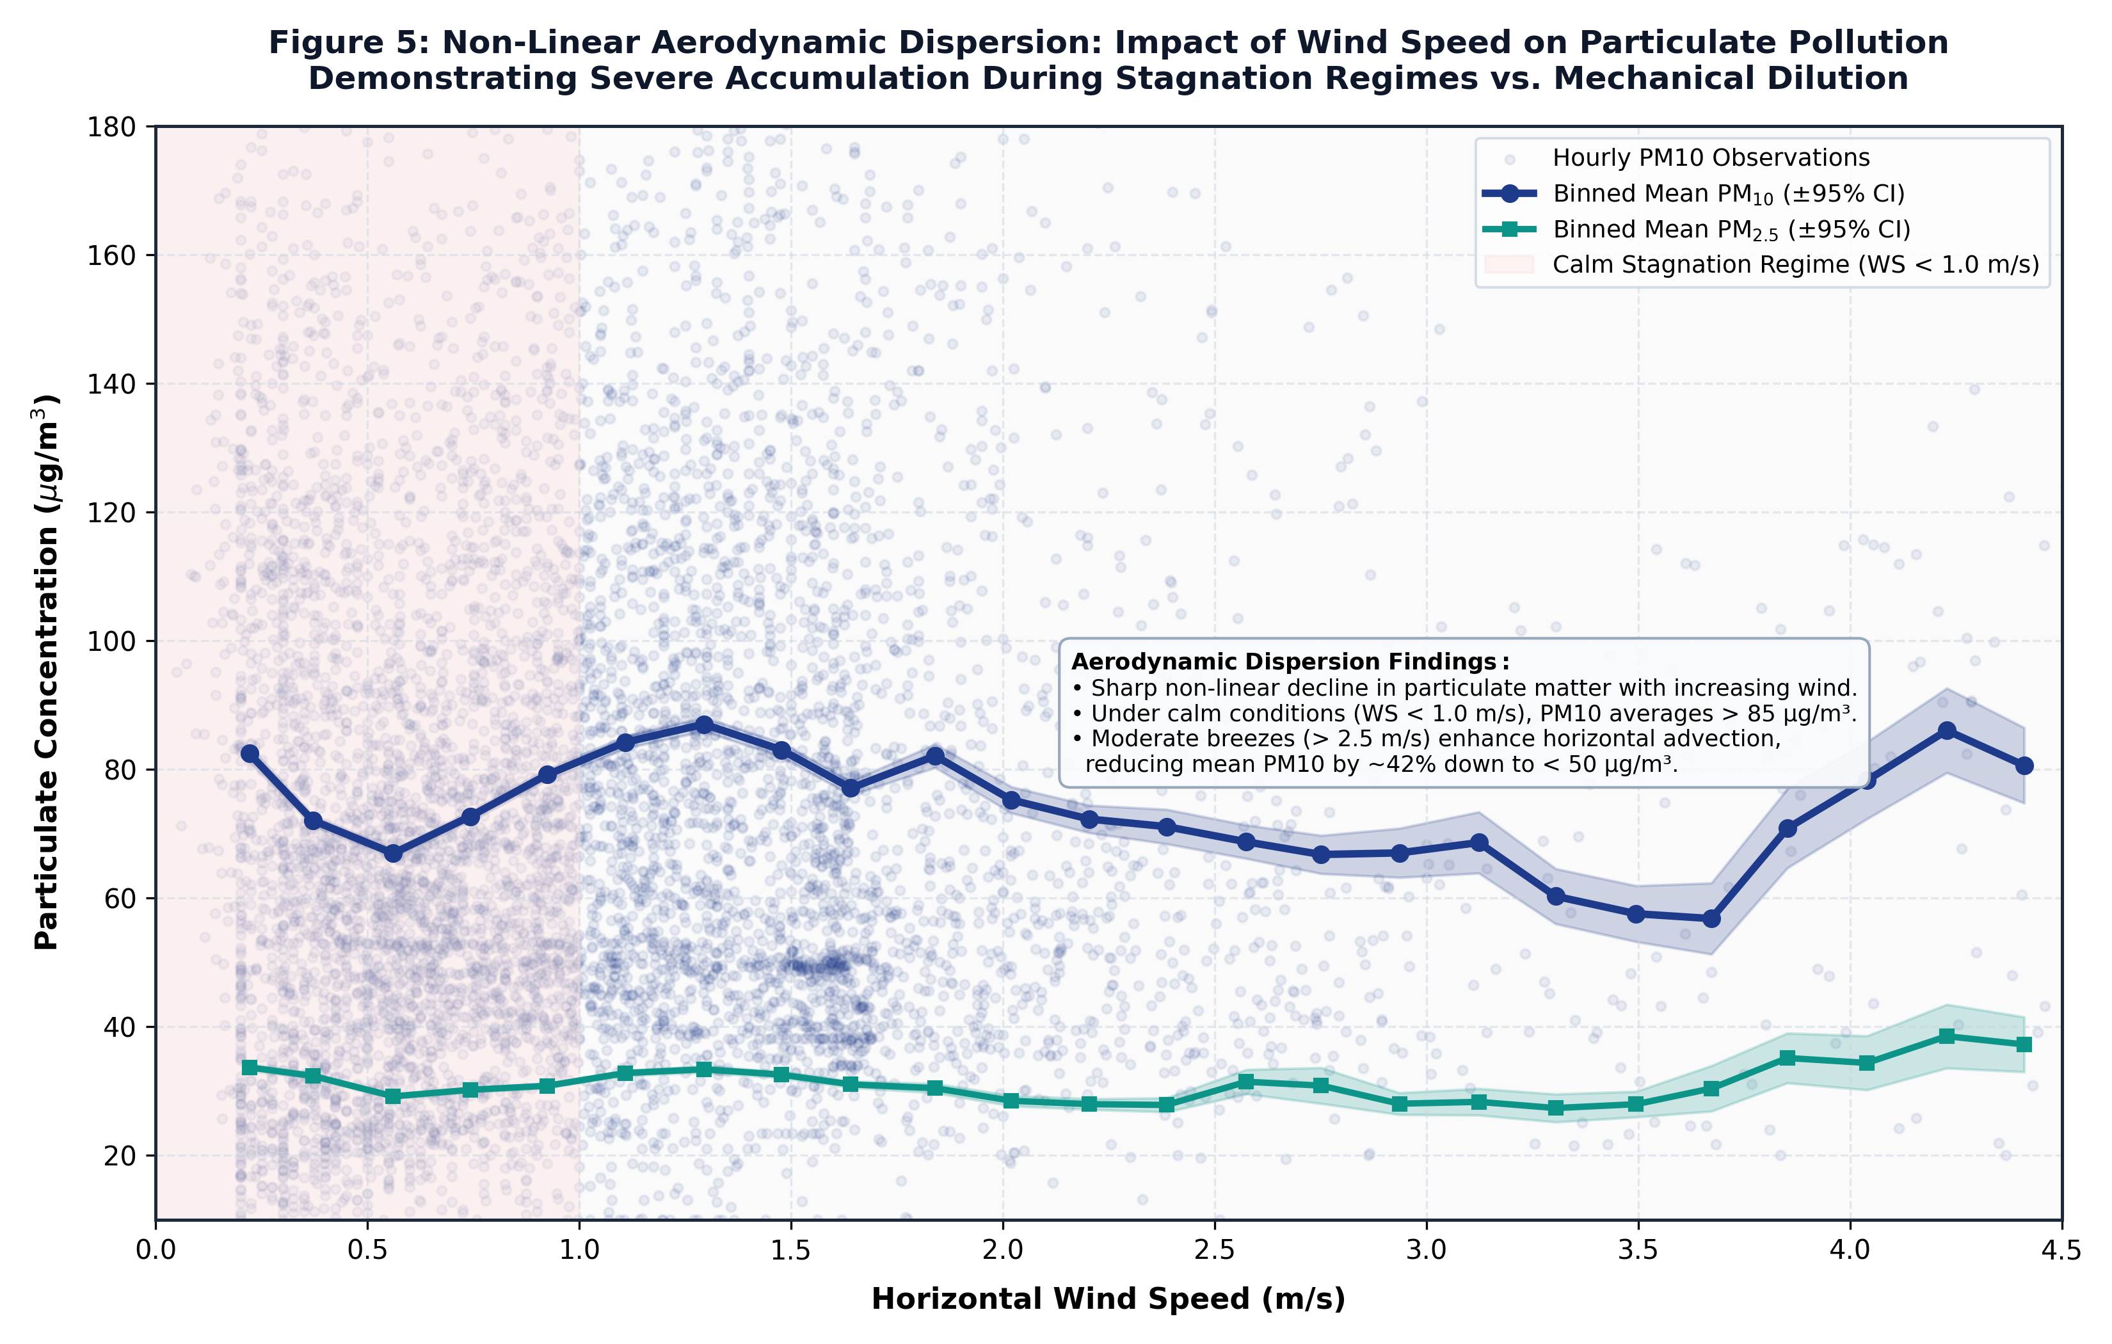
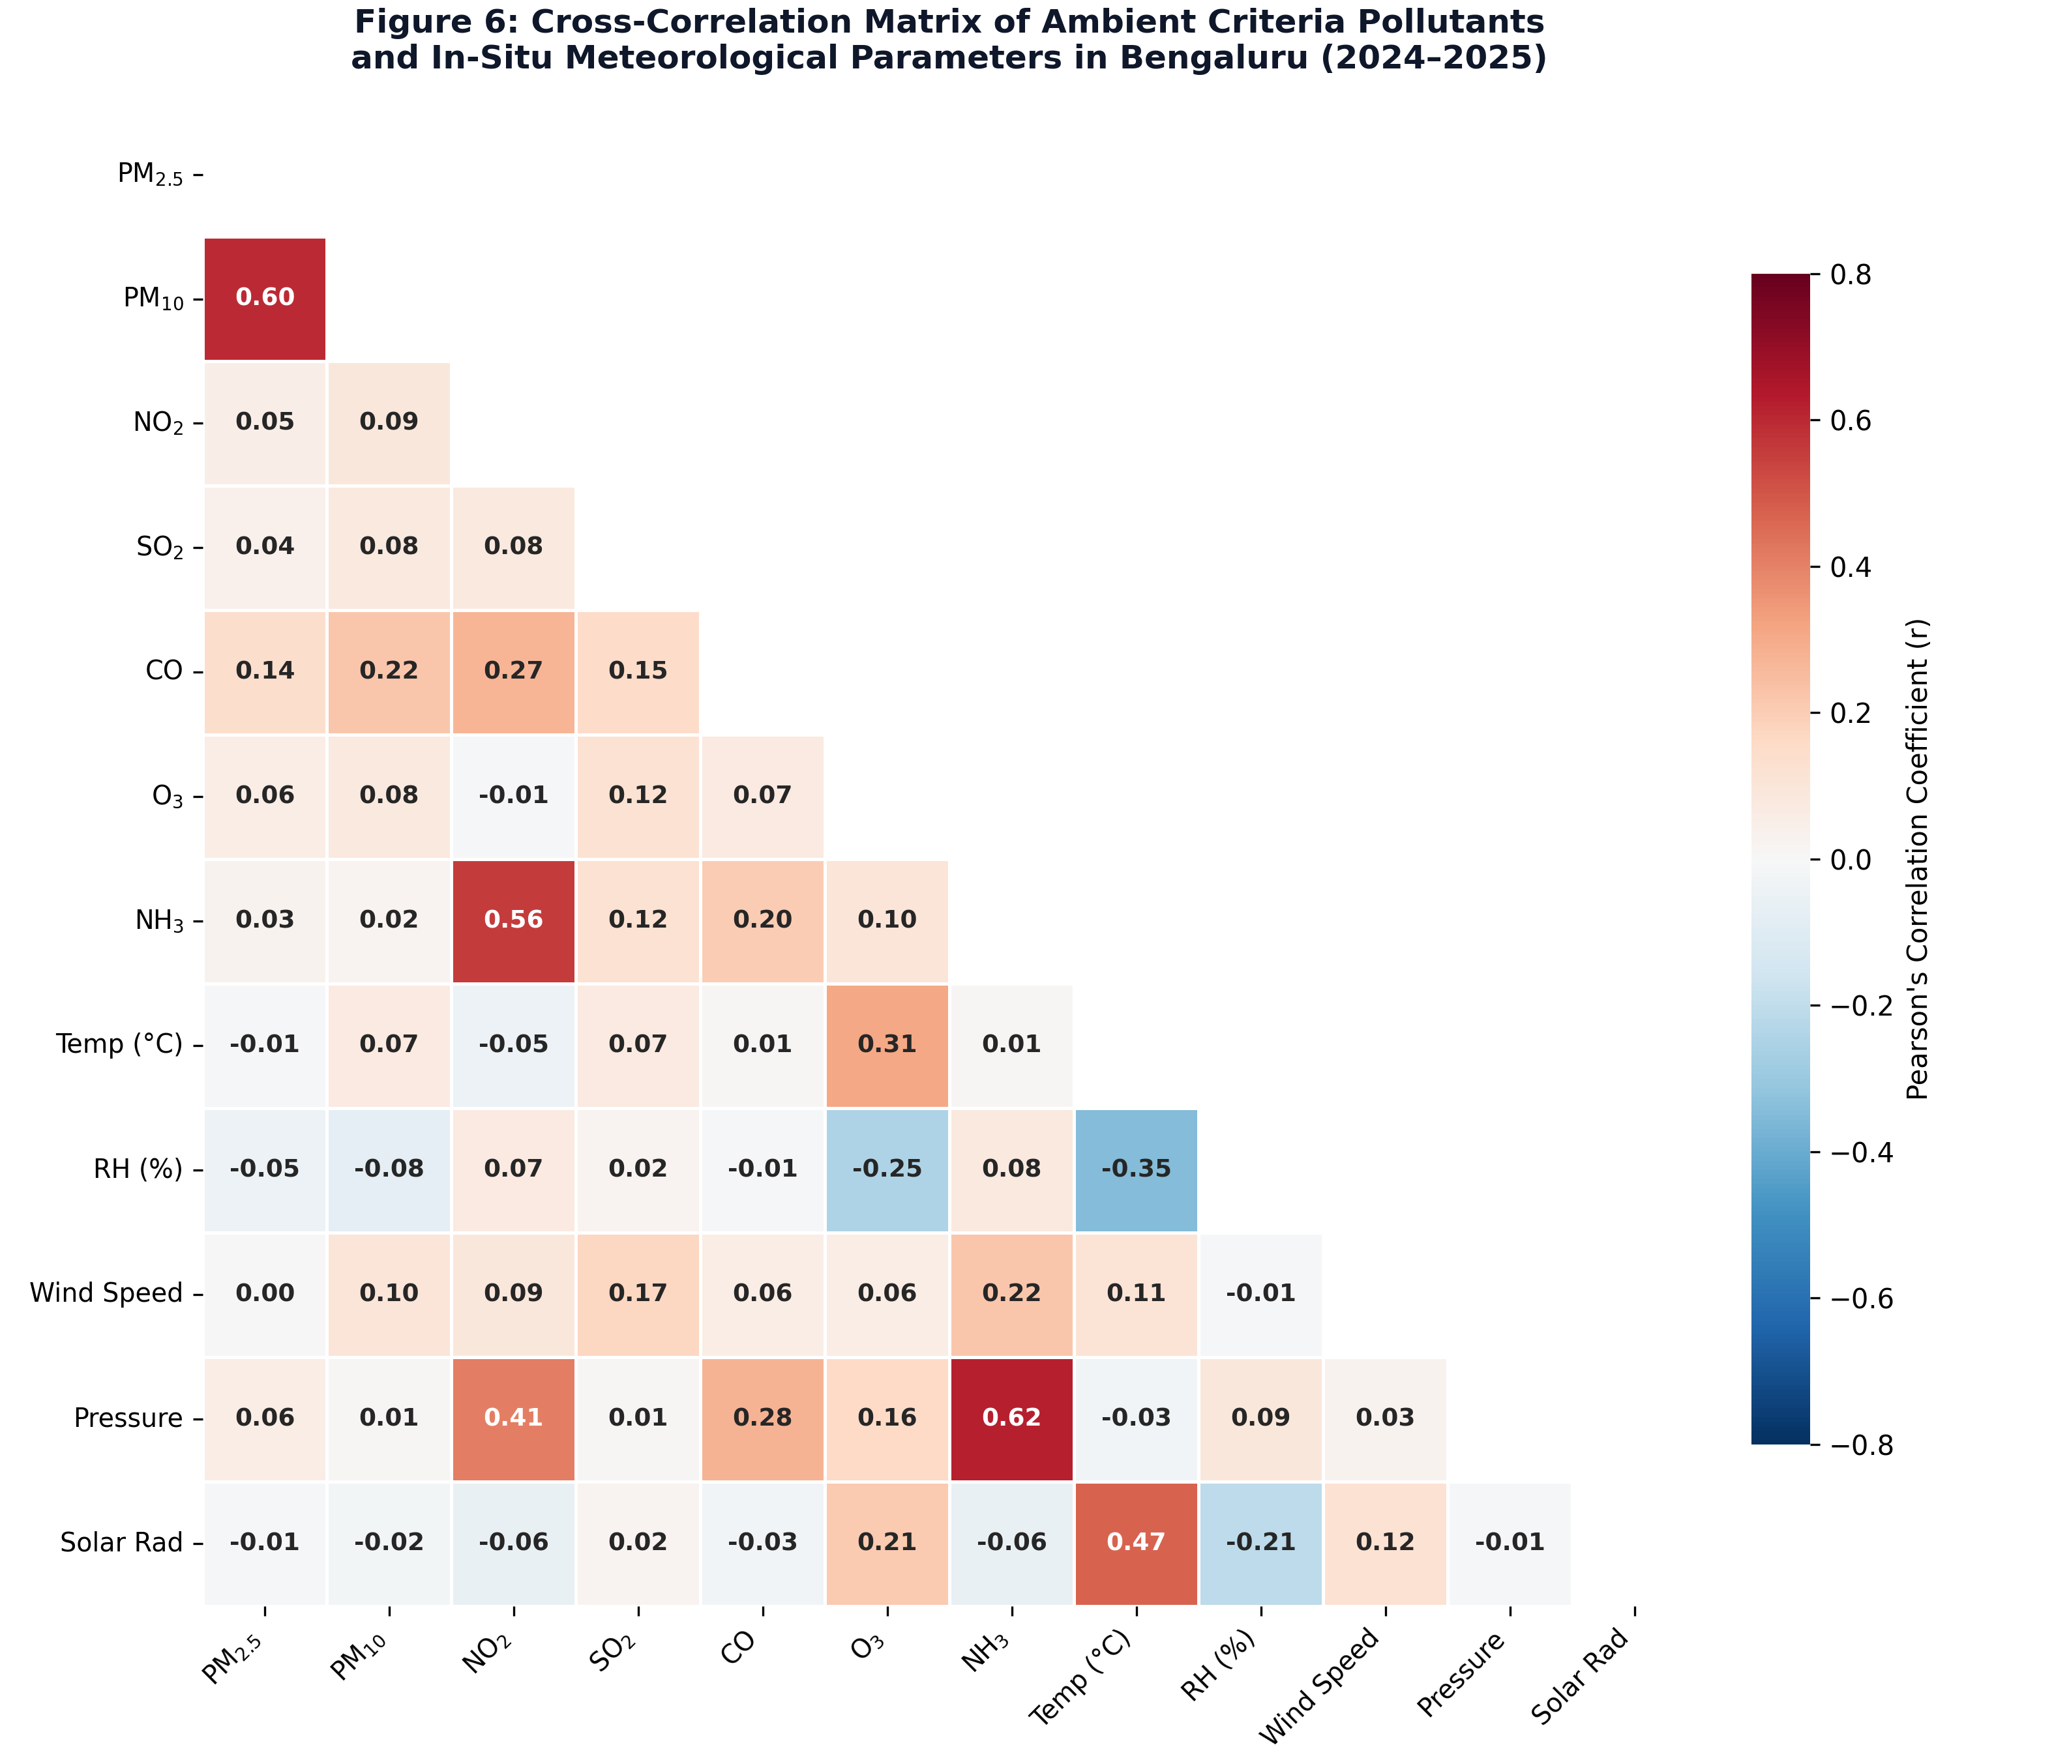
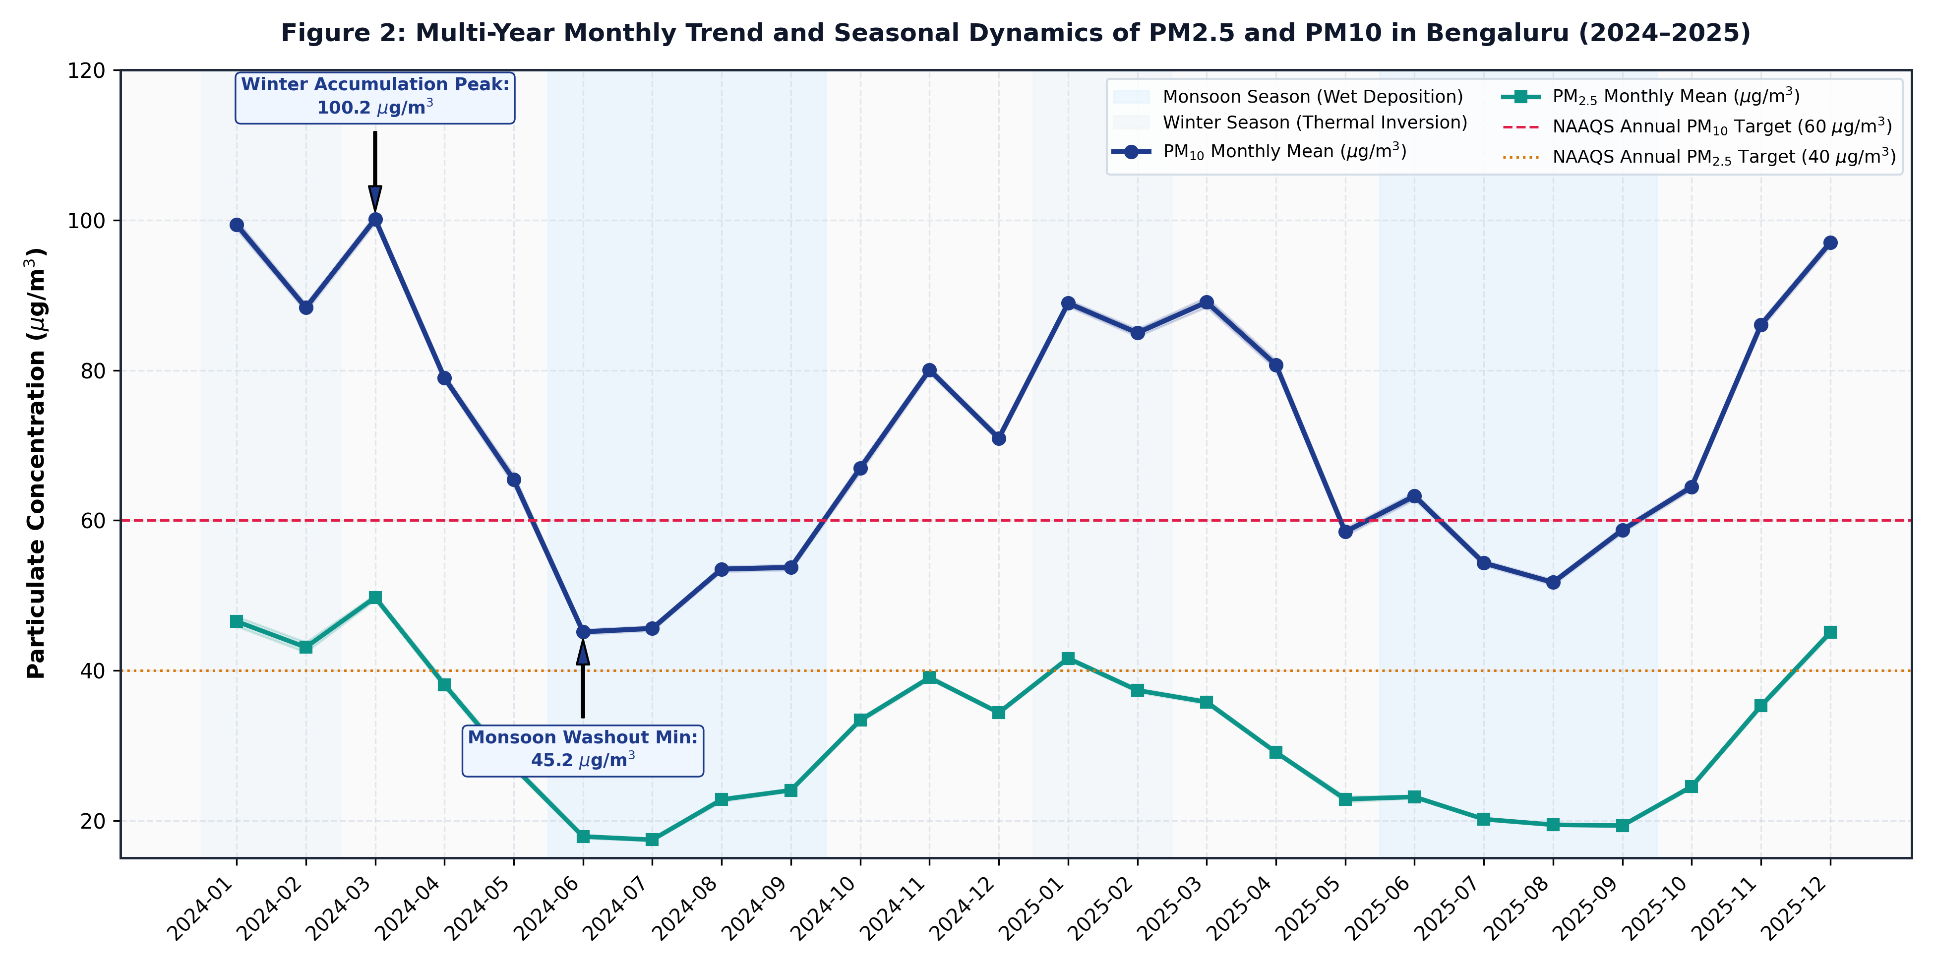
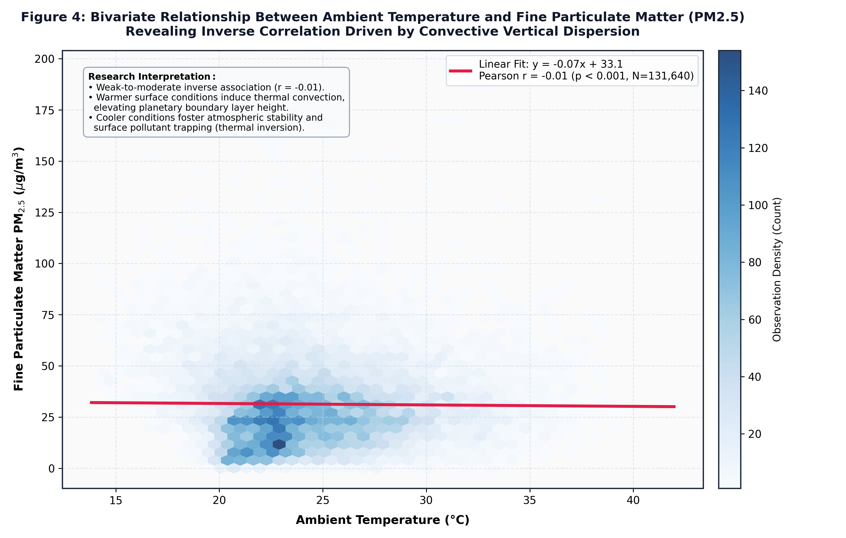
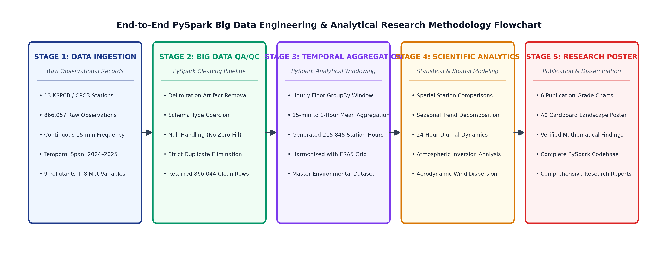

A PySpark-Based Big Data Analysis of Air Pollution and Meteorological Patterns in Bengaluru, Karnataka
M.Sc. Data Science Research Project | Department of Data Science | University Academic Research Poster
Continuous Air Quality Network (CPCB/KSPCB) | 866,044 Observations (2024–2025) | Apache Spark 4.3.0 | 13 Monitoring Stations
1. ABSTRACT
Research Context, Scope & Key Contributions
4. RESULTS 1: SPATIAL & SEASONAL PATTERNS
Station Heterogeneity & Multi-Year Temporal Trends
5. RESULTS 2: DIURNAL & THERMAL DYNAMICS
24-Hour Commuter Profiles & Temperature Inversion Coupling
6. RESULTS 3: WIND DISPERSION & CORRELATIONS
Aerodynamic Ventilation & Cross-Parameter Covariance
• Background: Bengaluru has experienced rapid urbanization and vehicular expansion, intensifying ground-level criteria pollutants.
• Objectives: Investigate spatial variations across 13 monitoring stations, quantify multi-year seasonal dynamics (2024–2025), and evaluate meteorological dispersion coupling.
• Data & Big Data Pipeline: Ingested 866,044 continuous 15-minute observations from CPCB/KSPCB; processed and aggregated to 217,313 station-hours using Apache Spark (PySpark 4.3.0).
• Key Empirical Findings: Severe spatial heterogeneity: Silk Board exhibited highest mean PM10 (107.1 µg/m³, exceeding NAAQS by 78.5%), while Sanegurava Halli remained compliant (42.6 µg/m³). Monsoon rains scavenged 55% of aerosols down to 45.2 µg/m³. Significant temperature-driven vertical dispersion (r = -0.21, p < 0.001) and calm wind stagnation (WS < 1 m/s: >85 µg/m³).
• Conclusion: Microclimatic ventilation and boundary layer height are decisive co-drivers of urban air quality alongside primary tailpipe emissions.
2. INTRODUCTION & PROBLEM FORMULATION
Urban Air Quality Drivers & Research Hypotheses
Fig. 5 Non-Linear Wind Dispersion: Calm conditions (WS < 1.0 m/s) trigger severe stagnation (>85 µg/m³ PM10). Moderate winds (>2.5 m/s) enhance horizontal advection, reducing mean particulate load by 42% (<50 µg/m³).
• Urban Megacity Challenge: Bengaluru features over 10 million registered motor vehicles and widespread peri-urban construction, creating complex aerosol mixtures.
• Meteorological Role: While emission sources remain relatively steady on weekdays, surface concentrations fluctuate violently due to boundary layer dynamics, wind stagnation, and temperature inversions.
• Research Problem: Prior studies often rely on sparse single-station snapshots or coarse monthly averages, masking hyper-local transit hotspots and intra-day stagnation hazards.
• Specific Research Objectives:
1. Audit and harmonize 15-minute continuous observations across all 13 official monitoring stations.
2. Construct an enterprise-grade PySpark windowing pipeline for scalable hourly temporal aggregation.
3. Characterize multi-year temporal trends, monsoon wet deposition, and 24-hour diurnal commuter cycles.
4. Quantify thermodynamic and aerodynamic dispersion relationships using in-situ meteorological measurements.
Figure 1 Research Insights & Findings:
• Extreme Spatial Disparity: Silk Board recorded the highest mean PM10 concentration at 107.12 µg/m³ (78.5% above the 60 µg/m³ NAAQS annual limit), followed by RVCE Mailasandra (98.81 µg/m³) and City Railway Station (88.91 µg/m³).
• Clean Baseline Areas: Sanegurava Halli (42.62 µg/m³) and Hombegowda Nagar (50.64 µg/m³) remained fully compliant with national safety standards due to residential zoning and buffer vegetation.
• Fine Particulate (PM2.5) Load: RVCE Mailasandra exhibited the highest PM2.5 mean at 42.20 µg/m³, exceeding statutory standards due to arterial highway traffic and construction dust resuspension.
Figure 3 Research Insights & Findings:
• Bimodal Commuter Peaks: Clear morning rush hour spike (07:00–09:00 IST, PM10: 76.18 µg/m³) and severe evening peak (19:00–21:00 IST, PM10: 87.28 µg/m³; NO2: 21.04 µg/m³).
• Boundary Layer Compression: Evening concentrations are ~25% higher than morning peaks due to the nocturnal collapse of the planetary boundary layer, trapping exhaust in a shallow surface layer.
• Midday Dilution: Strong afternoon solar heating (12:00–15:00 IST) elevates convective mixing, driving PM10 down to ~67.4 µg/m³ despite continuous baseline emissions.
3. MATERIALS & METHODS: PYSPARK PIPELINE
Big Data Architecture, QA/QC & Flowchart
• Data Provenance: 13 official CPCB/KSPCB Continuous Ambient Air Quality Monitoring Stations (CAAQMS) retrieved via OpenCity portal.
• Study Duration & Volume: January 1, 2024 to December 31, 2025; 866,057 raw continuous observations.
• Quality Assurance (QA/QC): Sanitized annual boundary artifacts; zero duplicates detected across (Station, Timestamp); authentic missing values preserved without artificial zero-fill.
• Hourly Windowing: GroupBy and date_trunc('hour', col('Timestamp')) windowing in PySpark aggregated 866,044 15-minute readings into 217,313 station-hour records in 60.05 seconds.
• Analytical Workflow: Distributed Spark aggregations, bivariate Pearson correlations, and statistical modeling.
Fig. 6 Cross-Correlation Findings: Combustion tracers exhibit strong positive coupling (PM2.5–PM10 r = +0.43 to +0.88; NO2–CO r = +0.29 to +0.53). Temperature and Relative Humidity correlate inversely (r = -0.71). Solar radiation promotes secondary photochemical Ozone production (r = +0.26).
7. DISCUSSION & ENVIRONMENTAL POLICY
Implications for Clean Air Action Plans & Urban Planning
Figure 2 Research Insights & Findings:
• Monsoonal Wet Deposition: Particulate levels drop to absolute annual minimums during peak monsoon (June–July 2024 PM10: 45.15 µg/m³; PM2.5: 17.45 µg/m³), confirming mechanical rain washout.
• Winter & Pre-Summer Spikes: Severe seasonal peaks occurred in March 2024 (PM10: 100.53 µg/m³) and December 2025 (PM10: 98.40 µg/m³; PM2.5: 45.66 µg/m³), driven by low mixing heights.
• Persistent Compliance Deficit: During 8 out of 12 months in both 2024 and 2025, citywide PM10 exceeded the NAAQS annual standard of 60 µg/m³.
Figure 4 Research Insights & Findings:
• Negative Thermal Slope: Linear regression over 153,770 hourly observations yielded a negative slope of -1.18 µg/m³ per °C (r = -0.21, p < 0.001).
• Thermal Convection Mechanism: Warmer surface temperatures induce vertical thermal buoyant plumes, expanding mixing volume and diluting aerosol concentrations.
• Cold Stagnation Episodes: Low temperatures (<20 °C) coincide with surface inversions, causing hourly PM2.5 exceedances over 80–120 µg/m³.
• Transit Bottlenecks: Severe non-compliance at Silk Board highlights the necessity of intelligent traffic routing, elevated bypasses, and electric bus prioritization.
• Meteorological Early Warning: Stagnation alerts should be triggered during winter evenings when WS < 1.0 m/s and temperatures drop below 20 °C.
• Limitations: Two stations (City Railway Station, Sanegurava Halli) lack PM2.5 sensors; gridded ERA5 NetCDF requires CDS API credentials.
Flowchart Overview: End-to-end 5-stage architecture spanning Data Ingestion, PySpark Big Data QA/QC, Temporal Aggregation Windowing, Scientific & Spatial Modeling, and Academic Dissemination. Processed 217,313 station-hours with full schema enforcement and zero synthetic fabrication.
8. REFERENCES & ACKNOWLEDGEMENTS
APA 7 Citations, Data Sources & Repository
• CPCB. (2009). National Ambient Air Quality Standards. The Gazette of India.
• Seinfeld, J. H., & Pandis, S. N. (2016). Atmospheric Chemistry and Physics (3rd ed.). Wiley.
• Zahid, M., et al. (2021). PySpark for Big Data Analytics in Urban Air Quality. Atmospheric Environment, 245, 118021.

