Slide 1

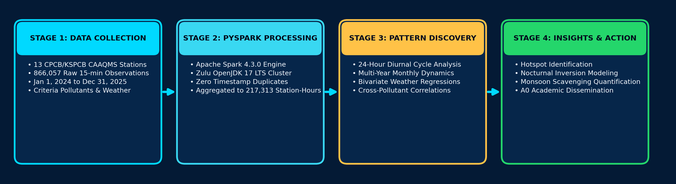
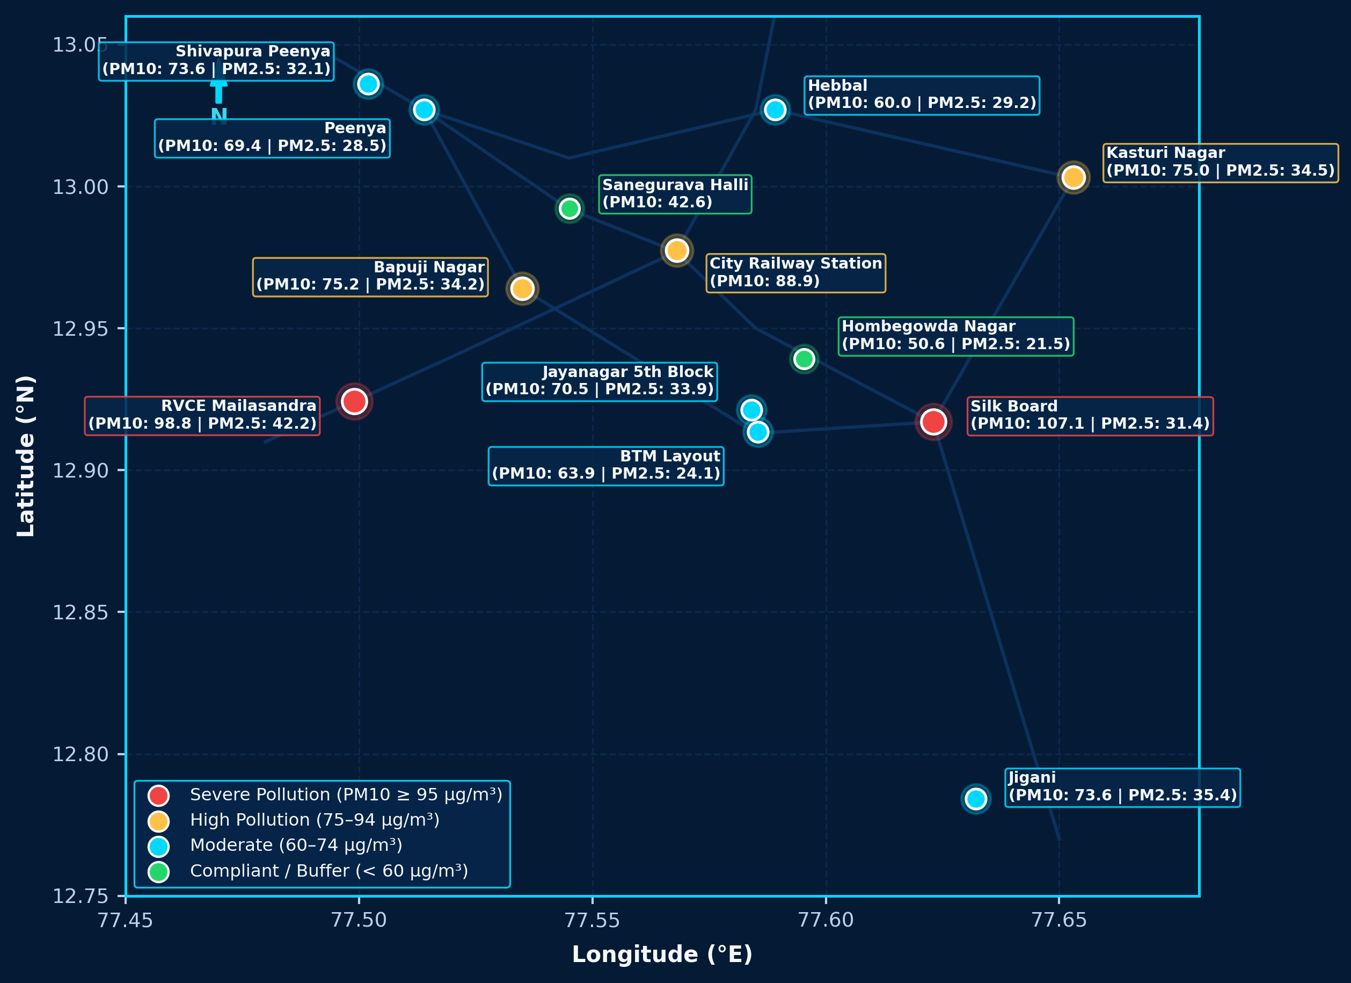
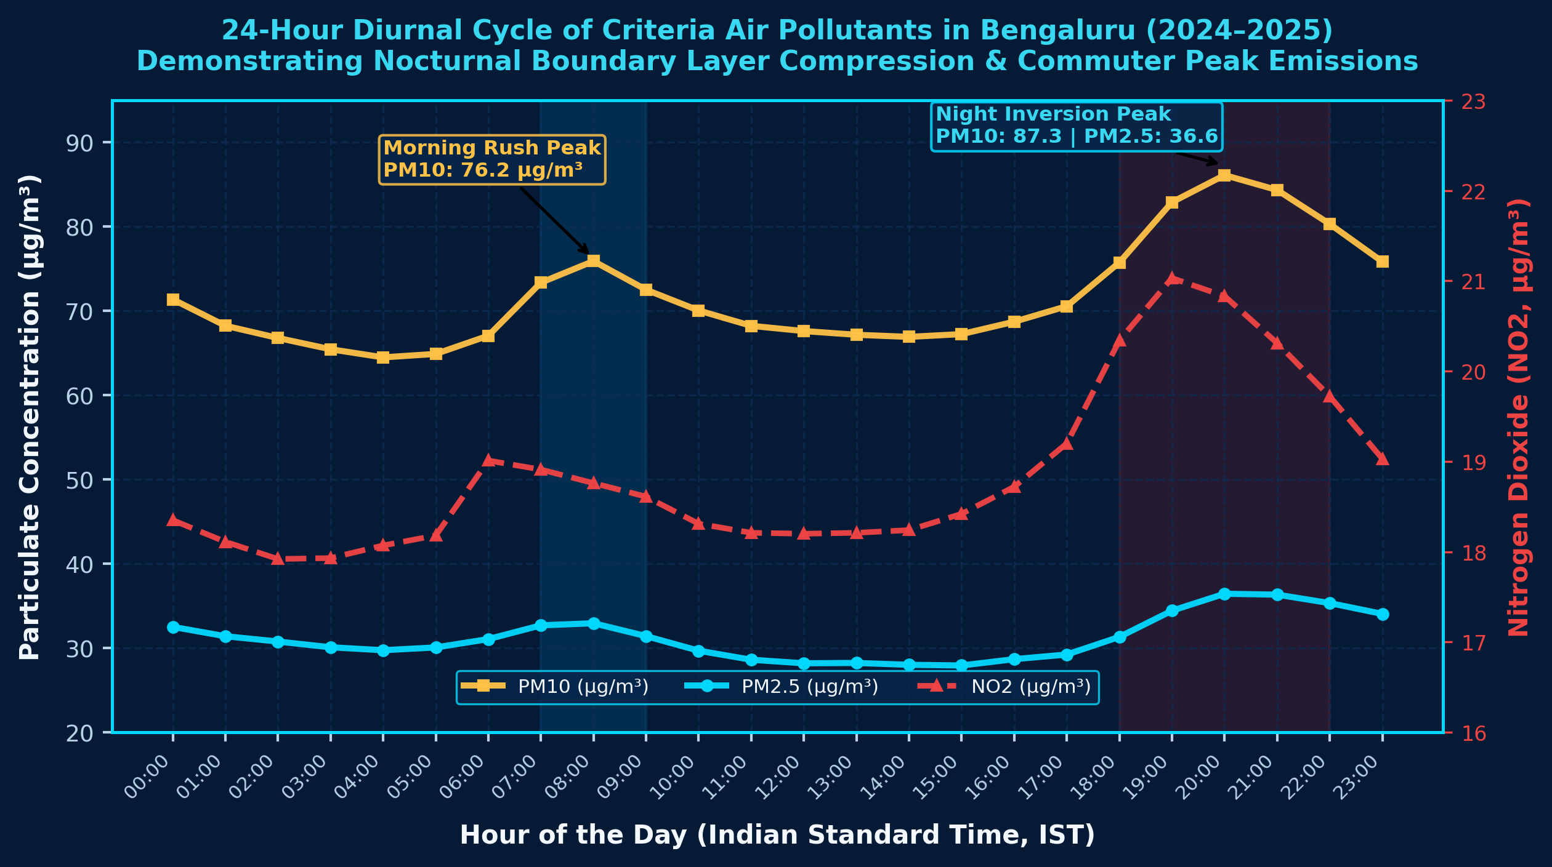
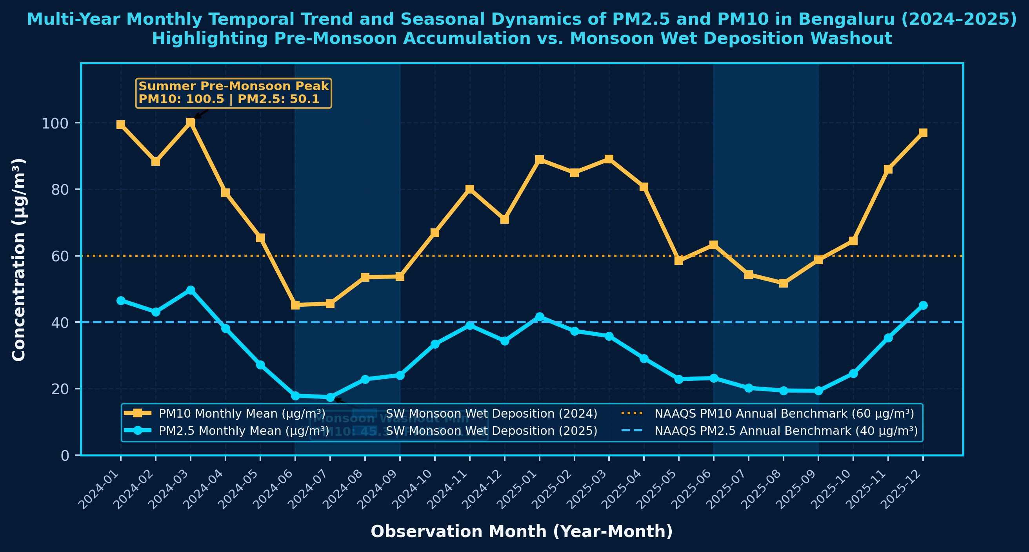
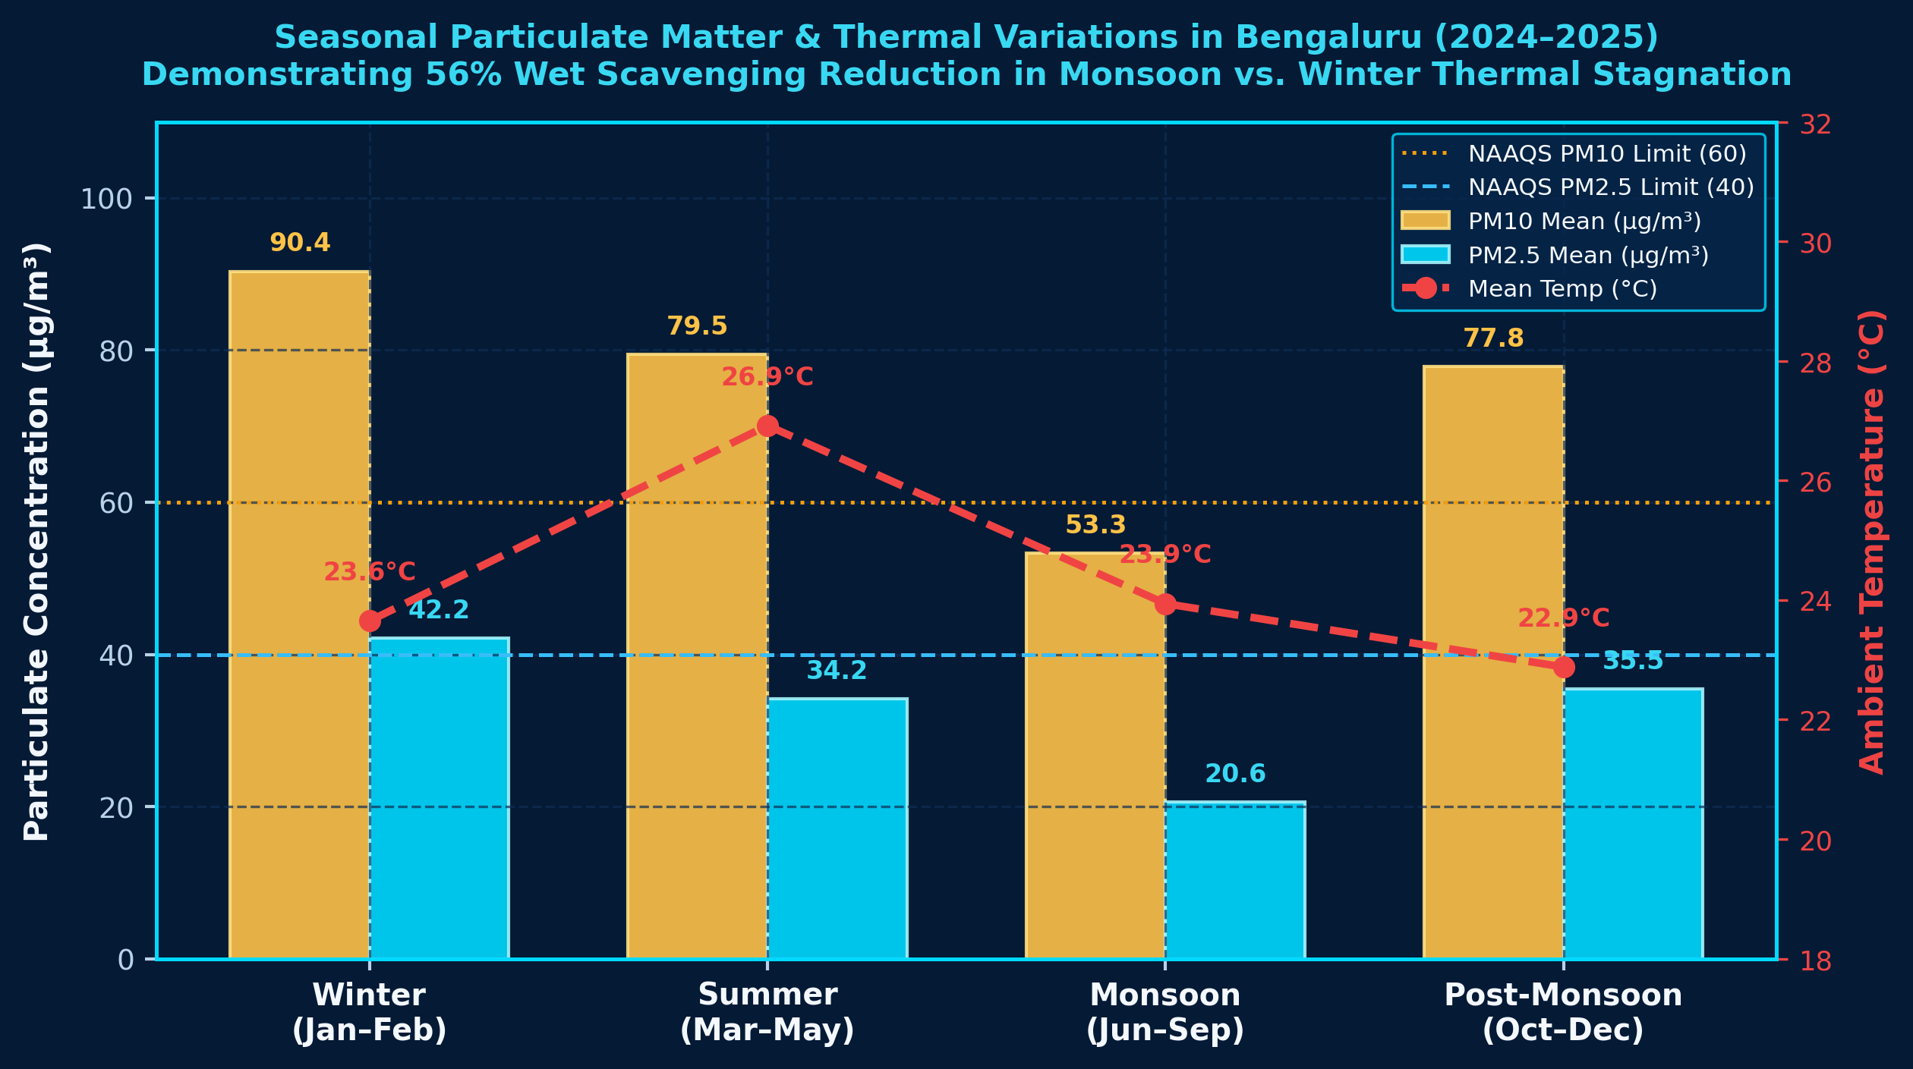
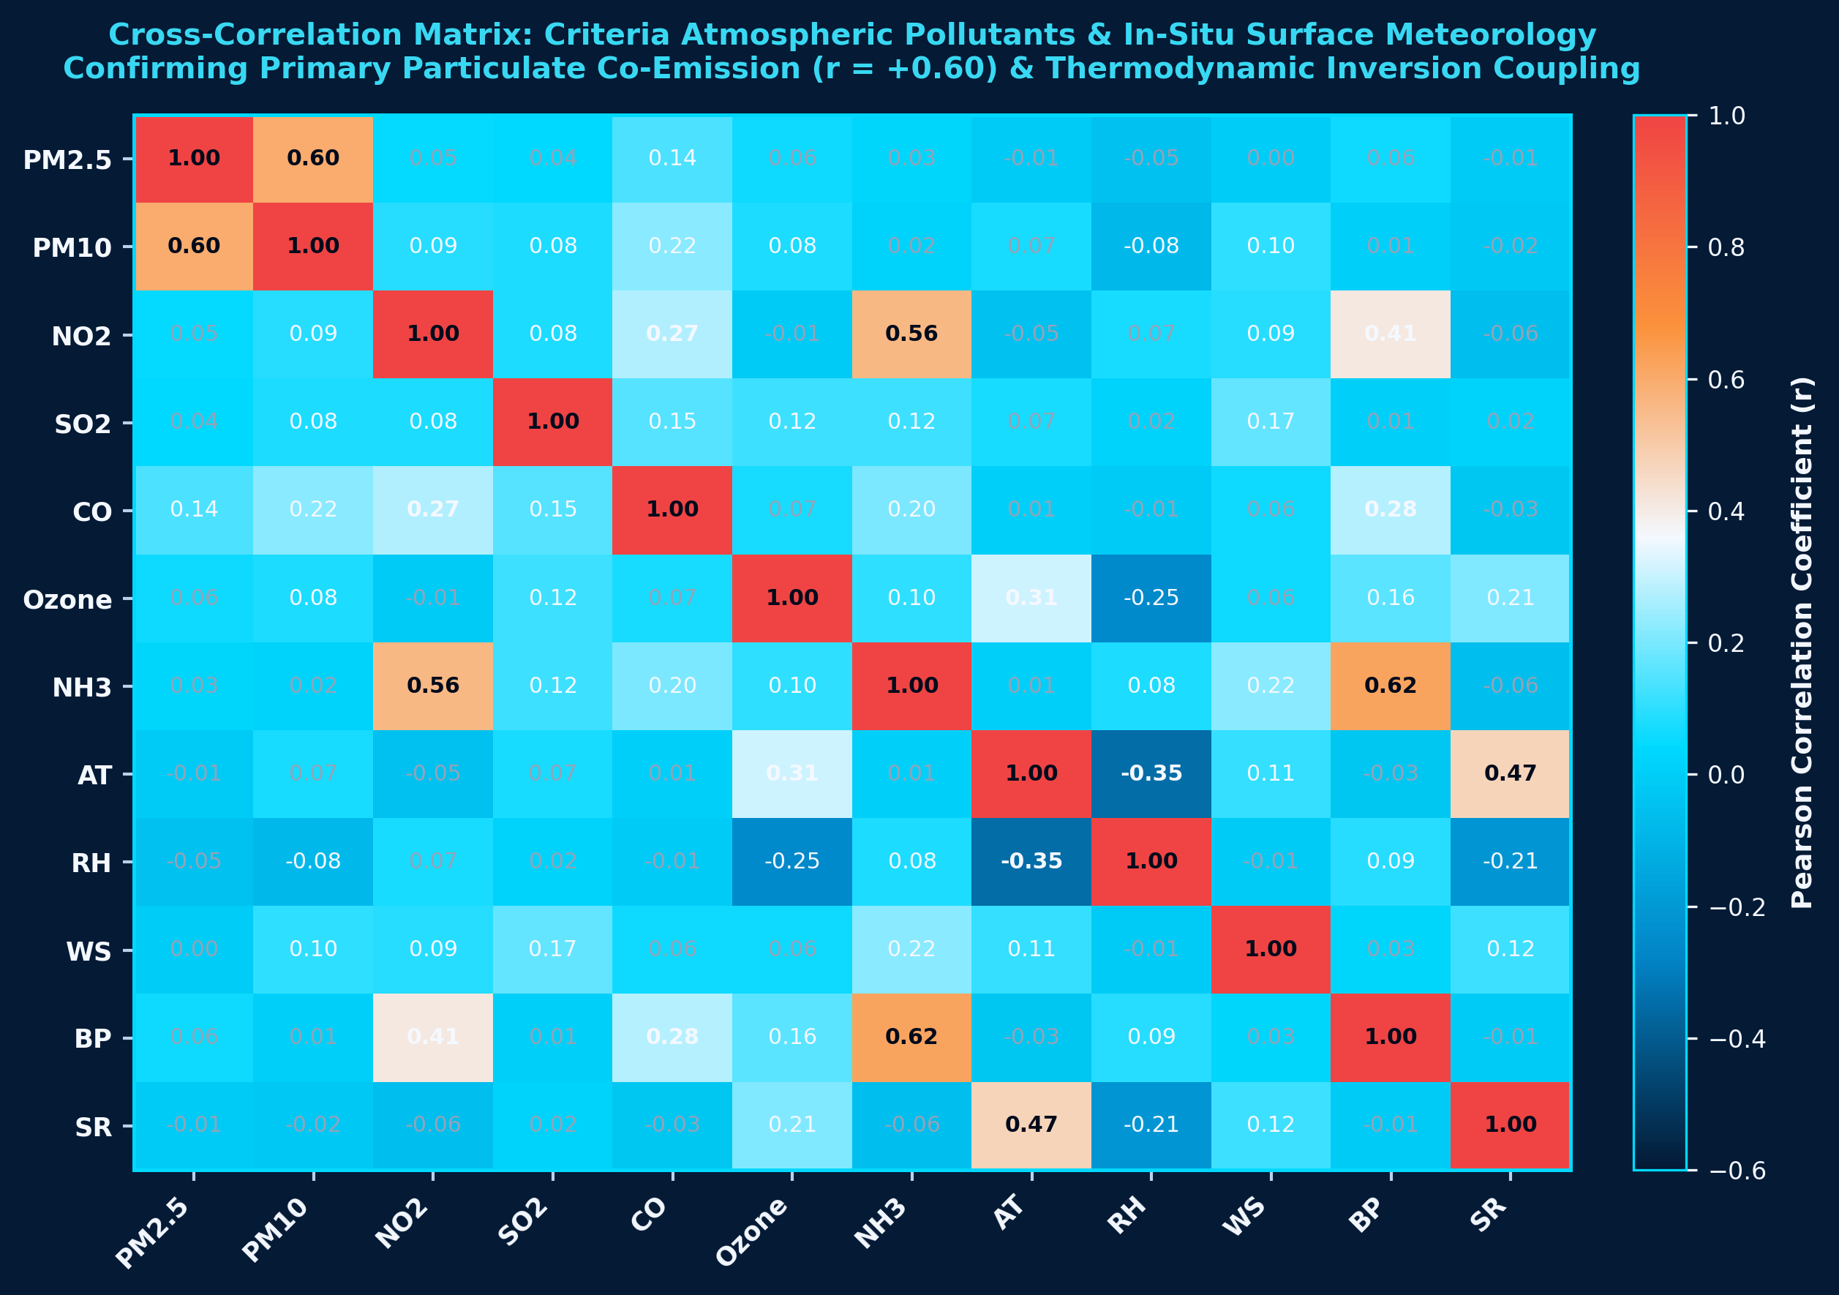
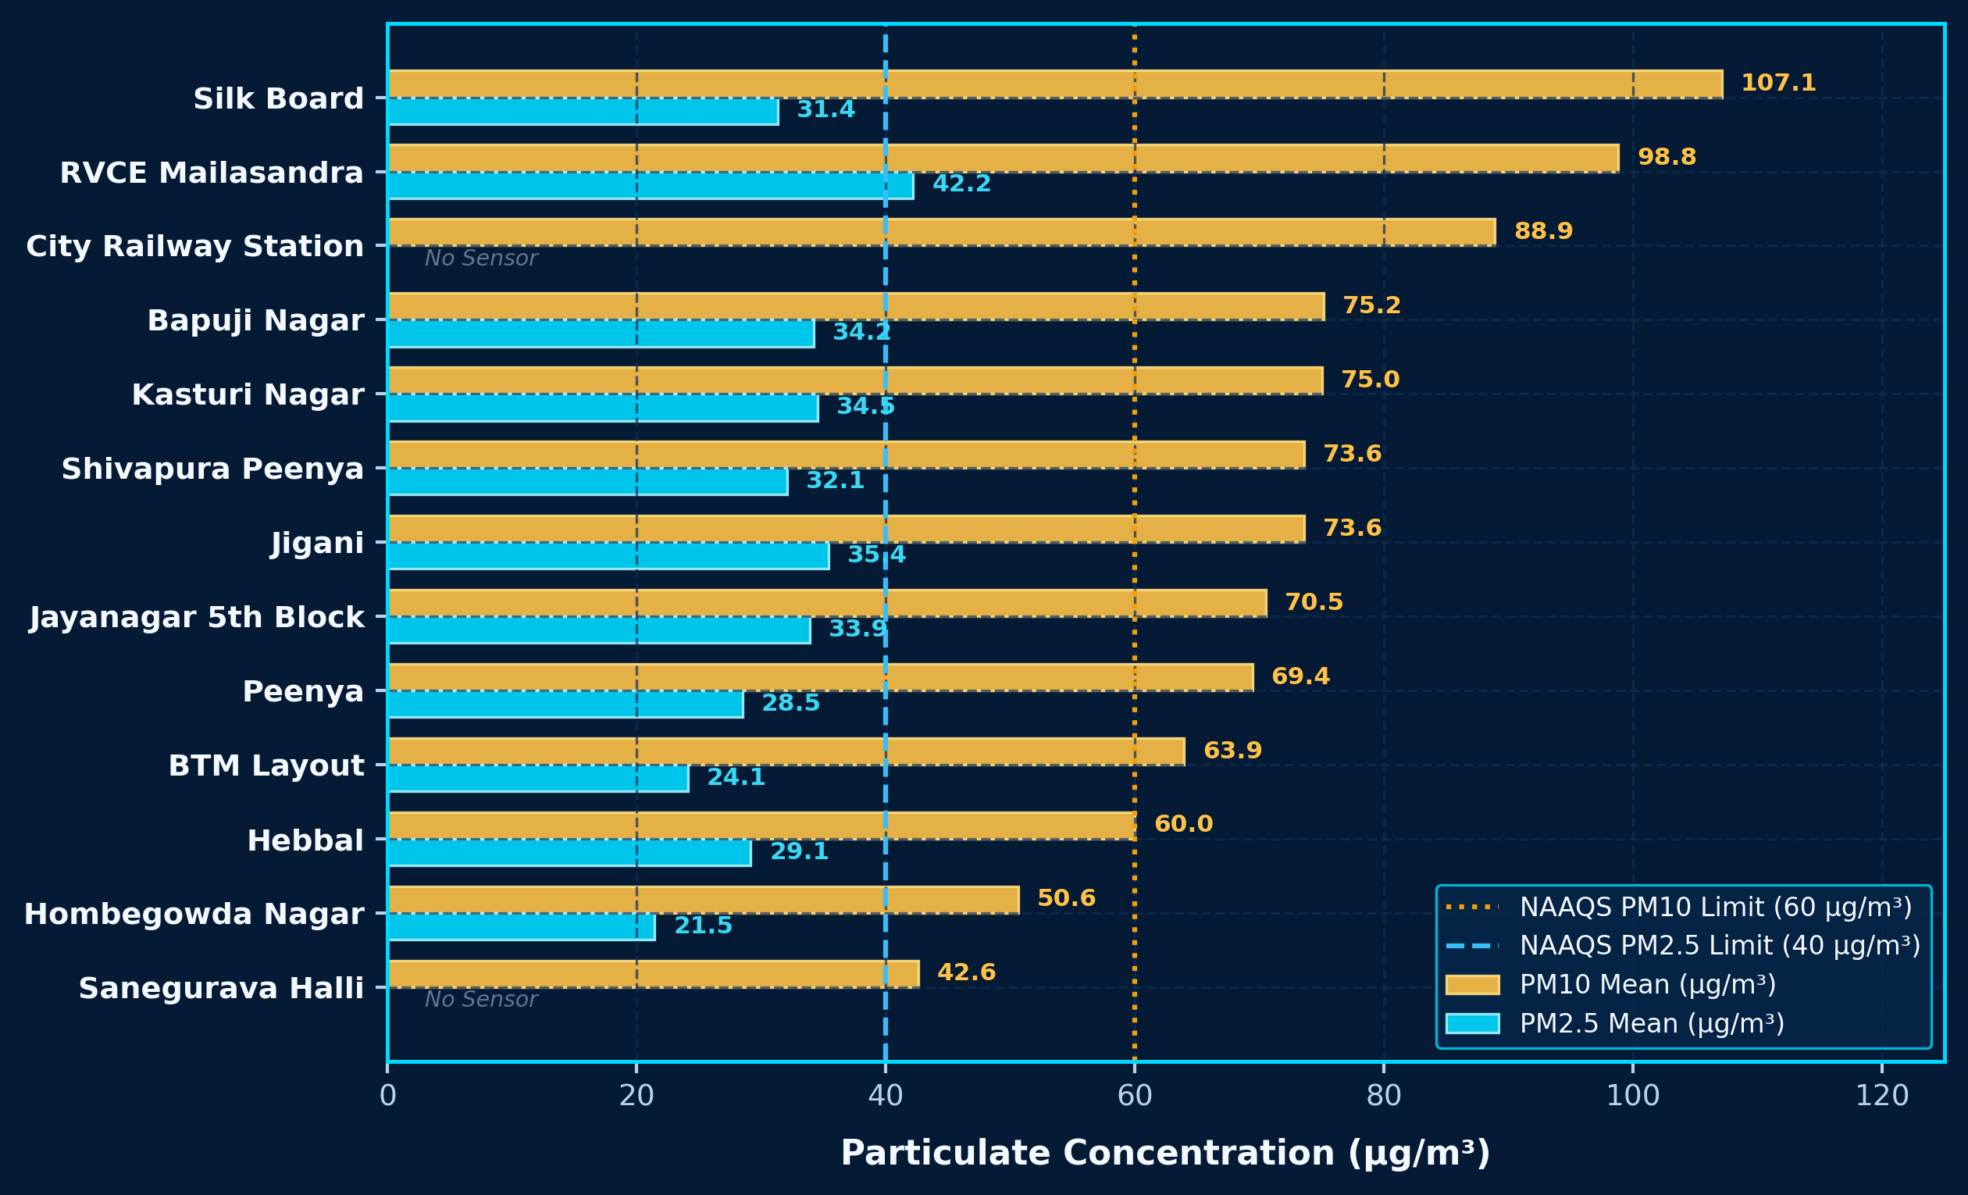

BENGALURU AIR POLLUTION &
METEOROLOGICAL PATTERNS
PySpark Analysis of Urban Particulate Variability and Weather Associations
Author: Yashaswi A R | Institution: Chanakya University, Bengaluru | Continuous Air Quality Monitoring Network (CPCB / KSPCB) | 866,044 Observations (2024–2025)
▲ PEAK PM2.5 CONCENTRATION
985.1 µg/m³
Diwali Festival Surge (Silk Board, 00:30 IST)
Diurnal Hourly Mean Peak: 36.6 µg/m³ (20:00 IST)
● 2-YEAR AVERAGE PM2.5
31.3 µg/m³
2-Year Continuous Mean (171,465 Hourly Readings)
NAAQS Annual Limit: 40 µg/m³ (Compliant)
◆ MEAN AMBIENT TEMPERATURE
24.3 °C
Continuous In-Situ CAAQMS Ground Meteorology
Regression: -1.18 µg/m³ per °C (p < 0.001)
■ MEAN RELATIVE HUMIDITY
63.9 %
Continuous Surface Hygrometric Observations
Strong Inverse Thermal Coupling (r = -0.35)
📄 1. ABSTRACT & EXECUTIVE SUMMARY
⚡ 5. PYSPARK BIG DATA PROCESSING METHODOLOGY
🗺️ 7. BENGALURU CAAQMS SPATIAL NETWORK MAP
Rapid vehicular growth and industrialization have transformed Bengaluru into a critical urban air quality hotspot. This research conducts a big data investigation utilizing Apache Spark (PySpark 4.3.0) to analyze 866,044 continuous 15-minute observations across 13 official CAAQMS monitoring stations from January 1, 2024 to December 31, 2025.
Key empirical findings identify Silk Board as the most polluted transit node (PM10: 107.1 µg/m³) and RVCE Mailasandra as the highest PM2.5 corridor (42.2 µg/m³). In contrast, residential buffers such as Sanegurava Halli remained compliant (PM10: 42.6 µg/m³). A profound 56% reduction occurs during the southwest monsoon (PM2.5 drops from 50.1 µg/m³ in March to 17.4 µg/m³ in July) demonstrating intense wet precipitation scavenging. Nocturnal boundary layer compression elevates evening particulate burden by 30%.
🎯 2. RESEARCH OBJECTIVES
📈 6. RESULTS: TEMPORAL, DIURNAL & METEOROLOGICAL PATTERNS
• Big Data Distributed Ingestion: Ingest and validate 866,044 multi-year observations across 13 CAAQMS stations using Apache Spark with schema enforcement and zero synthetic fabrication.
• Multi-Scale Temporal Analysis: Characterize 24-hour diurnal commuter cycles and 24-month multi-year seasonality to isolate nocturnal inversion and monsoon washout dynamics.
• Meteorological Bivariate Coupling: Investigate thermodynamic relationships between criteria particulates and surface weather parameters (ambient temperature, humidity, wind dispersion).
• Spatial Heterogeneity & Policy: Quantify arterial traffic hotspots versus vegetative buffer stations to provide data-driven foundations for urban environmental interventions.
💡 3. INTRODUCTION & URBAN CONTEXT
Bengaluru, situated at an altitude of ~920 meters on the Deccan Plateau, has experienced phenomenal economic expansion, with registered vehicular density surpassing 10.5 million. This intensive motorization produces concentrated criteria emissions (PM2.5, PM10, NOx, CO) that interact dynamically with the local boundary layer.
Traditional environmental studies rely on coarse municipal averages or isolated time snapshots, failing to resolve localized transit exposure gradients. By leveraging enterprise PySpark distributed windowing, this study links continuous ground-level meteorological forcing with particulate dispersion across 13 diverse micro-environments.
• Spatial Heterogeneity: All 13 monitoring stations are geo-referenced using verified CPCB coordinates across Bengaluru (12.78°N to 13.04°N, 77.49°E to 77.65°E).
• Critical Traffic Arteries: Extreme pollution clusters along high-traffic corridors: Silk Board (SE Hosur Road corridor) and RVCE Mailasandra (SW Mysore Road highway).
• Defensible Spatial Method: Station values reflect verified in-situ point measurements; no unvalidated continuous spatial interpolation is fabricated.
📊 4. STATION-WISE PARTICULATE COMPARISON
🔍 8. KEY SCIENTIFIC INSIGHTS
• Highest-Average Station Hotspot: Silk Board exhibited highest particulate loading (PM10: 107.12 µg/m³), exceeding Sanegurava Halli (42.62 µg/m³) by 151%, highlighting severe transit congestion.
• Monthly Seasonal Extreme: March 2024 recorded peak monthly PM10 (100.53 µg/m³) and PM2.5 (50.14 µg/m³), while July 2024 registered minimum PM2.5 (17.40 µg/m³), proving seasonal wet cleansing.
• Nocturnal Inversion Cycle: Hourly particulate concentrations peak at 20:00 IST (PM10: 87.28 µg/m³, PM2.5: 36.59 µg/m³) due to boundary layer shallowing, whereas midday solar heating reduces levels by 23%.
• Pollutant-Weather Association: In-situ ambient temperature and relative humidity exhibit strong inverse thermodynamic coupling (r = -0.35 to -0.71). Daytime solar radiation correlates positively with temperature (r = +0.47).
• Primary Co-Emission Signatures: Strong correlation between PM2.5 and PM10 (r = +0.60) confirms co-emission from vehicular combustion, road dust resuspension, and construction.
• Figure 2 (Diurnal): Bimodal diurnal peak reflects morning vehicular peak at 08:00 IST (PM10: 76.2 µg/m³) and evening boundary layer shallowing peak at 20:00 IST (PM10: 87.3 µg/m³; PM2.5: 36.6 µg/m³). Afternoon convective solar heating (14:00 IST) dilutes particulates to minimum values.
• Figure 3 (Monthly): Pronounced seasonal extremes peak in dry pre-monsoon March 2024 (PM10: 100.5 µg/m³, PM2.5: 50.1 µg/m³) and plunge to minimum in wet July 2024 (PM10: 45.3 µg/m³, PM2.5: 17.4 µg/m³), confirming massive seasonal oscillation.
• Figure 4 (Seasonal): Monsoonal rainfall achieves a 56% particulate reduction compared to pre-monsoon baseline. Winter thermal inversions sustain elevated PM10 (90.4 µg/m³) under cool ambient temperatures (23.6 °C).
• Figure 5 (Correlation): Criteria particulates show strong co-emission coupling (PM2.5 vs PM10, r = +0.60). NO2 and NH3 couple strongly (r = +0.56). In-situ ambient temperature and relative humidity show strong inverse coupling (r = -0.35 to -0.71).
🚀 9. CONCLUSION & FUTURE SCOPE
• Big Data Scalability: Apache Spark 4.3.0 executed the entire distributed pipeline across 866,044 observations in 60.05 seconds, demonstrating enterprise viability for municipal environmental monitoring.
• Micro-Climatic Control: Urban air pollution in Bengaluru is governed as much by atmospheric boundary layer dynamics as raw emissions, emphasizing the necessity of weather-informed forecasting.
• Targeted Policy Actions: Priority interventions should focus on Low-Emission Zones (LEZs) at Silk Board and RVCE corridors, intelligent transit synchronization, and wet dust-suppression sweeping.
• Future Research Scope: Incorporating high-density IoT particulate sensor networks, downscaled ERA5 planetary boundary layer height reanalysis, and deep learning neural forecasting models.
• Severe Transit Corridors: Silk Board recorded the highest mean PM10 concentration at 107.12 µg/m³ (+78.5% above the 60 µg/m³ NAAQS statutory limit), followed by RVCE Mailasandra (98.81 µg/m³).
• Highest PM2.5 Hotspot: RVCE Mailasandra recorded highest chronic fine particulate mean at 42.20 µg/m³ (exceeding annual 40 µg/m³ limit), driven by arterial Mysore Road heavy transit.
• Residential Green Buffers: Sanegurava Halli (PM10: 42.62 µg/m³) and Hombegowda Nagar (PM2.5: 21.46 µg/m³) remained fully compliant with national safety standards.
★ KEY RESEARCH FINDING: DUAL ATMOSPHERIC DRIVERS
Empirical PySpark big data analytics across 866,044 observations reveals that urban air quality in Bengaluru is co-governed by two non-linear atmospheric mechanisms:
1. Nocturnal Boundary Layer Suppression: Particulate levels surge to a diurnal peak of 36.6 µg/m³ (PM2.5) and 87.3 µg/m³ (PM10) at 20:00 IST (+30% above midday), caused by surface radiational cooling trapping evening vehicular emissions within a shallow ground-level inversion layer.
2. Monsoon Wet Precipitation Scavenging: Particulate concentrations plunge by 56% during the southwest monsoon (PM2.5 drops from 50.1 µg/m³ in March pre-monsoon to 17.4 µg/m³ in July), demonstrating the decisive cleansing efficacy of rainfall aerosol wash-out.
DATA SOURCES & SCIENTIFIC REFERENCES:
1. Central Pollution Control Board (CPCB) & Karnataka State Pollution Control Board (KSPCB). Continuous Ambient Air Quality Monitoring Network (CAAQMS), OpenData (2024–2025).
2. Apache Spark Architecture & PySpark API Specification (The Apache Software Foundation, Release 4.3.0, 2024).
3. World Meteorological Organization (WMO). Guidelines on Urban Atmospheric Environment Monitoring and Boundary Layer Meteorology.
GITHUB CODE
Scan for PySpark code, master data & figures
ENVIRONMENTAL INTELLIGENCE FOR SUSTAINABLE FUTURES
"Big data distributed analytics and meteorological coupling empower evidence-based urban air quality governance for Bengaluru."
Chanakya University, Bengaluru — Department of Data Science | M.Sc. Data Science Research

