Slide 1
Fashion retail forecasting by neural networks

Slide 2
Introduction
Accounting for demand uncertainty is one of the biggest hurdles in supply chain management and retailers have been employ numerous methods to avoid stock out due to demand uncertainty. Primary method for this is calculating and having safety stock.
Thus, this is where demand forecasting is used to avoid stock-out and maintain a high inventory fill rate.
A few methods used for modelling and predicting the demand are accurate response policy or quick response policy or any of the numerous forecasting models (Holt’s model, Winter’s model, etc.)
Here, we discuss training a multi-layer neural network model with a given data set of past sales records and train it to forecast for the future.

Slide 3
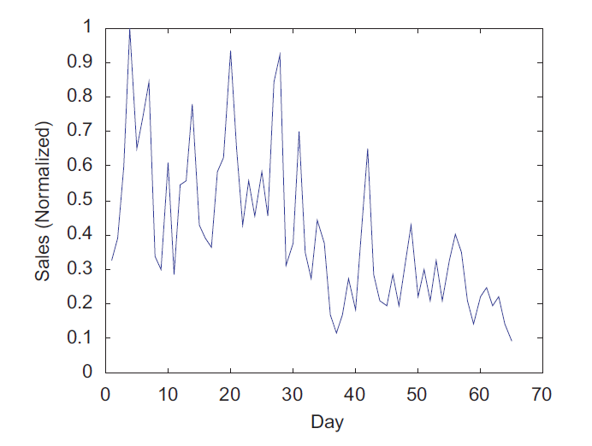
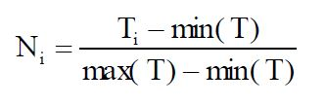
Data taken
Sales data of one fashion products in Years 2002 and 2003 are collected.
The time series 1 covers the whole life cycle in one season of one product. Its life cycle lasts for around 70 days, its sales pattern exhibits a global decent trend.

Slide 4
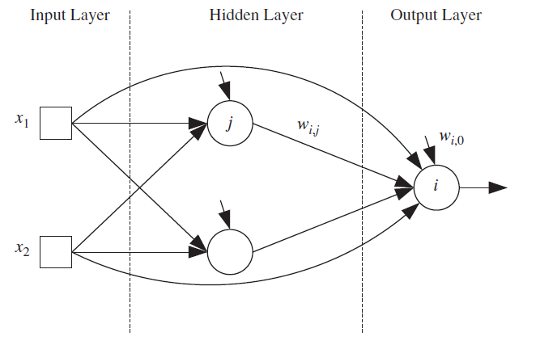
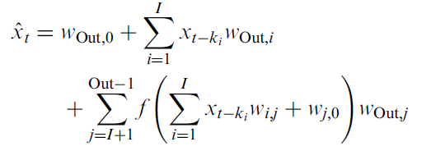
Neural Network

Slide 5
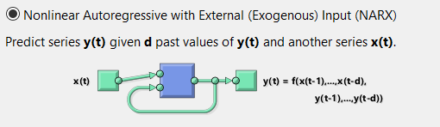
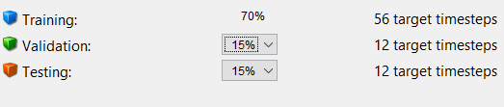
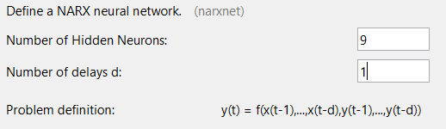
Neural Network in Matlab

Slide 6
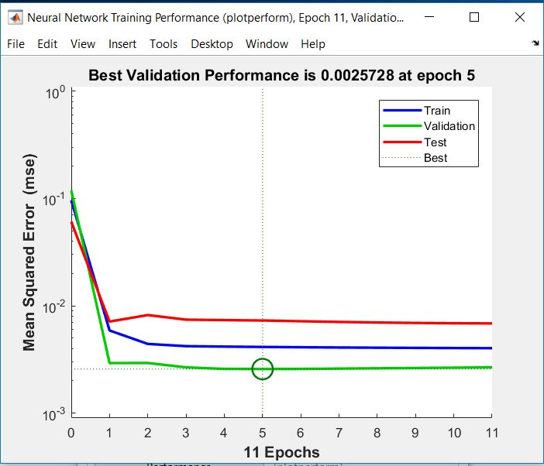
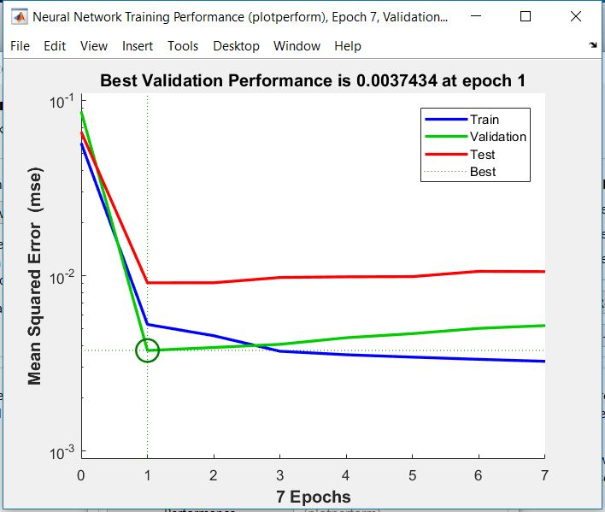
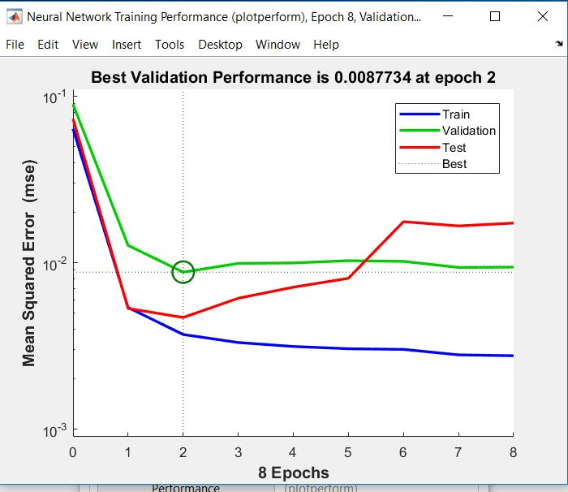
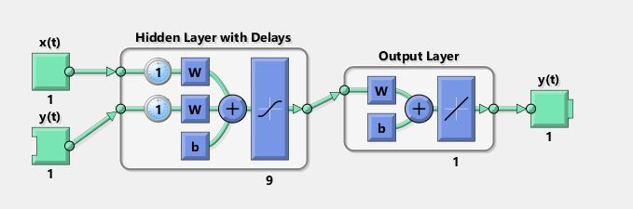
Neural Network in Matlab

Slide 7
Evolutionary Neural Networks
We can tune four parameters:
Number of layers (or the network depth) and neurons
Connections in between layers*
Dense layer activation function
Network optimizer
Finding Initial Number of Layers and neurons has a separate algorithm

Slide 8
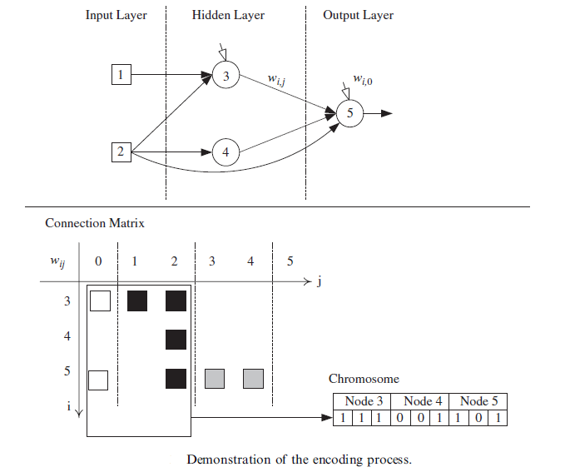


Breed
Mutate
Evolve

Slide 9
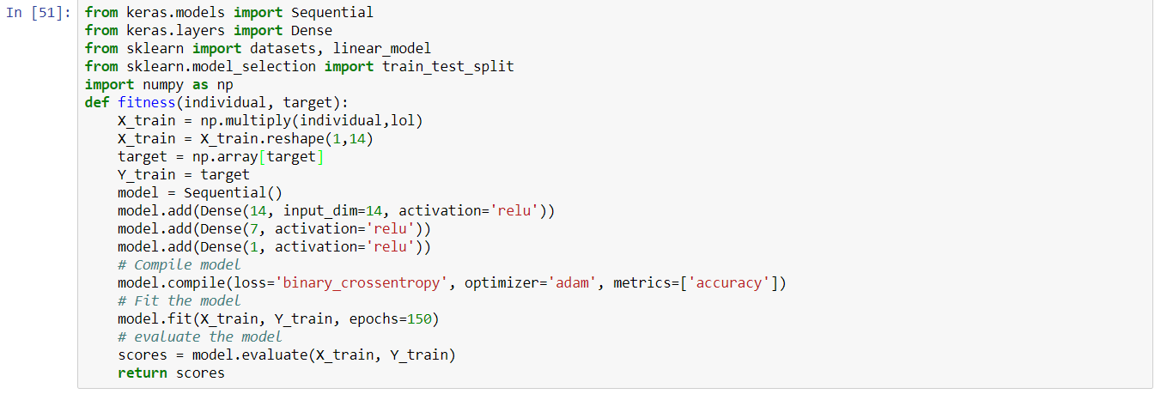
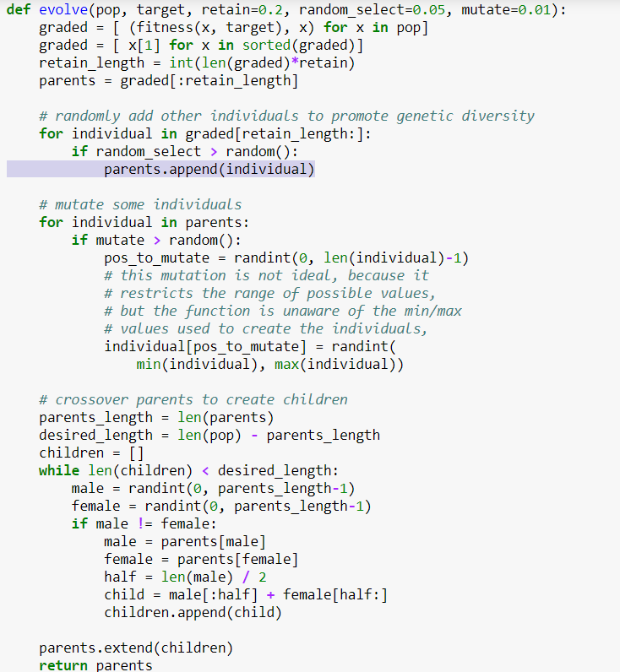
Implementation

Slide 10
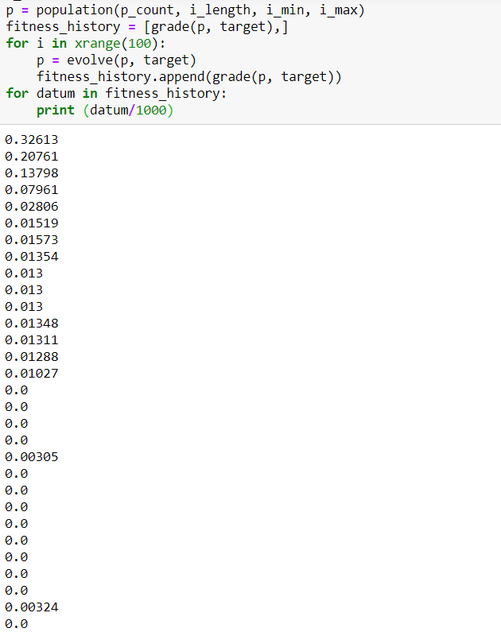
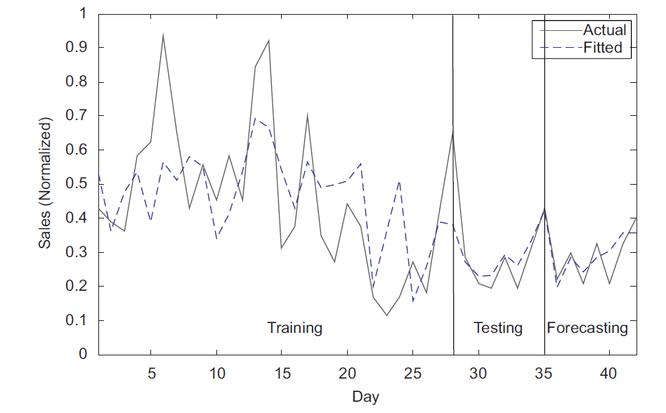
Results
Out of 1st time window: 2 3 4 7 8 9 10 13 14
Out of 1st time window given in paper:
2 3 4 8 10 11 12 13 14

Slide 11
Comparison
In statistics and econometrics, and in particular in time series analysis,
an autoregressive integrated moving average (ARIMA) model is a
generalization of an autoregressive moving average (ARMA) model.
Both of these models are fitted to time series data either to better
understand the data or to predict future points in the series (forecasting).
Model | ENN | SARIMA
MSE for 5th week | 0.0329 | 0.0855
6th week | 0.0712 | 0.0651
7th week | 0.0177 | 0.0095
8th week | 0.0023 | 0.0046
ANN
0.0025 - Tansig 0.0037 - Logsig 0.0087 – Linear

Slide 12
Conclusion
We have designed and coded an Evolutionary Neural Networks (ENN) for sales forecasting in fashion retailing. The data for the weekly sales is from paper and we constructed a neural network to forecast for the future weeks of sales with the given data as the training set. However, we have seen that the ENN approach can be used to obtain a reasonably accurate forecast.
One major drawback of this method is that it requires increasingly more computational power with increasing amount of data we take. We can work around this by employing pre-search approach and using BIC as the fitness function.

Slide 13
Thank You N Sai Abhishek Siddhartha S Gagan Aditya Reddy

